Slide 1
WHY SHOULD I WISH YOU HAPPY BIRTHDAY??
by- Aliya
*click on the arrow below, later you can use the keyboard

Slide 2
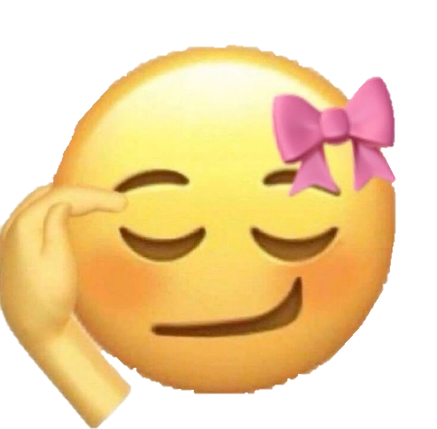
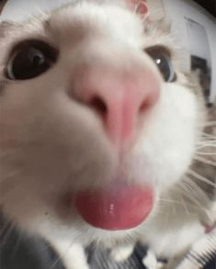
1. Its super cool

Slide 3
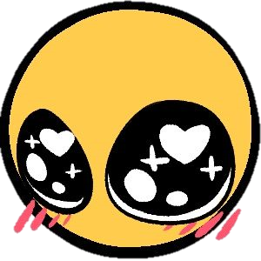
2. you’re handsome

Slide 4
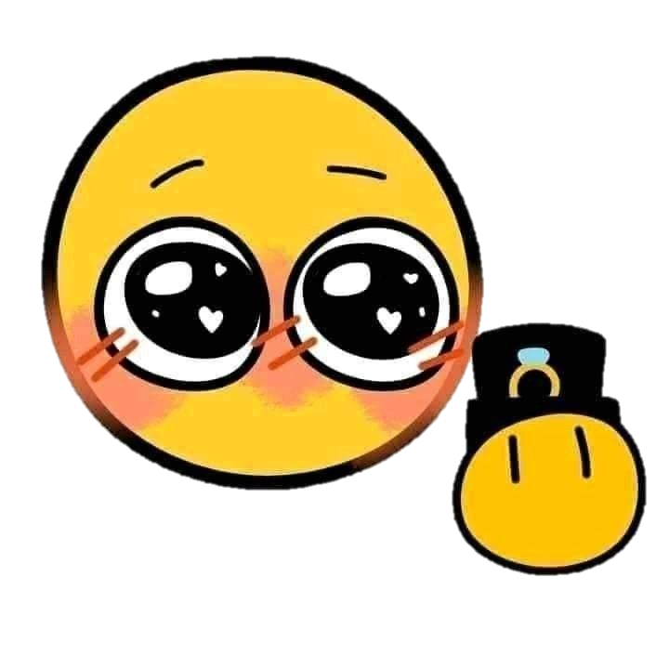
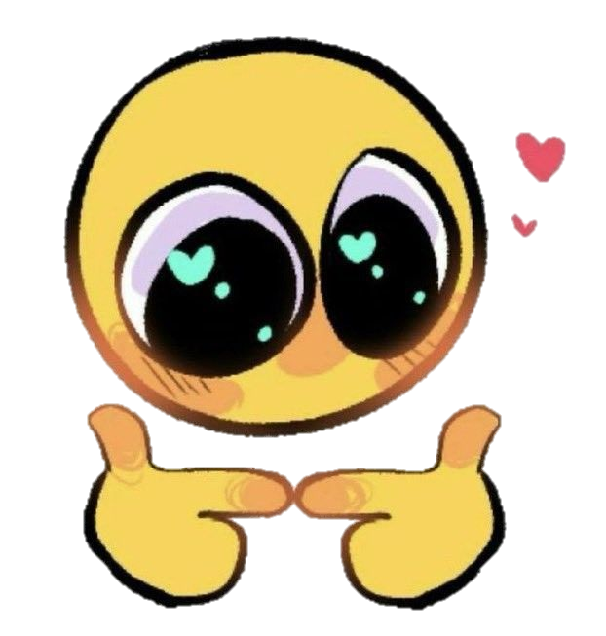
3. youre minee yay

Slide 5
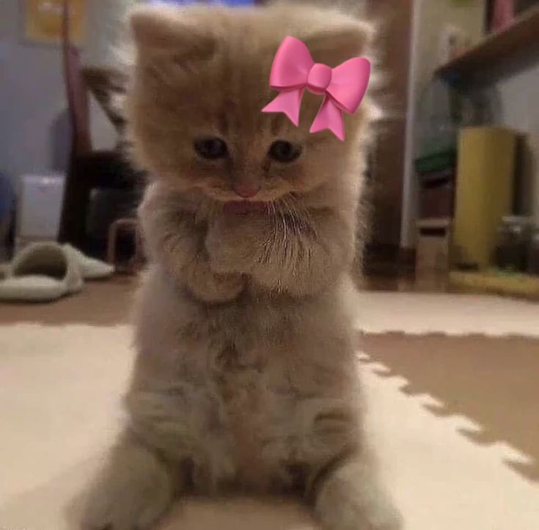
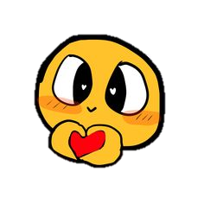
4. Your existence = worth celebrating

Slide 6
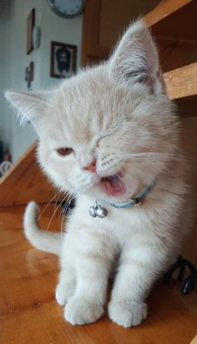
5. You don’t have any girl to wish you
Im a girl and im wishing you *wink* *wink*

Slide 7
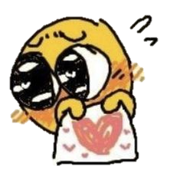
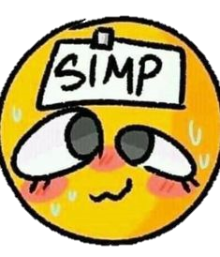
6. hah i might as well like you
Emphasis on MIGHT your honour

Slide 8
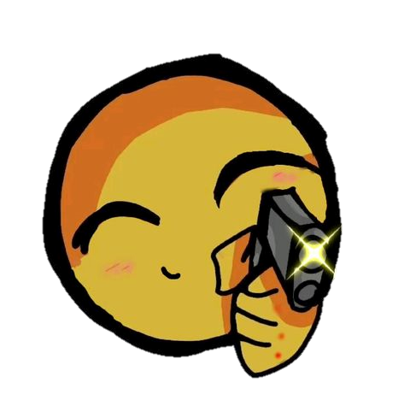
7. do we even need a reason hmph
_
dont even think of saying kmph
_

Slide 9
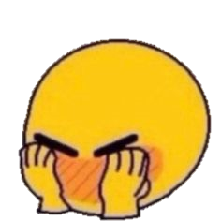
that’s it mwah
ANDDDD
THEREFORE
HAPPY BIRTHDAYYYYYYY
now you may click on the heart at the bottom

