Slide 1
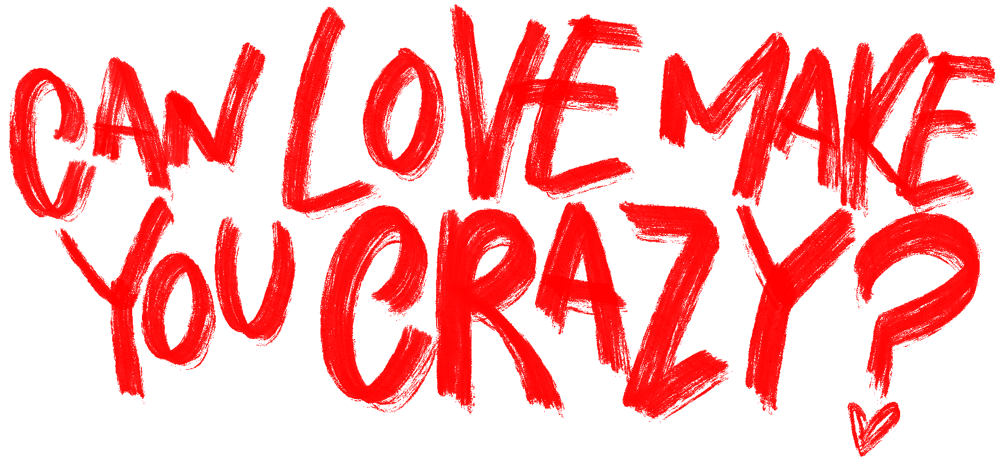
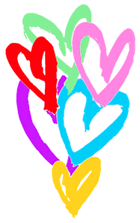

Slide 2





LOVE POTION RECIPE
Phenylethylamine
Norepinephrine
Endorphins
Oxytocin
Dopamine
*** 5ml
*** 4ml
*** 3ml
*** 2ml
*** 2ml

Slide 3
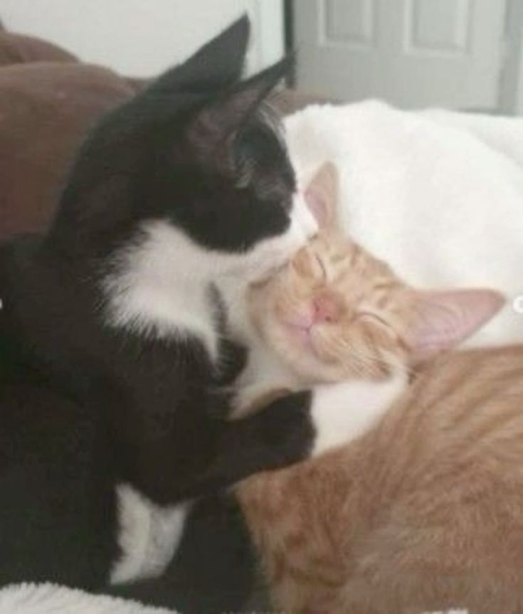





PHYSICAL RESPONSES
SWEATY
DILATED PUPILS
PALMS
FLUSHED
RACING
CHEEKS
HEART
BUTTERFLIES

Slide 4
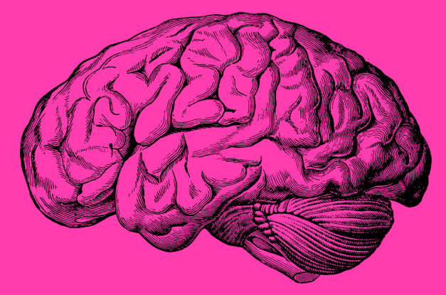

NEW LOVERS HAVE MUCH IN COMMON WITH ADDICTS
NUCLEUS ACCUMBENS
ALSO lights up in cocaine users and gamblers when they act out their addiction

Slide 5
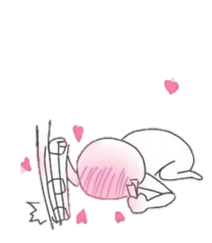
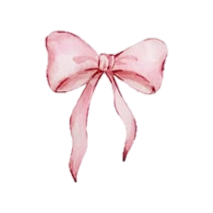
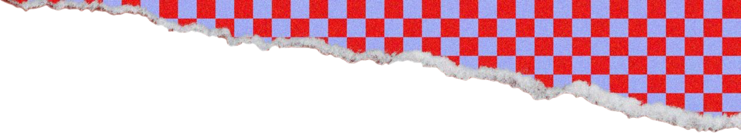

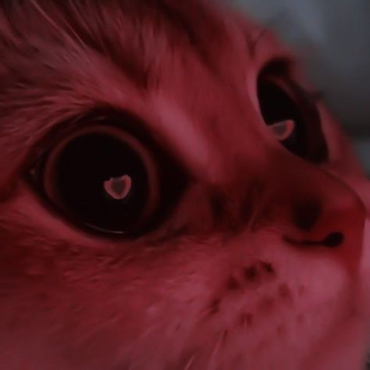
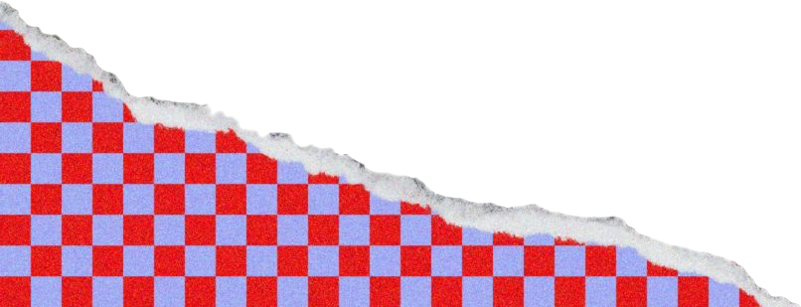
It’s okay to be a little bit selfish
PEOPLE IN LOVE OFTEN EXPERIENCE
EUPHORIA, CRAVINGS, DEPENDENCY, WITHDRAWAL,
AND OTHER BEHAVIOURS ASSOCIATED WITH ADDICTION

Slide 6

LOVE IS
EASY
PATIENT
RESPECT
BLIND
CRUEL
Love deactivates the neural pathways responsible for negative emotions, such as fear and social judgment.

Slide 7
GETTIN'
LOVE HEART XOXO LOCO
GETTIN'
CRAZY IN ⎯⎯⎯⎯⎯ LOVE
OUTTA ⎯⎯⎯⎯ CONTROL ⎯⎯⎯⎯ ♥
LOCO
LOCO
CAN LOVE MAKE YOU CRAZY?
YES

Slide 8
BUT I STILL LOVE YOU
you may press on the heart now

