Slide 1

Chess and well-beıng data analysıs
DSA 210: Project
Ali Yağız Kıvrak 32300

Slide 2

motıvatıon
- I usually play chess online and I am curious about if there is a relation between my playstyle and outcomes. (Determining patterns for win and loss)
I was wondering how my chess game outcomes are related to the outside world and my well-being.
My attention span is not so high, so I also checked the games I played during the lecture time and the other ones to seek any relationship if there are.
Having a large game dataset (since November 2018 – December 2024) is also a major reason to choose this topic

Slide 3
Data source
My Lichess account
Getting data by using Lichess API
- Added the exam dates, and lecture times manually, and created dictionaries which consists of «datetime» objects.

Slide 4
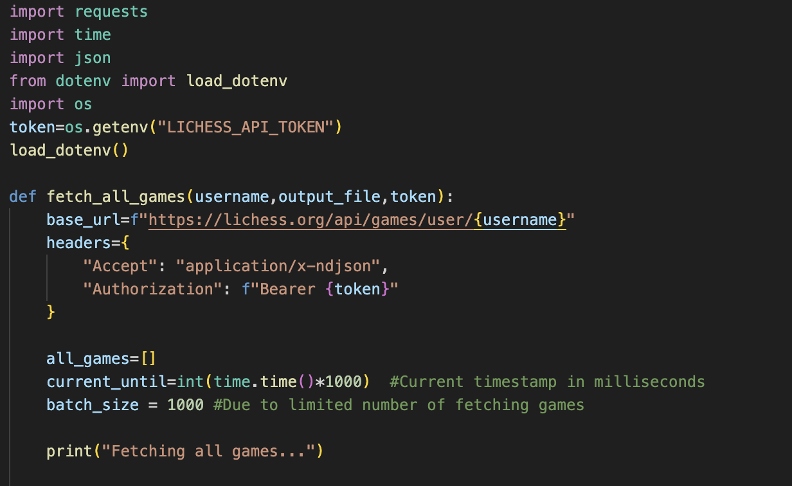
DATA SOURCE CONT’D

Slide 5
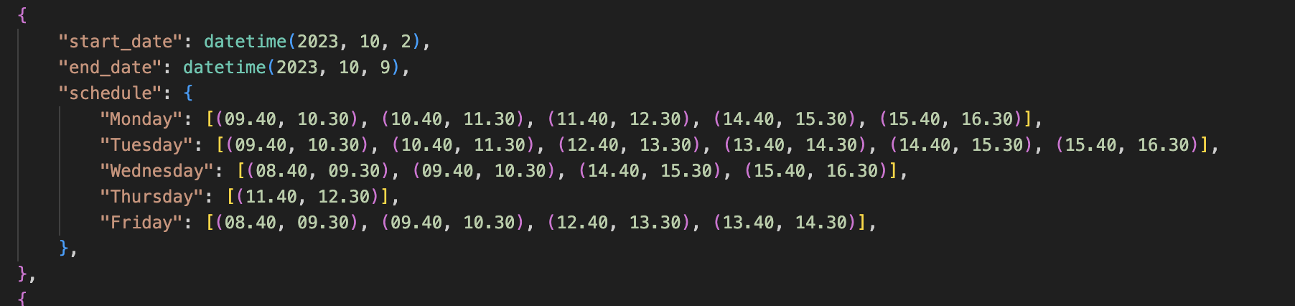
DATA SOURCE CONT’D

Slide 6
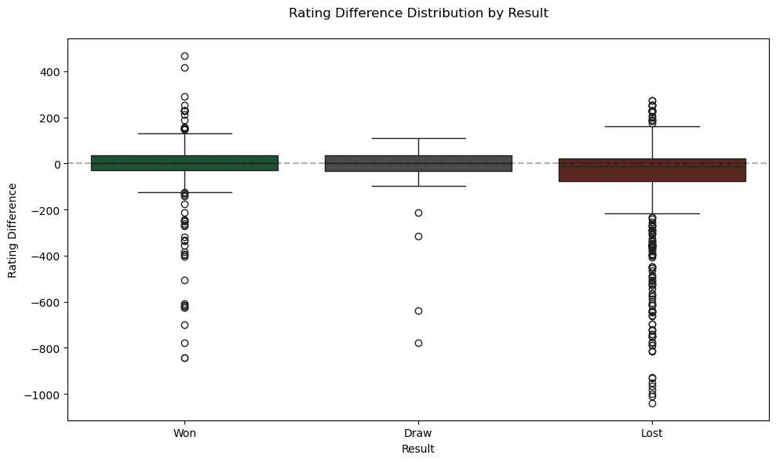
Data analysıs
As it was expected, the mean of the lost games is less than win/draws (I played against opponents wither higher ELO)

Slide 7
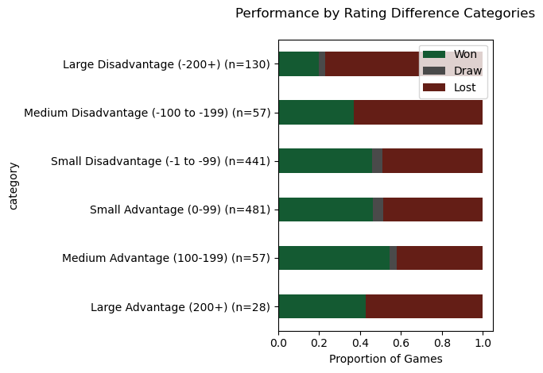
Data analysıs Cont’d
Most games are played against opponents with similar ELO ratings as expected.

Slide 8
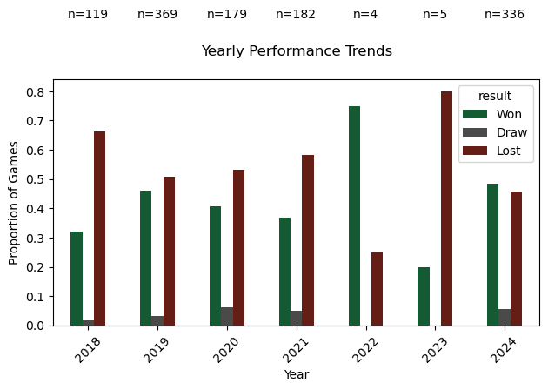
Data analysıs cONT’D
The year 2022 has less data, which I also expected due to my preparation period for my university entrance exam. The other years have similar patterns for this case.

Slide 9
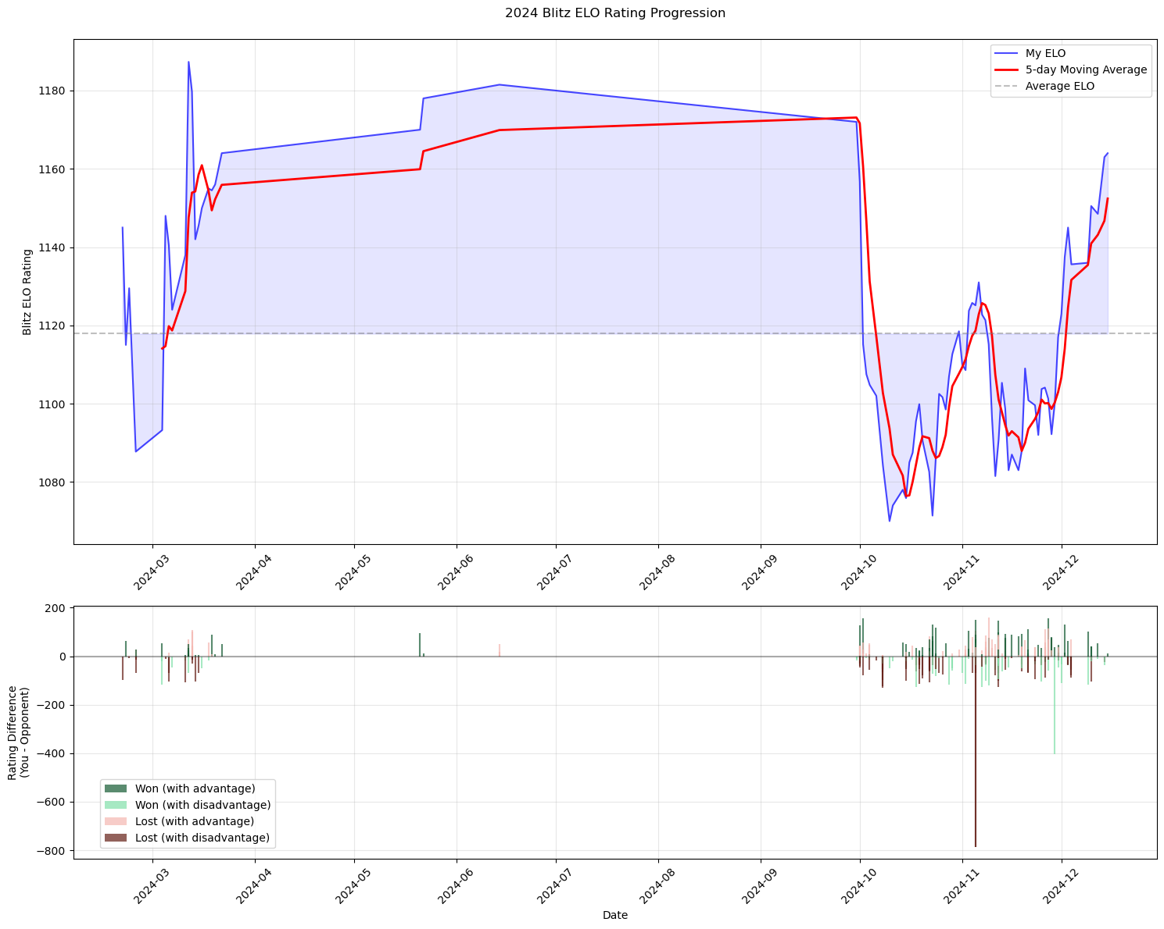
Data analysıs Cont’d
The top plot shows the change my ELO in 2024, and below there are more darker shades which is also logical since they are expected more than the lighter shades. Most of the games played in 2024 are during the data collection period.

Slide 10
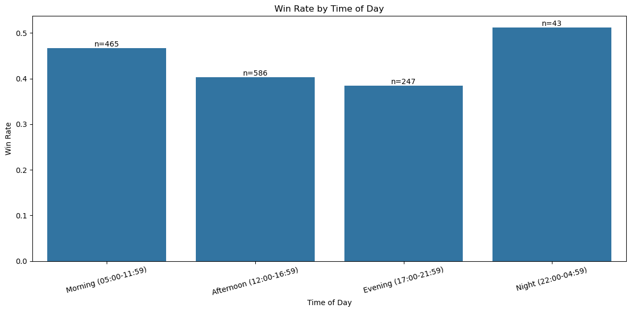
Data analysıs cONT’D
Most of the games played afternoon the least is at night.
The win rates might be interesting since although I play less games in the evening, I lost more.

Slide 11
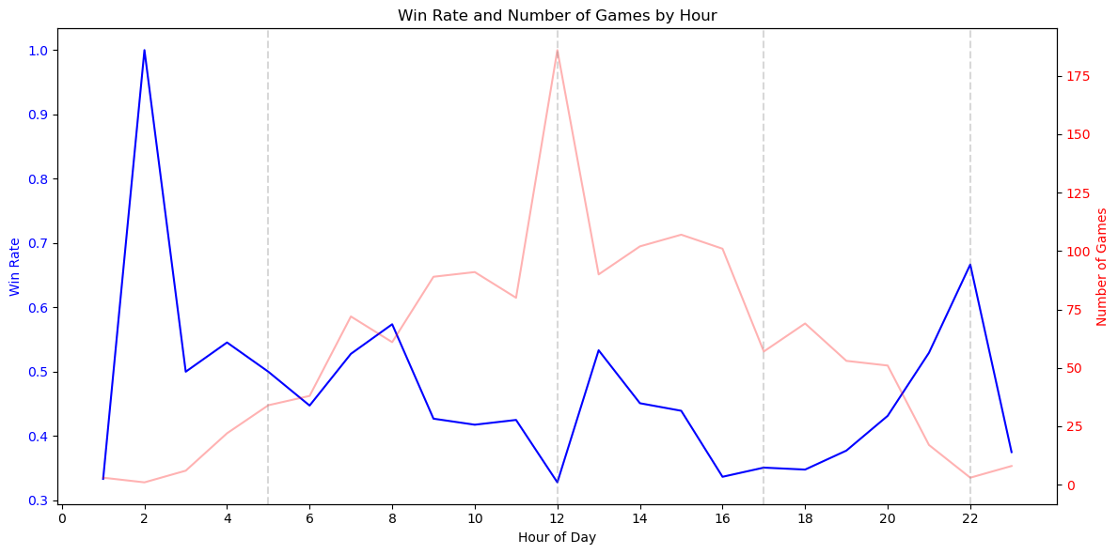
Data analysıs cONT’D
But in general the higher the number of games, the lower the win rate.

Slide 12
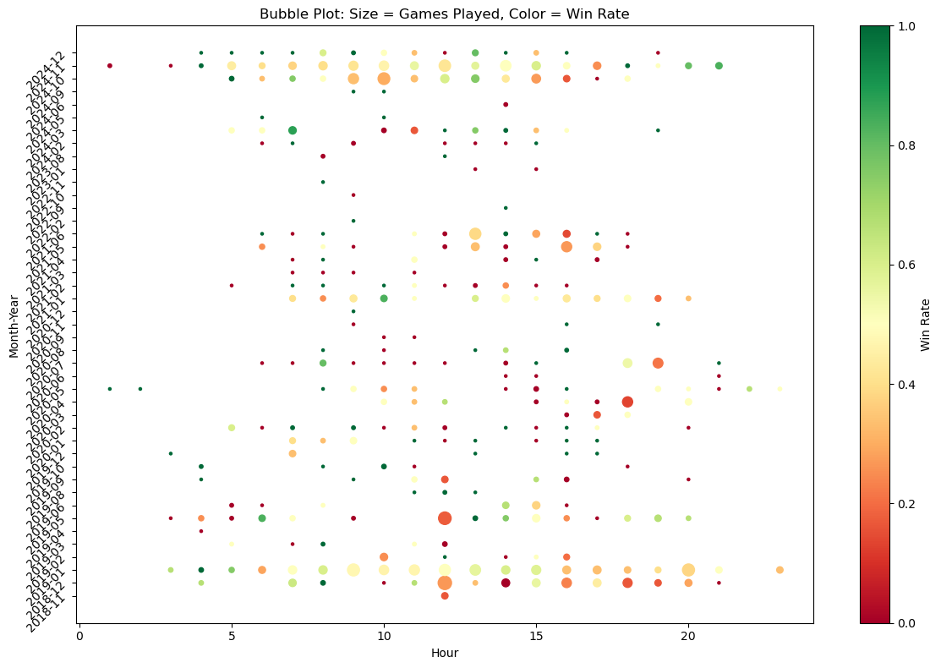
Data analysıs Cont’d
The most frequently played time intervals having higher bubbles which are generally in the afternoon and in 2019 and 2024 there are enough samples for almost every hours.

Slide 13
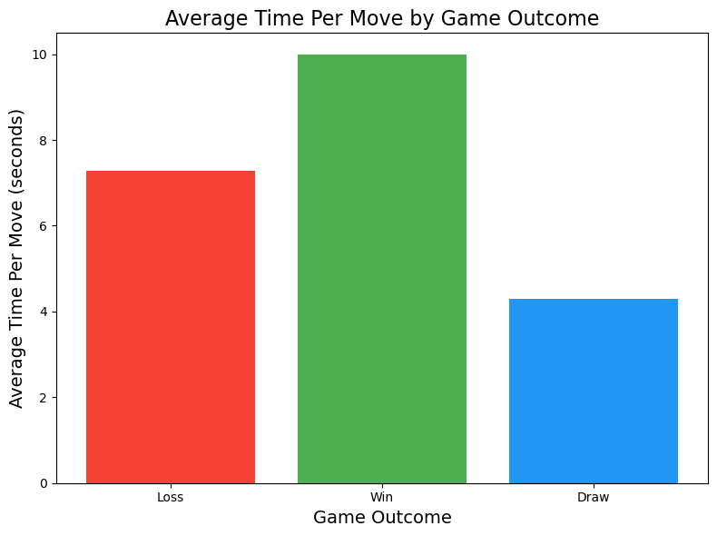
Data analysıs cONT’D
This is also expected since more time to think the correct move leads to higher win rates.

Slide 14
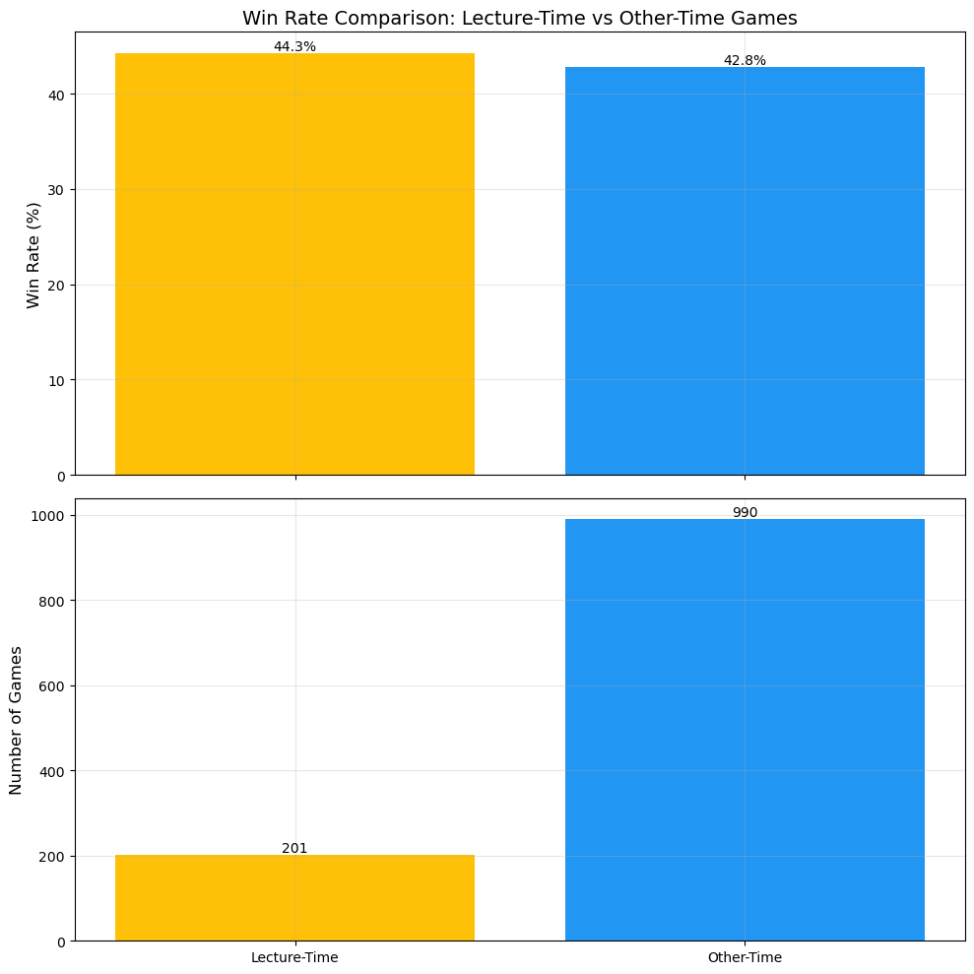
Data analysıs cONT’D
This I did not expect since even though I play less games during the lectures, I think there are enough sample to analyse an average win rate results, and it was unexpected that I performed better during lectures.

Slide 15
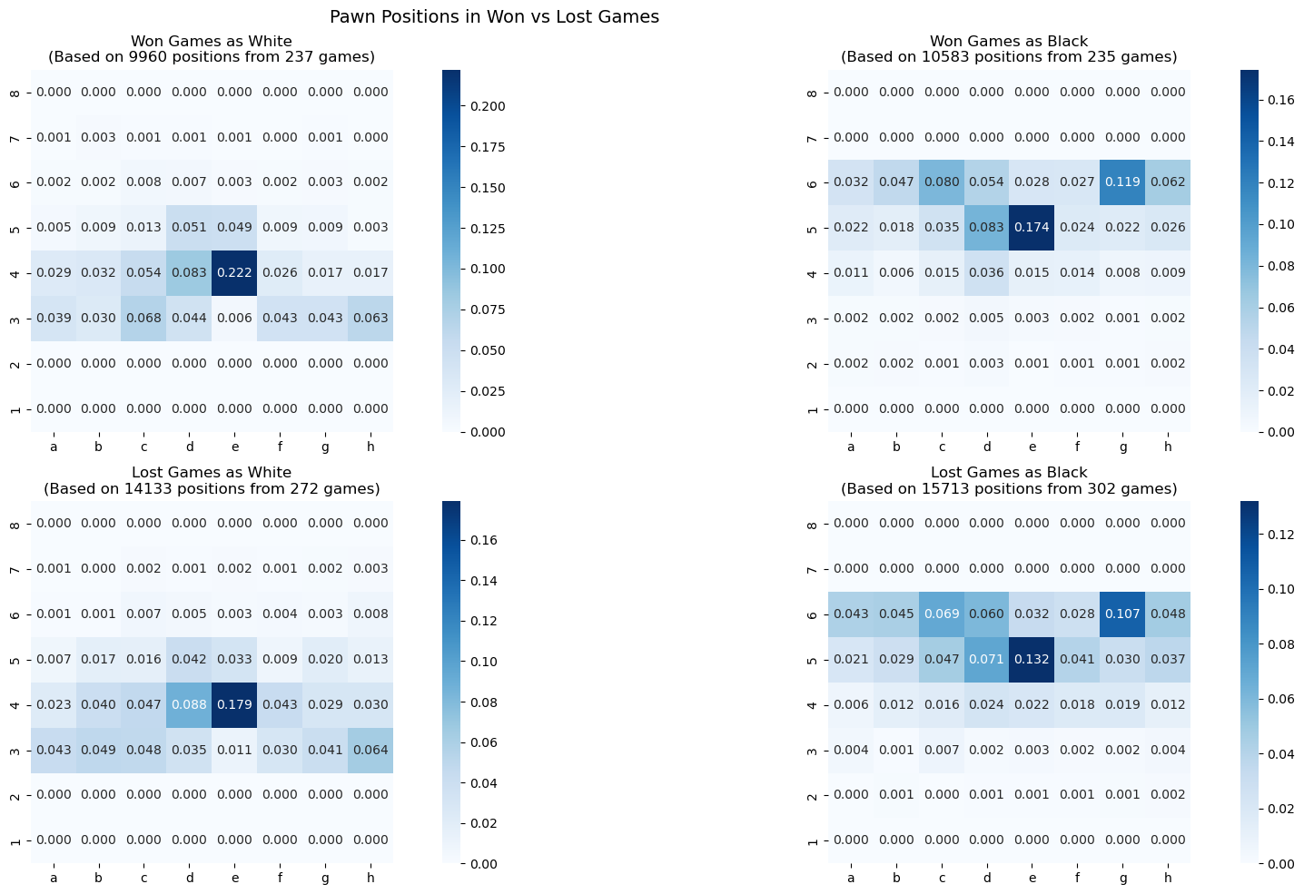
Data analysıs cONT’D
I prepared a heatmap for all pieces to take the average positions except the beginning squares of these pieces, and split the data into the games I played as black/white and won/lost. Blacks and whites having almost the same structure, there are slightly differences when I lost or won a game. This is the time when I question a different factor that may lead to win or lose: AGGRESSION.

Slide 16
AGGRESSION
Components: Pawn structure, center control, piece development, sacrifices, piece coordination. king attack.
Based on these I calculated an aggression score for each game.

Slide 17
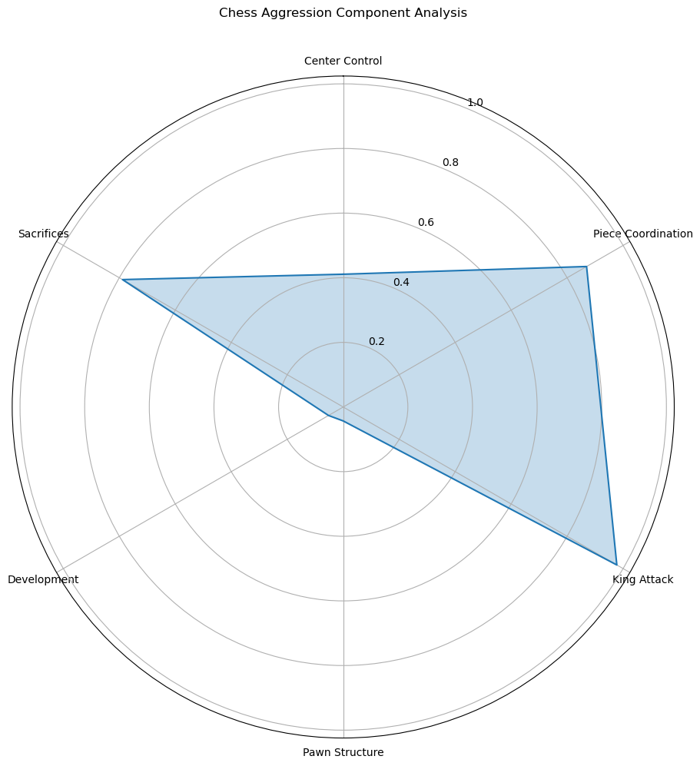
I preferred more using sacrifices or piece coordination rather than creating better pawn structures or development, which are generally considered the password for winning games. Since I am an amateur player, I tend to lose more in the end due to lack of material even though I play aggressively.

Slide 18
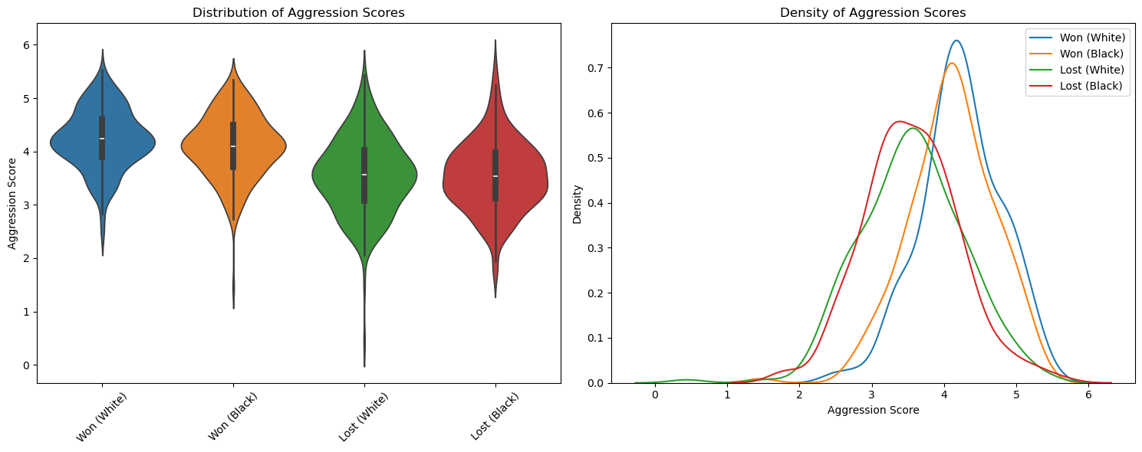
DATA ANALYSIS
As expected attacking to the opponents more, leads to winning more. But overaggression leads to blunders (very bad moves that lead to lose material or checkmate) due to lack of attention. So I also think what leads aggressive playing.

Slide 19
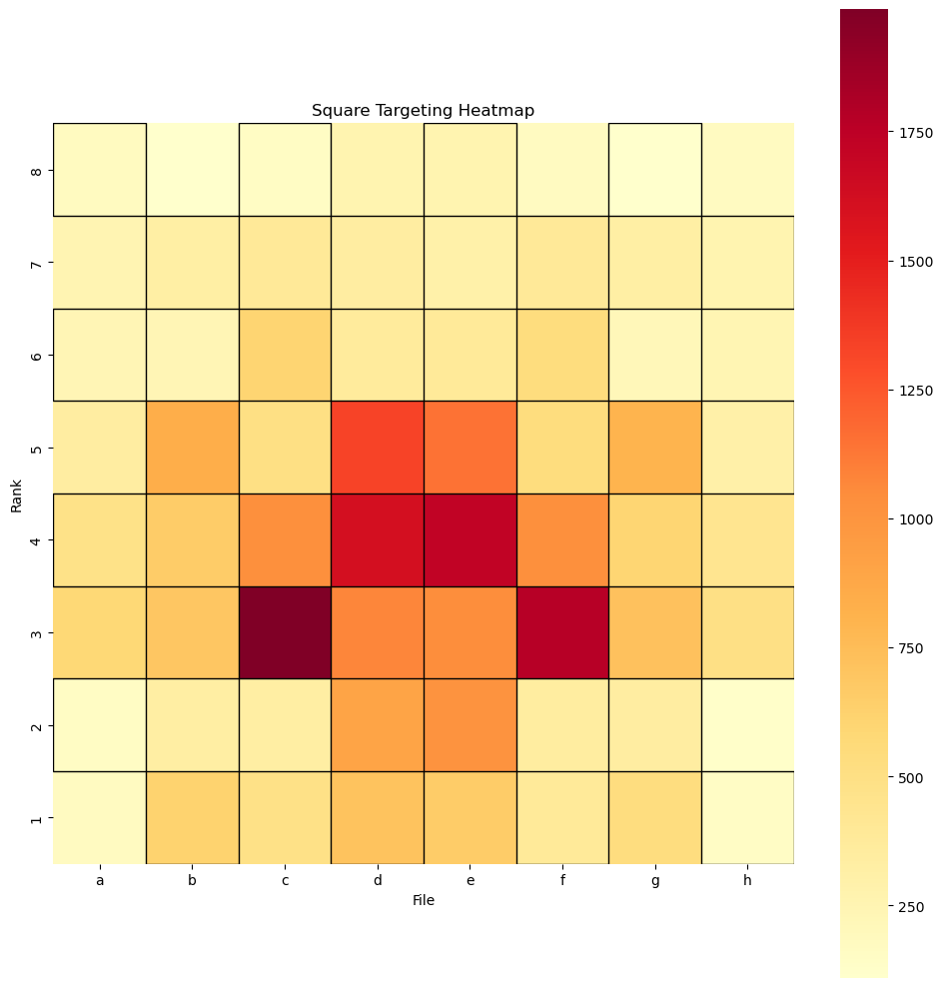
Data analysıs cont’d
Combining all the targets as I calculated for pieces, this shows where the actions happen most. The values are normalized for white and black pieces.

Slide 20
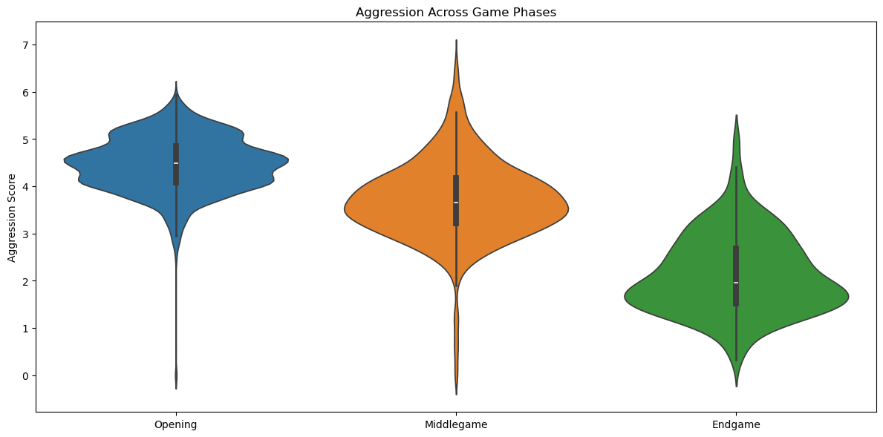
Data analysıs cont’d
It seems opening is the phase I play most aggressively, which is logical since I have more pieces.

Slide 21
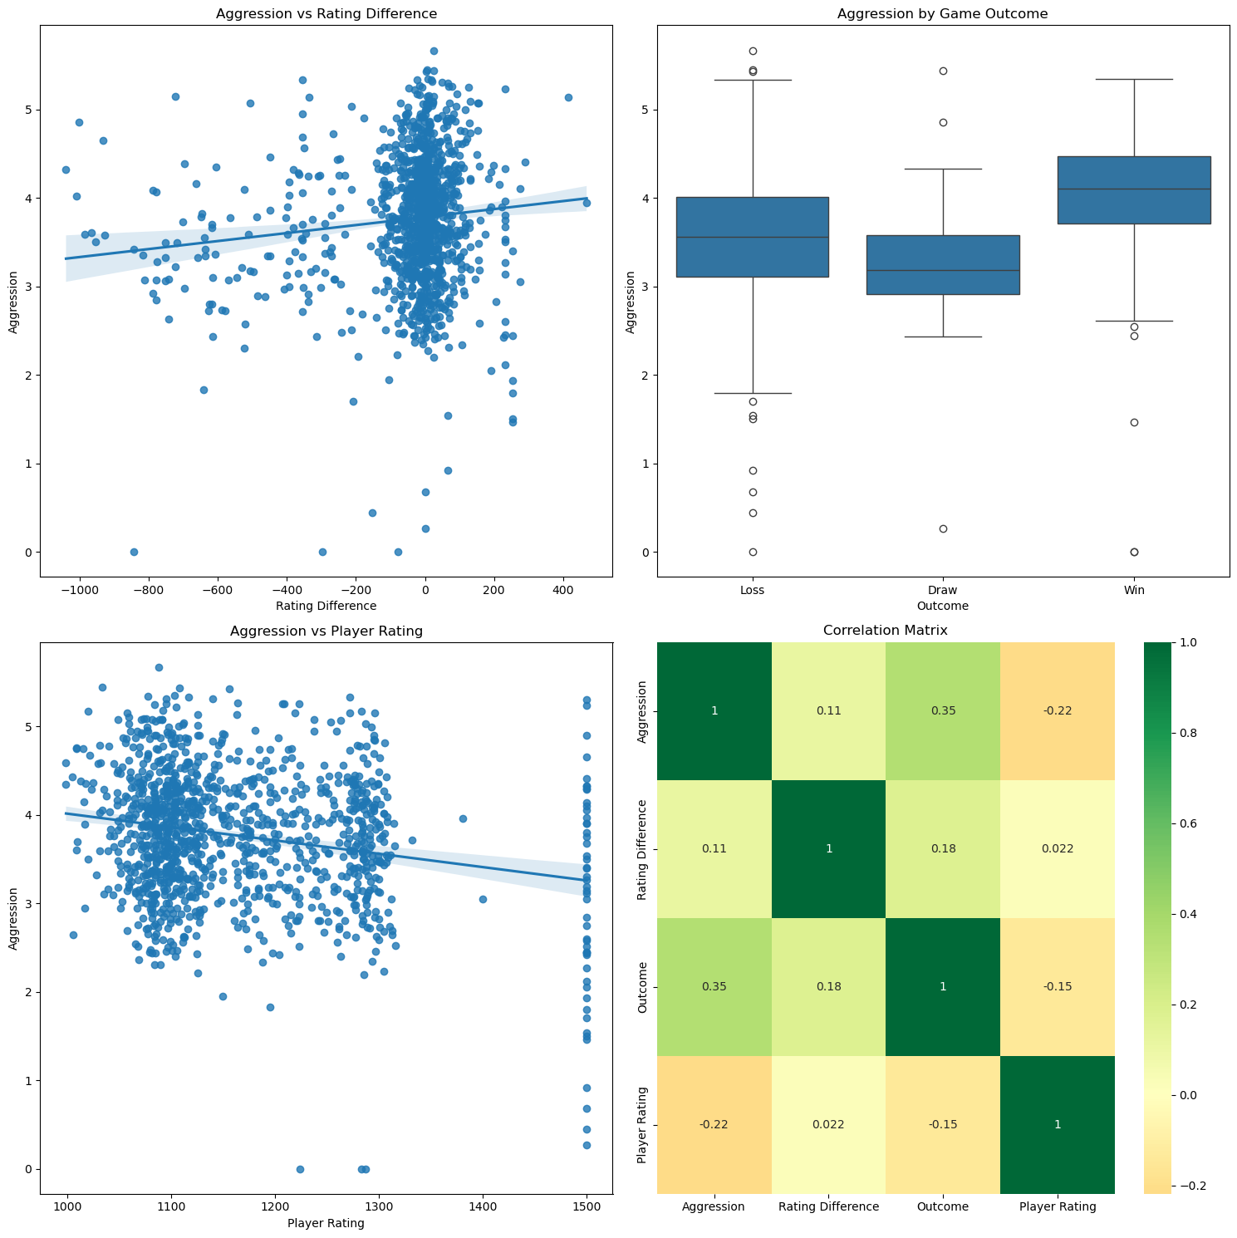
The better opponents tends me play more defensively as expected.
The outcome and aggression are the ones which are most correlated to each other among others.

Slide 22
Stress level
Combined effect of important dates on me (e.g. midterm exams, university entrance exam, COVID-19 pandemic, general and local elections on Turkey etc.)
The second factor it comes to my mind to analyse.
Determining an importance level for those components, I choose a mathematical model for which fits with my real-life experience best.

Slide 23
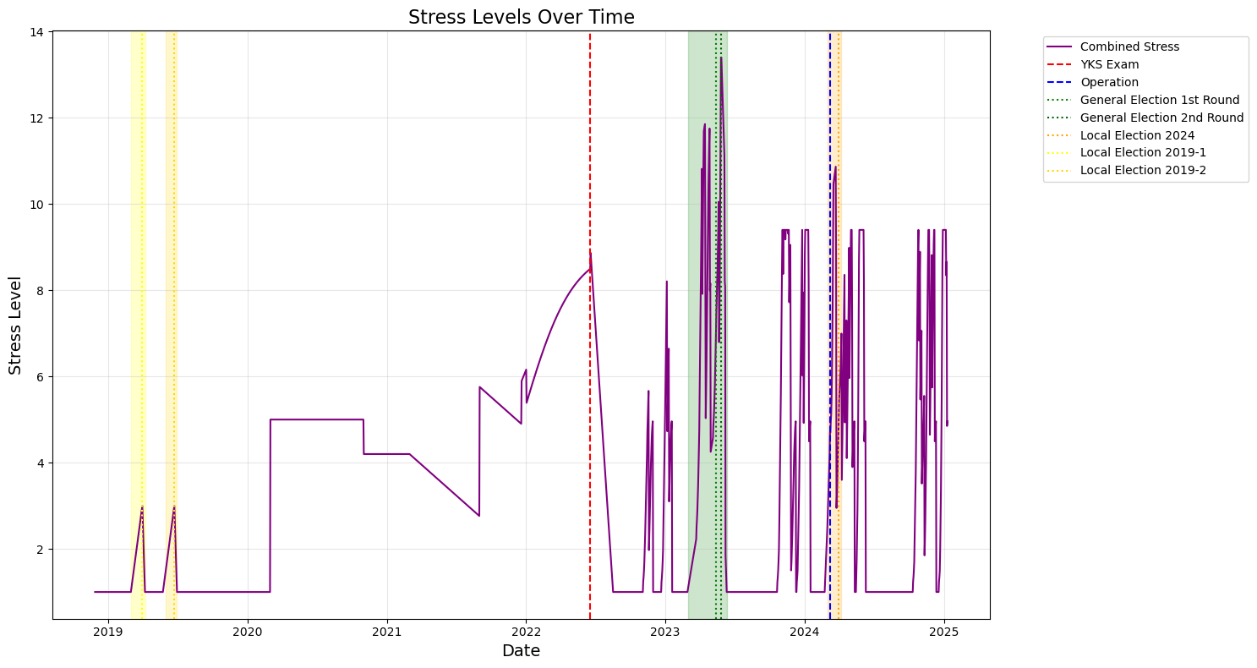
As expected, the most stressed times are correlated with important events.

Slide 24
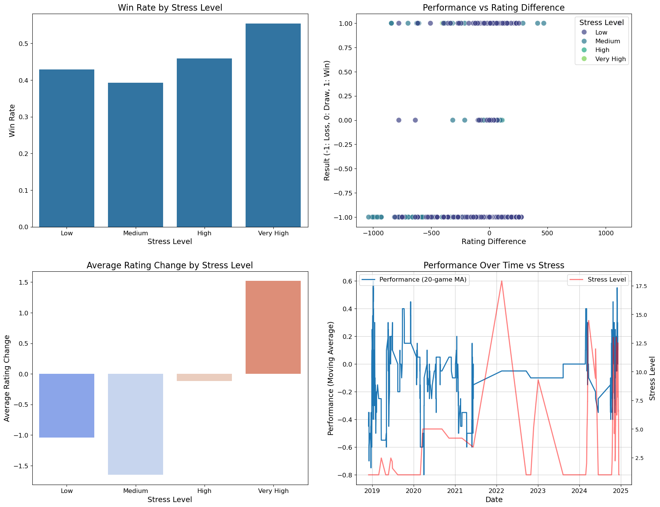
I was expected the exactly opposite but interestingly I performed better during a stress level. This may be caused due to lack of data for high stress levels, seems logically since when I have exams closer I play less (or sometimes no) chess.

Slide 25
Data analysıs CONT’D
Null Hypothesis (H0): When my stress level is higher, I play more aggressively and I lose more with respected to the games I played with a lower stress level. (Stress leads to aggressive playstyle, which leads to losses)

Slide 26
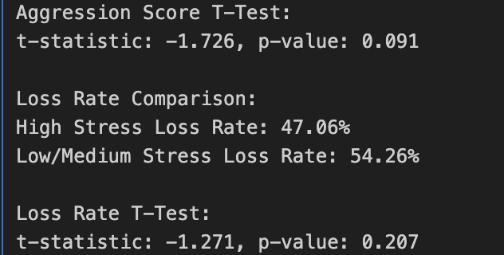
fındıngs
Testing hypothesis by using a t-test:
We are failed to reject the null hypothesis -> There is no evidence for having a correlation between win/lose rates and aggressive playstyle.

Slide 27
Lımıtatıons and future work
Choosing the model which fits best for calculating my stress level was hard.
The times when I do not play any games or I play a lot of games limited me as well. (The sample data I collected may have bias)

Slide 28
Lımıtatıons and future work
I also tried to create an ML model using RandomForestClassifier, and somehow got an output even though it was not so successful. But suddenly there are some complications during implementing the other codes so I got some errors and due to having less time, I failed to debug that code. But the confusion matrix and feature importance plot I got are the following:

Slide 29
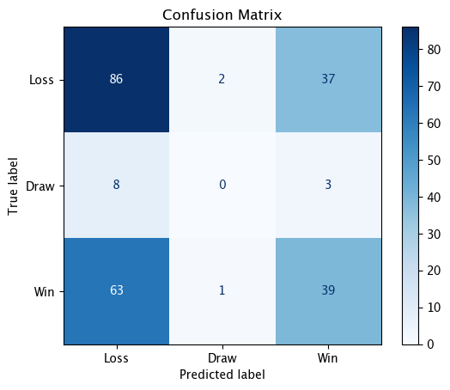
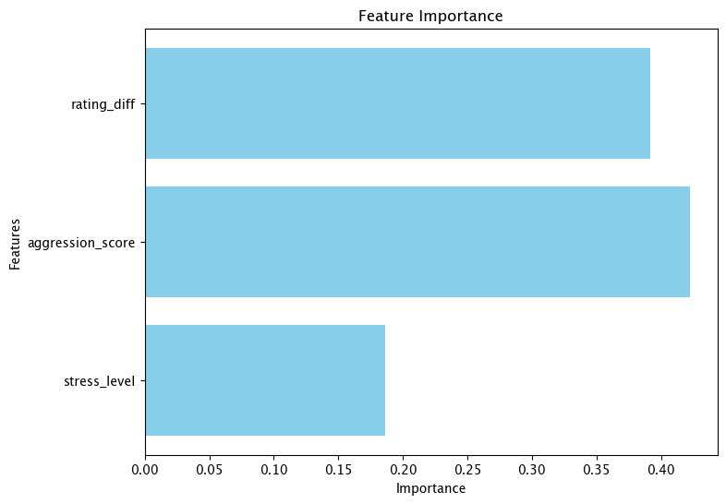
Lımıtatıons and future work

