Slide 1
Phishing Website Detection using Machine Learning
Internship Project Presentation
Presented by Khan Aliya Mohd Akram

Slide 2
Problem Definition
What is Phishing? Fraudulent websites mimicking legitimate ones to steal sensitive data.
Why it matters: Financial loss, identity theft, and trust erosion.
Goal: Detect phishing URLs using a machine learning model.

Slide 3
Project Workflow Overview
Flow: Data Collection → Feature Extraction → Preprocessing → Model Training → Evaluation → Deployment (Flask App)

Slide 4
Data Collection & Feature Extraction
Used public phishing and legitimate datasets.
Extracted 71 features from each URL.
Tools: Python, re, urllib, custom functions.

Slide 5
Data Preprocessing
Handled missing values and normalized features.
Encoded categorical variables.
Feature selection based on importance.

Slide 6
Model Selection & Training
Tried: Logistic Regression, Decision Tree, Random Forest.
Selected Random Forest for best performance.
Train-test split: 80:20.

Slide 7
Model Evaluation
Confusion Matrix, Accuracy: 96.2%.
Precision, Recall, F1-Score table.
ROC Curve: AUC = 0.98.

Slide 8
Key Insights from EDA
Phishing URLs often lack https.
Excessive special characters and long lengths.
Legitimate URLs are typically shorter.

Slide 9
Business Impact
Early identification of phishing attempts.
Integration potential in browsers or email filters.
Scalable and real-time predictions.

Slide 10
Challenges Faced
Initial feature mismatch (66 vs 71).
Encoding issues with domain names.
Deployment configuration in Flask.

Slide 11
Learnings & Takeaways
Technical: Feature engineering, Flask APIs.
Soft: Debugging, presentation skills.
Built full end-to-end ML application.

Slide 12
Internship Reflection
Gained hands-on experience in building a real-world ML application using Flask.
Enhanced understanding of data preprocessing, model training, and deployment.
Improved problem-solving through debugging, testing, and optimizing feature extraction.
Learned how to structure a project and maintain clean, modular code.

Slide 13
Mentor Feedback & Revisions
Feedback: Improve visuals, simplify model explanation.
Revisions: Added diagrams, clearer slides, impact section.

Slide 14
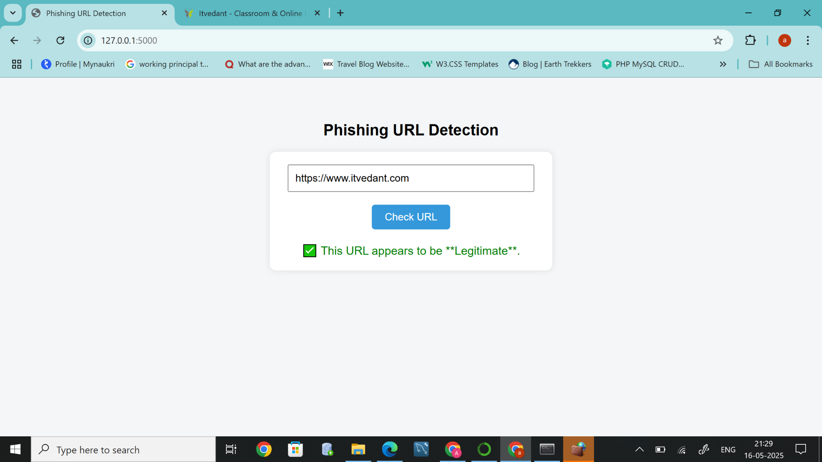
Screenshot: Legitimate URL Test

Slide 15
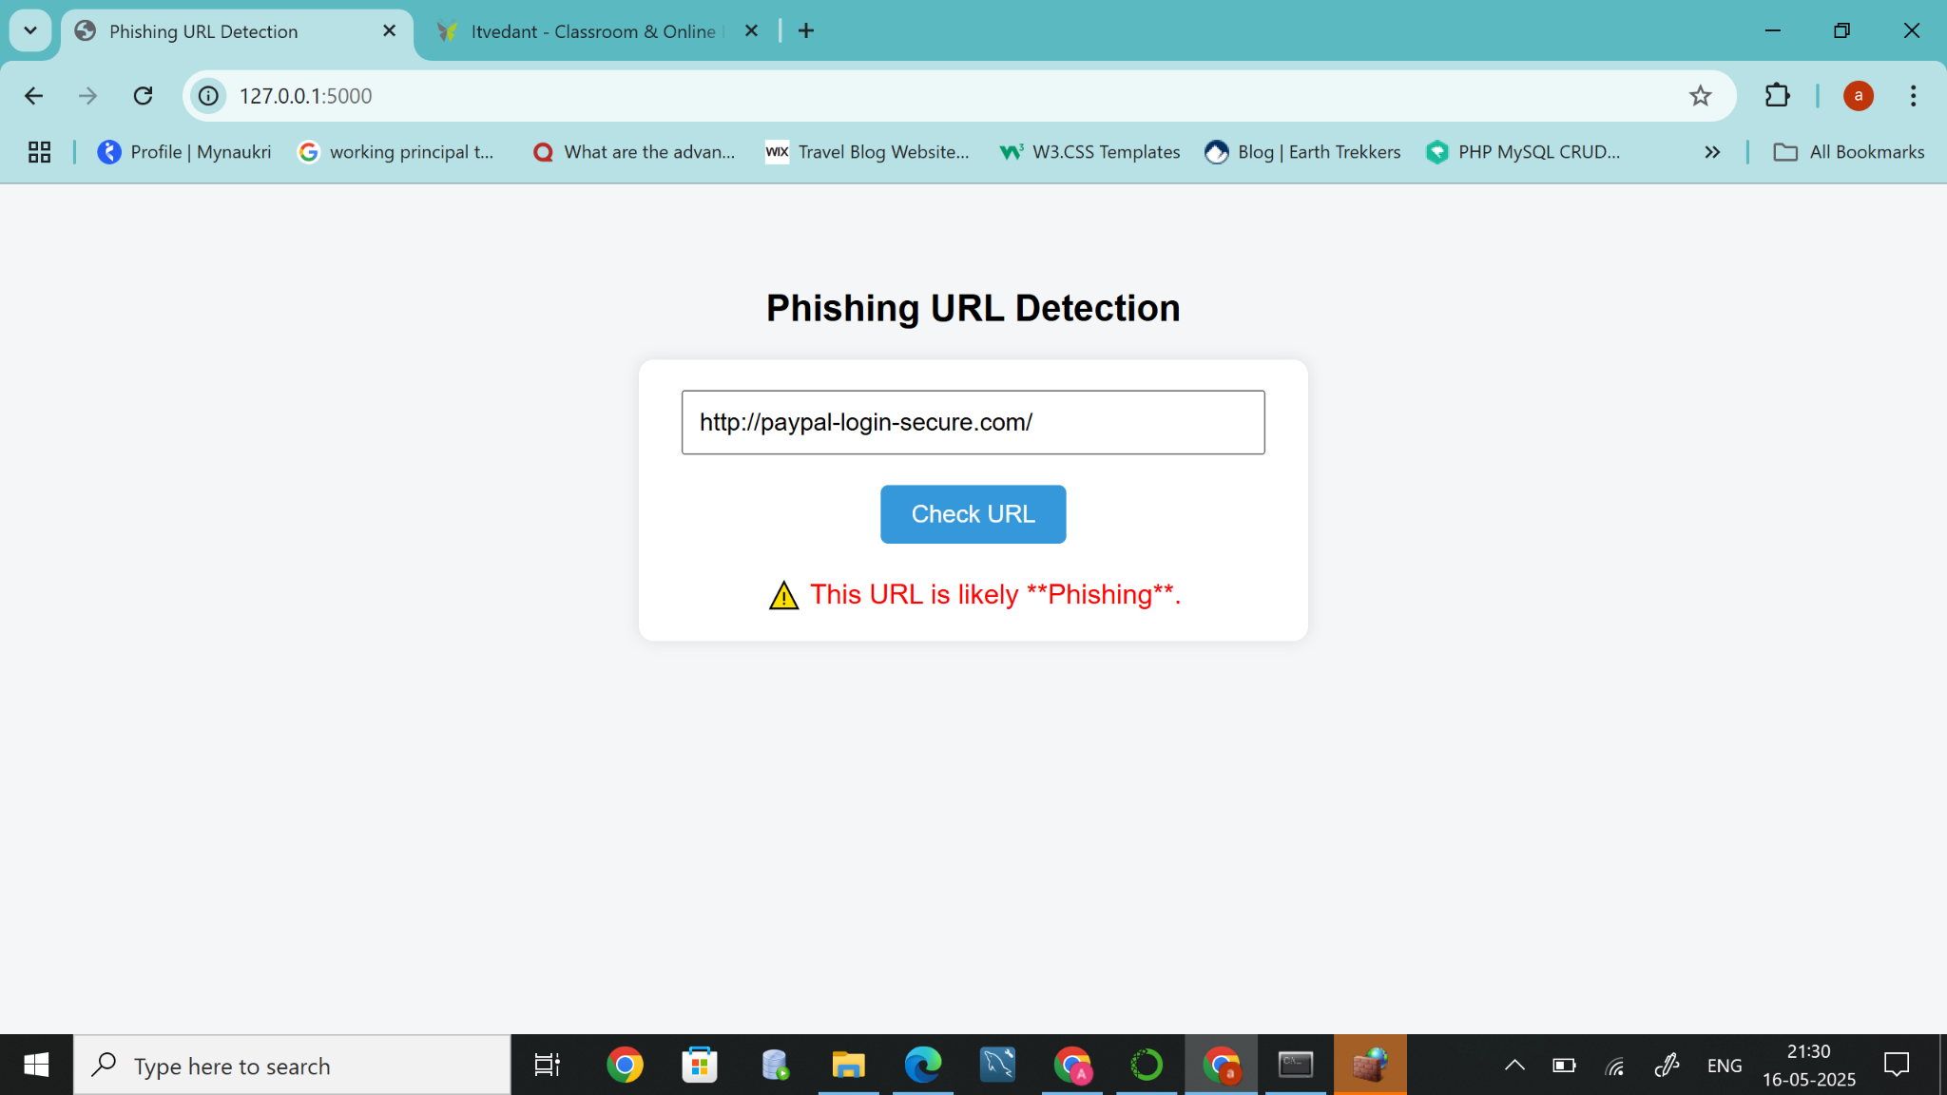
Screenshot: Phishing URL Test

Slide 16
Supporting Materials
Dataset: Phishing Websites Dataset from Wingz Portal
final_model.pkl: Trained RandomForestClassifier model used for prediction.
requirements.txt: Contains all Python dependencies required to run the app.
test_prediction.py: Script for testing the model output locally.
deployment_documentation.docx: Documented steps for setting up and running the app.
Flask App Files: Includes app.py, templates/index.html for backend and UI.
Dockerfile: Enables containerized deployment for consistency and portability.

Slide 17
Final Thoughts & Future Work
Project success: Phishing detection with high accuracy.
Future: Deep learning, enhanced UI, live data integration.

Slide 18
THANK YOU

