Slide 1

Oğuzhan Oktay Büyük Computer&Biomedical Engineering UNIVERSITY OF FATIH SULTAN MEHMET V.
INTRODUCTION TO DATA SCIENCE
RESEARCH HOMEWORK
(2015-2016 Academic Year Autumn Semester)
«Natural Language Processing (NLP)»

Slide 2
Outlines
What Does NLP Mean?
Major Examples of NLP Studies
Examples of NLP Projects
WorldWide NLP Example,
Turkish NLP Example

Slide 3

1. Natural Language Processing

Slide 4
What does the ‘NLP’ mean?
«Mainly, having ability of a computer program to understand human speech as it is spoken»
RELATIONAL AREAS
artificial intelligence
computer science
linguistics

Slide 5
Considered as
Human-computer interaction
A branch of science and natural languages like
Turkish, English, German are processed and used.

Slide 6
Study Scope
Huge studies are based on machine learning(AI)
Examining and using patterns in data to make a program's own understanding better

Slide 7
Major examples of NLP studies
Automatic summarization
Making an inference from a text and results with summary
Coreference resolution
Mentions and Entities are matched
Words in a text need to be meaningful with the whole of the text
Discourse analysis
Recognizing and classifying the speech acts in a chunk of text

Slide 8
Machine Translation
Automatically translate text from a human language to another
It is thought as difficult.
Question answering
Human language question is given and it decides to answer what it is.

Slide 9


Examples of NLP Projects
WordNet
Skype
Real Time speech translation

Slide 10
More on WordNET
A large lexical database of English
Nouns, verbs, adjectives and adverbs are grouped
Into sets of cognitive synonyms (synsets)
Synsets are interlinked by means of
Conceptual-semantic and lexical relations
The resulting network of meaningfully related words and concepts
can be navigated with the browser

Slide 11
WordNET
Provides database for freely accessible.
Has a browser based resulting network

Slide 12
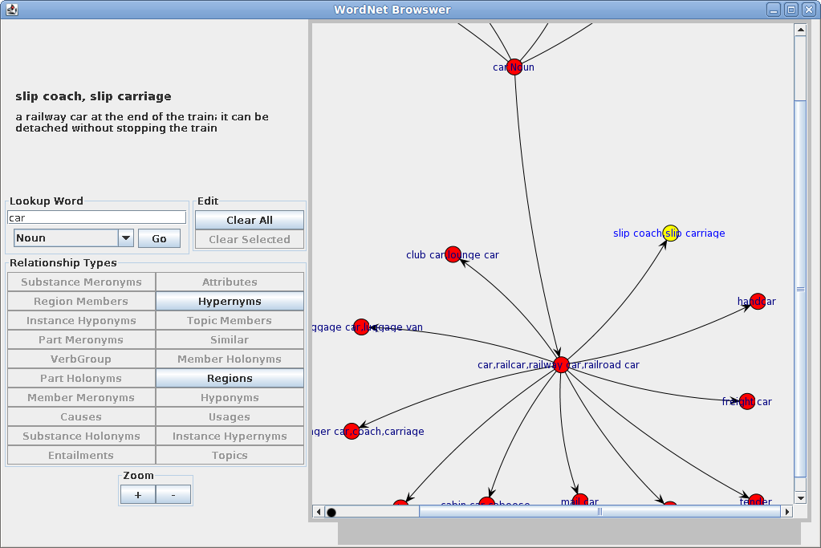
Reference: http://homepages.inf.ed.ac.uk/adubey/software/wnbrowser/index.html

Slide 13
TURKISH STUDIES ON NLP
ITU Turkish Natural Language Processing Pipeline
TS Corpus
A corpus-based concatenative speech synthesis system for Turkish
Bibliography on Turkish Information Retrieval and Natural Language Processing

Slide 14
ITU Turkish Natural Language Processing Pipeline
The platform operates as a SaaS (Software as a Service)
provides the researchers and the students the state of the art NLP tools in many layers:
preprocessing, morphology, syntax and entity recognition.

Slide 15
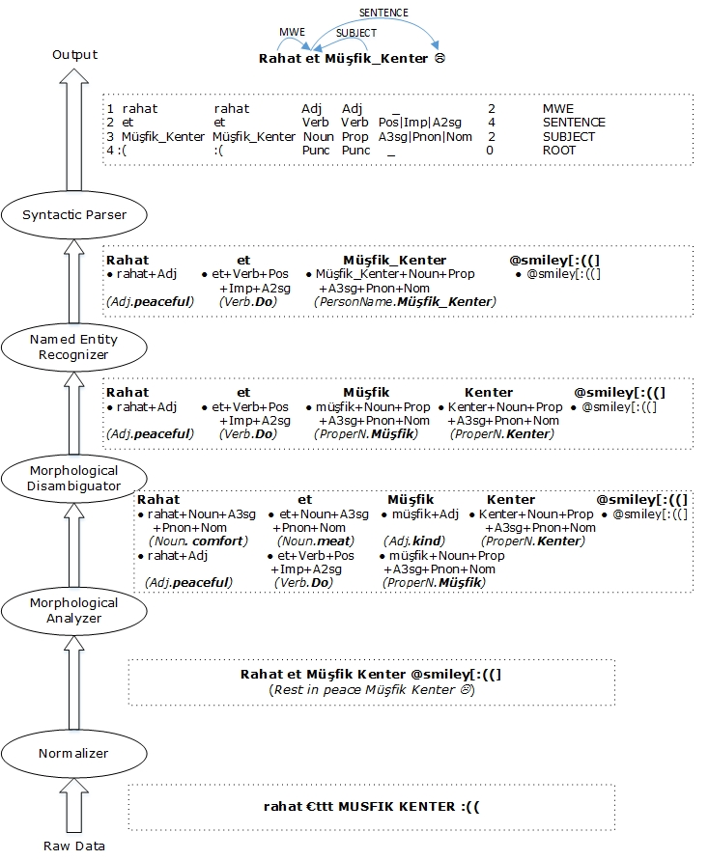
ITU Turkish
Reference: http://tools.nlp.itu.edu.tr/

Slide 16
TS Corpus
TS Corpus is a Free&Independent Project that aims building:
Turkish corpora,
developing Natural Language Processing tools
compiling linguistic datasets.

Slide 17
A corpus-based concatenative speech synthesis system for Turkish
Current research focuses on developing a large vocabulary automatic speech recognition system for Turkish.
Language modeling and speech decoding challenges associated with agglutinative languages and rich morphology

Slide 18

Thank you for listening

Slide 19

REFERENCES
1. Stanford University – Online Coursera, “Natural Language Processing”, accessible on http://online.stanford.edu/course/natural-language-processing
2. Microsoft Research, “Machine Translation”, accessible on: http://research.microsoft.com/en-us/projects/mt/
3. Wikipedia, “Natural language processing”
4. WordNet, “What is WordNet, NLP”, accessible on https://wordnet.princeton.edu/
5. Wnbrowser, “A Graphical WordNet Browser", accessible on: http://homepages.inf.ed.ac.uk/adubey/software/wnbrowser/index.html
6. ITU Turkish Natural Language Processing Pipeline, accessible on: http://tools.nlp.itu.edu.tr/
7. TS Corpus, accessible on: http://nlp.tscorpus.com/sentencer/
8. "A corpus-based concatenative speech synthesis system for Turkish", accessible on: http://www.cmpe.boun.edu.tr/~hasim/
9. Turkish IR & NLP http://ozguryilmazel.com/
10. “What's a Bibliography?”, accessible on: http://www.plagiarism.org/citing-sources/whats-a-bibliography/

