Slide 1
Employee Attrition Prediction
Data Analysis and Machine Learning
Internship Project Presentation
Presented by: Aliya Shaikh
Role: Data Science Intern Organization: Naviotech Solution Pvt. Ltd.
Date: October 2026

Slide 2
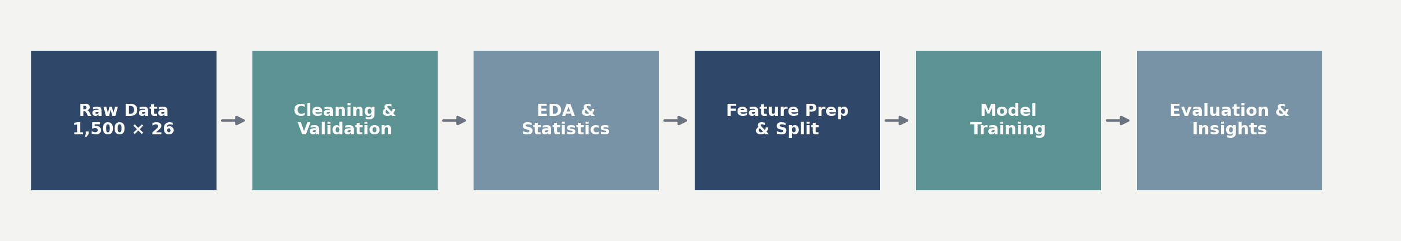
Project Overview
Problem statement, objectives and analytical approach
Problem Statement
Project Workflow
Employee attrition affects continuity, recruitment cost and team productivity. This project analyses employee records to identify patterns associated with attrition and builds a model to estimate whether an employee is likely to leave.
The project follows an end-to-end data science workflow: data preparation, exploratory and statistical analysis, supervised modelling, evaluation, and business interpretation.
Deliverables include a trained Random Forest model, evaluation metrics, feature-importance analysis and actionable retention recommendations.
Objectives
• Understand the dataset — and validate data quality
• Explore attrition patterns — across demographic, role and work-related variables
• Apply statistical tests — to assess associations with attrition
• Build and compare models — using a reproducible ML pipeline
• Identify key drivers — and translate results into retention actions

Slide 3
Dataset Description
Employee Attrition Analysis Dataset
1,500
Employee records
26
Variables
0
Missing values
0
Duplicate rows / IDs
Dataset Structure
Key Characteristics
• 20 numerical variables — including age, income, tenure, satisfaction, workload and absenteeism
• 6 categorical variables — gender, marital status, department, job role, overtime and attrition
• Target variable — Attrition: Yes / No
• Identifier — EmployeeID, excluded from modelling
• Attrition prevalence — 297 employees left; 1,203 stayed
• Class balance — 19.8% attrition, 80.2% retention
• Age range — 20–59 years
• Monthly income range — ₹3,001–₹19,999
• Tenure range — 1–29 years at company

Slide 4
Data Cleaning & Preprocessing
Quality checks and machine-learning preparation
Data Quality Checks
Preprocessing Pipeline
• Missing values — none detected across all 26 fields
• Duplicate records — none found
• Duplicate EmployeeIDs — none found
• Text consistency — column names and categorical values trimmed
• Contingency treatment — median imputation for numeric and mode imputation for categorical fields, if required
• Target encoding — Attrition mapped to 0 = No, 1 = Yes
• Feature matrix — 24 predictors; EmployeeID removed
• Train-test split — 80% training / 20% testing, stratified by attrition
• Split sizes — 1,200 training and 300 testing records
• Numeric transformation — median imputation followed by standard scaling
• Categorical transformation — most-frequent imputation and one-hot encoding
Result: The cleaned dataset retained all 1,500 records and 26 columns. Stratification preserved the 19.8% attrition rate in both training and test sets.

Slide 5
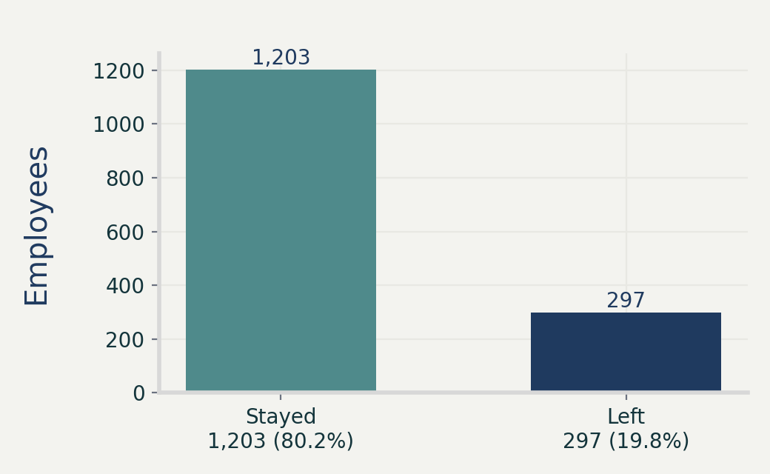
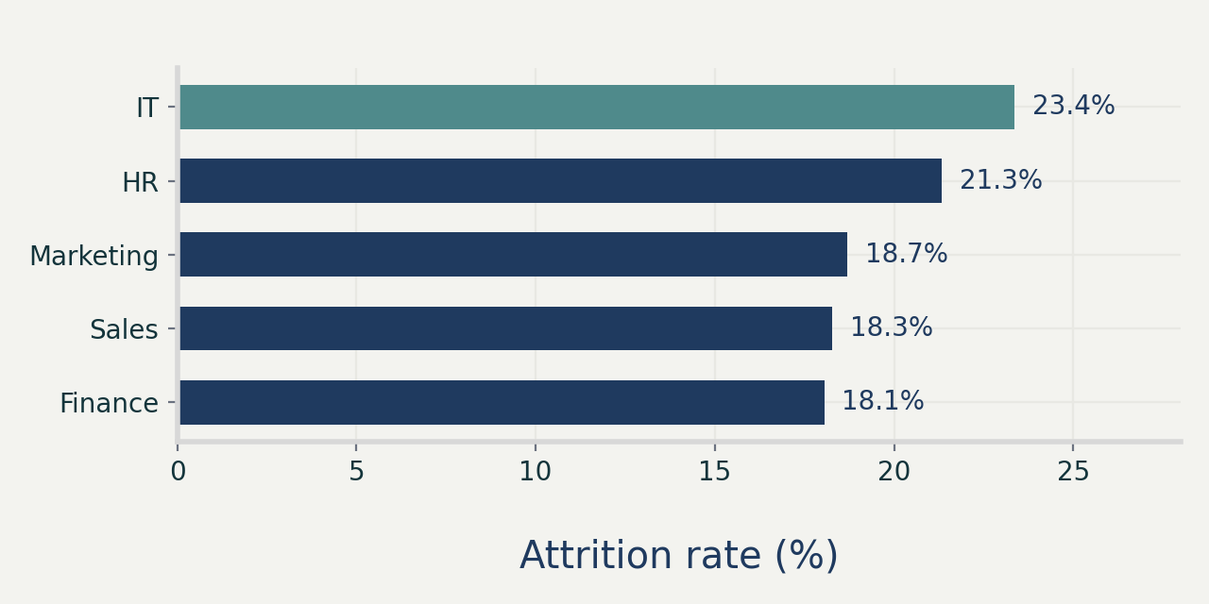
Exploratory Data Analysis
Attrition distribution and departmental patterns
Key EDA findings
• 297 of 1,500 employees left, giving an overall attrition rate of 19.8%.
• IT had the highest departmental attrition rate at 23.37%, followed by HR at 21.33%; Finance had the lowest at 18.05%.

Slide 6
Statistical Analysis & Feature Preparation
Testing associations before modelling
Categorical Associations
Numerical Comparisons
Chi-square tests with FDR adjustment examined Gender, Marital Status, Department, Job Role and Overtime.
Job Role showed the strongest unadjusted association with attrition (p = 0.0271; Cramér’s V = 0.0782), but was not significant after multiple-testing correction (adjusted p = 0.1353).
Overtime showed no statistical association in this dataset (p = 1.0000).
Mann–Whitney U tests compared employees who left with those who stayed.
Average weekly hours: median 46 for leavers versus 44 for stayers (p = 0.0225).
Absenteeism: median 10 for leavers versus 9 for stayers (p = 0.0124).
After FDR correction, these differences were suggestive rather than statistically significant (adjusted p = 0.1124).
Feature preparation: 24 predictors were retained; categorical variables were one-hot encoded and numerical variables standardised within a ColumnTransformer pipeline to prevent data leakage.

Slide 7
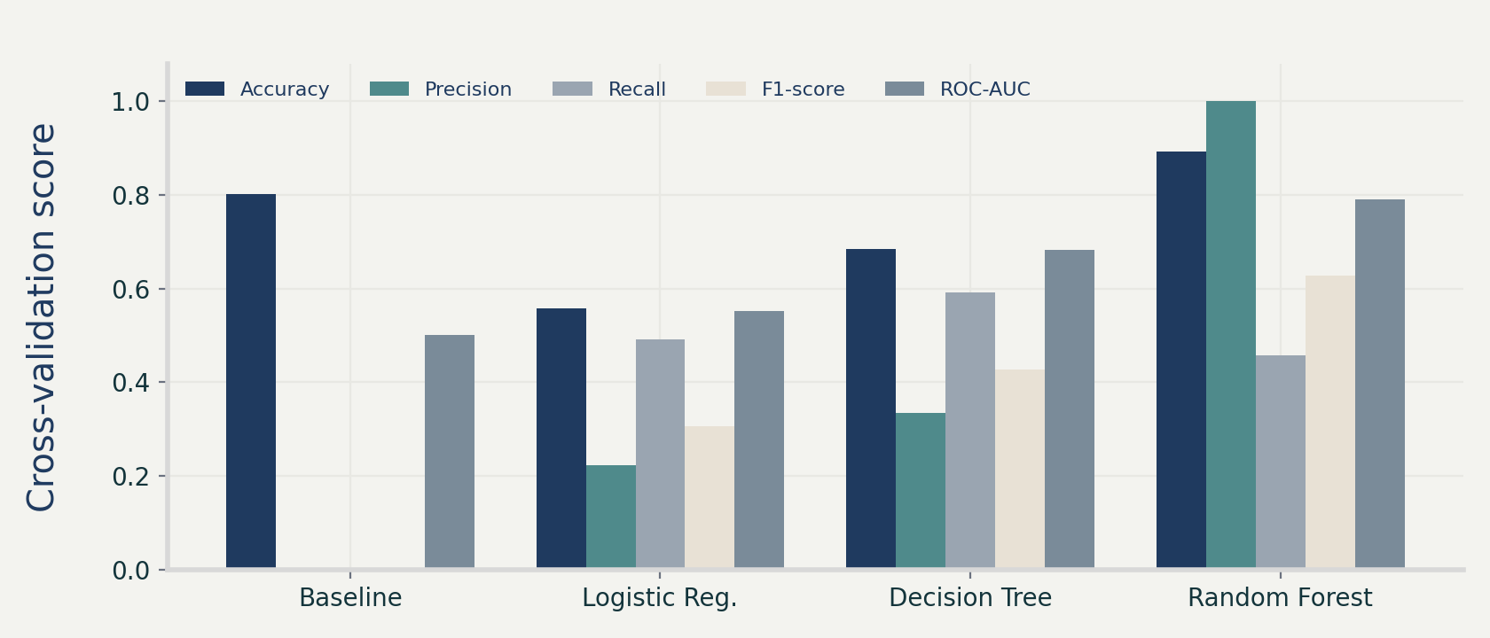
Machine Learning Models & Comparison
Five-fold stratified cross-validation on the training set
Models Tested
• Baseline — DummyClassifier, prior strategy
• Logistic Regression — class-weighted
• Decision Tree — class-weighted, leaf constraint
• Random Forest — 300 trees, class-weighted
Best model
Random Forest
Highest F1-score: 0.627
Highest ROC-AUC: 0.790

Slide 8
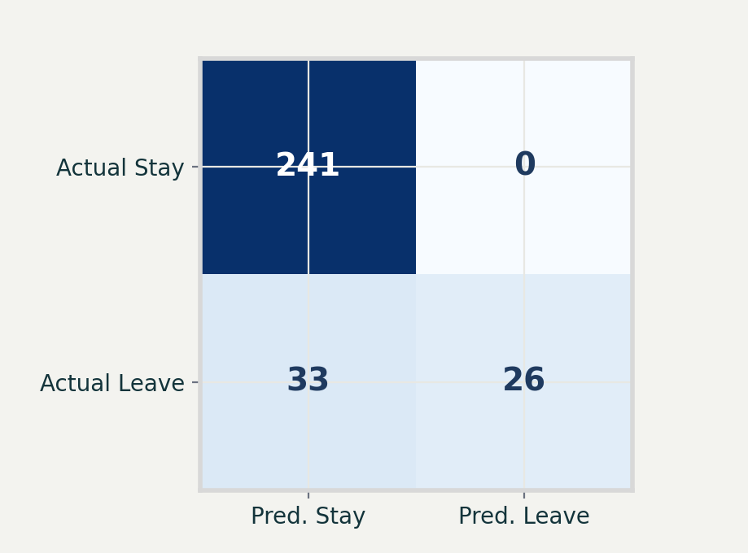
Random Forest Evaluation
Performance on the unseen 300-record test set
0.890
Accuracy
1.000
Precision
0.441
Recall
0.612
F1-score
0.799
ROC-AUC
Interpretation
• Correctly identified stayers — 241 of 241 non-attrition cases
• Identified leavers — 26 of 59 actual attrition cases
• Missed attrition cases — 33 employees were predicted to stay
• No false attrition alerts — all 26 attrition predictions were correct
• Business implication — high precision is useful for targeted intervention, while recall should be improved to capture more potential leavers

Slide 9
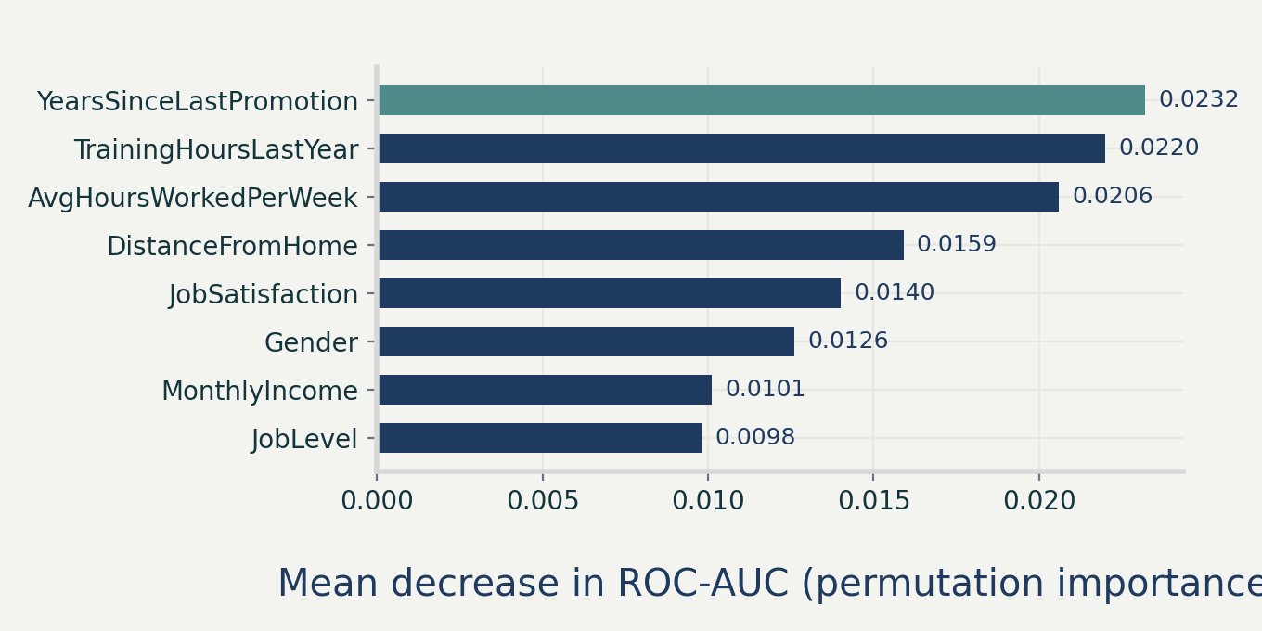
Feature Importance & Business Recommendations
Permutation importance based on ROC-AUC
Business Insights
• Career progression — time since last promotion is the leading predictor
• Development — training hours also influence predictions
• Workload — longer average weekly hours are associated with attrition risk
• Commuting — distance from home contributes to the model
• Engagement — job satisfaction remains relevant
• Department / role — IT and Assistant roles show higher observed attrition rates
Recommendations: Review promotion pathways, strengthen role-specific training, monitor workload and commuting burden, and prioritise retention support for higher-risk IT and Assistant roles.

Slide 10
Conclusion & Future Scope
Project outcomes and next steps
Conclusion
Future Scope
• End-to-end analysis — completed from data validation to model interpretation
• Random Forest performed best — F1-score 0.627 and ROC-AUC 0.790 in cross-validation
• Test performance — 89.0% accuracy, 100% precision, 44.1% recall and 0.799 ROC-AUC
• Practical value — the model can support targeted retention planning, while recognising the class-imbalance challenge
• Interpretability — permutation importance highlights promotion recency, training, workload and commute-related factors
• Improve minority-class detection — using resampling, threshold tuning or cost-sensitive learning
• Expand model comparison — include gradient boosting methods such as XGBoost or LightGBM
• Hyperparameter optimisation — apply systematic search with nested cross-validation
• Deploy the model — package the saved pipeline for batch or interactive scoring
• Enhance data — add compensation changes, engagement surveys, manager feedback and exit-interview reasons
Thank you | Aliya Shaikh | Data Science Intern, Naviotech Solution Pvt. Ltd.

