Slide 1
Network | # Nodes | # Edges | Nodes | Edges
Karate Club | 34 | 78 | Members of a karate club | Interaction between members outside the club
Windsurfers | 43 | 336 | Windsurfers in Southern California | Interpersonal contact between windsurfers during the fall of 1986
Les Miserables | 77 | 254 | Characters of the Les Miserables Novel | Co-occurrence of characters in the same chapter
Games of thrones | 107 | 352 | Characters of the Games of Thrones | Co-occurrence of characters within 15 words of one another in the third book of the series
Senators | 100 | 4949 | Senators of the US Congress | Number of bills sponsored by two senators in the 114th session of the Congress
OpenFlights | 2905 | 15645 | Airports from the openflights.org(on August 12, 2011) | Number of routes between two airports

Slide 2
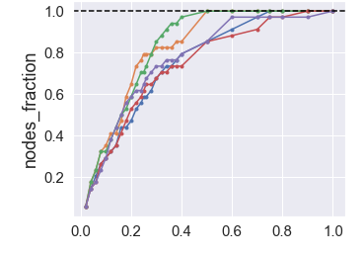
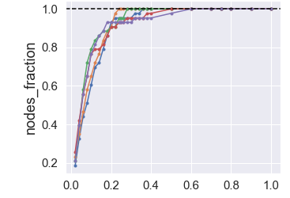
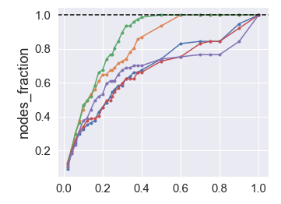
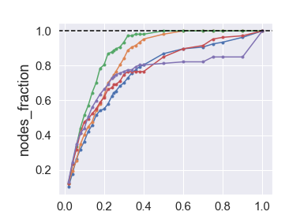
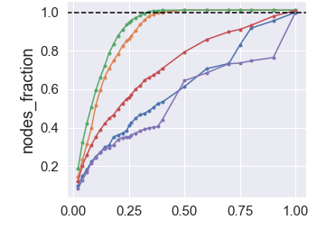
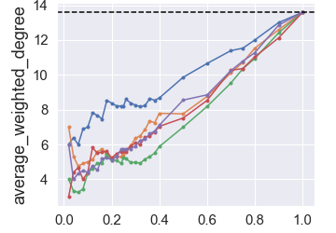
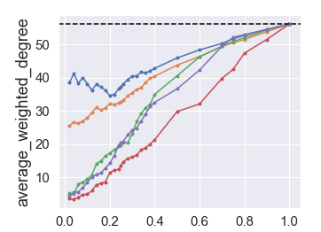
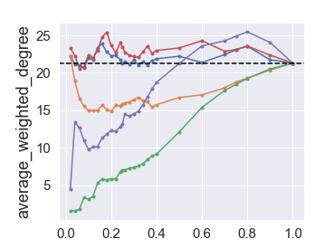
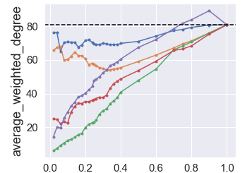
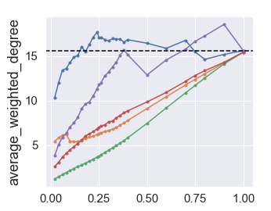
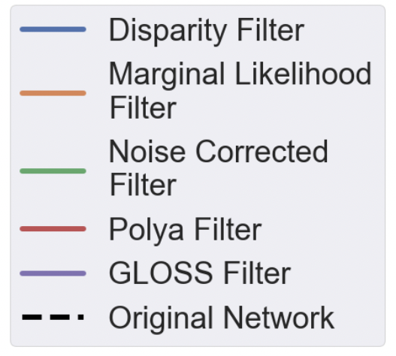
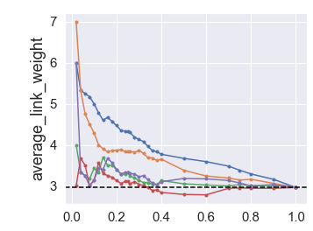
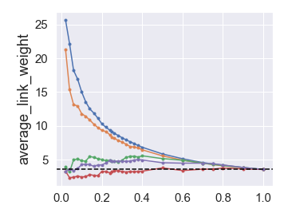
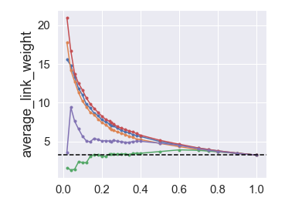
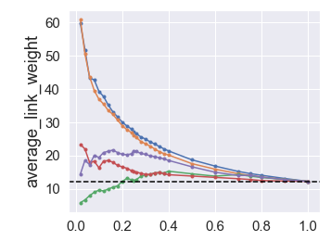
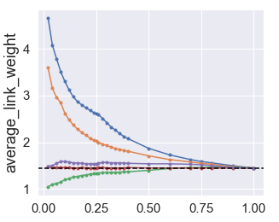
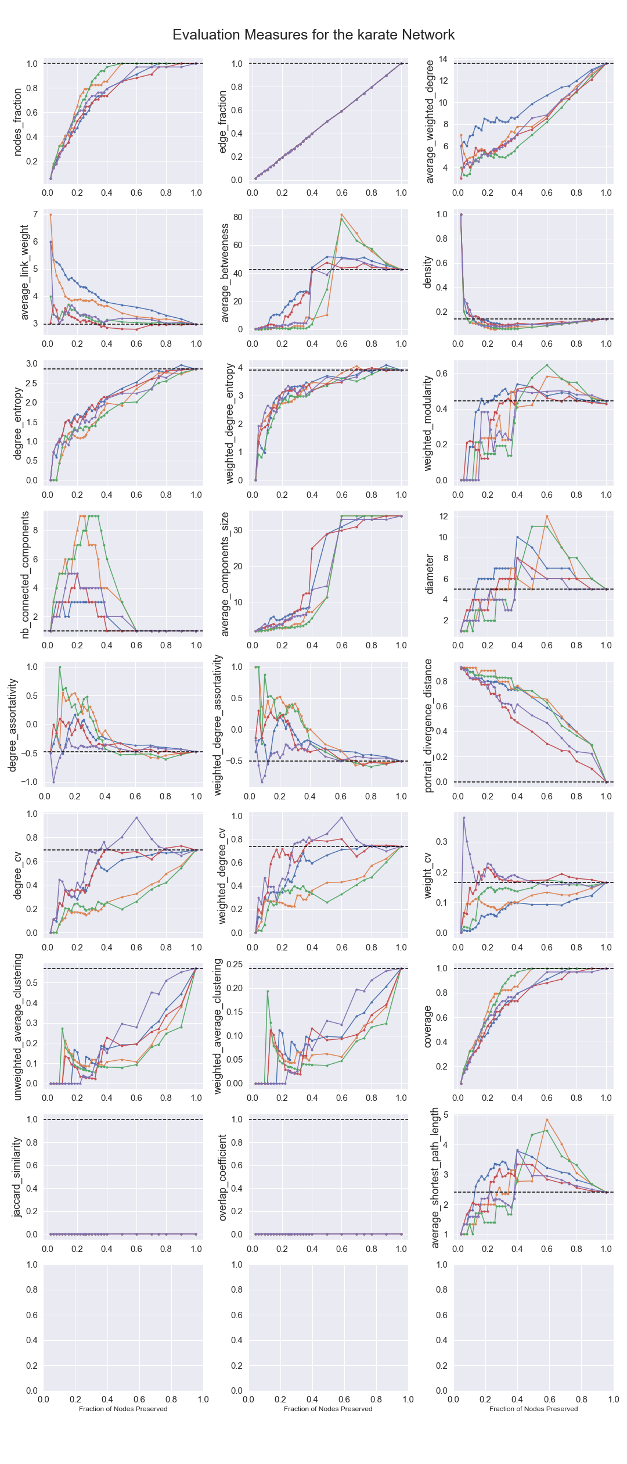
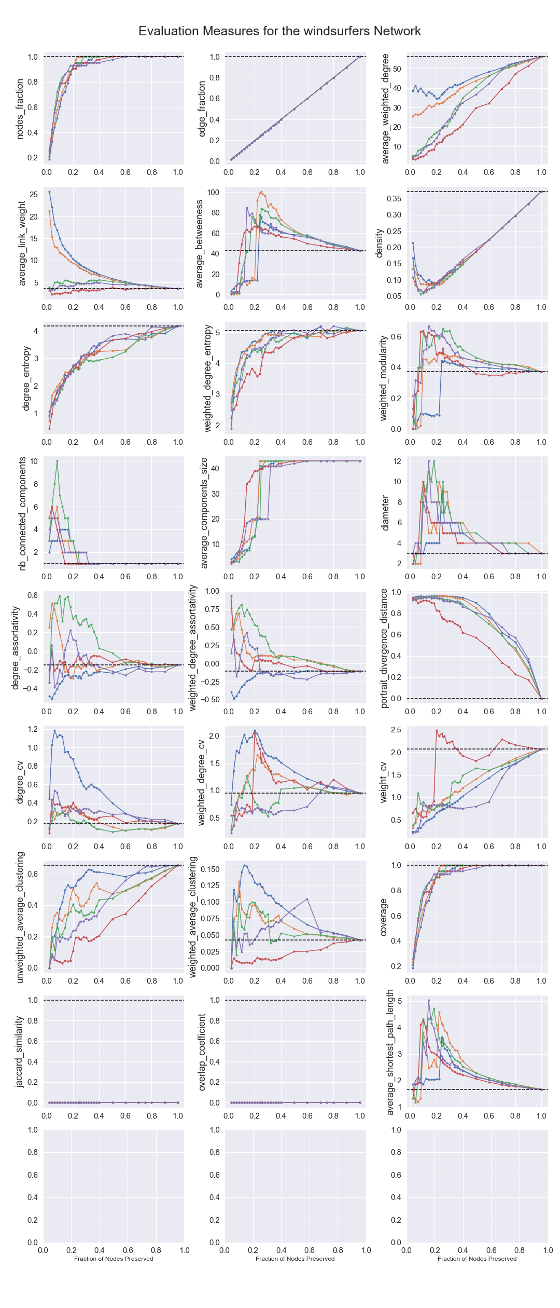
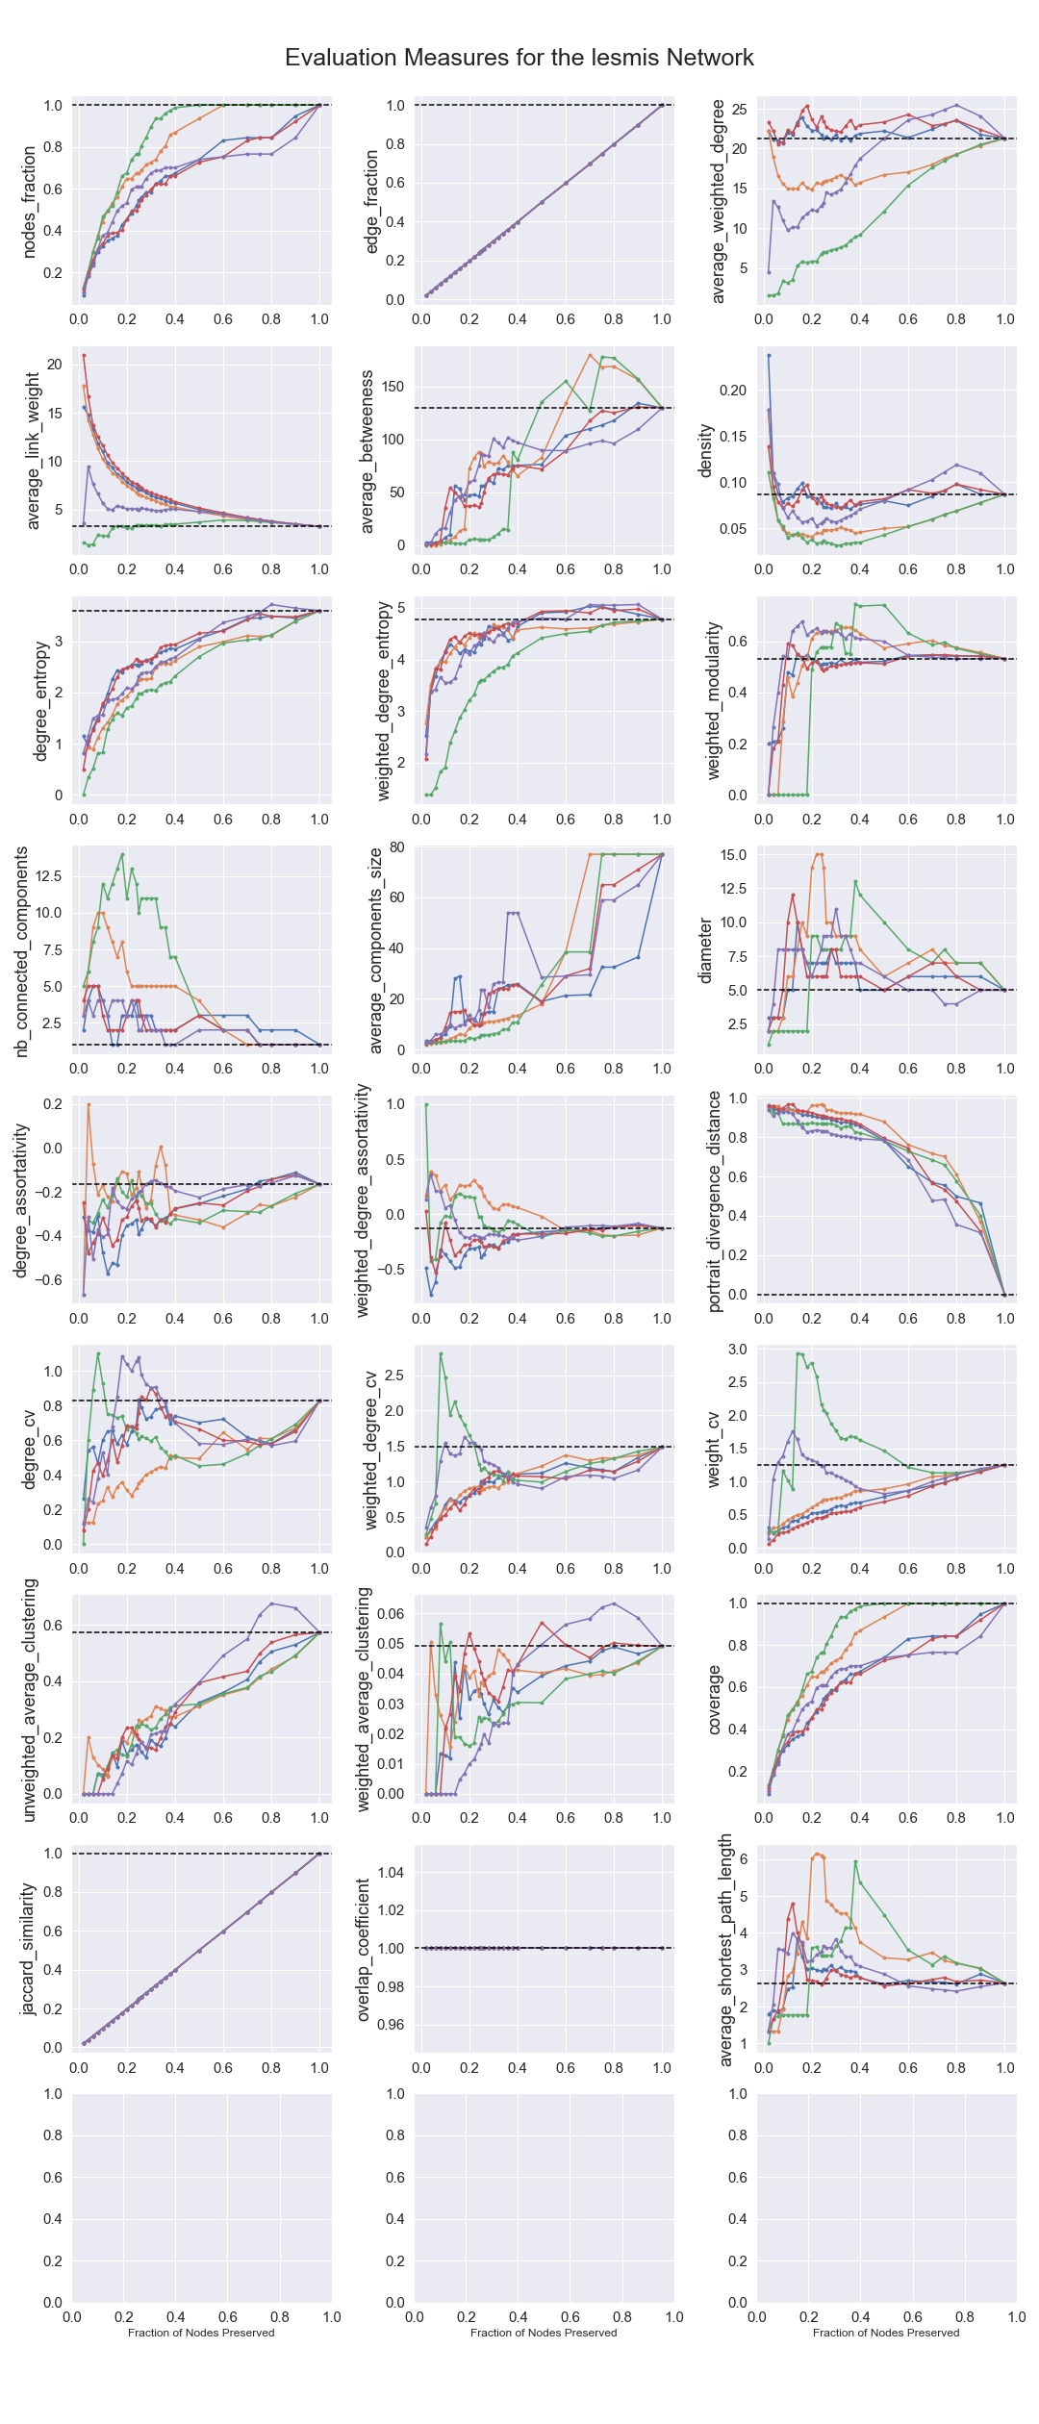
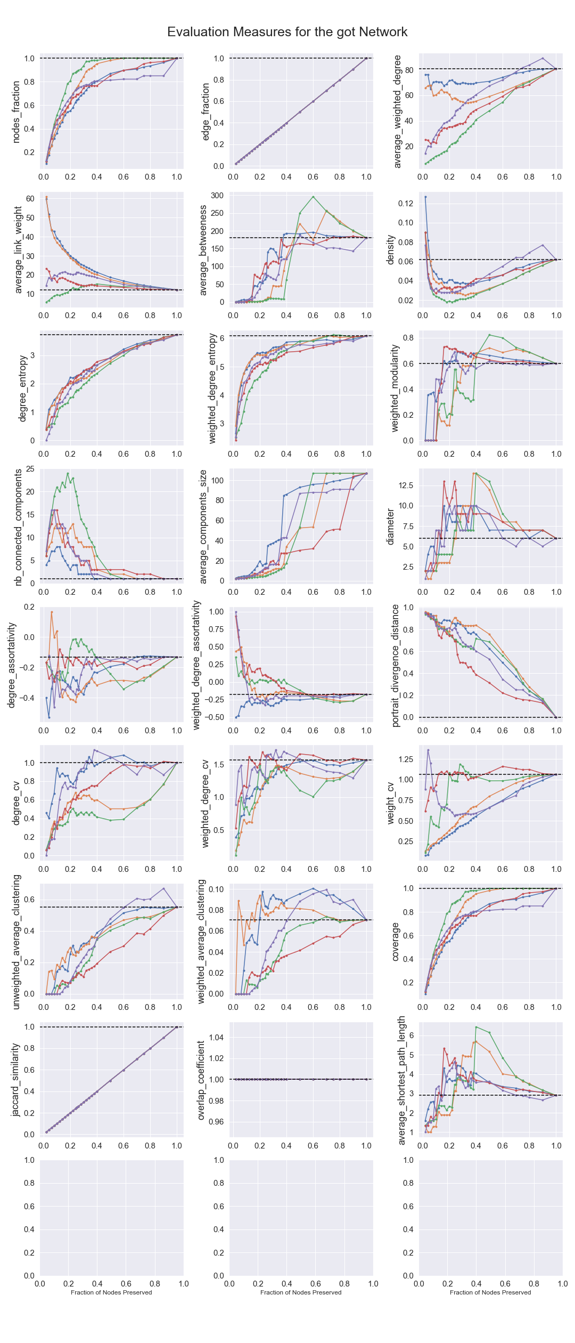
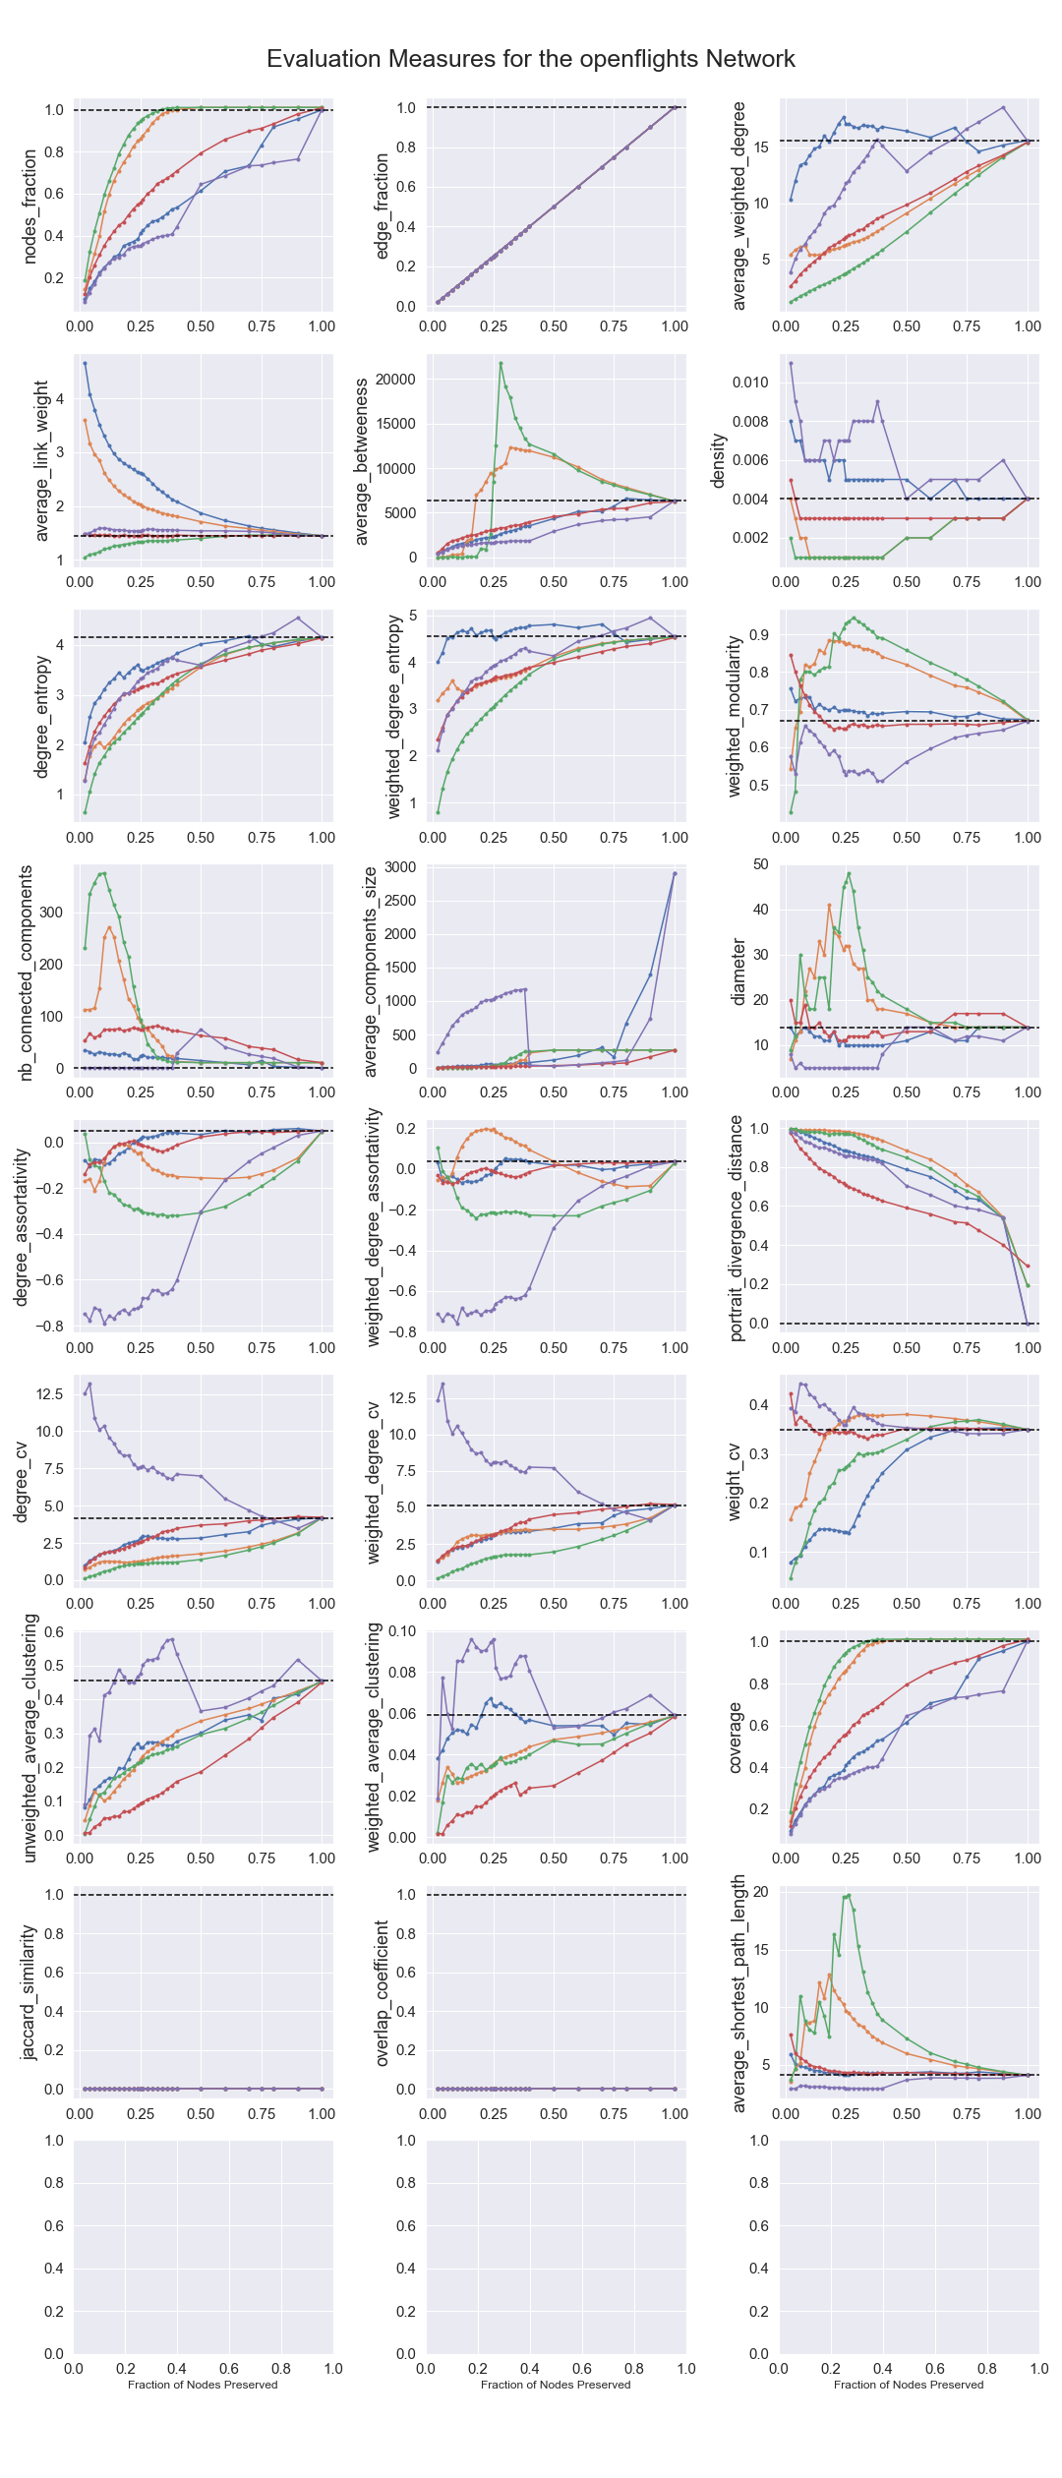
Karate Club
Windsurfers
Les Miserables
Games of thrones
Openfilghts
Noise Corrected Filter
Followed by the Marginal Likelihood Filter
Disparity Filter is the closest, followed by the Marginal likelihood filter and the gloss filter depending on the fraction of edges
Disparity Filter and the Marginal likelihood filter
Noise Corrected Filter and the Marginal likelihood filter results in low density bakbone

Slide 3
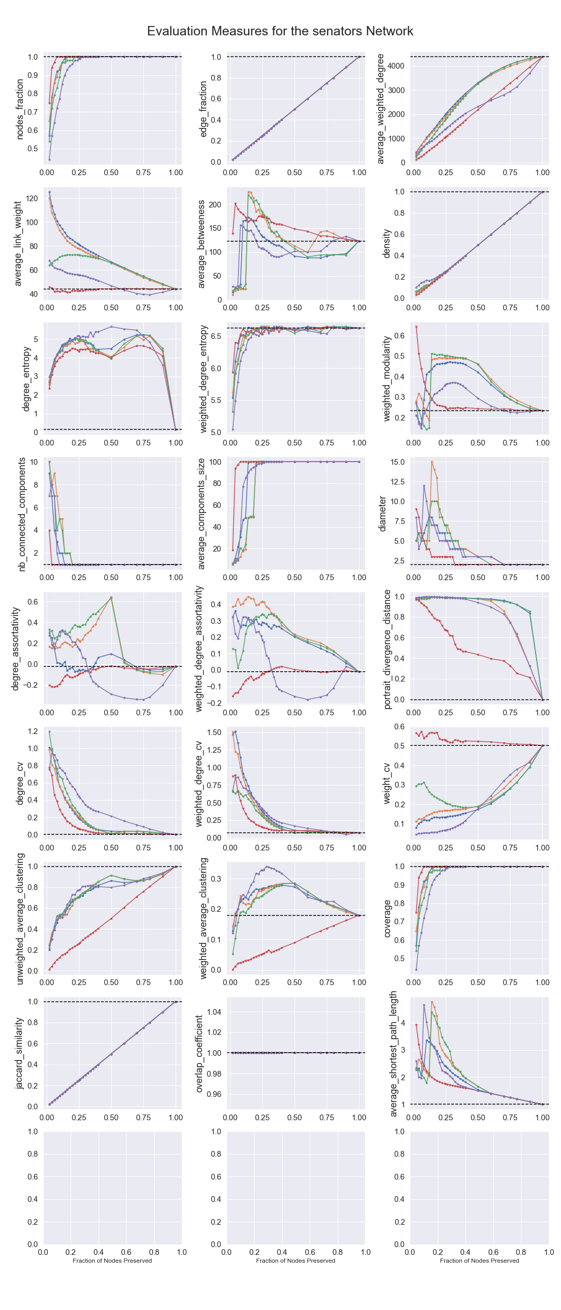

Slide 4
Karate Club | Karate Club
 | infection_participation
Marginal Likelihood Filter | 0.838
Noise Corrected Filter | 0.837
Disparity Filter | 0.400
GLOSS Filter | 0.144
Polya Filter | -0.119
Windsurfers | Windsurfers
 | infection_participation
Marginal Likelihood Filter | 0.779
Noise Corrected Filter | 0.746
Disparity Filter | 0.604
GLOSS Filter | 0.458
Polya Filter | -0.056
Les Miserables | Les Miserables
 | infection_participation
Marginal Likelihood Filter | 0.777
Polya Filter | 0.679
Disparity Filter | 0.658
Noise Corrected Filter | 0.657
GLOSS Filter | 0.513
The Marginal likelihood followed by the Noise Corrected Filter then the Disparity Filter
Games of Thrones | Games of Thrones
 | infection_participation
Marginal Likelihood Filter | 0.734
Noise Corrected Filter | 0.665
Disparity Filter | 0.440
GLOSS Filter | 0.283
Polya Filter | 0.039
Senators | Senators
 | infection_participation
Disparity Filter | 0.197
Noise Corrected Filter | 0.196
Marginal Likelihood Filter | 0.191
GLOSS Filter | 0.083
Polya Filter | 0.038
OpenFlights | OpenFlights
 | infection_participation
Disparity Filter | 0.218
Marginal Likelihood Filter | 0.146
Noise Corrected Filter | 0.083
Polya Filter | 0.010
GLOSS Filter | -0.062

Slide 6
Karate Club
Windsurfers
Les Miserables
Games of thrones
Openfilghts
Noise Corrected Filter
Followed by the Marginal Likelihood Filter
Disparity Filter is the closest, followed by the Marginal likelihood filter and the gloss filter depending on the fraction of edges
Disparity Filter and the Marginal likelihood filter
Noise Corrected Filter and the Marginal likelihood filter results in low density bakbone

