Slide 1
MultiThreading

Slide 2
Introduction
Unlike many languages that do not have built-in multithreading (such as C and C++) and must therefore make calls to operating system multithreading primitives, Java includes multithreading primitives as part of the language itself (actually in classes Thread, ThreadGroup, etc in java.lang package). This encourages the use of multithreading among a larger part of the applications-programming community.

Slide 3
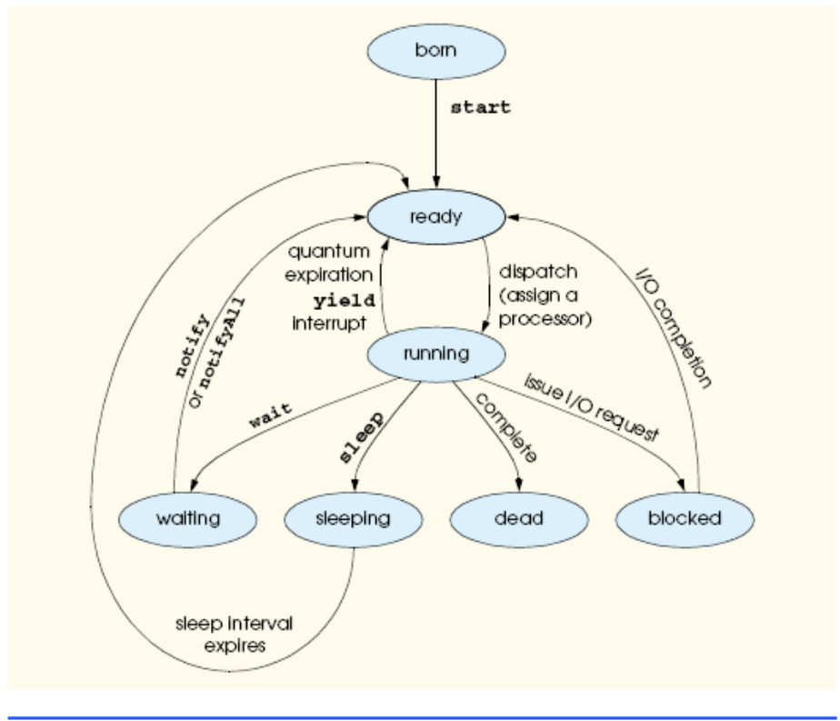
LifleCycle of a thread

Slide 4
An Overview of the Thread Methods
public Thread( String threadName ): constructs a Thread object whose name is threadName. The constructor
public Thread(): constructs a Thread whose name is "Thread-" concatenated with a number, like Thread-1, Thread-2, and so on.
run method: The code that “does the real work” of a thread is placed in its. The run
method can be overridden in a subclass of Thread or it may be implemented in a Runnable object; Runnable is an important Java interface that we study soon.
A program launches a thread’s execution by calling the thread’s start method,
which, in turn, calls method run. After start launches the thread, start returns to its
caller immediately. The caller then executes concurrently with the launched thread. The
start method throws an IllegalThreadStateException if the thread it is trying to start has already been started.

Slide 5
The static method sleep is called with an argument specifying how long the currently
executing thread should sleep (in milliseconds); while a thread sleeps, it does not
contend for the processor, so other threads can execute. This can give lower priority threads
a chance to run.
The interrupt method is called to interrupt a thread. The static method
interrupted returns true if the current thread has been interrupted and false otherwise.
A program can invoke a specific thread’s isInterrupted method to determine
whether that thread has been interrupted.
Method isAlive returns true if start has been called for a given thread and the
thread is not dead (i.e., its controlling run method has not completed execution).

Slide 6
Method setName sets a Thread’s name. Method getName returns the name of the Thread. Method toString returns a String consisting of the name of the thread, the priority of the thread and the thread’s ThreadGroup.
The static method currentThread returns a reference to the currently executing
Thread.
Method join waits for the Thread to which the message is sent to die before the
calling Thread can proceed; no argument or an argument of 0 milliseconds to method
join indicates that the current Thread will wait forever for the target Thread to die
before the calling Thread proceeds. Such waiting can be dangerous; it can lead to two particularly serious problems called deadlock and indefinite postponement.

Slide 7
Synchronization:
When a running thread calls wait, the thread enters a waiting state for the particular object on which wait was called. One thread in the waiting state for a particular object becomes ready on a call to notify issued by another thread associated with that object.
Every thread in the waiting state for a given object becomes ready on a call to notifyAll by another thread associated with that object.
A thread enters the dead state when its run method either completes or throws an
uncaught exception.
Priority
setPriority (int priority), int getPriority()
Thread.MIN_PRIORITY (a constant of 1)
Thread.MAX_PRIORITY (a constant of 10).
Thread.NORM_PRIORITY (aconstant of 5)
A thread can call the yield method to give other threads a chance to execute.

Slide 8
A Simple example
public class Fruite
{
public static void main(String[] args)
{
AppleThred apple = new AppleThred();
OrangeThread orange = new OrangeThread();
apple.start();
orange.start();
}
}

Slide 9
class AppleThred extends Thread
{
public void run()
{
for(int i = 0; i < 10; i++)
System.out.println("Apple" + i);
}
}
class OrangeThread extends Thread
{
public void run()
{
for(int i = 0; i < 6; i++)
System.out.println("Orange" + i);
}
}

Slide 10
Out put:
Apple0
Apple1
Apple2
Apple3
Apple4
Orange0
Apple5
Orange1
Orange2
Apple6
Orange3
Apple7
Orange4
Apple8
Orange5
Apple9

Slide 11
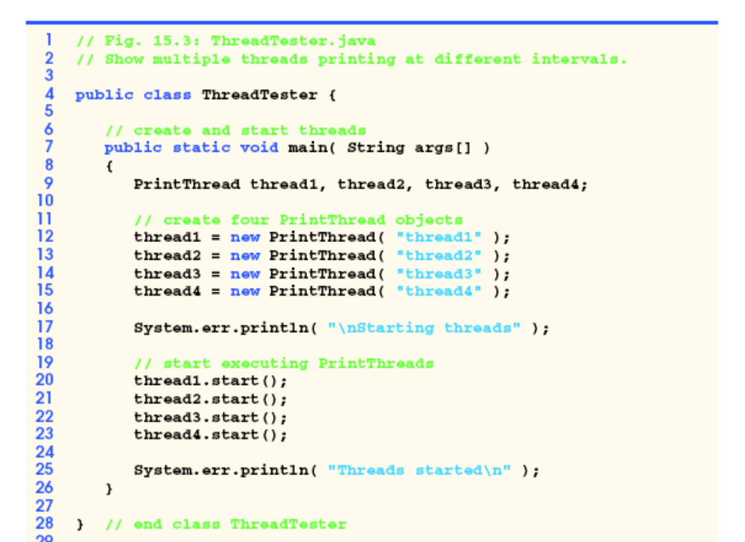
Another Example

Slide 12
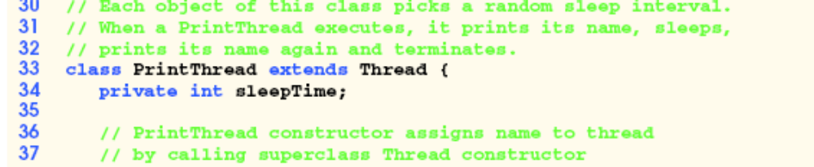
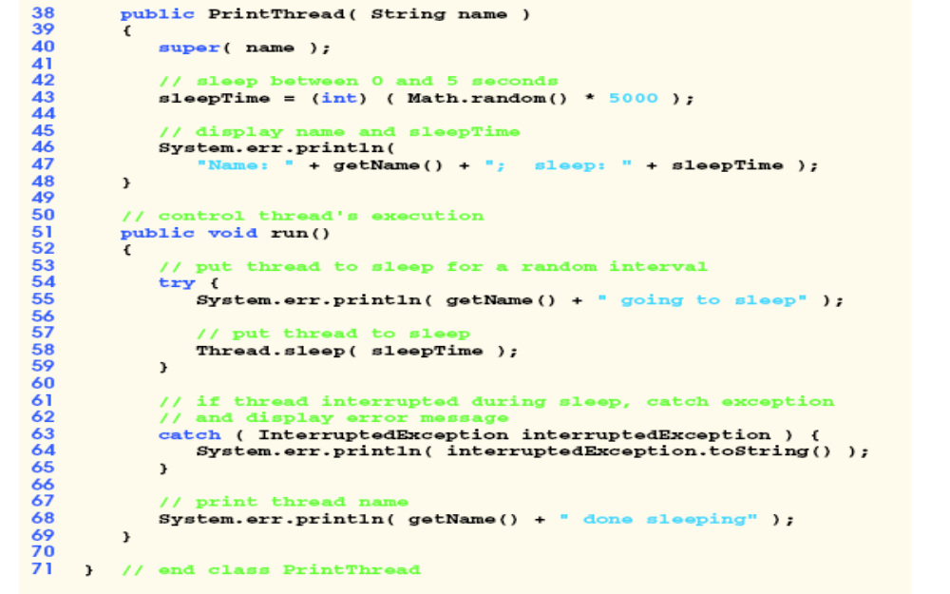

Slide 13
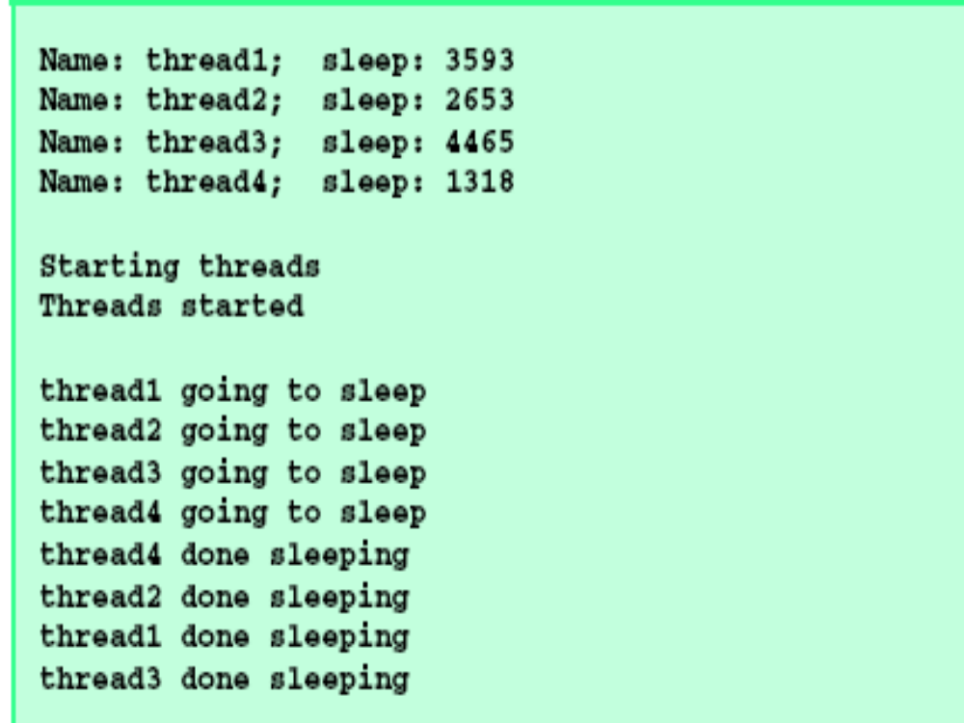
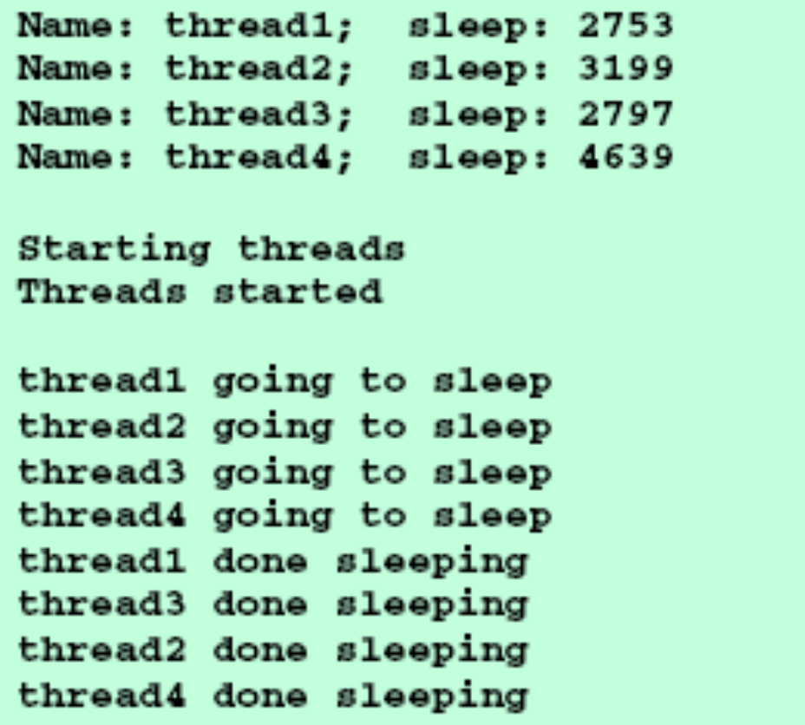

Slide 14
Runnable interface
if we want multithreading support in a class that already extends a class other than
Thread, we must implement the Runnable interface in that class, because Java does not
allow a class to extend more than one class at a time.
The constructor:
public Thread( Runnable runnableObject )
public Thread( Runnable runnableObject, String threadName )
constructs a Thread with the name threadName and registers method run of its
runnableObject argument as the method to be invoked when the thread begins execution.
As always, the thread object’s start method must be called to begin the thread’s
execution.

Slide 15
// This program is not synchronized.
public class Anything
{
public static void main(String args[])
{
Callme target = new Callme();
Caller ob1 = new Caller(target, "Hello");
Caller ob2 = new Caller(target, "Synchronized");
Caller ob3 = new Caller(target, "World");
// wait for threads to end
try {
ob1.t.join();
ob2.t.join();
ob3.t.join();
} catch(InterruptedException e) {
System.out.println("Interrupted");
}
System.out.println(“ Let’s continue working now that all threads have finished”);
}
}

Slide 16
class Callme {
void call(String msg) {
System.out.print("[" + msg);
try {
Thread.sleep(1000);
} catch(InterruptedException e) {
System.out.println("Interrupted");
}
System.out.println("]");
}
}
//*************

Slide 17
class Caller implements Runnable {
String msg;
Callme target;
Thread t;
public Caller(Callme targ, String s) {
target = targ;
msg = s;
t = new Thread(this);
t.start();
}
public void run() {
target.call(msg);
}
}

Slide 18
[Hello[Synchronized[word]
]
]
Let’s continue working now that all threads have finished

Slide 19
Synchronization
Use the keyword synchronized
Class callme{
Synchronized void call(String msg)
{
….
}
Also
Synchronized ( object)
{
Any work on the object goes here
}

Slide 20
In the previous example we could do this:
class Callme {
synchronized void call(String msg) {
System.out.print("[" + msg);
try {
Thread.sleep(1000);
} catch(InterruptedException e) {
System.out.println("Interrupted");
}
System.out.println("]");
}
}
Then we would get:
[Hello]
[Synchronized]
[word]
Let’s continue working now that all threads have finished

Slide 21
Or we could synchronize on object (on class Callme)
// This program uses a synchronized block.
public class Anything
{
public static void main(String args[])
{
Callme target = new Callme();
Caller ob1 = new Caller(target, "Hello");
Caller ob2 = new Caller(target, "Synchronized");
Caller ob3 = new Caller(target, "World");
// wait for threads to end
try {
ob1.t.join();
ob2.t.join();
ob3.t.join();
} catch(InterruptedException e) {
System.out.println("Interrupted");}
System.out.println(“Let’s Continue”); }}

Slide 22
class Callme {
void call(String msg) {
System.out.print("[" + msg);
try {
Thread.sleep(1000);
} catch (InterruptedException e) {
System.out.println("Interrupted");
}
System.out.println("]");
}
}

Slide 23
class Caller implements Runnable {
String msg;
Callme target;
Thread t;
public Caller(Callme targ, String s) {
target = targ;
msg = s;
t = new Thread(this);
t.start();
}
// synchronize calls to call()
public void run() {
synchronized(target) { // synchronized block
target.call(msg);
}
}
}

Slide 24
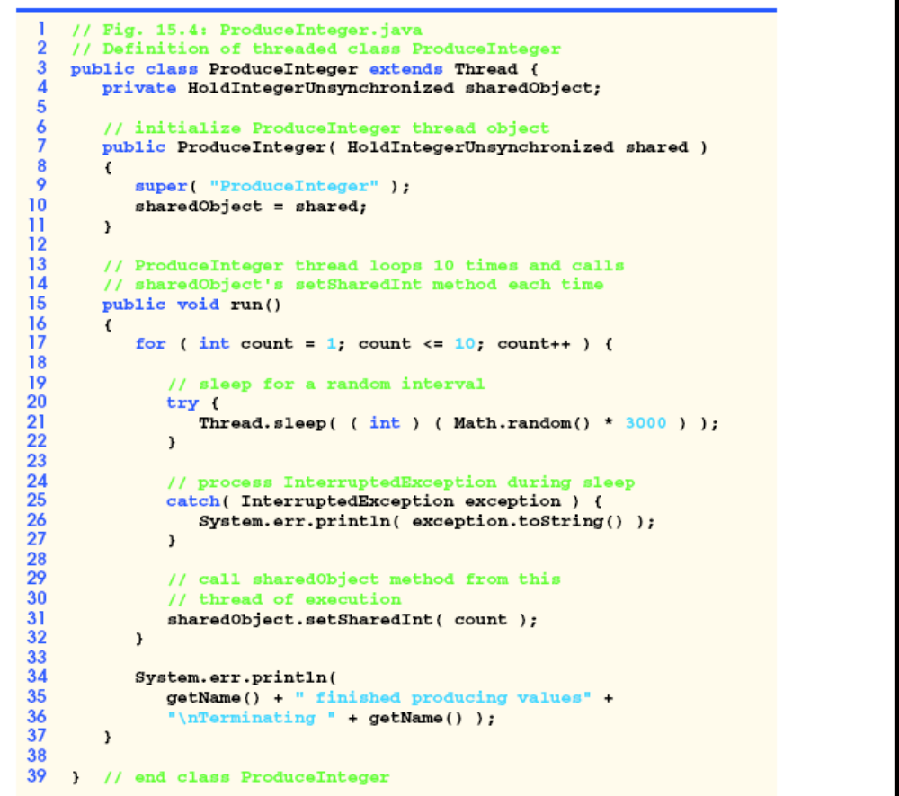
More synchronization

Slide 25
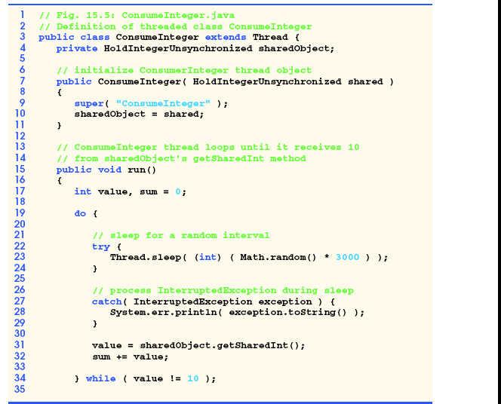

Slide 26
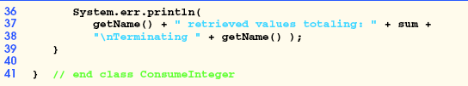
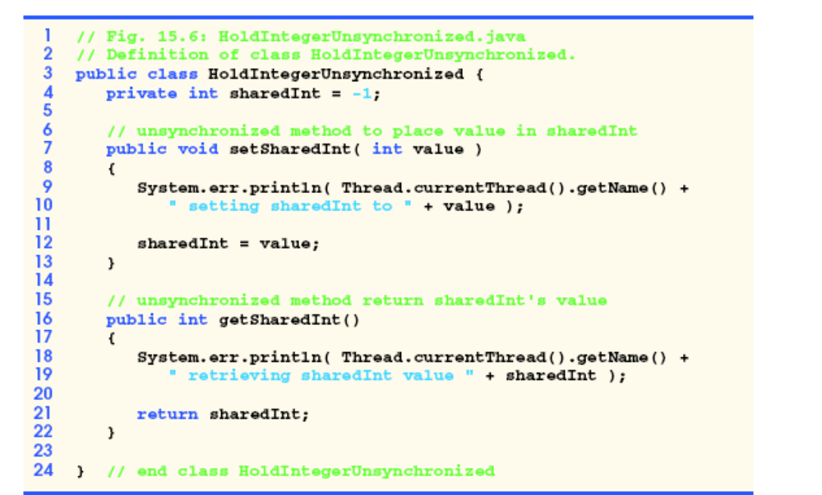

Slide 27
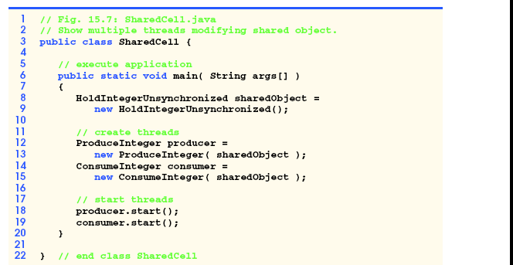

Slide 28
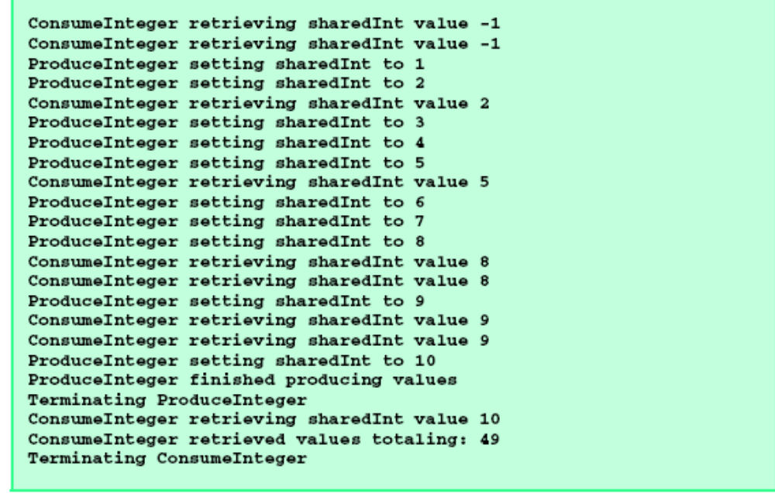

Slide 29
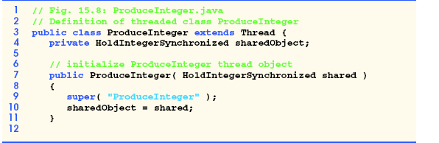
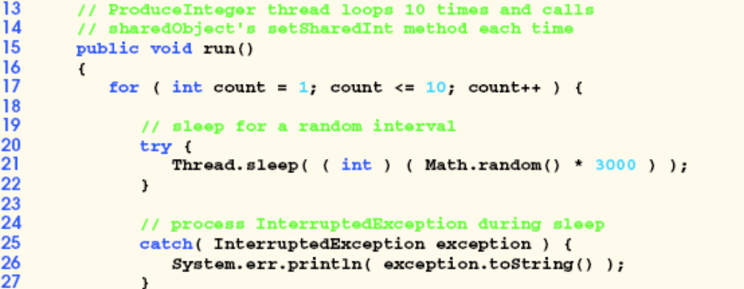

Slide 30
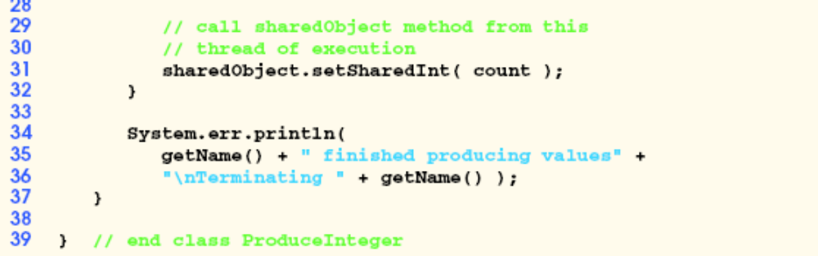

Slide 31
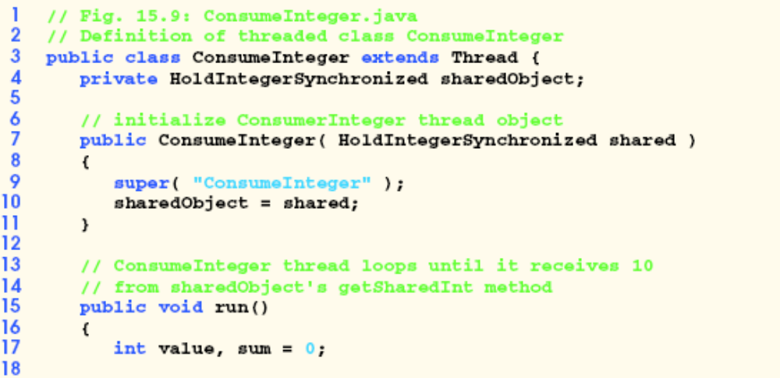
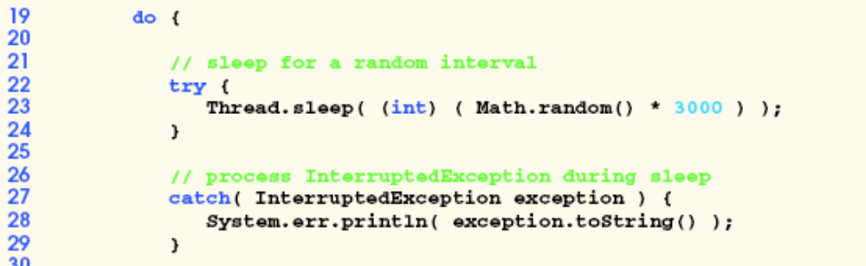

Slide 32
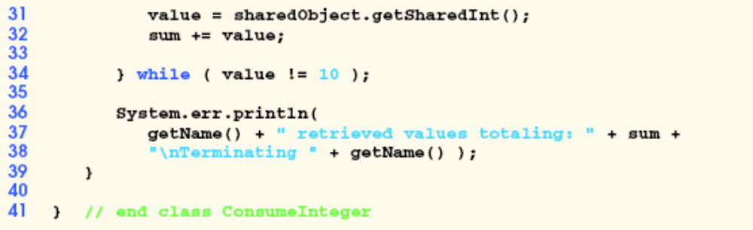

Slide 33
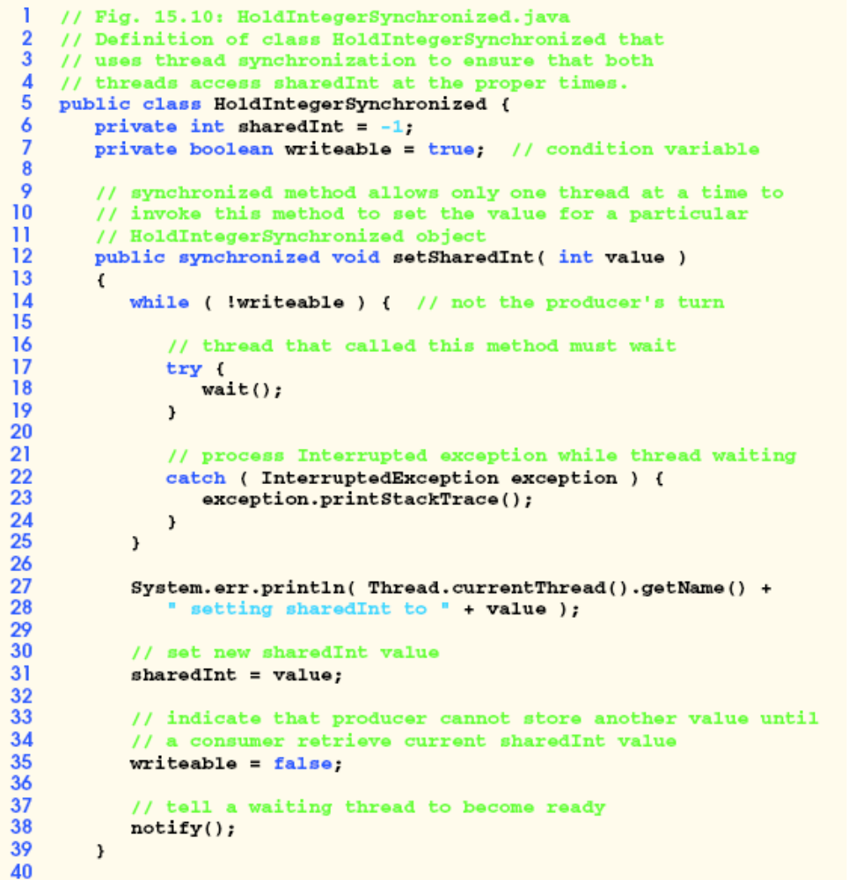

Slide 34
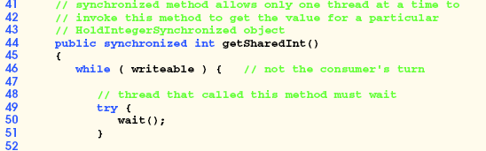
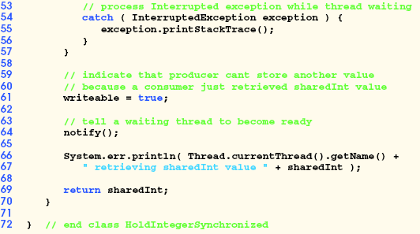

Slide 35
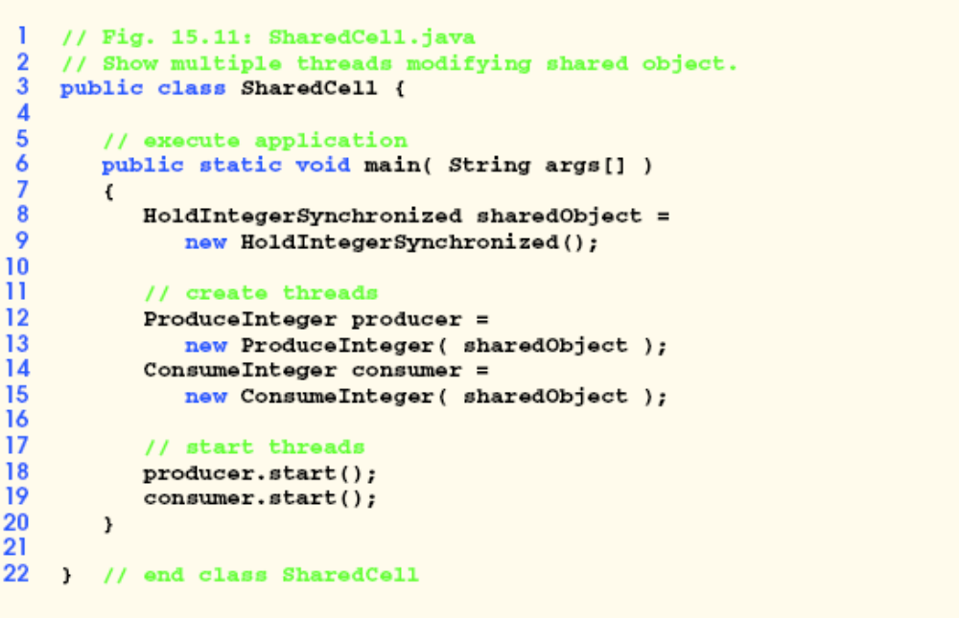

Slide 36
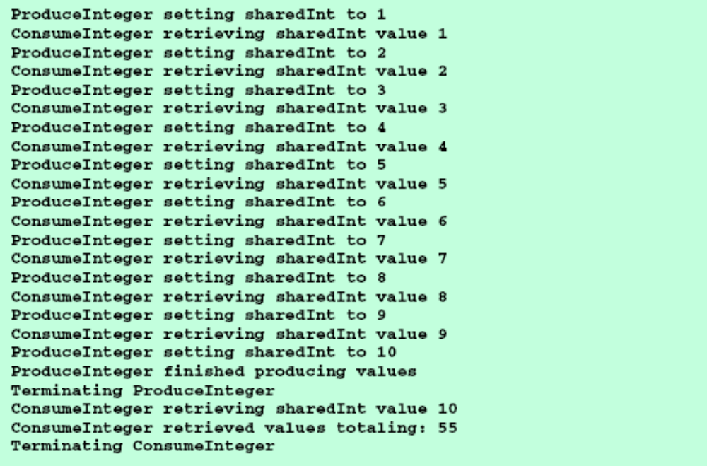

Slide 37
Thread Group
Sometimes it is useful to identify various threads as belonging to a thread group; class
ThreadGroup contains methods for creating and manipulating thread groups. It may, for example, be
desirable to interrupt all the threads in a group.
public ThreadGroup( String stringName ) constructs a ThreadGroup with name stringName.
public ThreadGroup( ThreadGroup parentThreadGroup,
String stringName ) constructs a child ThreadGroup of parentThreadGroup called stringName.
public Thread( ThreadGroup threadGroup, String stringName ) constructs a Thread that belongs to threadGroup and has the name stringName.

