Slide 1
Files and Streams

Slide 2
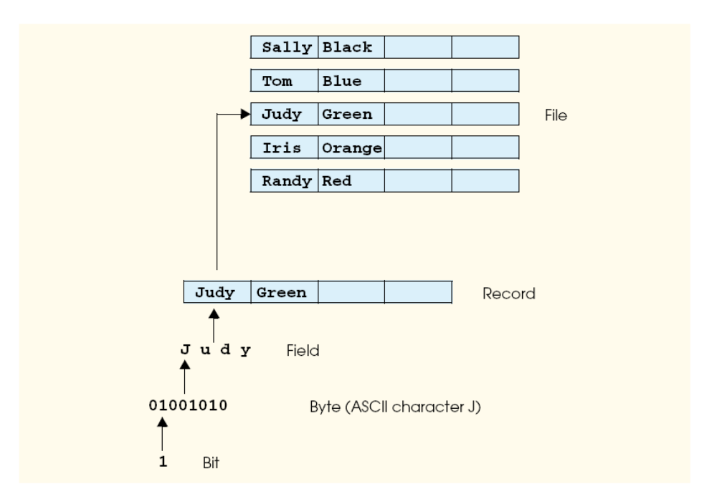
Data Hierarchy

Slide 3
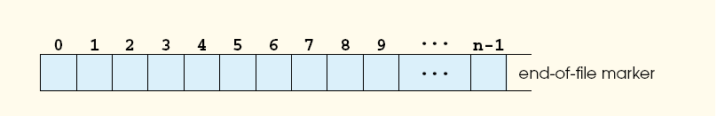
Files and Streams
Java views each file as a sequential stream of bytes.
A Java program opens a file by creating an object and associating a stream of bytes with the object. Java also can associates streams of bytes associated with devices. In fact,Java creates three stream objects that are associated with devices when a Java program begins executing—System.in, System.out and System.err.

Slide 4
Java programs perform file processing by using classes from package java.io. This package includes definitions for the stream classes, such as FileInputStream (for byte-based input from a file), FileOutputStream (for byte-based output to a file), FileReader (for character-based input from a file) and FileWriter (for characterbased output to a file). Files are opened by creating objects of these stream classes that inherit from classes InputStream, OutputStream, Reader and Writer, respectively.
Thus, the methods of these stream classes can all be applied to file streams as well.
To perform input and output of data types, objects of class ObjectInputStream,DataInputStream, ObjectOutputStream and DataOutputStream will beused together with the byte-based file stream classes FileInputStream and FileOutputStream.

Slide 5
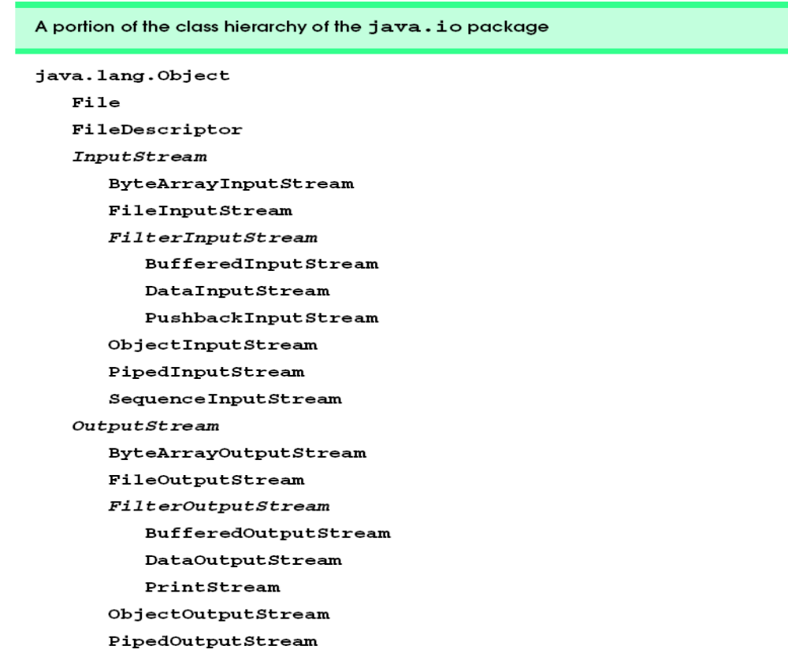
Java I/O classes
The inheritance relationships of many of the
Java I/O classes (abstract classes are shown in italic font).

Slide 6
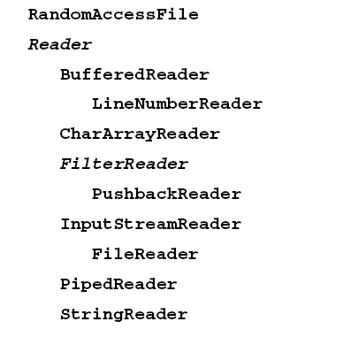
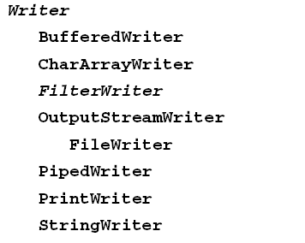

Slide 7
The java.io package contains an abundance of classes for processing input and output.
We will concentrate on the classes
for processing sequential files (FileInputStream and FileOutputStream),
for processing object streams(ObjectInputStream and ObjectOutputStream)
and for processing random-access files (RandomAccessFile).
We also discuss class File, which is particularly useful for retrieving information about a file or a directory from a disk. Objects of class File do not open files or provide any file-processing capabilities.One application of a File object is to determine whether a file exists before attempting to open the file.

Slide 8
File
public File( String name )
public File( String pathToName, String name )
public File( File directory, String name )
boolean canRead()
boolean canWrite()
boolean exists()
boolean isFile() Returns true if the name specified as the argument to the File constructor is a file; false otherwise.
boolean isDirectory() Returns true if the name specified as the argument to the File constructor is a directory; false otherwise.
boolean isAbsolute() Returns true if the arguments specified to the File constructor indicate an absolute path to a file or directory;false otherwise.

Slide 9
String getAbsolutePath() Returns a String with the absolute path of the file or directory.
String getName() Returns a String with the name of the file or directory.
String getPath() Returns a String with the path of the file or directory.
String getParent() Returns a String with the parent directory of the file or directory
long length() Returns the length of the file in bytes. If the File object represents a directory, 0 is returned.
long lastModified()
String[] list() Returns an array of Strings representing the contents of a directory

Slide 10
import java.io.*;
public class ten1
{
public static void main(String[] args) throws Exception
{
final int numArgs = args.length;
if(numArgs == 0)
{
System.out.println("Usage java ten1 filename");
System.out.println("Press a key to continue...");
char ch = (char) System.in.read();
System.exit(0);
}

Slide 11
File f = new File(args[0]);
File dir = new File("folder");
if(f.exists())
{
System.out.println(f.getName() + " exists.");
System.out.println("The length of file is " +f.length()+" byes.");
if(f.canRead())
System.out.println("OK to read.");
if(f.canWrite())
System.out.println("OK to write.");
}

Slide 12
else
System.out.println("File <"+f.getName()+"> does not exist.");
if(dir.mkdir())
System.out.println("direcory <"+dir.getName()+"> created.");
else if(dir.exists())
System.out.println("direcory <"+dir.getName()+"> already exist.");
if(f.isFile())
System.out.println("<"+f.getName()+"> is a file.");
if(dir.isDirectory())
System.out.println("<"+dir.getName()+"> is a directory.");
System.out.println("the absolute Path of <"+f.getName()+"> is "+
f.getAbsolutePath());
System.out.println("the canonical path of <"+f.getName()+"> is "+
f.getCanonicalPath());
System.out.println("the parent directory of <"+dir.getName()+"> is "+
dir.getParent());

Slide 13
if(f.isHidden())
System.out.println("the file <"+f.getName()+"> is hidden.");
else
System.out.println("the file <"+f.getName()+"> is not hidden.");
String dirname = f.getAbsolutePath();
File f1 = new File("d:/jdk2/bin/ten");
if(f1.isDirectory())
{
System.out.println("directory of " + dirname);
String s[] = f1.list();
for(int i = 0; i < s.length; i++)
System.out.println("\t"+ s[i]);
}
}
}

Slide 14
FileInputStream
import java.io.*; // A program to read Text files
public class ten9
{
public static void main(String[] args) throws Exception
{
int size;
InputStream f = new FileInputStream("ten9.java");
System.out.println("Total available bytes :" + (size = f.available()));
int n = size / 40;
System.out.println("First " + n + " bytes of the file one read() at a time.");
for(int i = 0; i < n; i++)
System.out.print((char) f.read());
System.out.println("\nStill available : " + f.available());
System.out.println("Reading the next " + n + " with one read(b[])");
byte[] b = new byte[n];

Slide 15
if(f.read(b) != n)
System.err.println("Could'nt read " + n + " bytes.");
System.out.println("new String(b, 0, n)");
System.out.println("\nStill available : " + (size = f.available()));
System.out.println("Skipping half of remaining bytes with skip()");
f.skip(size/2);
System.out.println("Still available :" + f.available());
System.out.println("Reading "+n/2 +" into the end of array.");
if(f.read(b, n/2, n/2) != n/2)
System.err.println("Couldn't read " + n/2 + " bytes");
System.out.println("new String(b, 0, b.length)");
System.out.println("\nStill available:" + f.available());
f.close();
}
}

Slide 16
FileOutputStream
import java.io.*;
public class ten10
{
public static void main(String[] args) throws Exception
{
String str = new String();
byte[] buf;
OutputStream f = new FileOutputStream("file1.txt");
System.out.print("Enter string:");
str = simpleIO.readStr();
}

Slide 17
while(!str.trim().equals("stop"))
{
buf = str.getBytes();
f.write(buf);
f.write('\n');
System.out.print("Enter string:");
str = simpleIO.readStr();
}
f.close();
}

Slide 18
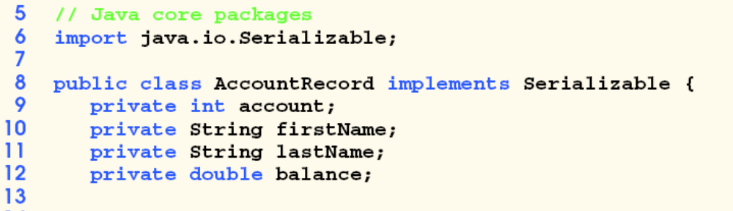
Serilizable interface
Any object to be saved and retrieved must implement Serializable interface
No methods in this interface

Slide 19
ObjectOutputStream, ObjectInputStream
Constructors:
ObjectOutputStream(OutputStream outs) throws IOException
ObjectInputStream(InputStream ins) throws IOException,StreamCorruptedException
All common methods for writing and reading plus for serilizable object writing and reading:
final void writeObject(Object ob) and
Object readObject()

Slide 20
Import java.io.*
public class myclass implements Serializable
{
public String name;
public int id;
public float Ave;
public int unit;
}

Slide 21
import java.io.*;
public class ten15
{
final static int m = 2;
private static myclass[] ob = new myclass[m];
public static void main(String[] args) throws Exception
{
while(true)
{
switch(menu())
{
case 1:
enter();
break;
case 2:
report();
break;

Slide 22
case 3:
search();
break;
case 4:
save();
break;
case 5:
restore();
break;
case 6:
System.exit(0);
}//end of switch
} //end of while
}//end of main()
//***

Slide 23
static int menu() throws Exception
{
int c;
System.out.println("1.Enter data in array.");
System.out.println("2.Report data.");
System.out.println("3.Search a student.");
System.out.println("4.Save data in file.");
System.out.println("5.Restore data from file.");
System.out.println("6.Exit.");
System.out.print("Enter your select(1-6):");
c = simpleIO.readInt();
return c;
}
//***

Slide 24
static void enter() throws Exception, IOException
{
for(int i = 0; i < m; i++)
{
ob[i] = new myclass();
System.out.print("Enter name:");
ob[i].name = simpleIO.readStr();
System.out.print("Enter id:");
ob[i].id = simpleIO.readInt();
System.out.print("Enter ave:");
ob[i].ave = simpleIO.readFloat();
System.out.print("Enter units:");
ob[i].unit = simpleIO.readInt();
}//end of for
}
//***

Slide 25
static void report() throws EOFException, IOException, ClassNotFoundException
{
FileInputStream f1 = new FileInputStream("ob.txt");
ObjectInputStream inFile = new ObjectInputStream(f1);
myclass ob1 = new myclass();
try {
for(int i = 0; i < m; i++)
{
int c;
ob1 = (myclass) inFile.readObject();
System.out.println("name="+ob1.name);
System.out.println("id="+ob1.id);
System.out.println("ave="+ob1.ave);
System.out.println("unit="+ob1.unit);
}//end of for
}//end of try

Slide 26
catch(EOFException e)
{
System.out.println("error");
inFile.close();
} //end of catch
catch(ClassNotFoundException e)
{
System.out.println("class error");
}
}//end of report
//***

Slide 27
static void save() throws Exception, IOException
{
FileOutputStream f = new FileOutputStream("ob.txt");
ObjectOutputStream outFile = new ObjectOutputStream(f);
for(int i = 0; i < m; i++)
{
outFile.writeObject(ob[i]);
outFile.flush();
}
outFile.close();
}

Slide 28
static void search() throws Exception, IOException
{
int num;
System.out.print("Enter student number to search:");
num = simpleIO.readInt();
int i;
for(i = 0; i < m; i++)
{
if(num == ob[i].id)
break;
}
if(i < m)
System.out.println("Favourite student exist.");
else
System.out.println("Favourite student not exist.");
}
//***

Slide 29
static void restore() throws EOFException, IOException, ClassNotFoundException
{
FileInputStream f1 = new FileInputStream("ob.txt");
ObjectInputStream inFile = new ObjectInputStream(f1);
for(int i = 0; i < m; i++)
{
ob[i] = (myclass) inFile.readObject();
}
inFile.close();
}
}

Slide 30
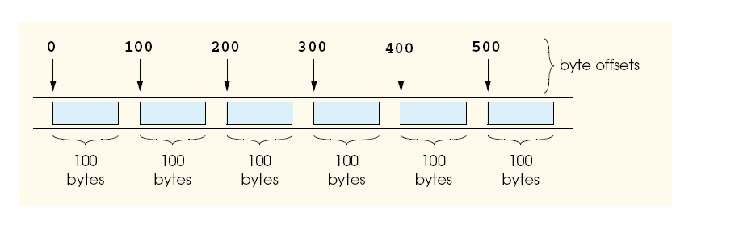
RandomAccessFile
Java’s view of a random-access file composed of fixed-length. records (each record in this figure is 100 bytes long). A random-access file is like a railroad train with many cars—some empty, some with contents.

Slide 31
Constructor:
RandomAccessFile(File file, String mode)
RandomAccessFile(String filename, String mode)
Mode: “r”, “rw”
long getFilePoint()
seek(long)

Slide 32
import java.io.*;
public class ten16
{
final static int len = 30;
public static void main(String[] args) throws Exception
{
RandomAccessFile f = new RandomAccessFile(“myfile", "rw");
String name;
for(int i = 0; i < 5; i++)
{
System.out.print("Enter the name:");
name = simpleIO.readStr();
f.seek(i*len);
f.writeUTF(name);
}

Slide 33
System.out.print("Enter num to search:");
int num = simpleIO.readInt();
f.seek(len*num);
name = f.readUTF();
System.out.println("Your favorite student is:" + name );
f.close();
}
}

Slide 34
Utility class SimpleIO
public class simpleIO
{
public static int readInt() throws Exception
{
String inputString = new String();
boolean flag = false;
char newChar;
int inputNumber;
newChar = (char)System.in.read();
while ((newChar >='0' && newChar <= '9') || (newChar =='-' || newChar=='+'))
{
if((newChar =='-' || newChar =='+' ) && (inputString.length() != 0))
flag = true;
if(flag == false)
inputString = inputString + newChar;
newChar = (char)System.in.read();
flag = false;
}
//abort the Enter key
newChar = (char)System.in.read();
inputNumber=Integer.parseInt(inputString);
return inputNumber;
}

Slide 35
public static String readStr() throws Exception
{
char newChar;
String string = new String();
newChar = (char)System.in.read();
while(newChar != '\n')
{
string = string + newChar;
newChar = (char)System.in.read();
}
return string;
}
}

