Slide 1
WAVERITY ASSESSMENT
DTS Flow-Rate
Prediction
Deep Learning with ConvLSTM on Distributed Temperature Sensing Data
Toghrul Aliyev | Strategic AI Task | June 2017 Well Data

Slide 2
FIBER OPTIC SYSTEMS — FUNDAMENTALS
Light Propagation
KEY SPECIFICATIONS
Fiber optic cables transmit light via total internal reflection. A core surrounded by cladding with lower refractive index keeps light confined through kilometres of cable.
Spatial Resolution
~1 m per depth point
Sampling Frequency
Every 30 seconds
Backscattering Effect
Raman backscattering occurs when photons interact with molecular vibrations. The intensity ratio of Anti-Stokes to Stokes components is temperature-dependent.
Borehole Length
3 – 4 km
Temperature Accuracy
± 0.1 °C
DTS Principle
An OTDR (Optical Time Domain Reflectometer) sends laser pulses, then times the returning backscattered light. Distance is computed from the round-trip time at speed of light in fiber.
Signal Medium
Raman Backscatter
Data Volume
Millions of rows/year
Slide 2 of 10 | DTS Flow-Rate Prediction

Slide 3
DTS APPLICATION IN OIL & GAS INDUSTRY
🌡️ Flow Profiling
⚙️ Well Integrity
Temperature anomalies along the borehole reveal fluid entry points. Warm inflows indicate oil/water, cool inflows indicate gas zones.
Continuous temperature monitoring detects casing leaks, fluid crossflow, and unexpected pressure changes in real-time.
📈 Production Optimisation
🔍 PLT Cross-Validation
By identifying high and low contributing zones, engineers optimise perforations and improve total recovery per well.
DTS data complements Production Logging Tool (PLT) tests by providing continuous spatial resolution at every meter of depth.
Slide 3 of 10 | DTS Flow-Rate Prediction

Slide 4
PROBLEM STATEMENT
Predict Flow-Rate at Every Depth
from DTS Temperature Profiles
INPUT
TARGET
OUTPUT
DTS Temperature
Flow Rate (m³/d)
Flow Profile
Time × Depth matrix
Sampled every 30 sec
Coverage: 1500–1685 m
PLT Flowrate 2 data
Half-rate test snapshot
25 June 2017, 18:38
Predicted contribution
per depth interval
Continuous spatial map
→
→

Slide 5
DTS DATA ANALYSIS
368
287
67
5
Aligned depth
points matched
Training
sequences
Test
sequences
Engineered
features
ENGINEERED FEATURES
DATA PIPELINE
Temp
Raw DTS temperature (°C)
1. Load DTS CSV
Filter to June 25 snapshot at 18:38
dT/dz
Spatial temperature gradient
2. Parse PLT Excel
Extract Flowrate 2 per depth (ft→m)
d²T/dz²
Second-order depth derivative
3. Merge (merge_asof)
Tolerance = 20 m, nearest depth match
4. Feature Engineering
Gradient, rolling stats on 368 points
T_roll_mean
11-point rolling mean (depth window)
5. 80/20 Spatial Split
Train: depth 1500–1648 m | Test: deeper
T_roll_std
11-point rolling std deviation
6. Sequence Windows
seq_len=8 → overlapping depth sequences
Slide 5 of 10 | DTS Flow-Rate Prediction

Slide 6
MODEL ARCHITECTURE — ConvLSTM
Input
Sequence
Conv1D
×2 Layers
BiLSTM
×2 Layers
FC Head
Flow Rate
Output
→
→
→
→
8 × 5
16→32 ch
GELU + BN
hidden=32
dropout 0.3
32→16→1
GELU+Drop
scalar/depth
DESIGN CHOICES
MODEL SUMMARY
Conv1D
Captures local depth patterns across the sequence window. Permutes input for channel-first processing.
Total Parameters
19,361
Optimizer
AdamW (lr=1e-3)
Batch Norm
Stabilises training on small petroleum dataset; reduces sensitivity to initialisation.
Weight Decay
1e-4
GELU Activation
Smoother gradient flow than ReLU; shown to work well with both conv and dense layers.
Loss Function
MSE
Epochs
200 (best saved)
Dropout 0.3
Regularises the 19,361-parameter model to avoid overfitting on 287 training sequences.
Patience
40 (early stop)
Grad Clip Norm
1.0
AdamW + Cosine LR
AdamW decouples weight decay; cosine schedule warms down to 1e-7 over 200 epochs.
Batch Size
32
Slide 6 of 10 | DTS Flow-Rate Prediction

Slide 7
IMPLEMENTATION — KEY CORRECTIONS
Feature Leakage Prevention
BUG 1
Depth Alignment Tolerance
BUG 2
Rolling statistics and gradients are now engineered on the full merged dataset BEFORE the 80/20 spatial split. This prevents temporal information from test depths contaminating training features.
merge_asof tolerance widened from 5 m to 20 m, ensuring 368 aligned depth points (vs. <200 with tight tolerance). Critical for small PLT datasets with uneven depth sampling.
Label Scaler Fit Scope
BUG 3
Gradient Clip Order + AdamW
BUG 4
label_scaler is fitted on the FULL target range before splitting. This prevents inverse-transform errors where test depths exceed the training scaler's observed range.
Gradient clipping (norm ≤ 1.0) is applied BEFORE optimizer.step(), not after. Optimizer switched from Lion to AdamW for better convergence on tabular depth sequences.
Model Size vs. Dataset
BUG 5
Visualisation Depth Alignment
BUG 6
Architecture down-scaled (Conv 16→32 ch, LSTM 32 hidden) to match 287 training samples. seq_len reduced from 16 to 8 to maximise usable windows.
Scatter plot of actual test points now uses [seq_len-1:] offset to align with the sequence-shifted prediction array, eliminating misleading depth misalignment in plots.
Slide 7 of 10 | DTS Flow-Rate Prediction

Slide 8
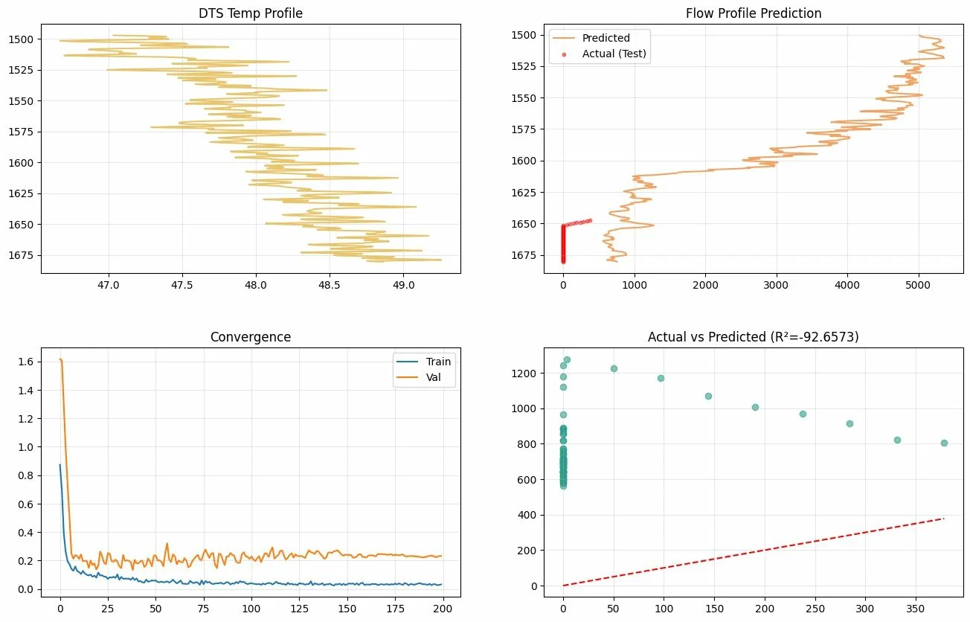
TRAINING & CONVERGENCE ANALYSIS
Slide 8 of 10 | DTS Flow-Rate Prediction

Slide 9
RESULTS INTERPRETATION
MSE
R²
AIC
BIC
Params
579,758
−92.66
39,611
82,296
19,361
(m³/d)²
Score
Information
Criterion
Trainable
WHY R² IS NEGATIVE — AND WHAT IT MEANS
IMPROVEMENT PATHWAYS
The Core Challenge
Physics-informed loss
The test set sits at greater depths (1648–1685 m) where the PLT Flowrate 2 data shows extreme values (up to 1250+ m³/d) — far outside the training range distribution (1500–1648 m). This is a domain shift problem, not a model failure per se.
Add penalty for monotonicity — flow should decrease with depth in producing zones
Cross-depth transfer
Spatial Extrapolation
Train on Flowrate 1 (full rate) data as auxiliary task; fine-tune on Flowrate 2
Ensemble approach
With only 67 test sequences from a narrow depth band, the model must extrapolate beyond its spatial training support. Temperature gradients behave differently in this deeper zone due to distinct lithology and perforation density.
Combine ConvLSTM with Gaussian Process regression to quantify prediction uncertainty
Richer PLT data
Model Performance in Training Region
Incorporate temperature anomaly features from the full DTS time series, not just one snapshot
Train MSE reaches 0.033 in scaled space (convergence confirmed by epoch 200). The convergence plot shows healthy train/val separation without divergence, indicating the architecture is sound.
Temporal context
Stack multiple time snapshots (before/after 18:38) to capture transient flow signals
Slide 9 of 10 | DTS Flow-Rate Prediction

Slide 10
CONCLUSIONS
Key Takeaways
01
DTS as ML Input
02
ConvLSTM is Well-Suited
Temperature profiles carry rich spatial information about flow dynamics. Engineered gradients and rolling statistics significantly amplify the predictive signal.
The hybrid architecture captures both local depth patterns (Conv1D) and long-range sequential dependencies (LSTM) — matching the physics of wellbore flow profiles.
03
Domain Shift is the Key Challenge
04
Path to Production
The large R² gap between train (converged) and test (extrapolation zone) highlights that more PLT depth coverage — or physics constraints — is needed for reliable deployment.
With physics-informed loss functions, multi-snapshot temporal features, and auxiliary Flowrate 1 supervision, this framework can become a practical DTS inversion tool.

