Slide 1
Immune cell & cytokine dynamics across the menstrual cycle
Effects of hormonal birth control and PCOS status on vaginal immune populations Group B — Menstruation Study

Slide 2
Study design
• Longitudinal study: 27 female participants • 4 time points across the menstrual cycle: week_prior → onset → end_bleeding → week_post • 108 vaginal swab samples collected • 14 use hormonal birth control / 13 do not • ~50% have PCOS (polycystic ovary syndrome) • Measurements: — Flow cytometry: immune cell populations — Luminex: 8 inflammatory cytokines

Slide 3
Immune cell counts — with p-values
Time point | BC n | No BC n | CD45+ BC | CD45+ NoBC | p (CD45) | Neutro BC | Neutro NoBC | p (Neutro) | CD8+ BC | CD8+ NoBC | p (CD8)
week_prior | 15 | 12 | 81326 | 111288 | 0.079 | 63997 | 89226 | 0.172 | 2165 | 2058 | 0.845
onset | 15 | 12 | 80880 | 90622 | 0.884 | 54903 | 64429 | 0.769 | 2759 | 2044 | 0.143
end_bleeding | 15 | 12 | 66674 | 79748 | 0.479 | 46049 | 53358 | 0.903 | 2122 | 2536 | 0.164
week_post | 15 | 12 | 70474 | 63564 | 1.000 | 60023 | 54292 | 1.000 | 1098 | 1634 | 0.087
Median counts (cells/sample). p-values: Wilcoxon test, BC vs No BC.

Slide 4
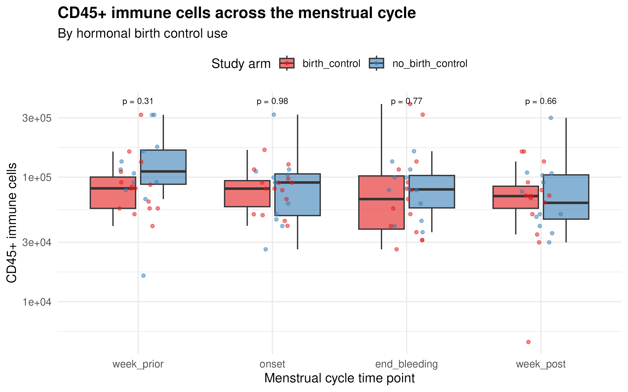
CD45+ immune cells — birth control effect
Key observation: CD45+ counts tend to be lower in the birth control group at onset, suggesting hormonal contraception may dampen the inflammatory spike at menstruation onset.

Slide 5
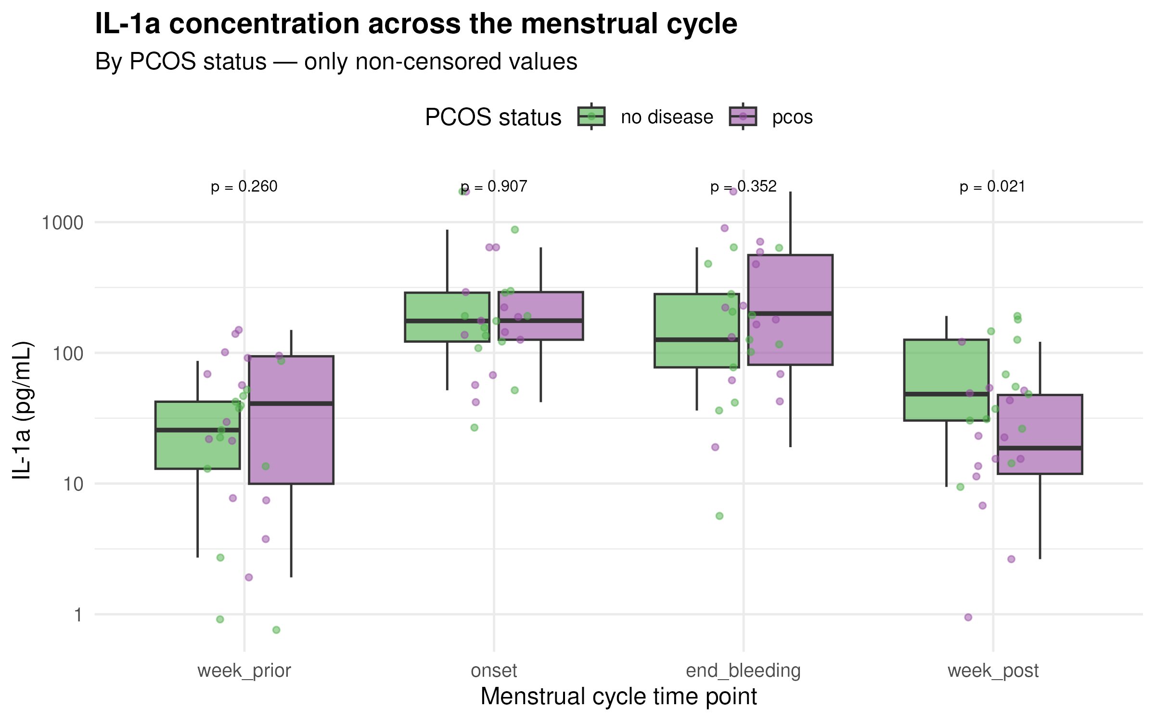
IL-1a cytokine — PCOS effect
Key observation: IL-1a differs by PCOS status, particularly at onset and end_bleeding, suggesting altered inflammatory signalling in PCOS.

Slide 6
Mixed-effects model results — with p-values
Outcome | Predictor | F | Num | Den | p
log(CD45+) | Time point | 1.67 | 3 | 75 | 0.180
log(CD45+) | Birth control | 0.71 | 1 | 25 | 0.406
log(CD45+) | Time point × Birth control | 0.22 | 3 | 75 | 0.881
log(Neutrophils) | Time point | 1.41 | 3 | 75 | 0.246
log(Neutrophils) | Birth control | 0.39 | 1 | 25 | 0.537
log(Neutrophils) | Time point × Birth control | 0.11 | 3 | 75 | 0.951
log(IL-1a) | Time point | 22.75 | 3 | 74 | < 0.001 | ***
log(IL-1a) | Birth control | 6.96 | 1 | 24 | 0.014 | *
log(IL-1a) | Time point × Birth control | 0.34 | 3 | 74 | 0.800
log(CD4/CD8 ratio) | Time point | 9.57 | 3 | 75 | < 0.001 | ***
log(CD4/CD8 ratio) | Birth control | 0.07 | 1 | 25 | 0.797
log(CD4/CD8 ratio) | Time point × Birth control | 0.76 | 3 | 75 | 0.519
Key: Green = significant (p < 0.05) Findings: 1. IL-1a: strong time effect (p < 0.001) + arm effect (p = 0.014) 2. CD4/CD8: time effect (p < 0.001) 3. CD45+: no significant effects

Slide 7
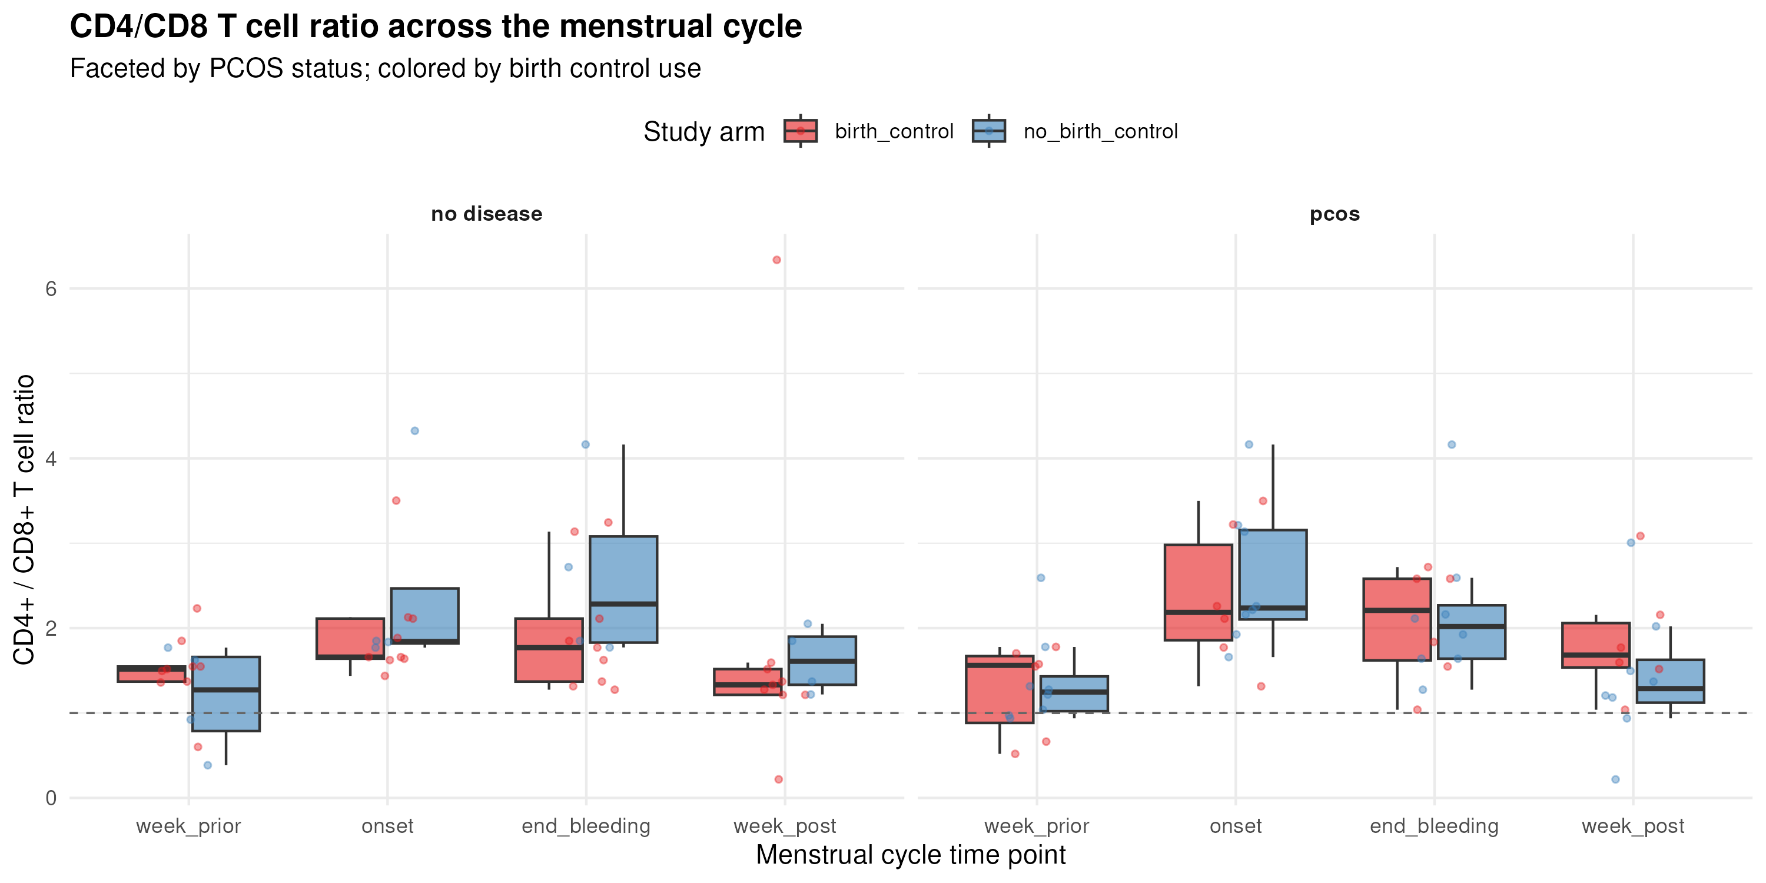
CD4/CD8 T cell ratio — combined effects
Dashed line = equal helper/cytotoxic T cells. Ratio shifts across cycle and varies with both birth control and PCOS status.

Slide 8
Key findings
1. IL-1a peaks at onset & end_bleeding, and is lower in birth control users (p = 0.014). → Hormonal contraception dampens inflammatory cytokine release. 2. CD4/CD8 T cell ratio shifts across the cycle (p < 0.001), but is not affected by birth control. → T cell subsets traffic differentially during menstruation. 3. CD45+ and neutrophils are stable across the cycle. → Innate cell numbers are less variable than cytokine signalling. 4. PCOS shows trends in cytokine profiles but not significant with n = 27. 5. Many cytokines (TNFa, IFNg, IL-6) were frequently below detection limits.

Slide 9
Limitations & next steps
Limitations: • Small sample (n = 27) — limited power for interactions • Censored cytokine data reduces usable observations • No data on birth control type (pill vs. IUD vs. implant) • PCOS diagnosis method not specified Next steps: • Compare specific birth control types • Use censored regression (tobit) models • Include age / sexual activity as covariates • Pathway analysis: cytokines × cell types

