Slide 1

The United Kingdom
By
Nathan Brown!!

Slide 2
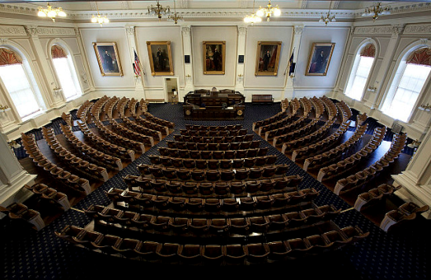
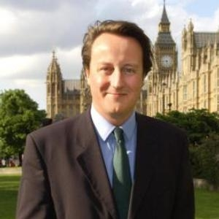

What is The United Kingdom’s government like?
The United Kingdom has a Constitutional Monarchy
The parliament consists of 2 bodies- the House of Lords and the House of Seniors
Their Regional Government holds 129 Representatives
The British-Irish address issues of concern to all of Britain and Ireland
Northern Ireland is divided into districts
The Local Government in Scotland and Wales are unitary authorities
U.K.’s House of Representatives
David Cameron:
David Cameron is the U.K.’s current leader.
The United Kingdom made the game “Metropolis Street Racer”

Slide 3
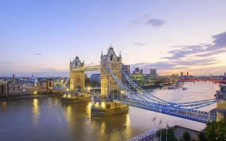
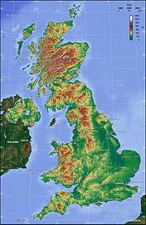
Geography
Map of U.K.

Slide 4


INTERMISSION!!!!!
😐
😐
😐

Slide 5
Registered on March22
http://www.google.com/imgres?q=david+cameron&hl=en&gbv=2&biw=1366&bih=684&tbm=isch&tbnid=hp_jUTCtC6lfyM:&imgrefurl=http://www.topnews.in/people/david-cameron&docid=hlf973kkjL2PIM&imgurl=http://www.topnews.in/files/David_Cameron.JPG&w=300&h=300&ei=4UtrT5e_K4zsgge34fmVBg&zoom=1&iact=hc&vpx=545&vpy=176&dur=3829&hovh=225&hovw=225&tx=119&ty=129&sig=106776484805727675684&page=1&tbnh=151&tbnw=140&start=0&ndsp=22&ved=1t:429,r:3,s:0...........................................................................................................................................................................................................................................................................
Registered on March 22
://www.google.com/imgres?q=United+Kingdom+house+of+representatives&hl=en&biw=1366&bih=684&gbv=2&tbm=isch&tbnid=nEggB5ZkF548tM:&imgrefurl=http://blog.travelpod.com/travel-photo/wheresgordon/2/1319053373/new-hampshire-legislature.jpg/tpod.html&docid=aopEF6y6myYYAM&imgurl=http://images.travelpod.com/users/wheresgordon/2.1319053373.new-hampshire-legislature.jpg&w=640&h=416&ei=wkxrT6HSLsXiggfR0I2XBg&zoom=1&iact=hc&vpx=192&vpy=172&dur=1786&hovh=181&hovw=279&tx=141&ty=157&sig=106776484805727675684&page=1&tbnh=170&tbnw=227&start=0&ndsp=18&ved=1t:429,r:0,s:0
Registered on March 23
http://www.google.com/imgres?q=metropolis+street+racer&um=1&hl=en&sa=N&biw=1366&bih=684&tbm=isch&tbnid=eg5GJO2vv- 5vaM:&imgrefurl=http://www.amazon.com/Metropolis-Street-Racer/dp/B000035YBQ&docid=DPo69NGfb_OJYM&imgurl=http://ecx.images- amazon.com/images/I/31OFGsvpCsL._SL500_AA300_.jpg&w=300&h=300&ei=BZ5sT5XJCfH22AW6xaGXBg&zoom=1&iact=hc&vpx=205&vpy=143&dur=15 12&hovh=225&hov:0w=225&tx=129&ty=128&sig=100374526104355824275&page=1&tbnh=157&tbnw=198&start=0&ndsp=15&ved=1t:429,r:0,s
Registered on March 23
http://www.google.com/imgres?q=united+kingdom+geography&hl=en&gbv=2&biw=1366&bih=684&tbm=isch&tbnid=bL-UaIE3P21HjM:&imgrefurl=http://en.wikipedia.org/wiki/Geography_of_the_United_Kingdom&docid=zepyQi5MlU4FqM&imgurl=http://upload.wikimedia.org/wikipedia/commons/thumb/a/a2/Uk_topo_en.jpg/220px-Uk_topo_en.jpg&w=220&h=340&ei=OKJsT6e8BMnC2wWxyJ3kBQ&zoom=1&iact=hc&vpx=182&vpy=121&dur=662&hovh=272&hovw=176&tx=112&ty=168&sig=100374526104355824275&page=1&tbnh=160&tbnw=104&start=0&ndsp=25&ved=1t:429,r:0,s:0

