Slide 1


Harnessing Supervised Machine Learning
for
Cardiovascular Disease Analysis and Prediction
Applied Data Science – Final Presentation
Professor : Dr Amir Hesam Salavati
Presenter : Ali Zahedzadeh
mail: alizahedzadeh7@gmail.com

Slide 2

Abstract
Introduction
Results
Conclusion
Cardiovascular Disease
Supervised Machine learning
(Random Forest, Decision Tree, Logistic Regression and etc.)
1 / 12

Slide 3

Abstract
Introduction
Results
Conclusion
2 / 12

Slide 4

Abstract
Introduction
Results
Conclusion
About Dataset
Heart disease dataset
Column | Description
Age | Age of the patient in completed years
Sex | Gender of the patient
Cp | Chest Pain type (1: typical angina, 2: atypical angina, 3: non-anginal pain, 4: asymptomatic)
Trestbps | Resting blood pressure (in mm Hg)
Chol | Cholesterol in mg/dl fetched via BMI sensor
FBS | Fasting blood sugar > 120 mg/dl (1 = true; 0 = false)
Resting | resting electrocardiographic results
Thalach | Maximum heart rate achieved
Exang | Exercise-induced angina (1 = yes, 0 = no)
Oldpeak | Previous peak
Ca | Number of major vessels (0-4)
Thal | 0 = Normal, 1 = Fixed, 2 = Reversible, 3 = Non-Reversible
Target | 0 = Less chance of heart attack, 1 = More chance of heart attack
UCI ML Repository
https://archive.ics.uci.edu
3 / 12

Slide 5
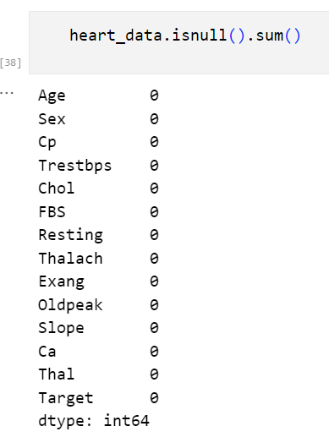
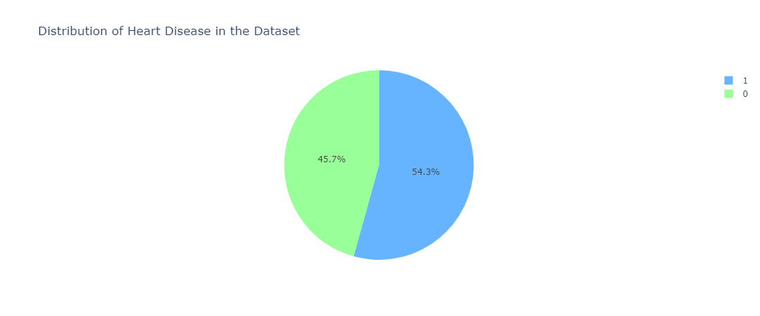
Abstract
Introduction
Results
Conclusion
About Dataset
No null Values
Balanced Dataset
165 cardiac disease & 138 noncardiac disease
4 / 12

Slide 6
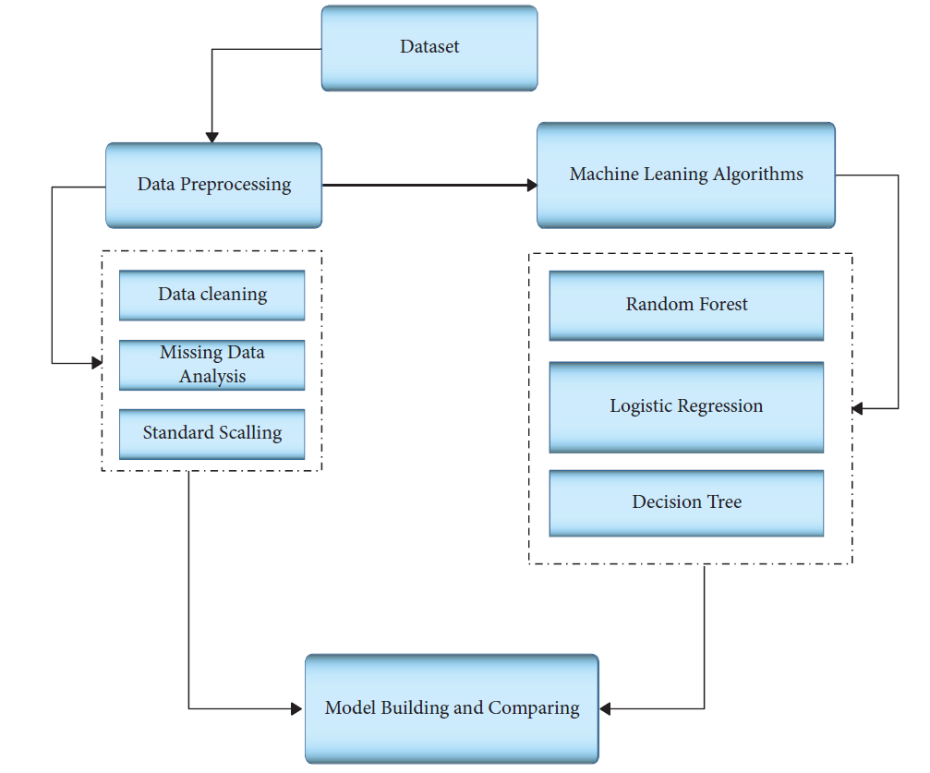
Abstract
Introduction
Results
Conclusion
Methodology
System’s schematic diagram
5 / 12

Slide 7
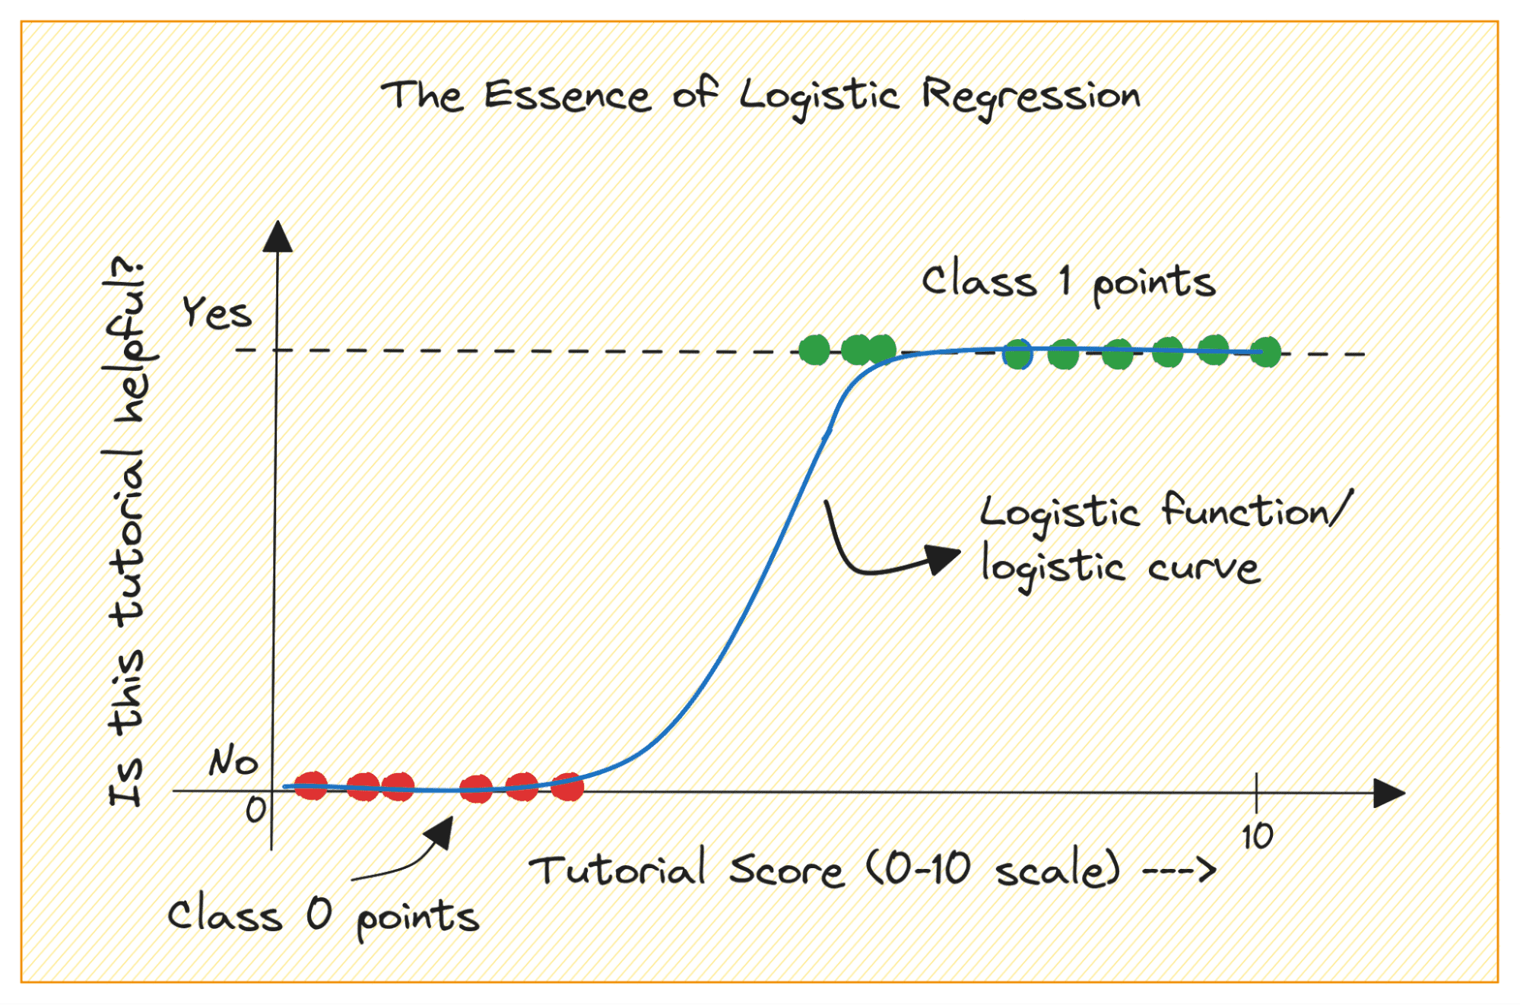
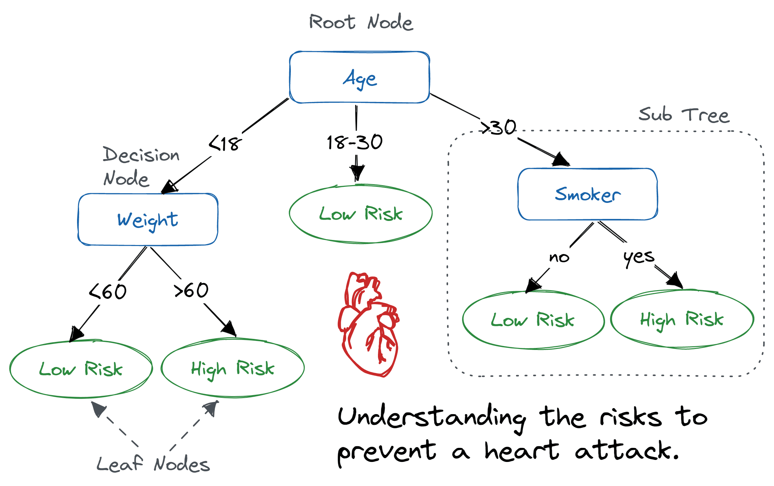
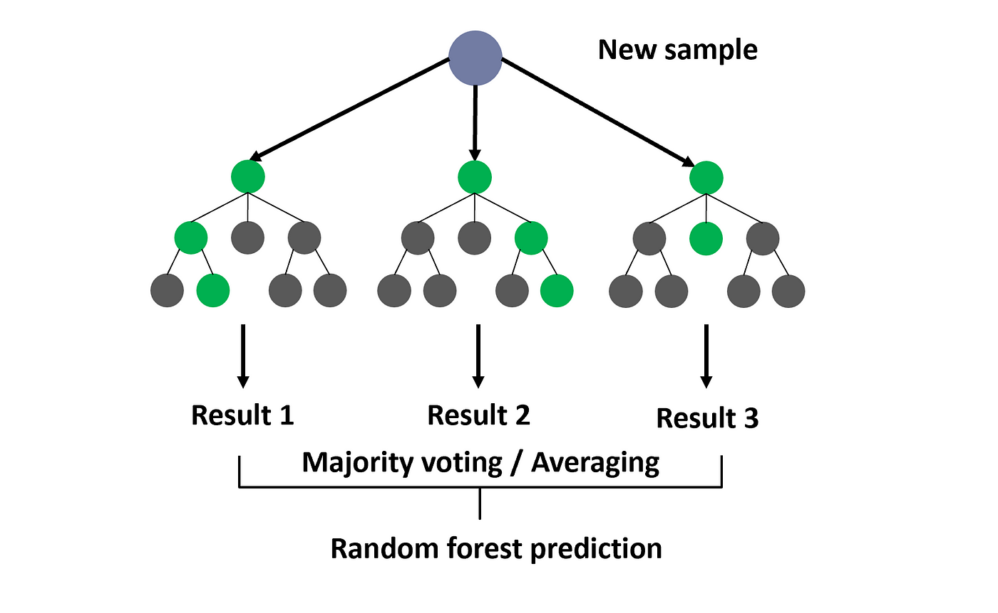
Abstract
Introduction
Results
Conclusion
Methodology
Logistic Regression
Decision Tree
Random Forest
6 / 12

Slide 8
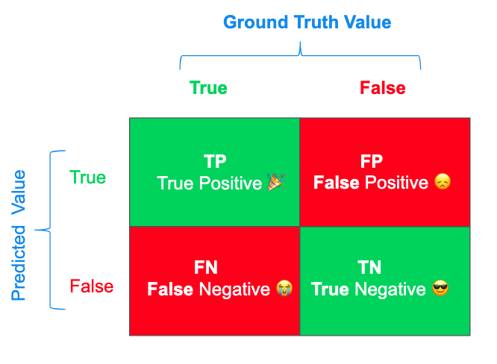
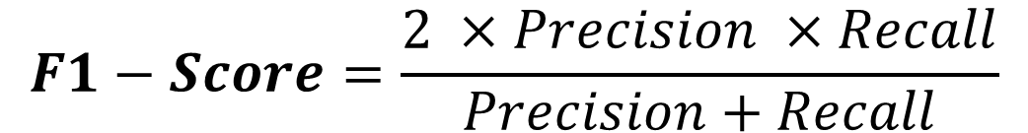
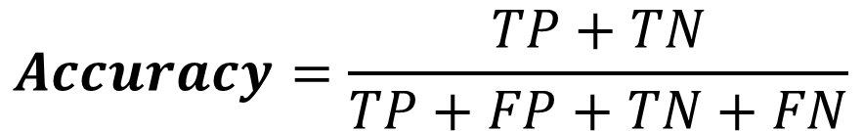
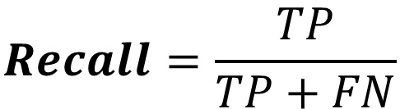
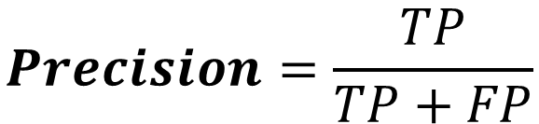
Abstract
Introduction
Results
Conclusion
About Metrics
$$Precision=\frac{TP}{TP+FP}$$
$$Recall=\frac{TP}{TP+FN}$$
$$Accuracy=\frac{TP+TN}{TP+FP+TN+FN}$$
$$F1−Score=\frac{2 ×Precision ×Recall}{Precision+Recall}$$
7 / 12

Slide 9
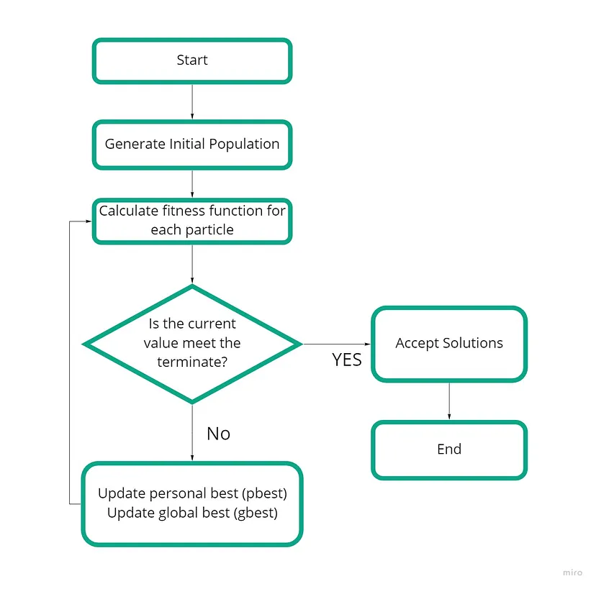
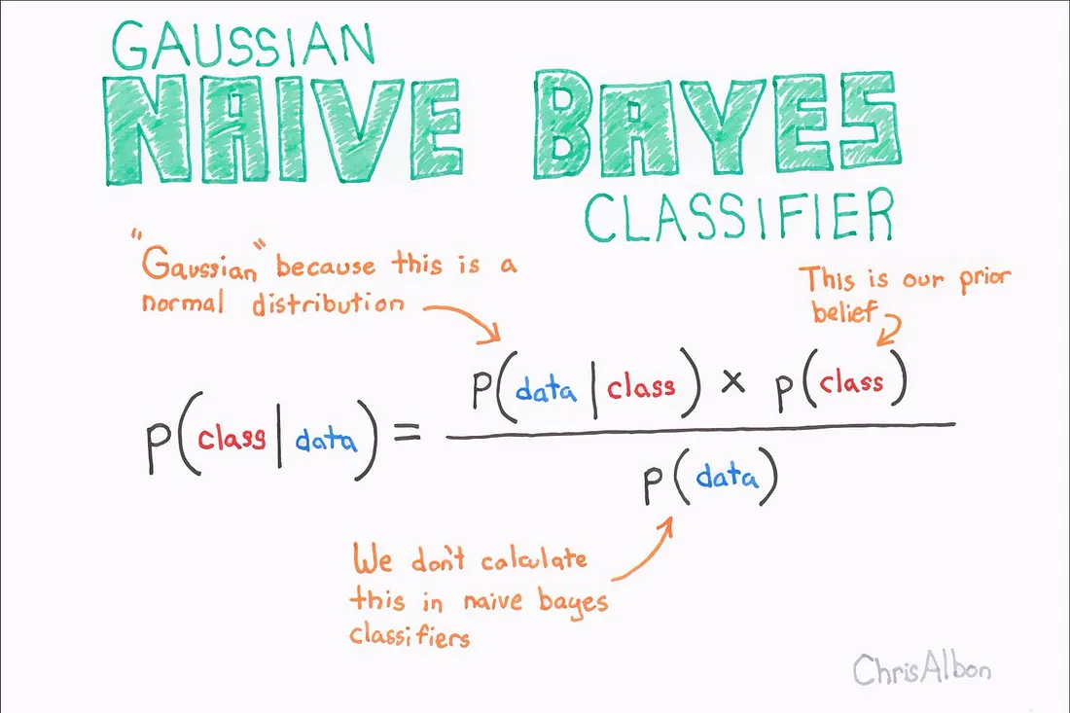
Abstract
Introduction
Results
Conclusion
Related Works
PSO algorithm
Naïve Bayes Classifier
Prediction system for heart disease using Naive Bayes and particle swarm optimization
January 2018
Particle Swarm Optimization (PSO)
Naïve Bayes Classifier
8 / 12

Slide 10
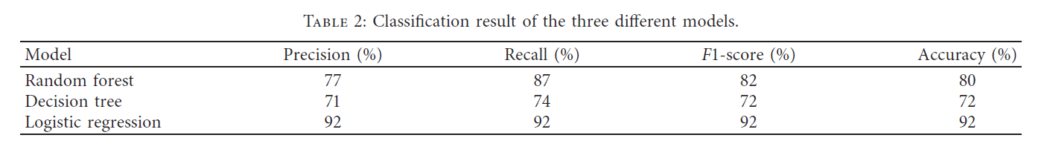
Abstract
Introduction
Results
Conclusion
Paper Result
9 / 12

Slide 11
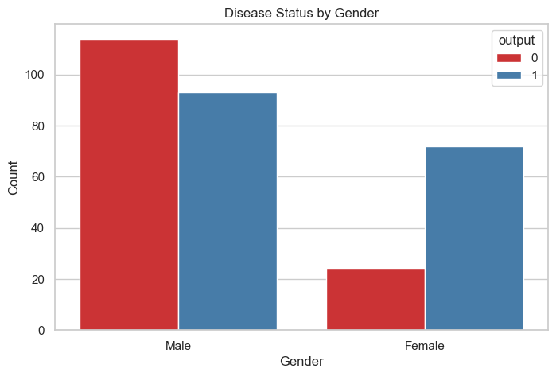
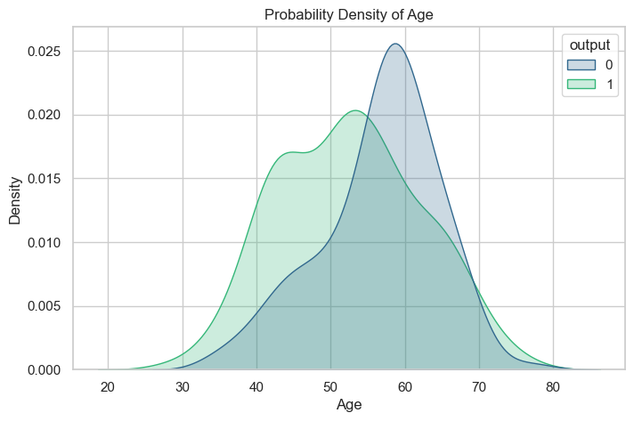
Abstract
Introduction
Results
Conclusion
Reproduced Result - Data Analysis
10 / 12

Slide 12
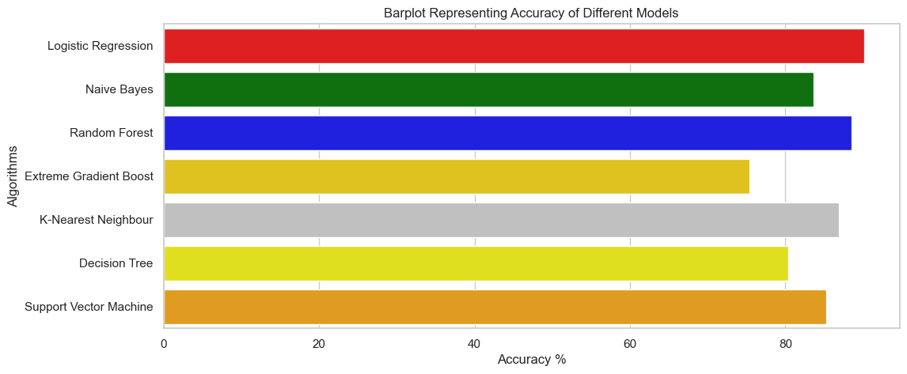
Abstract
Introduction
Results
Conclusion
Reproduced Result - Models Evaluation
Model | Accuracy
Logistic Regression | 90.163934
Naive Bayes | 83.606557
Random Forest | 88.524590
Extreme Gradient Boost | 75.409836
K-Nearest Neighbour | 86.885246
Decision Tree | 80.327869
Support Vector Machine | 85.245902
11 / 12

Slide 13
Abstract
Introduction
Results
Conclusion
The study emphasizes the potential impact of the developed diagnostic system using machine learning in predicting heart disease, with the possibility of early identification of at-risk patients and improved accuracy in diagnosing cardiac abnormalities.
Logistic Regression is identified as the best model for predicting heart disease due to its consistently higher accuracy, precision, and overall performance compared to other machine learning algorithms (Based on Paper Result)
Rapid and cost-effective heart disease prediction using accessible dataset and evolving machine learning algorithms, offering the potential to significantly impact public health by identifying at-risk individuals and contributing to a reduction in the rising death rate.
Other models can be used for this study that have acceptable accuracy (Based on Reproduce Result)
12 / 12

Slide 14

mail: alizahedzadeh7@gmail.com

Slide 15
Refrences
https://www.kaggle.com/datasets/redwankarimsony/heart-disease-data
https://archive.ics.uci.edu
https://www.popai.pro
https://www.geeksforgeeks.org/understanding-logistic-regression
https://towardsdatascience.com/3-techniques-to-avoid-overfitting-of-decision-trees-1e7d3d985a09
https://www.researchgate.net/
https://medium.com/@roiyeho/random-forests-98892261dc49

Slide 16
Thank you for your attention

