Slide 1
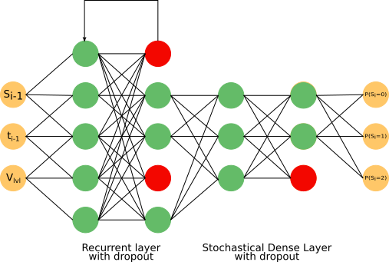
SNN architecture.

Slide 2
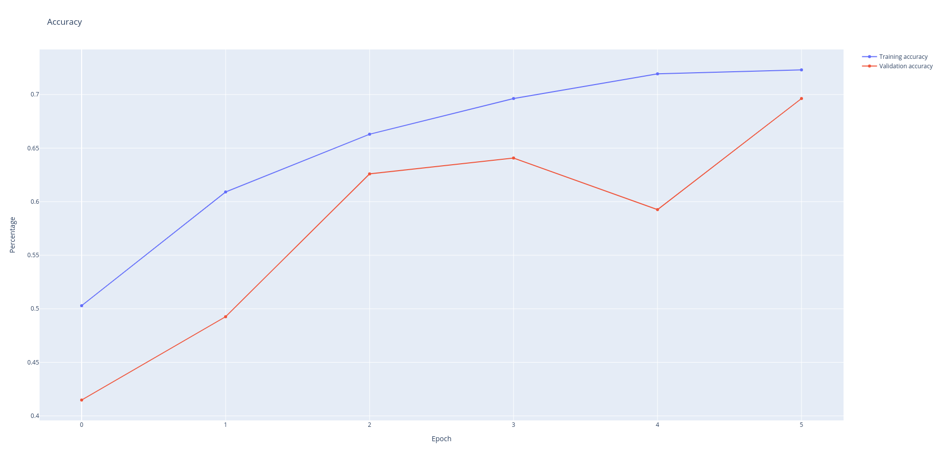
SNN Trainning Accuracy

Slide 3
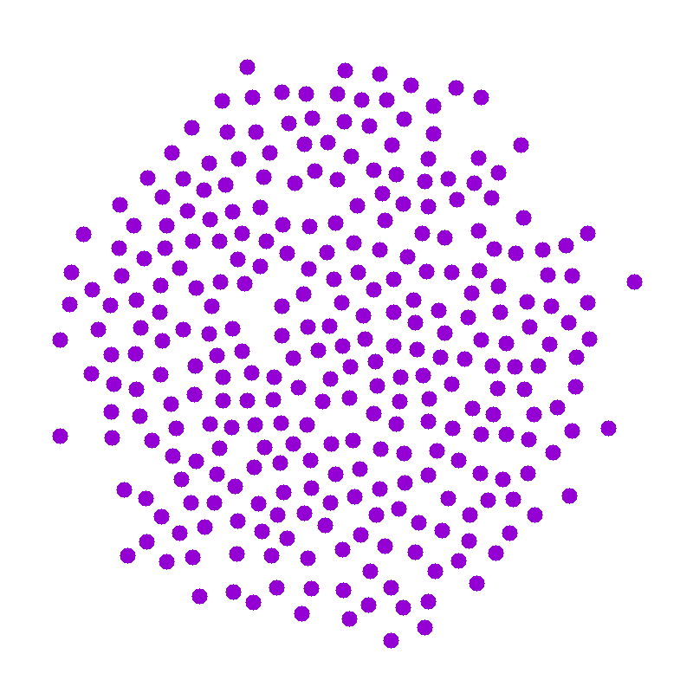
Initial State for constant V_{lvl} = 4
S₀ = 0 (Defective)

Slide 4
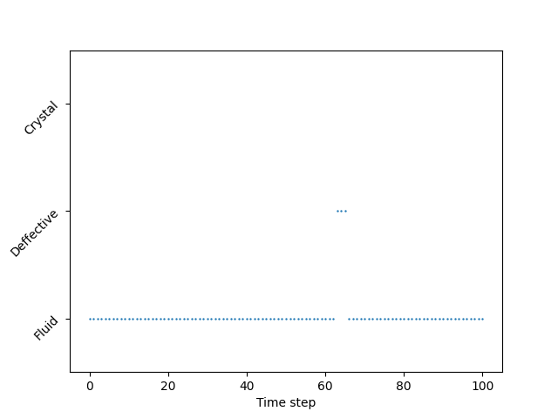
Trajectory 1

Slide 5
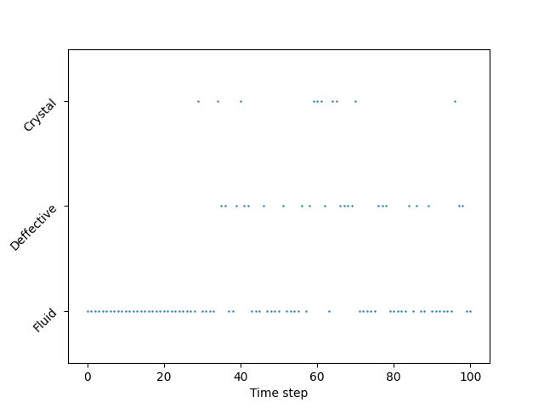
Trajectory 2

Slide 6
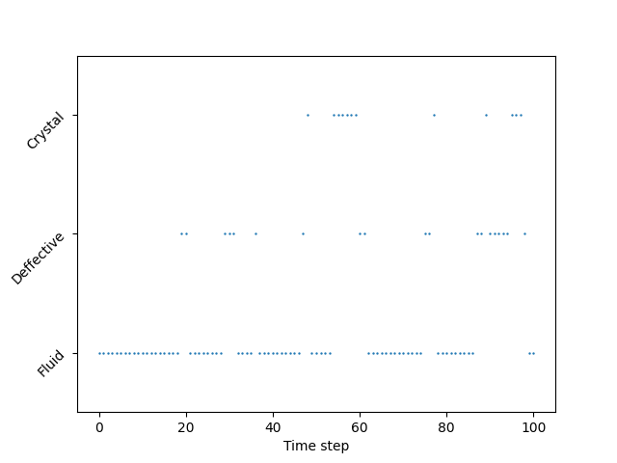
Trajectory 3

Slide 7
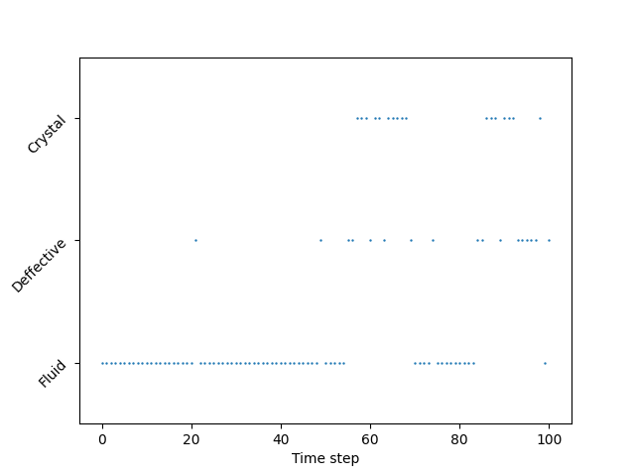
Trajectory 4

Slide 8
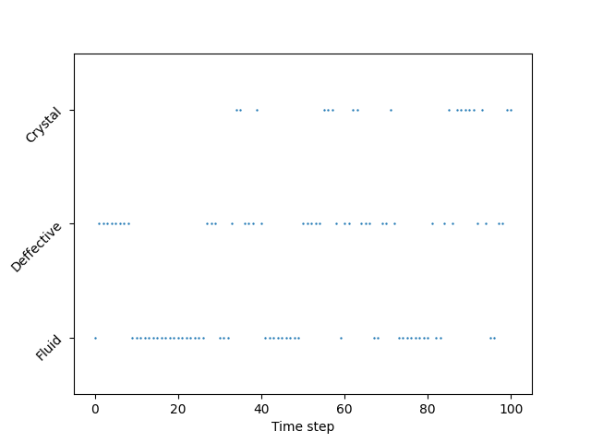
Trajectory 5

