Slide 1
Non-Parametric Statistics
Sign Test on Proportions

Slide 2
When Do We Use the Sign Test?
When no assumption about the population distribution can be made
To obtain a quick and easy answer to the question: “Is there a difference between the two parameters in the data?”
When comparing populations are not independent

Slide 3
Example of Sign Test: Aspiring Freshmen
Students with low SAT scores are taking a summer remedial math course to be able to enroll as freshmen in the fall.
To evaluate the accuracy of this test they are given a pretest, before the course is started, and an after-test at the conclusion of the course.
If the course is effective, then the students’ scores on the after-test should be higher than their score on the pretest.

Slide 4
Let’s Pretend…
That the director of the program claims that this program will be a success: In average, students’ grades improve after participating in the summer program.
μ₁ > μ₂
Some party pooper disagrees and claims that this summer program is a waste of time, energy and money: no improvement at the end of the summer.
μ₁ = μ₂

Slide 5
Hypothesis
Party-Pooper’s Claim:
This will be our H0: μ₁ = μ₂
Program Director’s Claim:
This will be our H1: μ₂ > μ₁
µ₂: population mean of the students pre-test scores
µ₁: population mean of the students after-test scores

Slide 6
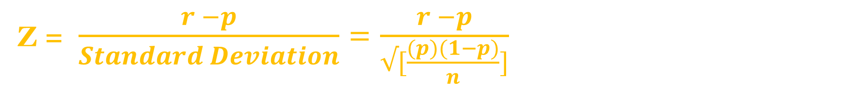
Assuming a confidence level of 95%, then the level of significance α = 0.05
If H0: μ₂ = μ₁
This means that the ratio of “success” is p ≈ 0.5 => q = (1 – p) ≈ 0.5
(i.e. if there are 9 “+”, there are also 9 “-”. Thus, p ≈ $\frac{9}{18}=0.5$ )
Since H1: μ₂ > μ₁
This is a one-tail test and since α = 0.05, the critical value is 1.645
Thus the sample test-statistic will be:
Z = $\frac{r −p}{Standard Deviation}$ = $\frac{r −p}{√[\frac{(p)(1−p)}{n}]}$

Slide 7
To perform the sign test, we want to:
Compare each student pretest with his or her after-test:
After – Pre = X
If X > 0, then mark + in the sign column
If X < 0, then mark – in the sign column
If X = 0, then mark 0 and remove the student’s data from the count
Note how many:
“+” signs
“-” signs
zeros
Students | Pretest | After-Test
1 | 82 | 95
2 | 76 | 88
3 | 84 | 90
4 | 65 | 77
5 | 54 | 74
6 | 68 | 66
7 | 77 | 86
8 | 48 | 73
9 | 82 | 82
10 | 78 | 77
11 | 81 | 85
12 | 57 | 75
13 | 78 | 78
14 | 76 | 73
15 | 88 | 89
16 | 90 | 98
17 | 83 | 87
18 | 85 | 88
Sign
+
+
+
+
+
-
+
+
0
-
+
+
0
-
+
+
+
+

Slide 8
To be able to use this test, the sum of the + and – signs has to be equal or greater than 12.
13 “+” signs
3 “–” signs
2 zeros
Observe there are:
Note that the 2 zero-values are excluded and with regard to the sign test, n = total of non zero signs = 18 – 2 => n = 16

Slide 9

Knowing there are
13 “+” signs,
3 “–” signs,
and 2 “zeros”,
We need to compute the ratio of success:
$$\frac{Number of+Signs}{\sum{(+ and −Signs)}}$$

Slide 10
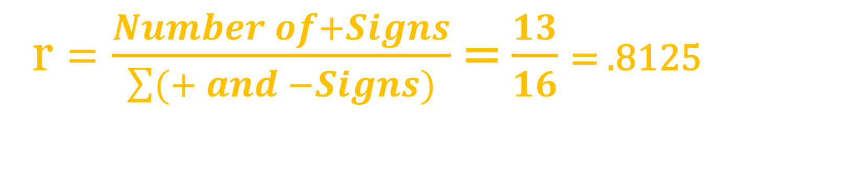
Knowing there are 13 + signs, 3 – signs, and 2 zeros,
The ratio of “success” is:
r = $\frac{Number of+Signs}{\sum{(+ and −Signs)}}$ = $\frac{13}{16}$ = .8125

Slide 11


Recall:
Assuming α = 0.05
If H0: µ₂ = µ₁ p ≈ 0.5 thus (1-p) ≈ 0.5
Since H1: µ₂ > µ₁ => one-tail test and z = 1.645
But from the sign test on our sample, we obtain r = 0.8125
Hence the test-statistic will be:
Z = $\frac{r −p}{√[\frac{(p)(1−p)}{n}]}$ = $\frac{0.8125 −0.5 }{√[\frac{0.25}{16}]}$ = 2.5

Slide 12
To find the p-value corresponding to z = 2.5, we need to look at the Standard Normal Probability table.
Since the p-value is a probability and the probability is an area,

Slide 13
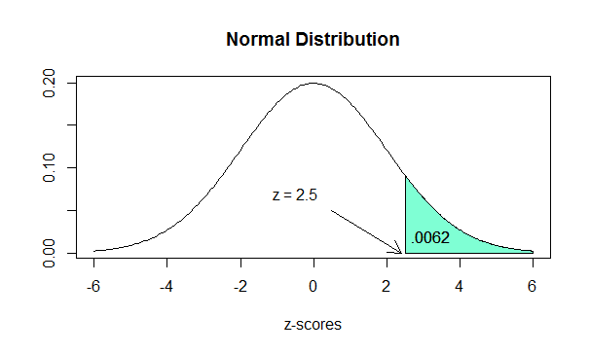
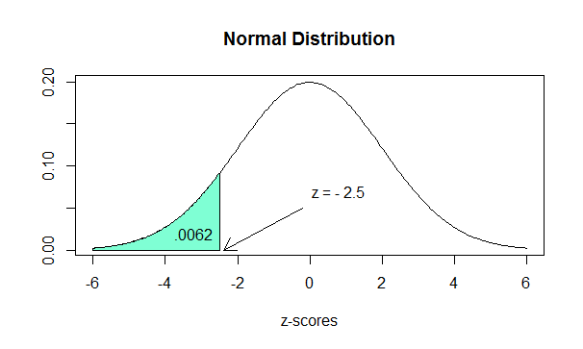
The Probability
P(z ≥ 2.5) ≡ P(z ≤ -2.5)
=
Our Situation
The Standard Normal Probability table.

Slide 14
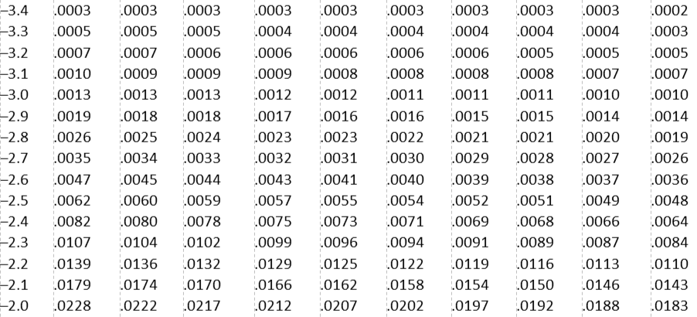
Finding the P-Value
Standard Normal Probability Table
To find the p-value corresponding to z = 2.5, we need to look at the Standard Normal Probability table.
Table entry
Table entry for
is the area under the standard normal curve
z
.
to the left of
z
z
z
.00
.01
.02
.03
.04
.05
.06
.07
.08
.09
Since P(z ≥ 2.5) ≡ P(z ≤ -2.5)
Then scroll down to Z = - 2.50
P-value = 0.0062

Slide 15
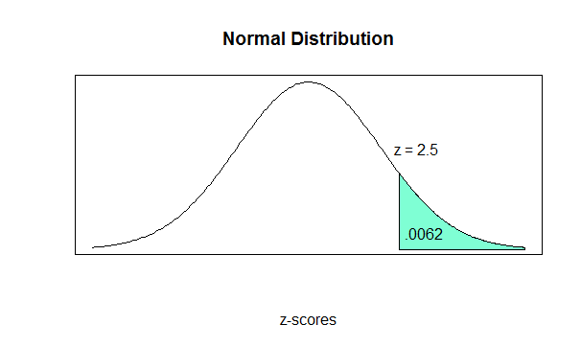
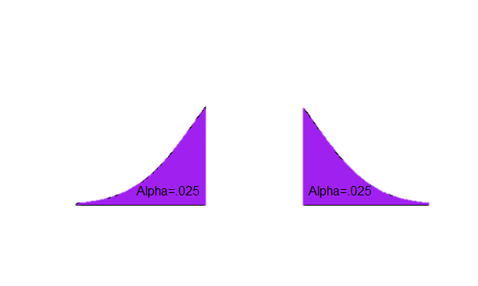
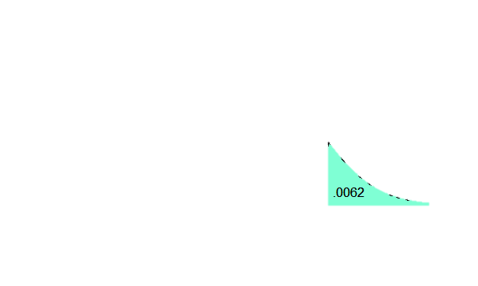

Slide 16
Conclusion
The null hypothesis for our example states:
H0: μ₁ = μ₂ that the program did not improve students grades
However, the our sample z score 2.5 is in the critical region
Also, the P-value for the sample test statistic is 0.0062, and
0.0062 < 0.05, the critical area
Thus we reject the null hypothesis H0 that the summer course has no effect on the students performance.
Thus, this evidence is sufficient to claim that the math summer course indeed increases these students scores

Slide 17
Inspired by: https://www.youtube.com/watch?v=P40BhFAiIKg “Understandable statistics”, 6th Edition, H. and C. Brase, Houghton Mifflin

