Slide 1
PriceCompare
⚖
Cross-store price comparison with product matching and price tracking
Midterm seminar · October 2026
Presented by: ____________________ Guide: ____________________
Notes:
Introduce the project: one search, six Indian stores, side-by-side prices, price history and alerts.

Slide 2
The problem: same product, six stores, six names
Prices for the same electronics differ by 5–15% between Indian stores, and change daily.
Comparing by hand means six searches, six result pages, six naming styles.
Accessories (cases, chargers) clutter every search for a phone.
No store tells you whether today's price is actually a good one.
Amazon
₹69,900
Apple iPhone 15 (128 GB) - Black
Flipkart
₹66,999
APPLE iPhone 15 (Black, 128 GB)
Reliance Digital
₹59,900
Apple iPhone 15 128 GB Black
Same phone, three titles, ₹10,000 apart
Notes:
Show the three real titles for one phone. The point: a tool must recognise these as one product.

Slide 3
Objectives
1
Search all stores at once
2
Match the same product
3
Compare side by side
One query, six stores in parallel; a failing store never breaks the search.
Group listings across stores while keeping 128 GB / 256 GB / Pro / Plus apart.
Lowest price and saving highlighted; results appear as each store answers.
4
Track prices daily
5
Alert on price drops
6
Measure quality
Record prices every day and show a 30-day trend per product.
Email the user when any store goes below a target price.
Automated tests, and matcher accuracy on a labelled dataset.

Slide 4
What exists today, and the gap
System | How it works | What it misses
Store search pages | One store at a time | No cross-store view
Google Shopping | Merchant data feeds | Coverage depends on feeds; little history for Indian stores
Price-tracker sites | Track one listing URL | No matching across stores; user finds every URL
Browser extensions | Overlay on a product page | Only once you are already on a product page
PriceCompare | Live multi-store search + automatic matching + history + alerts | Open source, no paid feeds

Slide 5
System architecture
Browser
FastAPI routes
Search service
SQLite
pages + JSON API
cache · search log · price history · alerts
Amazon
Flipkart
Snapdeal
Vijay Sales
Croma
Reliance Digital
Store adapters run in a thread pool: the search takes as long as the slowest store, not the sum
Matching: normalise → spec / variant / model guards → Jaccard + fuzzy
Side-by-side table · 30-day sparklines · price-drop alerts (scheduled checker)

Slide 6
Getting the data: no store has a public API
Store | Data source used | Why
Amazon, Snapdeal | Server-rendered HTML | Stable enough; parsed with BeautifulSoup
Flipkart, Reliance Digital | JSON embedded in the page (window.__INITIAL_STATE__) | Far more stable than their hashed CSS class names
Vijay Sales, Croma | The JSON search service their own site calls | Structured, fast, includes price and rating
Retries + CAPTCHA detection
Residential proxy on the host
One fixture test per store
Blocked pages raise a clear error instead of returning nothing.
Stores block cloud IPs (HTTP 403/503); the hosted copy routes through a proxy.
A saved copy of each real search page; breaks the build when a store changes its markup.

Slide 7
Product matching: explainable rules, measured
1
Normalise
lower-case, tokenise; "128 GB" → 128gb; "15.40 cm" → 15d40cm; WH-1000XM5 kept whole; "Pro+" → pro plus; filler words removed
2
Guard
specs must agree (8 GB ≠ 16 GB, RAM may be omitted); screen size within 1.5"; variant words (Pro, Max, Plus, Ultra) and model numbers (15 ≠ 16, Flip 5 ≠ Flip 6) must match
3
Score
Jaccard overlap of word sets ≥ 0.45; a shared model code (G502) is enough on its own; a fuzzy string score rescues "Fire-Boltt" vs "Fire Boltt"
4
Cluster
greedy, cheapest first → one row per product; accessories sink; rows ranked by query match and store count

Slide 8
Features completed for the midterm
Progressive loading
30-day price history
Page renders at once; each store column fills in as it answers (0.4 s to 9 s), then the comparison is built.
One price per listing per day; sparkline, 30-day low and a "lowest in N days" flag per row.
Price-drop alerts
Two more stores
Email + target price on any row; a scheduled checker re-searches and emails when a store goes below it.
Croma (JSON API) and Reliance Digital (embedded page state), with fixtures and tests.

Slide 9
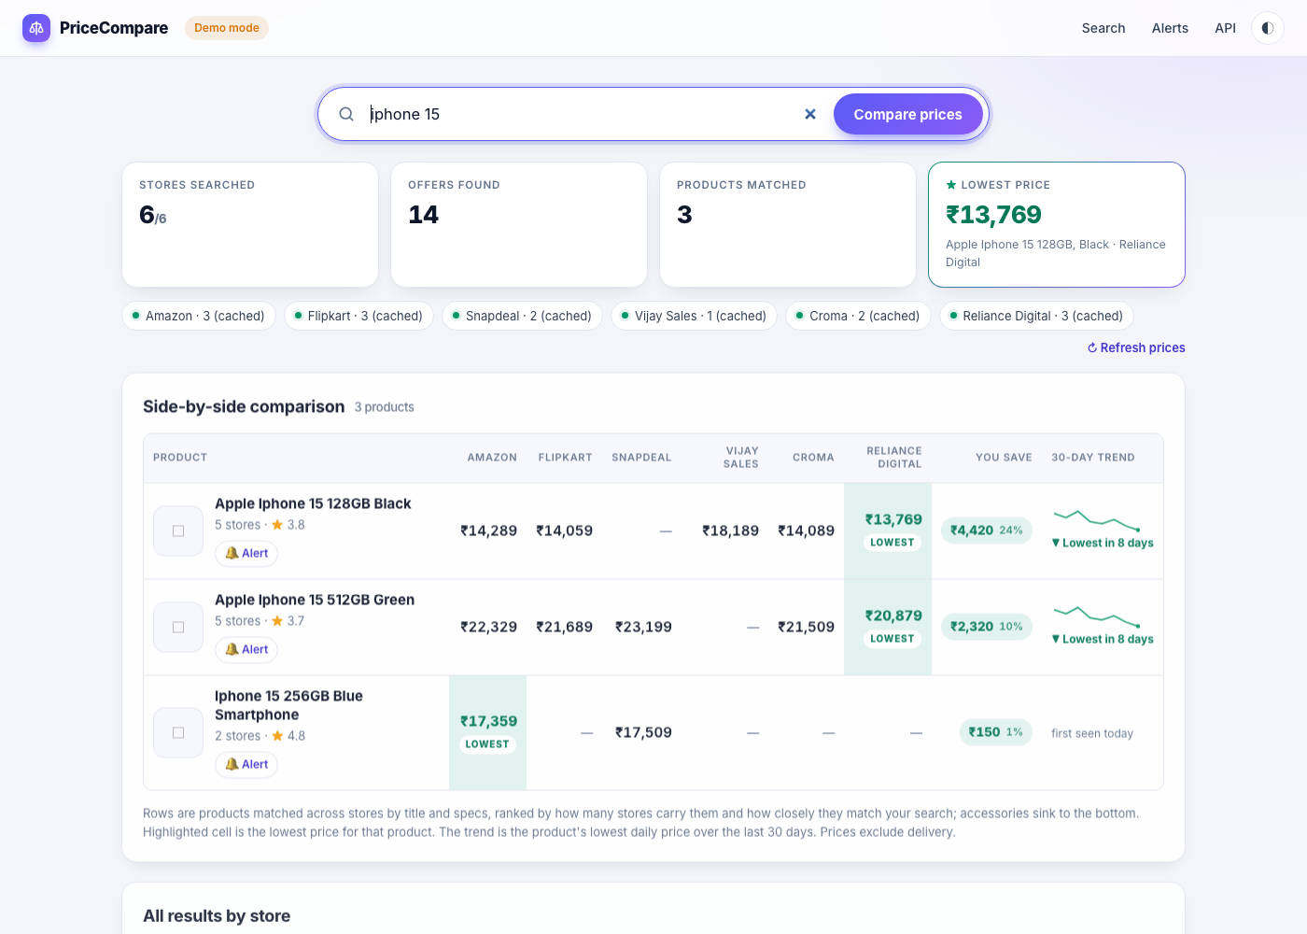
The results page
1
Summary
stores answered, offers, products, lowest price
2
Comparison table
one row per product, lowest cell highlighted, saving
3
30-day trend
sparkline + lowest-in-N-days flag
4
Alert
set a target price on any row

Slide 10
Measured: matcher accuracy on 78 labelled pairs
78
hand-labelled title pairs
(40 same, 38 different)
93.6%
accuracy now
(80.8% before)
69
automated tests,
all passing
Notes:
The dataset exposed real bugs: single-digit model numbers were dropped, RAM and storage only needed one shared value, 'with MagSafe Case' was treated as an accessory. Fixing them moved accuracy from 80.8% to 93.6%. Five hard cases remain, e.g. MX Master vs MX Anywhere.

Slide 11
Deployed and working today
6
8
0.4–9.2 s
3 h
stores searched
in parallel
product rows for
"iphone 15" live
per-store response
(Vijay Sales to Flipkart)
result cache, so
repeats are instant
Live at price-compare-alpha-lime.vercel.app
Source on GitHub with feature-level commits · runs locally (make dev / make demo) and in Docker
Demo mode with simulated stores for offline presentations
Live demo: search "iphone 15" → columns fill in as stores answer → comparison table → set an alert

Slide 12
Challenges and current limitations
Bot protection
Stores block data-centre IPs. Solved with a residential proxy; Croma's API also needed the storefront channel code, found by testing from the cloud.
Fragile markup
Store HTML changes without notice. Prefer embedded JSON and search APIs; fixture tests catch breakage.
Matching ambiguity
"MX Master" vs "MX Anywhere" differ by one word; rules cannot know that. A learned classifier is a possible extension.
Serverless storage
On Vercel only a temp folder is writable, so history and alerts reset on restart. Needs a hosted database.

Slide 13
Plan for the second half
Done
Next
Then
Final
Adapters, matching, cache, deploy, progressive UI, history, alerts, evaluation set
Hosted Postgres / Redis so history and alerts persist in production
CI on every push, auto-deploy from GitHub; 200+ labelled pairs; learned matcher vs rules
User study (10–15 people), final report and presentation

Slide 14
Thank you · Questions?
Live: price-compare-alpha-lime.vercel.app
Code: github.com/alizeeshan1234/price-compare-capstone-project

