Slide 1


Skin Disease Classification Using Vision Transformers (ViT)
Developed By:
Mohammad Aljabali aljabali89m@gmail.com 320210603046
Mohammad Enaim anymmhmd4@gmail.com 320210603004
Supervised by Dr. Ibrahim Al Tarawneh
Department of Computer Science Tafila Technical University Tafila
2025

Slide 2
INTRODUCTION
PAGE 02
what is the problem?
Context & Importance :
Skin diseases are among the most common medical issues worldwide.
Early and accurate diagnosis is crucial for effective treatment
Project Overview :
We propose a Vision Transformer-based model for classifying various skin lesions.
Emphasis on capturing subtle visual features that traditional methods might miss.

Slide 3

PAGE 03
Problem Identification
conflicting Diagnostic Accuracy
Variations in clinical expertise can lead to misdiagnosis or delays.
why its important?
ARTIFICIAL INTELLIGENCE
01
Limited Access to Specialists
Rural and remote areas often lack dermatological services.
Gaps in Existing Solutions
02
Traditional methods rely on manual feature engineering.
CNN-based approaches have achieved success but may struggle with very nuanced lesions.

Slide 4
PAGE 04
Gap and Motivation
Problem Background & Related Work
Lack of specialized medical datasets for transformers.
Need for more interpretable, accurate models in clinical settings.
03
Background
01
The skin diseases depends on image-based evaluations
Automated classification can serve as a second opinion or triage tool.
Related Work
02
Esteva et al. (2017): Demonstrated CNN performance at dermatologist level for melanomas.
Dosovitskiy et al. (2020): Introduced the Vision Transformer, showing excellent results on large-scale image tasks.

Slide 5
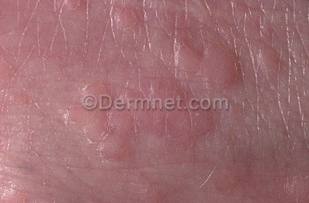
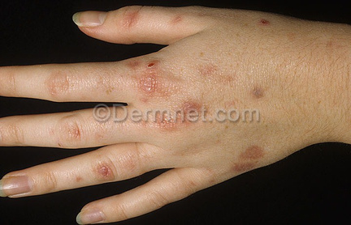
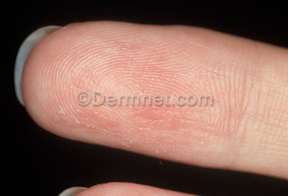
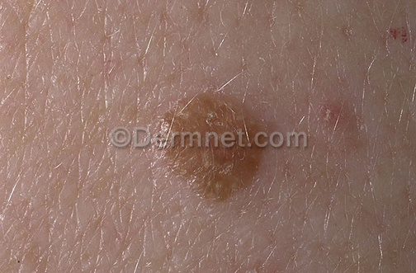
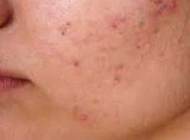
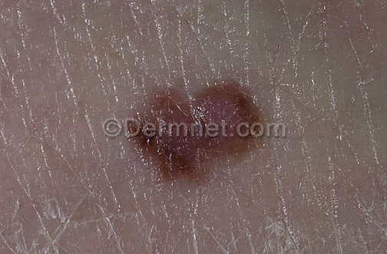
Training Data Overview
PAGE 05
asses & Image Counts (Training Set):
04
Pigment: 1,020 images
01
Infectious: 6,000 images
02
EKZAMA: 4,070 IMAGES
05
Benign: 10,900 images
Data Source:
Images obtained from Kaggle
6 main folders (each folder = 1 class)
Total (Train): 30,900 images
03
AKNE: 2,149 IMAGES
06
Malign: 6,783 images
Observation:
Benign has the largest number of images (10.9k).
Pigment has the fewest images (1,020).

Slide 6
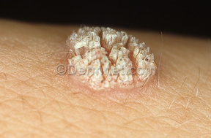

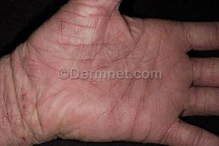
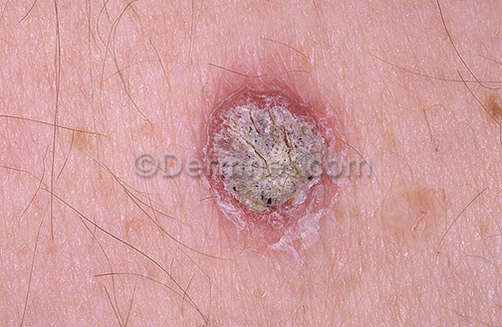
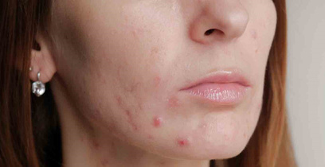
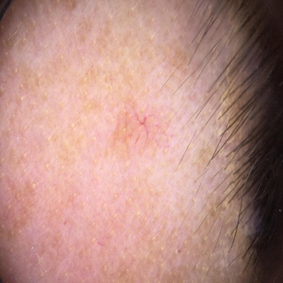
Validation Data Overview
PAGE 06
asses & Image Counts (Validation Set):
04
Pigment: 135 images
01
Enfeksiyonel: 750 images
02
EKZAMA: 508 IMAGES
05
Benign: 1,361 images
Data Source:
Images obtained from Kaggle
6 main folders (each folder = 1 class)
Total (Validation): 3,923 images
03
AKNE: 322 IMAGES
06
Malign: 847 images

Slide 7
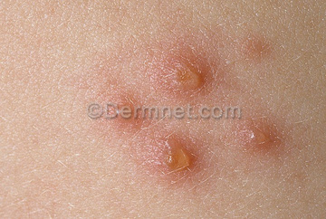

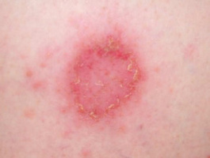
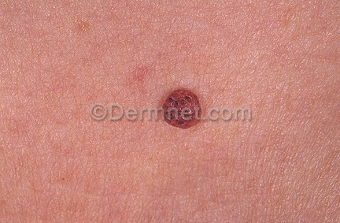
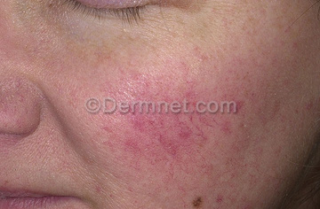
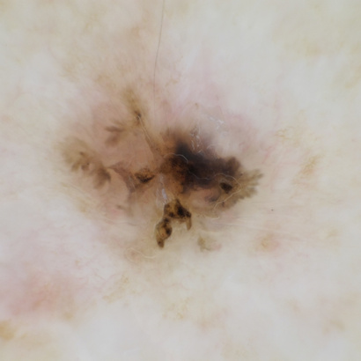
Test Data Overview
PAGE 07
asses & Image Counts
(Test Set):
04
Pigment: 136 images
01
Enfeksiyonel: 750 images
02
EKZAMA: 510 IMAGES
05
Benign: 1,361 images
Data Source:
Images obtained from Kaggle
6 main folders (each folder = 1 class)
Total (Test): 3,928 images
Training ~70%, Validation ~15%, Testing ~15% (approximate).
Similar class distribution in Val/Test to reflect real-world scenarios.
03
AKNE: 322 IMAGES
06
Malign: 849 images

Slide 8
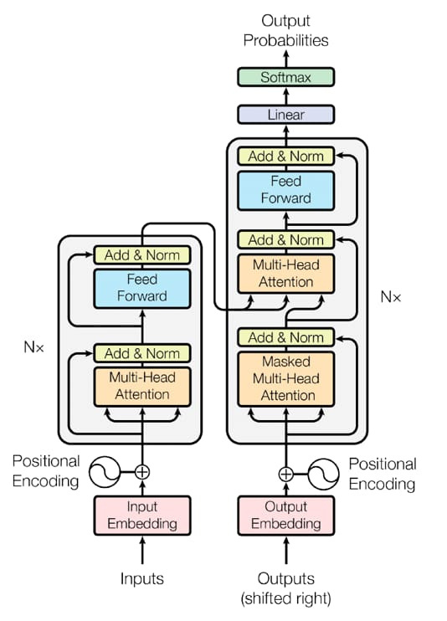
Overall Framework
PAGE 08
Transformer
introduced in the original paper "Attention Is All You Need" (Vaswani et al., 2017).
What is a Transformer?
A deep learning model for sequence-to-sequence tasks.
Unlike RNNs and LSTMs, it does not rely on recurrence, allowing for parallel processing.
Uses self-attention mechanisms to capture dependencies between input elements.
residual step

Slide 9
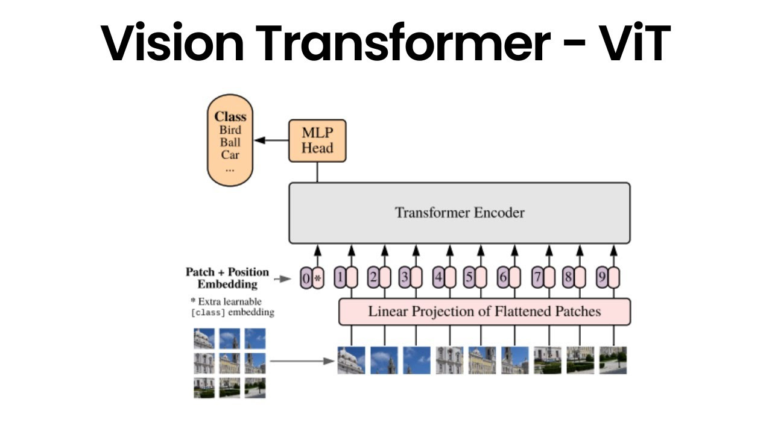
Model Architecture (Vision Transformer + Baseline)
PAGE 09
How we deal with the problem?
WHAT IS A VISION TRANSFORMER (VIT)?
Transformer models to image classification.
Unlike CNNs, which rely on convolutions, ViT uses self-attention mechanisms to learn spatial relationships between different image regions.

Slide 10
EFFICIENTNET-B7
PAGE 10
EfficientNet-B7 is a deep convolutional neural network designed for high accuracy with optimal efficiency.
Uses compound scaling to balance network depth, width, and resolution.
More computationally efficient compared to traditional CNNs like ResNet and Inception.
Best Use Cases:
Medical Imaging (e.g., skin lesion classification, radiology
Autonomous Vehicles (image recognition, scene segmentation).
Industrial Defect Detection (quality control).
Not Ideal For:
Small datasets without augmentation.
Low-power embedded AI applications

Slide 11
PAGE 11
Experiment Setup
Parameter | Vision Transformer (ViT-B/16) | EfficientNet-B7
Batch Size | 32 | 32
Epochs | 10 | 50
optimizer | Adam | Adam
learning rate | 1e-4 | 1e-7
Loss Function | CrossEntropyLoss | CrossEntropyLoss
Model Comparisons:
Vision Transformer (ViT-B/16) vs. EfficientNet-B7
Trained using PyTorch with Adam optimizer
Batch Size: 32, Epochs: 10-20

Slide 12
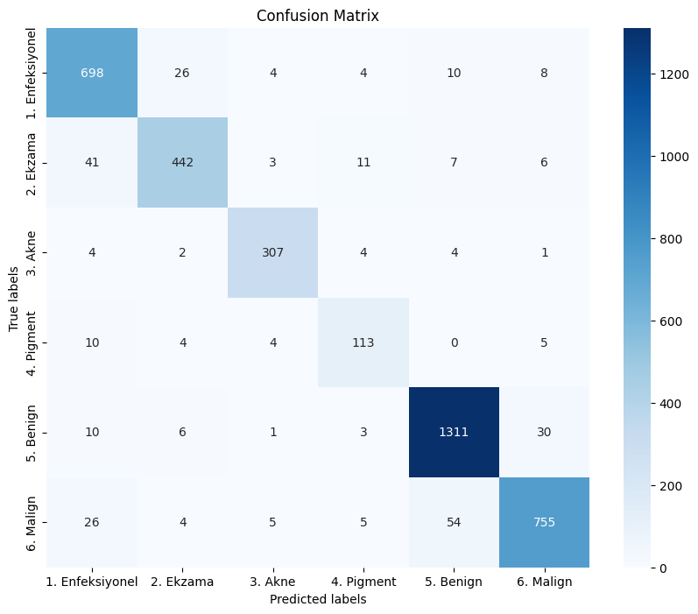
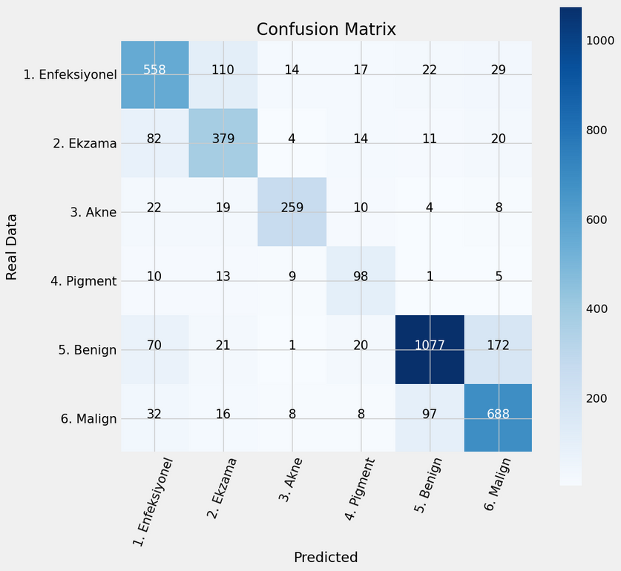
Evaluation Metrics
PAGE 12
VISION TRANSFORMER (VIT-B/16)
EFFICIENTNET-B7

Slide 13
PAGE 13
Model Performance Comparison
Observations:
ViT achieves higher accuracy and recall, making it preferable for critical cases.
EfficientNet-B7 is still effective but struggles with complex lesion patterns.
Misclassification is higher in Pigment disorders and Benign vs. Malignant differentiation.
Model | Accuracy (%) | Precision | Recall | F1-Score
ViT-B/16 | 92.66% | 0.92 | 0.92 | 0.92
EfficientNet-B7 | 79% | 0.79 | 0.78 | 0.78

Slide 14
PAGE 14
Conclusion
Successfully built and fine-tuned two models to classify skin lesions into 6 categories.
Achieved high accuracy (>90%) showing its effectiveness for nuanced lesion classification.
Key Findings
Vision Transformer handles global context effectively, outperforming the baseline CNN in most metrics.
EfficientNet-B7 remains a strong alternative, especially when computational resources or data size might be limited.
Model confusion often occurs in visually similar classes (e.g., Pigment vs. Benign lesions), highlighting potential needs for more balanced data or advanced augmentation.

Slide 15
PAGE 15
Future Recommendations
Expand the Dataset
Explore Other Transformer Variants
Clinical Validation & Collaboration

Slide 16
PAGE 16
References

Slide 17
Thank You For Your Attention
PAGE 17
any questions?

