Slide 1

Makina Sense
FINAL PROJECT · DEMO DAY
Predict before the machine stops.
AI-powered predictive maintenance: sensor readings in, failure risk, failure type and a maintenance action out.
THE TEAM
01
02
03
Aiham Bawaneh
Mahmoud Bani-Hani
Mohammad Aljabali
04
05
Reem Aldelki
Shahed Alkhawaga
Notes:
Suggested speaker split (about 20 minutes in total, adjust freely): Speaker 1 (slides 1–4, 3.5 min): problem, data, roadmap. Speaker 2 (slides 5–9, 5 min): cleaning, EDA, preprocessing, data paths, features. Speaker 3 (slides 10–11, 3.5 min): Model 1. Speaker 4 (slides 12–15, 5 min): Model 2, the system diagram and the linking code. Speaker 5 (slides 16–20, 5.5 min): web prototype, insights, limitations, next steps, conclusion. Slide 21 is the repository map and the last slide (22) is Thank you. Open by naming the team and the one-line promise: we predict a machine failure before it happens, and tell the technician which kind of failure to expect.

Slide 2

Unplanned downtime costs more than the machine.
02 · THE BUSINESS PROBLEM
REACTIVE
PREVENTIVE
PREDICTIVE · OUR APPROACH
Wait for a breakdown, then respond. Production stops, orders slip, repairs are rushed.
Service on a fixed calendar. Safer, but healthy parts are replaced early and sudden failures still happen.
Use operating signals to act earlier: read the sensors, estimate the risk, and prioritise inspections.
From five sensor readings and the machine type: will this machine fail, and if so, what kind of failure should we prepare for?
decision support for maintenance teams, not autonomous machine control.
Makina Sense
Business problem
Notes:
Speaker 1 (about 1 minute). Frame it as a business problem, not a modelling exercise. Three maintenance strategies: reactive, preventive, predictive; we are building the third. Say the question out loud: will it fail, and what type of failure. These are the two models you will see later. Stress the objective: decision support, not autonomous control; the technician stays responsible. Do not quote cost figures unless you can cite them.

Slide 3

10,000 machine records, and only 339 failures.
03 · DATASET AND DATA COLLECTION
10,000
339
14
Inputs (5 readings + type)
records
failures (3.39%)
columns in the source file
Type L / M / H, air temperature, process temperature, rotational speed, torque, tool wear
Source
Target 1
AI4I 2020 Predictive Maintenance Dataset, UCI Machine Learning Repository. A public synthetic dataset that reflects real predictive-maintenance data from industry. DOI 10.24432/C5HS5C
Machine failure: 0 = no failure, 1 = failure
Target 2
Failure-type flags: TWF tool wear, HDF heat dissipation, PWF power, OSF overstrain, RNF random
Why this matters
With 3.4% failures, a model that always says "healthy" is 96.6% accurate and useless. We judge models by F1, precision and recall, not accuracy.
Collection
Downloaded from UCI. For practice we also built a controlled dirty copy (missing values, duplicates, outliers) to clean in Milestone 2
Makina Sense
Dataset
Notes:
Speaker 1 (about 1.5 minutes). Say where the data comes from (UCI, DOI on the slide), what a row is, and the two targets. The key point is the imbalance: 339 failures out of 10,000, which is why accuracy is the wrong metric and why a larger working set was built later. The original UCI file was clean; the dirty copy was created by us for the cleaning milestone.

Slide 4

Four milestones, one end-to-end pipeline.
04 · HOW WE GOT HERE
M1 · Understand
M2 · Clean
M3 · Explore and prepare
M4 · Model and integrate
Select AI4I 2020, inspect the schema, identify the targets and the industrial context.
Create a controlled dirty copy, quantify the issues, cap outliers, impute and remove duplicates.
Explore, engineer features, encode Type, split the data and scale the numeric features.
Compare classifiers, train Model 1 and Model 2, connect the inference logic and build a Flask web prototype.
a prototype that turns sensor data into interpretable maintenance signals.
Raw sensor data → clean → explore → prepare → Model 1 (will it fail?) → Model 2 (what kind?) → risk level and maintenance action.
Makina Sense
Roadmap
Notes:
Speaker 1 (about 1 minute). Quick orientation: problem and data, then cleaning, exploration and preparation, then models and evaluation, then the web prototype, results, limitations and next steps. Hand over to Speaker 2 for cleaning.

Slide 5

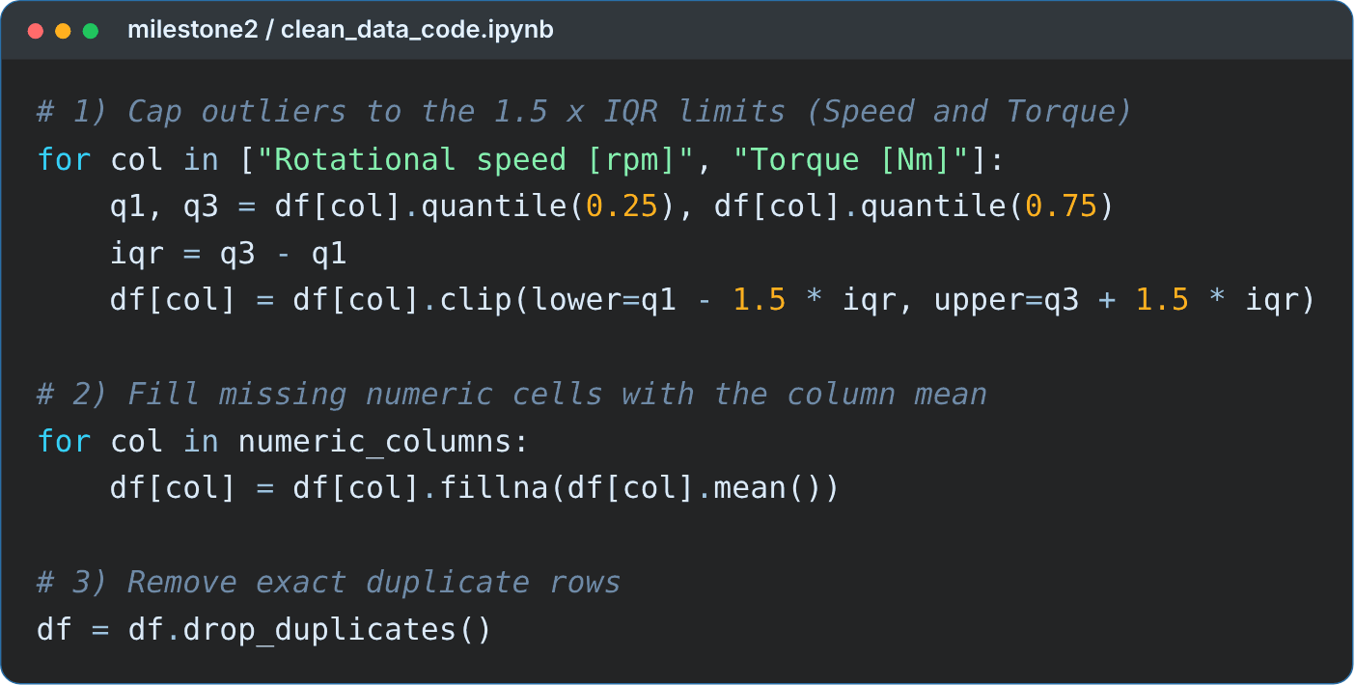
Cleaning the deliberately corrupted copy.
05 · DATA CLEANING · MILESTONE 2
The original UCI file was clean, so we built a corrupted copy and documented a repeatable cleaning order.
1 · IQR clipping
460 outlier values (394 speed, 66 torque) capped at the 1.5 × IQR limits, not deleted.
2 · Mean imputation
4,040 missing cells filled with the column mean.
3 · Duplicate removal
100 exact duplicates dropped: 10,100 rows back to 10,000.
After cleaning: 0 missing cells, 0 duplicates, outliers capped, not deleted.
Makina Sense
Cleaning · Milestone 2
Notes:
Speaker 2 (about 1 minute). The dirty working copy had 10,100 rows, 4,040 missing cells, 100 duplicates and 460 IQR outlier values. Walk through the three decisions in their fixed order, not the code line by line: clip outliers, impute with the mean, remove duplicates. Outliers are capped, not deleted, because extreme torque and speed are where failures live. If asked about the median: mean imputation was our simple choice; comparing it with the median is a possible follow-up.

Slide 6

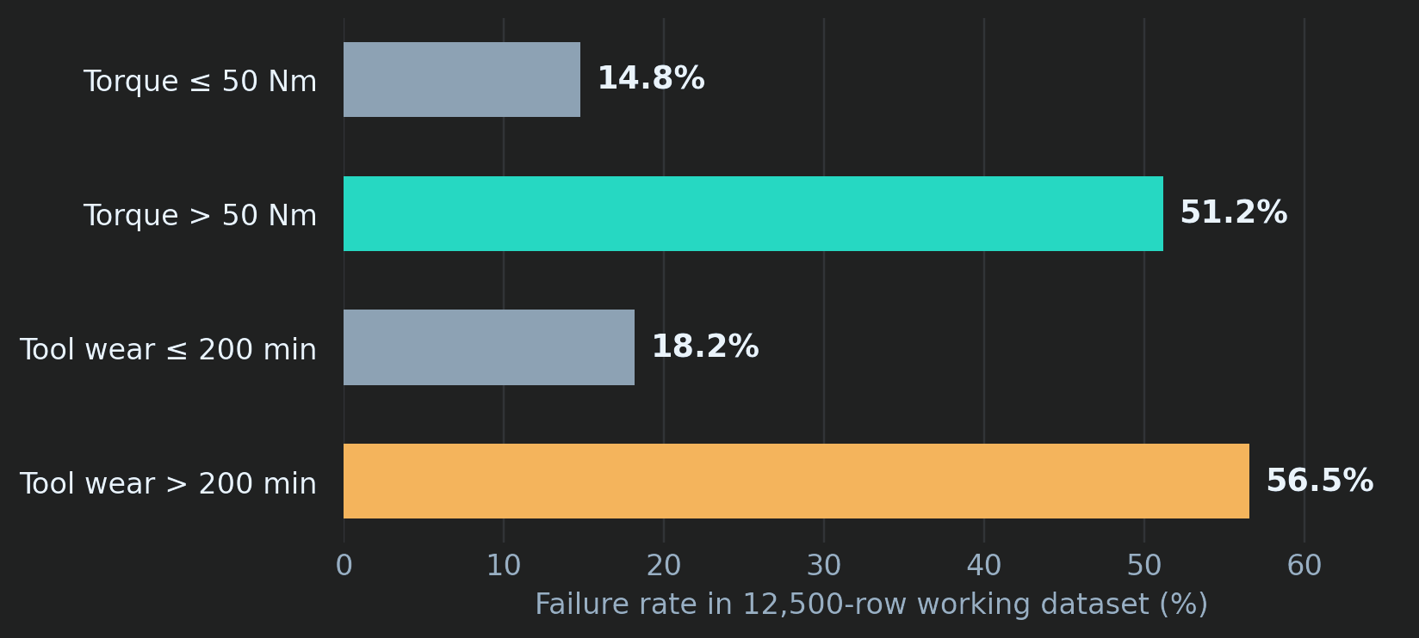
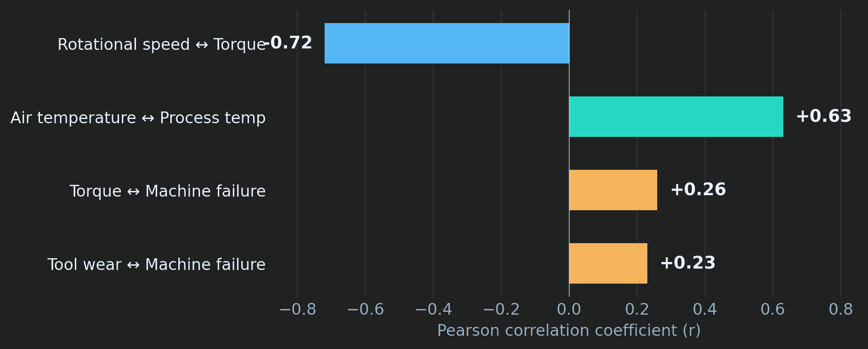
Operating conditions reveal clear risk patterns.
06 · EXPLORATORY ANALYSIS
Measured on the 12,500-row working set, which includes synthetic failures. These are associations, not causes.
3.46× higher failure rate
3.11× higher failure rate
Speed and torque: r ≈ −0.72
Torque above 50 Nm: 14.8% to 51.2%
Tool wear above 200 min: 18.2% to 56.5%
Air and process temperature: r ≈ +0.63
Makina Sense
EDA
Notes:
Speaker 2 (about 1.5 minutes). Read the charts for the audience. Left: failure rate rises from 14.8% to 51.2% when torque is above 50 Nm (3.46 times) and from 18.2% to 56.5% when tool wear is above 200 minutes (3.11 times). Right: speed and torque are strongly negatively correlated (about -0.72); air and process temperature are positively correlated (about +0.63). Say the caveat yourself: these rates come from the 12,500-row working set that includes synthetic failures, and correlation is not causation. Use them as investigation signals, not universal thresholds. Link forward: this is why we built features from these pairs; note that Mechanical_Power_W is derived from torque and speed, so they share information.

Slide 7

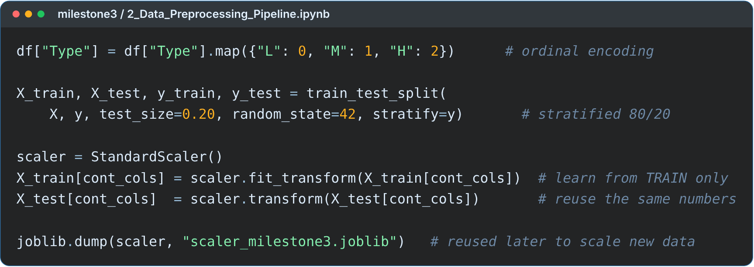
Encode, split, then scale, in that order.
07 · PREPROCESSING · MILESTONE 3
1 · Encode machine type
L, M, H become 0, 1, 2 because the quality grades are ordered.
2 · Stratified train/test split
Working set of 12,500 rows: 10,000 train and 2,500 test. Failure share: 22.71% in train, 22.72% in test.
3 · StandardScaler, fitted on train only
The test set never influences the scaler. It is saved with joblib and reused by the app.
Why scale? Speed is about 1,500 rpm and torque about 40 Nm; scaling puts them on one footing for distance-based models like KNN.
Makina Sense
Preprocessing · Milestone 3
Notes:
Speaker 2 (about 1 minute). Three steps and the reason for each. The key sentence for the rubric: the scaler is fitted on the training data only, so the test set stays unseen. The 12,500-row working set contains 2,500 synthetic failure rows added because the original has only 3.4% failures; the next slide explains how that shapes the evaluation.

Slide 8

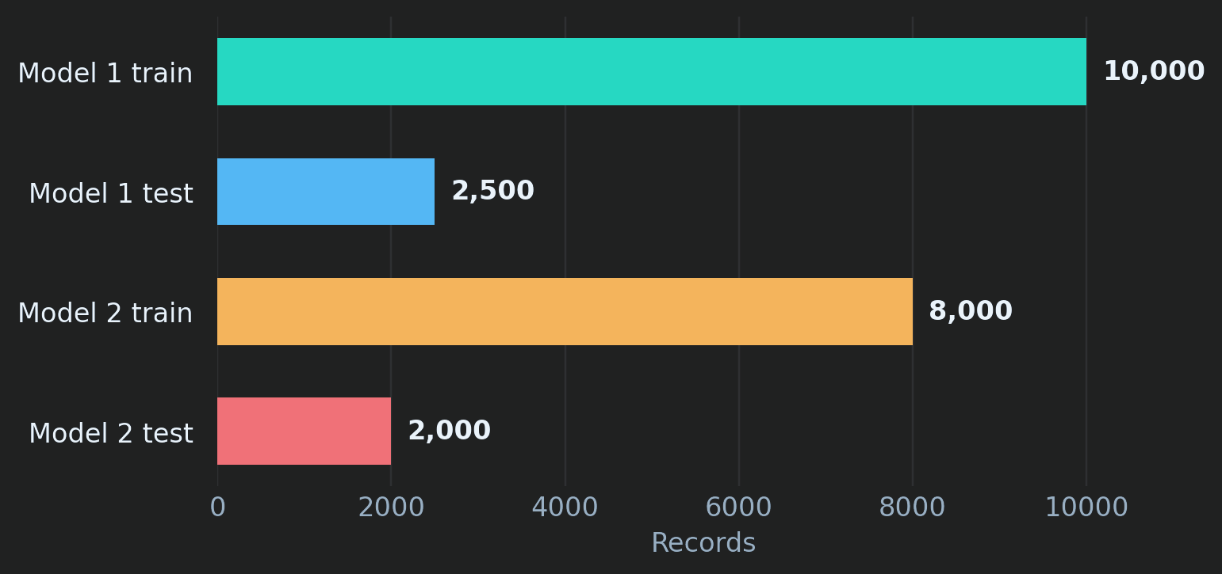
Two models, two datasets, on purpose.
08 · TWO DATA PATHS
Model 1 · failure detection
Milestone 3 working set: 12,500 rows, 10,000 train and 2,500 test. It includes 2,500 synthetic failure rows. Failure rate 22.71% (train) and 22.72% (test).
Model 2 · failure type
Original AI4I rows only: 10,000 rows, 8,000 train and 2,000 test, stratified on Machine failure. Synthetic and cleaned rows are left out because their type labels do not follow the physical rules.
all 2,500 synthetic rows are failures, and 494 of the 568 test failures (87%) are synthetic.
Makina Sense
Data paths
Notes:
Speaker 2 (about 1 minute). Model 1 needs more failures to learn from, so it uses the 12,500-row working set with 2,500 synthetic failures. Model 2 needs trustworthy type labels, so it uses only the original rows. Consequence: the two models never share a test set. The evaluation caveat is the most important sentence on this slide: all 2,500 synthetic rows are failures, and 494 of the 568 failures in the Model 1 test set (87.0%) are synthetic. We verified this exactly: every one of the 2,500 test rows matches one row of AI4I_with_synthetic_data_cleaned_data.csv, and 494 of the failures are rows with UDI above 10,000 (the synthetic rows); the other 74 are original rows. The notebooks do not print this count. The team's own Milestone 4 deck also says that an original-only test score is not reported.

Slide 9

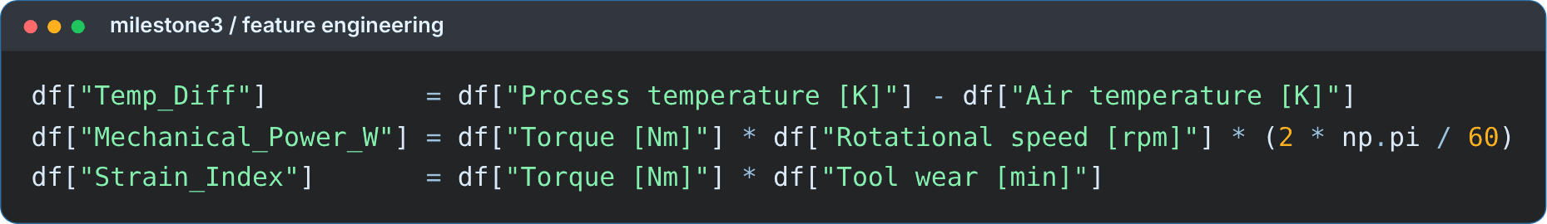
Three engineered features add physical context.
09 · FEATURE ENGINEERING · MILESTONE 3
Temp_Diff
Mechanical_Power_W
Strain_Index
Process temperature − air temperature. A low gap together with low speed marks heat-dissipation failures.
Torque × speed × 2π / 60. Power outside a safe range marks power failures.
Torque × tool wear. A value above a limit marks overstrain failures.
All three are computed from raw readings before scaling.
Two of the three most important features of Model 1 are engineered: Temp_Diff is second, Mechanical_Power_W third.
Makina Sense
Feature engineering
Notes:
Speaker 2 (about 1 minute). Each feature comes from the physics of the machine, not from trial and error. In the failure-type notebook the rules are written as: low temperature difference with low speed for heat dissipation (HDF), power outside a safe range for PWF, and torque times tool wear above a limit for overstrain (OSF). Evidence that it worked: in the feature-importance chart later, Temp_Diff is second (0.195) and Mechanical_Power_W third (0.159). The formulas are applied to raw values before scaling; the web app does it in the same order.

Slide 10

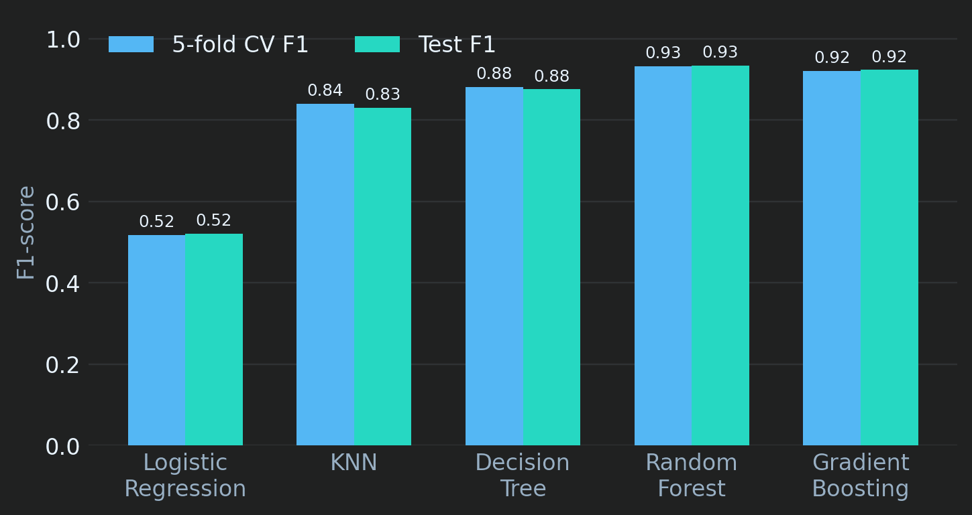
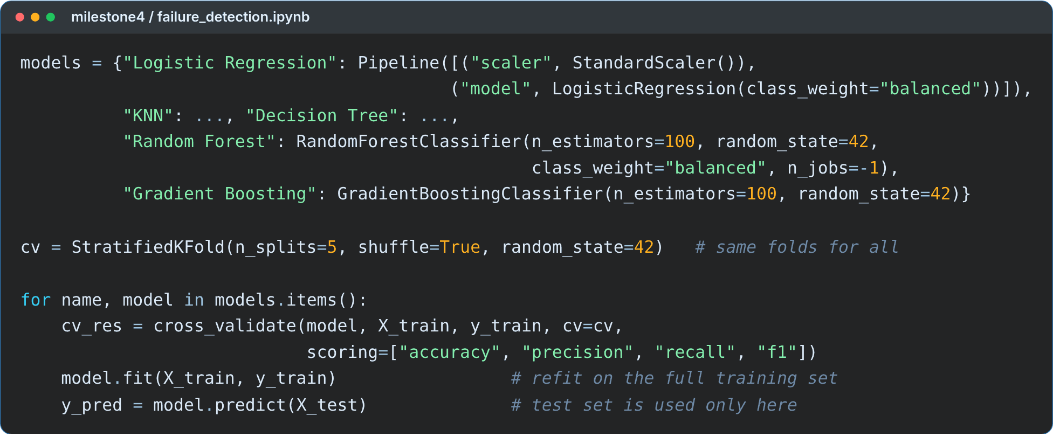
Five models, one fair protocol.
10 · MODEL 1 · WILL IT FAIL?
Protocol
Selection rule
Tie-breaker
Stratified 5-fold CV on the training set; the test set stays untouched until the end.
Highest mean CV F1: Random Forest 0.9327, Gradient Boosting 0.9208.
On the test set, Random Forest recall is 0.9067 and Gradient Boosting 0.8820.
Makina Sense
Model 1 · Milestone 4
Notes:
Speaker 3 (about 1.5 minutes). Why these five: a linear baseline (Logistic Regression), a distance model (KNN), a single tree, and two tree ensembles. All were scored with the same stratified 5-fold cross-validation on the training set, and judged by F1 because of the imbalance. Mean CV F1: Random Forest 0.9327, Gradient Boosting 0.9208, Decision Tree 0.8812, KNN 0.8402, Logistic Regression 0.5179. On the unseen test set: Random Forest F1 0.9338, Gradient Boosting 0.9235, Decision Tree 0.8758, KNN 0.8305, Logistic Regression 0.5207. Random Forest and Gradient Boosting are close; Random Forest has the highest CV F1 and catches more failures (test recall 0.9067 against 0.8820), which matters for maintenance. Do not read the code; point to the loop that treats every model the same way. Logistic Regression and KNN are wrapped with a StandardScaler inside a pipeline during CV.

Slide 11

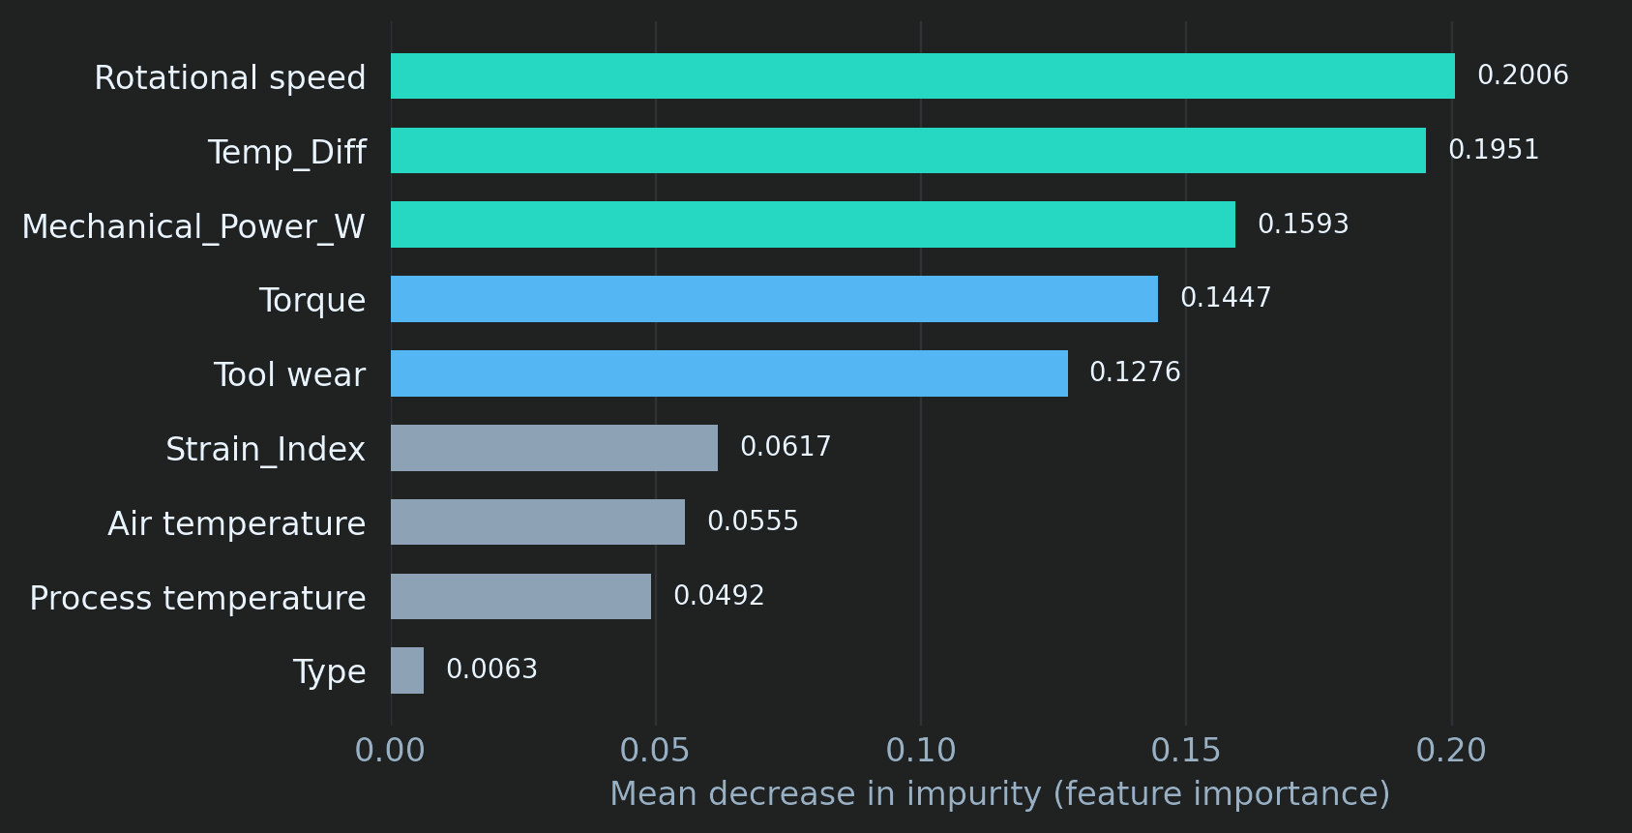
On held-out data: 53 missed failures, 20 false alarms.
11 · MODEL 1 RESULTS
0.934
0.971
F1 on test set
accuracy
0.963
0.907
precision
recall
Confusion matrix (2,500 test rows)
Predicted OK
Predicted fail
Actually OK
1,912
20
Actually fail
53
515
73 errors: 53 missed failures (73%) and 20 false alarms (27%). Balanced accuracy 94.8%. Next lever: tune the threshold to the cost of a miss.
Makina Sense
Model 1 evaluation
Notes:
Speaker 3 (about 2 minutes). Test-set numbers from our notebook: F1 0.9338, accuracy 0.9708, precision 0.9626, recall 0.9067, balanced accuracy 0.9482. Confusion matrix: 1,912 true negatives, 20 false positives, 53 false negatives, 515 true positives. In plain language: 20 false alarms are 20 unnecessary inspections; 53 misses are failures the model did not see, the costlier error in maintenance, so the next lever is the decision threshold. Feature importance on the right: rotational speed 0.2006, Temp_Diff 0.1951, Mechanical_Power_W 0.1593, torque 0.1447, tool wear 0.1276, Strain_Index 0.0617, air temperature 0.0555, process temperature 0.0492, Type 0.0063. Importance shows predictive contribution, not cause, and correlated features share it. Caveat for the limitations slide: the test set has 568 failures out of 2,500 rows (22.7%), far more than the 3.4% of the original data, because the working set includes synthetic failures.

Slide 12

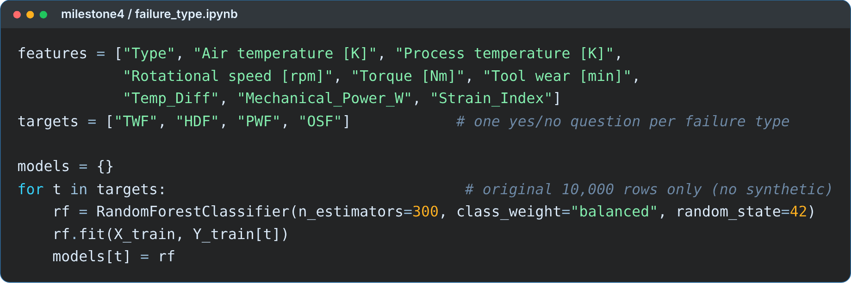
Four specialists, one yes/no question each.
12 · MODEL 2 · WHAT KIND OF FAILURE?
One Random Forest per failure type
TWF, HDF, PWF and OSF, each answering yes or no. One machine can have several types (24 such rows exist).
Trained on the original 10,000 rows
Synthetic and cleaned rows are left out: their type labels do not follow the physical rules. 80/20 stratified split, 300 trees, balanced weights, unscaled features.
RNF (random failure) is not modelled
Only 19 cases, random by design.
If no type reaches 50%, the app reports "Unclassified" and recommends a general inspection.
Makina Sense
Model 2 design
Notes:
Speaker 4 (about 1.5 minutes). Why four binary models instead of one multi-class model: one machine can show several failure types at the same time (24 rows in the original data), so yes/no per type is the honest framing. Why the original rows only: in the notebook we excluded the synthetic and cleaned rows because their failure-type labels do not follow the physical rules of the original data. Why RNF is excluded: 19 cases, random by design. If asked why Model 2 does not train on the same data as Model 1: Model 1 needs more failures, Model 2 needs trustworthy type labels, so each uses the data that suits its question. Model 2 gets unscaled features because Random Forest does not depend on feature scale.

Slide 13

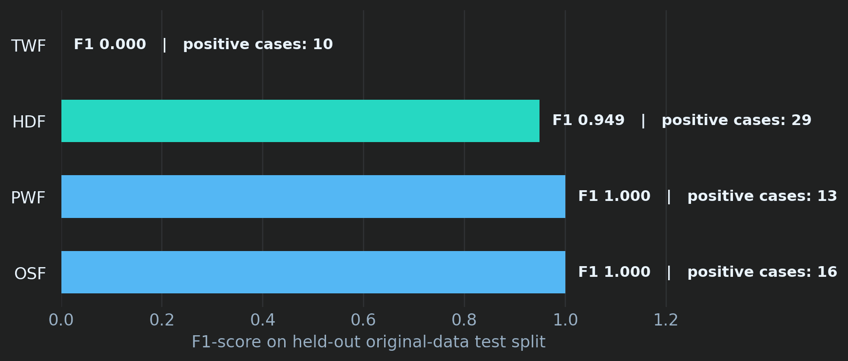
Three types are near-perfect; tool wear is not.
13 · MODEL 2 RESULTS
Type
Test F1
CV F1
Positives
OSF
1.000
0.995
16
PWF
1.000
0.984
13
HDF
0.949
0.950
29
TWF
0.000
0.063
10
Few positives per type (10 to 29 in the 2,000-row test). The CV column is computed on the whole 10,000-row file, separately from the 80/20 test.
Why the easy types are easy
Why TWF fails
They follow clear physical rules in this simulated data, and our engineered features encode those rules.
Only 46 examples; tool-wear failures happen at a random moment inside a 200 to 240 minute window. The app labels it "low reliability".
Makina Sense
Model 2 evaluation
Notes:
Speaker 4 (about 1.5 minutes). Test F1: OSF 1.000 (16 positives), PWF 1.000 (13), HDF 0.949 (29), TWF 0.000 (10). Cross-validation F1: OSF 0.995, PWF 0.984, HDF 0.950, TWF 0.063. Do not present 1.000 as a triumph: with 13 and 16 positives and rule-generated data it mostly shows the rules are learnable; the notebook itself says to trust the CV column more than a single split with tiny counts. Be open about the protocol: the CV column runs on the whole original file, not on the training split only. Present the TWF failure honestly: the model finds none of the 10 test cases, there are only 46 examples, and failures occur at a random moment in a 200 to 240 minute wear window, so the app tags that type as low reliability. This transparency earns marks under Insight and Justification. To improve TWF we need more examples.

Slide 14

Model 1 decides if. Model 2 decides what.
14 · HOW THE TWO MODELS WORK TOGETHER
SCALED
Model 1
Gate: P ≥ 0.5?
→
→
Output
Raw input
Feature engineering
StandardScaler fitted on train
Random Forest: P(failure)
yes ↓ continue
no: healthy, stop
Risk level: Low, Medium, High or Critical
Type, air temp, process temp, speed, torque, tool wear
→
+ Temp_Diff, Power, Strain. 9 features, Type encoded.
→
→
Model 2
Failure type(s), or Unclassified
UNSCALED
same 9 features, raw units
→
waits for the gate
→
4 Random Forests: TWF HDF PWF OSF
Maintenance action
Model 1 reads
features, Model 2 reads
ones. Mixing them gives confident, wrong answers.
Reuse, never refit
Independent probabilities
Rule-based advice
The saved StandardScaler is applied to new inputs.
Type scores do not add up to 100%.
The maintenance text is rules, not a trained model.
Makina Sense
System diagram
Notes:
Speaker 4 (about 2 minutes). This is the slide that shows we built a system, not two separate notebooks. Walk left to right. One input goes through the same feature engineering. Then two branches: the cyan branch is scaled and feeds Model 1; the amber branch stays in raw units and feeds Model 2. Model 1 outputs a failure probability. If it is below 0.5 we stop: no failure type is reported. If it is 0.5 or above, Model 2 runs and every type with probability of at least 0.5 is reported; if none qualifies the result is Unclassified. The risk level uses the probability: below 0.2 Low, below 0.5 Medium, below 0.8 High, otherwise Critical. Each type maps to a rule-based action, for example HDF: check the cooling system and airflow. Bottom row: the saved scaler is reused, never refitted; the four type probabilities are independent; the maintenance text is rule-based guidance, not a separately trained model. The red strip: the two models were trained on different versions of the features, so the app must give each one the right version.

Slide 15

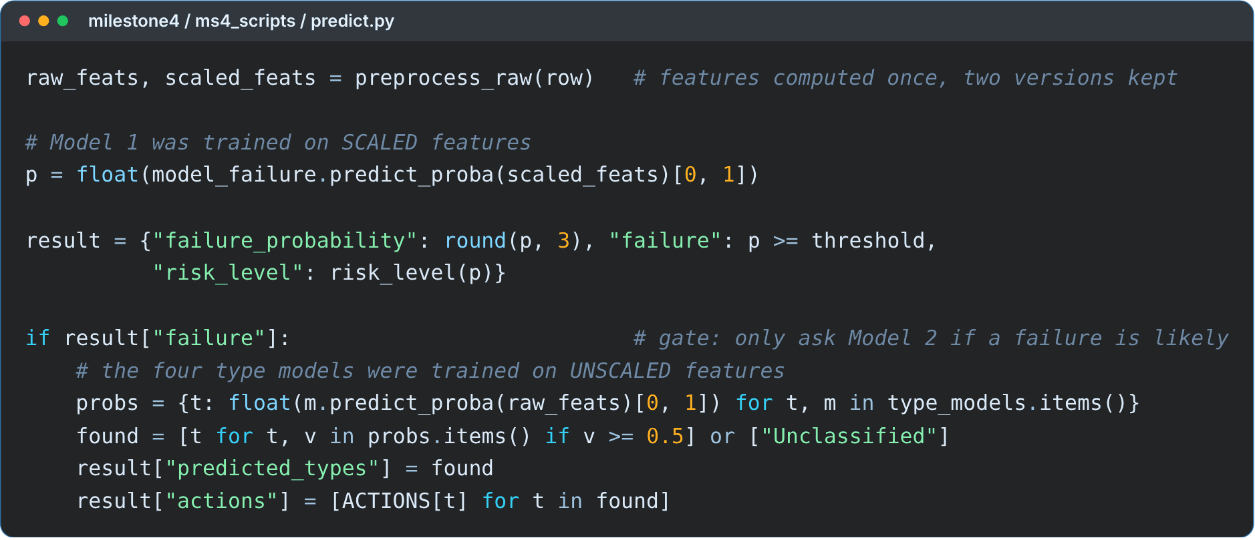
One function links the system: predict_machine.
15 · THE LINKING CODE
1 · Model 1 on scaled features
Returns the failure probability.
2 · The gate
Only if probability is at least 0.5 do we continue.
3 · Model 2 on raw features
Four type probabilities; types at 0.5 or more are reported.
4 · Rules turn it into advice
A risk level and a maintenance action per type.
Makina Sense
predict.py · ms4_scripts
Notes:
Speaker 4 (about 1 minute). Do not read the code. Point at four things: the scaled matrix goes to Model 1, the if-statement is the gate, the raw matrix goes to the type models, and the dictionary of actions turns types into advice. The file is predict.py in milestone4/ms4_scripts, and the Flask app calls this function. Hand over to Speaker 5.

Slide 16
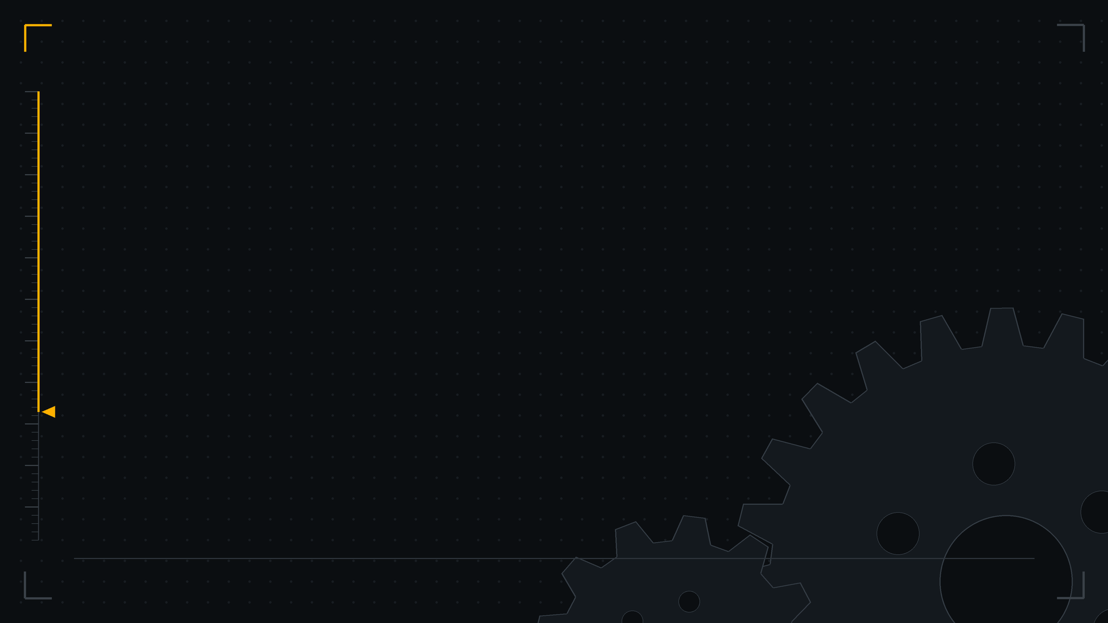
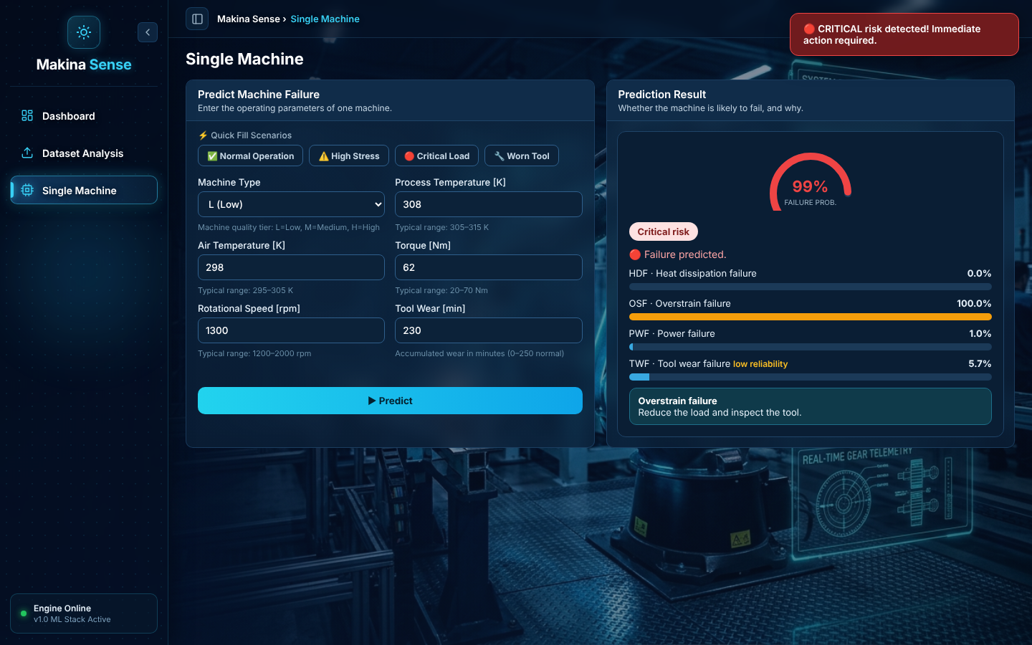
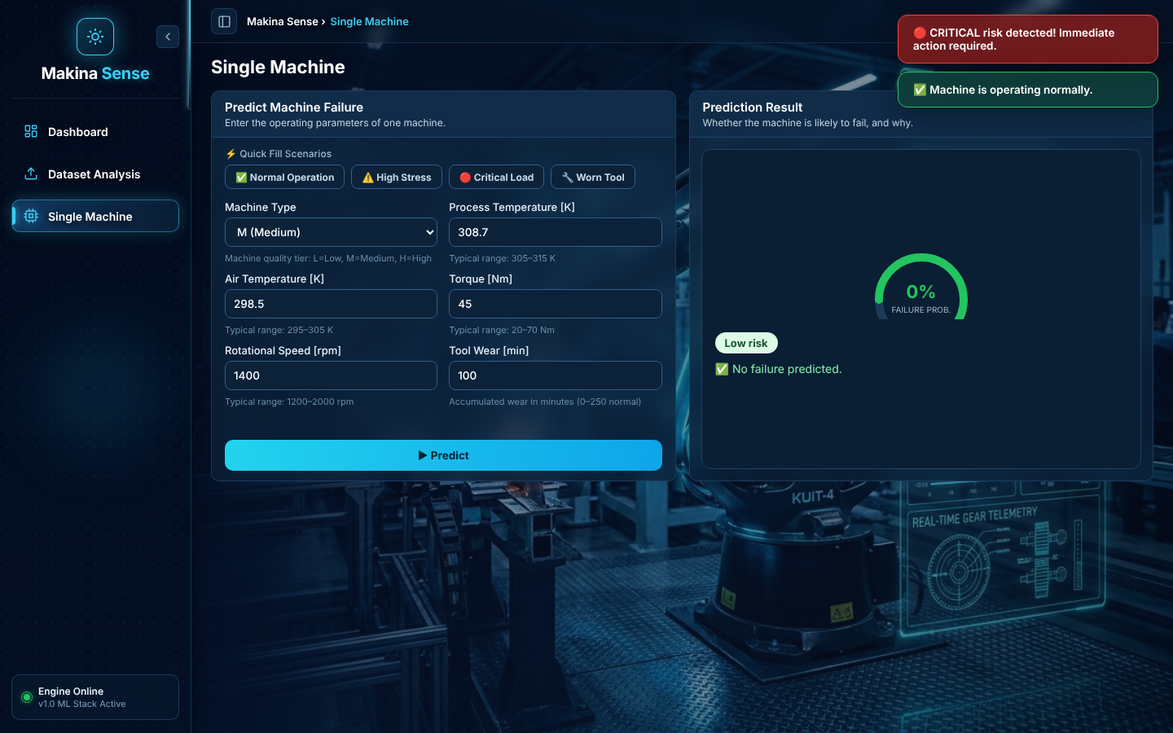
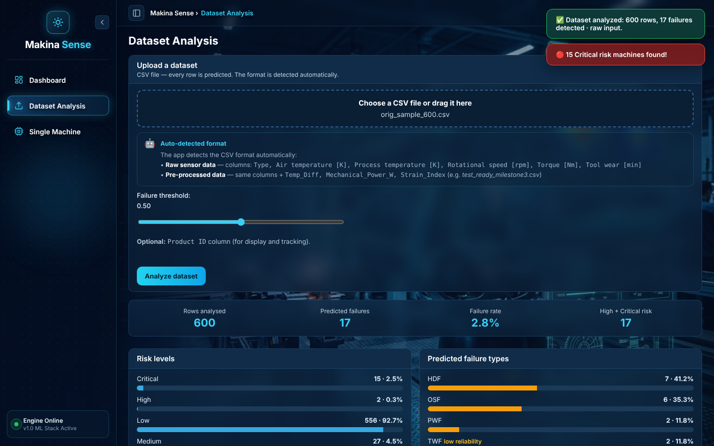
A technician types six numbers and gets advice.
16 · THE PROTOTYPE
Machine at risk
Healthy machine
Upload a CSV
L, 298 K, 308 K, 1300 rpm, 62 Nm, 230 min: 99%, Critical, overstrain
M, 298.5 K, 308.7 K, 1400 rpm, 45 Nm, 100 min: normal operation
600 rows from the original data, labels hidden: 17 flagged, 15 of them critical
Flask serves the page and predict.py does the work. Three views: Dashboard, Dataset Analysis, Single Machine. All screens are from our own app.
Makina Sense
Web prototype
Notes:
Speaker 5 (about 1.5 minutes). If the live demo works, run the first two examples live: the risky machine (L, 298, 308, 1300, 62, 230 gives about 99% and Critical, overstrain) and the normal one (M, 298.5, 308.7, 1400, 45, 100). Keep these screenshots as a backup in case the laptop misbehaves. The third screenshot is an upload of 600 rows taken from the original dataset with the labels removed (the sample contains 18 real failures; the app flagged 17). It demonstrates the feature; do not quote accuracy from it. For raw CSV uploads use files with the six raw columns. The app also shows the type reliability: TWF is tagged low reliability.

Slide 17

What a maintenance manager can take away.
17 · RESULTS AND BUSINESS INSIGHTS
Watch the load, not the label
Two warning signs
Speed, temperature gap, power and torque drive the prediction. Machine quality grade (L, M, H) barely matters.
Failure rates were about 3× higher above 50 Nm torque or above 200 min of tool wear. Use them as investigation signals, not fixed thresholds.
An alarm is trustworthy; silence is not a guarantee
A first action, not just a score
Precision 96% means few wasted visits. Recall 91% means about 1 failure in 10 is still missed.
The app suggests where to look first: cooling, power supply, load, or the tool. The technician stays responsible for the diagnosis.
earlier alerts, a failure-type hint to guide the first inspection, and one interface for single machines or whole files.
Makina Sense
Business insights
Notes:
Speaker 5 (about 1.5 minutes). Plain language, no jargon. Four messages. One: the drivers are load-related, not machine grade (Type has importance 0.006). Two: failures concentrate at high torque (above 50 Nm) and high tool wear (above 200 minutes); in our working set each goes with about three times the failure rate. These are investigation signals, not universal thresholds, and the rates include synthetic failures. Three: precision and recall in plain words; recall 91% means some failures are still missed, so the system supports technicians and does not replace inspection. Four: the output is a first action, not just a number. Close with the business value, then say we want to be straight about how far these numbers can be trusted, which leads into the next slide.

Slide 18

How far should you trust 0.93? With caution.
18 · LIMITATIONS
Synthetic data shapes the score
TWF is not detected
RNF is not modelled
F1 0.00. Only 46 examples, at a random moment in a 200 to 240 min window.
Only 19 cases, random by design.
3.4%
22.7%
failures in the original data
failures in the Model 1 test set
Label inconsistencies
Model 2 CV protocol
27 rows: 9 failures without a type flag, 18 flagged rows that are not failures.
CV runs on the whole original file, not on the training split only.
All 2,500 synthetic rows are failures, and 494 of the 568 test failures (87%) are synthetic. Scores on a real line, where failures are rare, may be lower.
Scaled CSV mode
No field validation
Pre-scaled uploads feed scaled values to the type models, which expect raw ones. Use raw files.
Scores are not calibrated and the 0.5 thresholds are defaults.
Makina Sense
Limitations
Notes:
Speaker 5 (about 2 minutes). This slide earns marks for honesty, so do not rush it and do not apologise. Left: the original data has 3.4% failures (339 of 10,000). Our Model 1 test set has 568 failures out of 2,500 rows, 22.7%, because the working set includes 2,500 synthetic failure rows, all of them failures. 494 of the 568 test failures (87%) are synthetic; we verified this by matching every test row to the synthetic data file (the other 74 are original failures). The notebooks do not print this count. So the headline F1 of 0.93 was measured in an easier setting than a real plant, and an original-only test score is not reported in our notebook; that is the first item of the next steps. Right: TWF is not detected (F1 0.00, only 46 examples, random timing in a 200 to 240 minute wear window); RNF is not modelled (19 cases); 27 label inconsistencies in the original data; the Model 2 cross-validation runs on the whole original file; the app's pre-scaled upload mode passes scaled values to the type models (the code comments say the type predictions are approximate in that mode), so use raw files; scores are not calibrated, thresholds are defaults, and nothing was tested on a real production line.

Slide 19
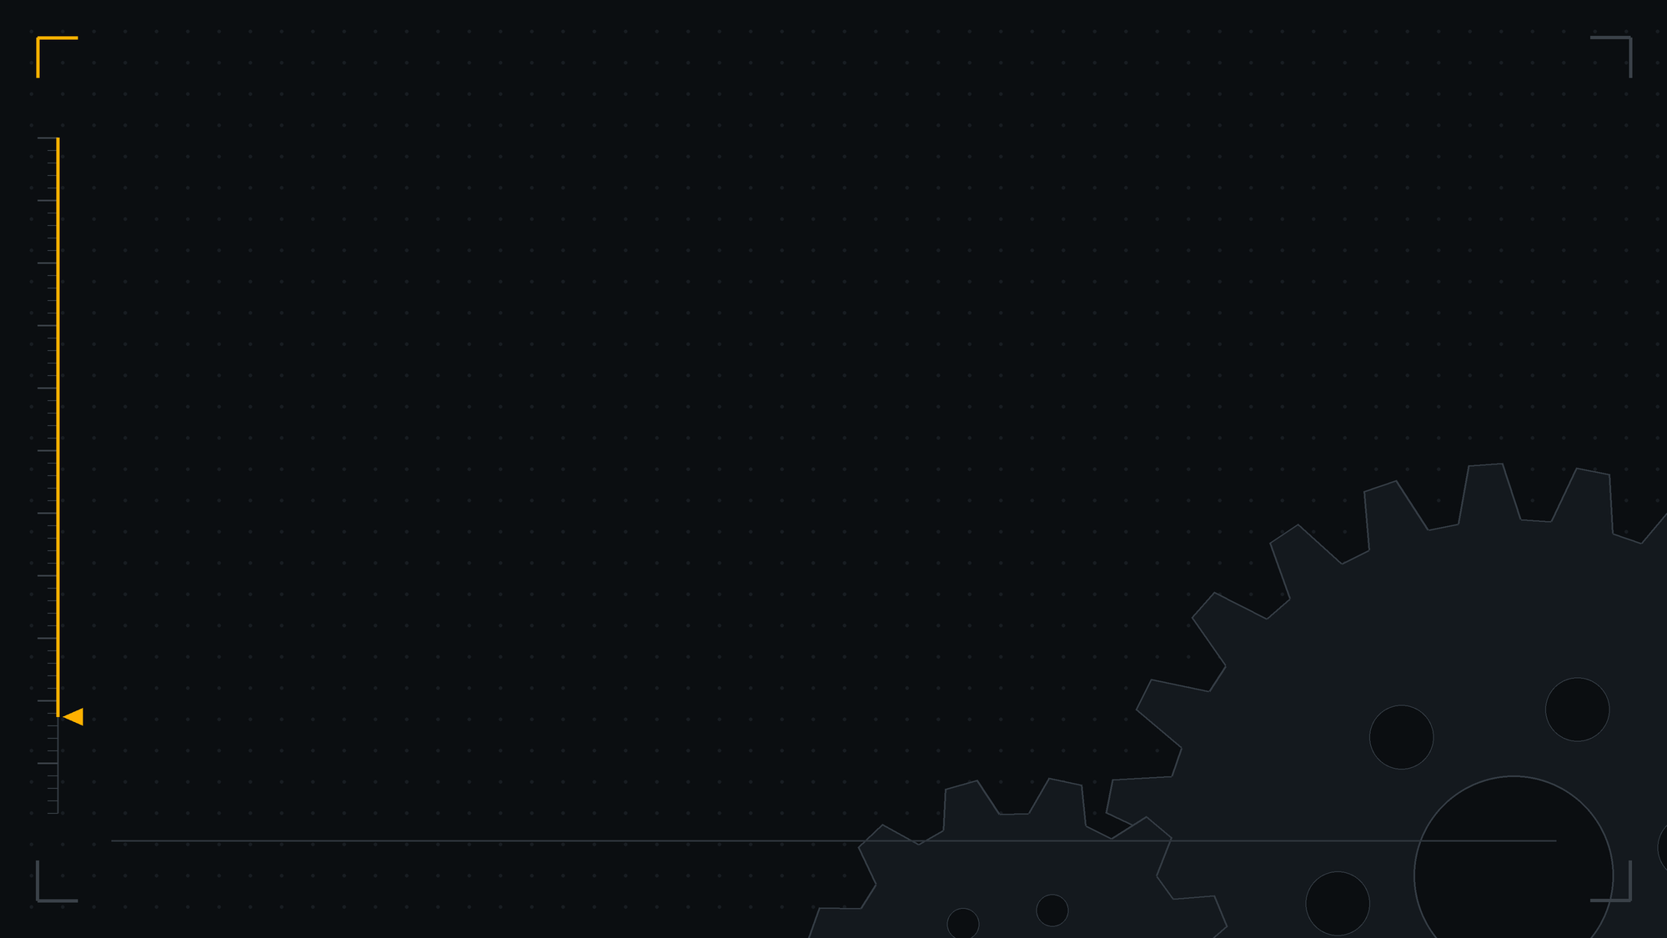
Next steps: evidence first, then the pipeline.
19 · NEXT STEPS
P0 · FIX THE EVIDENCE
P1 · FIX THE PIPELINE
P2 · PREPARE FOR FIELD USE
Report Model 1 on original rows only
Correct pre-scaled CSV handling for the type models
Tune the decision threshold to the cost of a miss
Run Model 2 CV on the training split only
Collect more real failures, especially TWF
Run test_predict.py and test_api.py and commit the output
Calibrate probabilities
Validate on real machine logs, with human review
Tune hyperparameters with Grid Search
Release gate: reproducible execution, an original-only evaluation and verified end-to-end predictions.
Makina Sense
Next steps
Notes:
Speaker 5 (about 1 minute). Connect every item to a limitation. P0, fix the evidence: report Model 1 on original rows only (our Milestone 4 deck already lists it as the planned improvement), rerun Model 2 cross-validation on the training split, and collect more real failures. P1, fix the pipeline: correct the pre-scaled upload mode, run the two test scripts and commit their output, tune hyperparameters with Grid Search. P2, prepare for field use: tune the threshold to the cost of a miss (53 missed failures against 20 false alarms), calibrate the probabilities, validate on real machine logs. These are plans, not results; say so. Keep it short and move to the conclusion.

Slide 20

Two models, one answer a technician can act on.
20 · CONCLUSION
Model 1 · will it fail?
Model 2 · what kind?
One working app
Random Forest. Test F1 0.934, precision 0.963, recall 0.907, on a test set with synthetic failures.
Four Random Forests. HDF, PWF and OSF are strong; TWF is not detected.
Six inputs in; risk level, failure type and maintenance action out.
Detect. Understand. Act earlier.
A prototype today; a validated industrial tool only after stronger real-world evidence.
Makina Sense
Conclusion
Notes:
Speaker 5 (about 0.5 minute). Three sentences, one per card, then the takeaway line, then the honest caveat in the strip. Next comes the repository map, then the Thank you slide, and then Q&A.

Slide 21


Everything is public and organised by milestone.
21 · REPOSITORY MAP
milestone1/ … milestone3/
Open the project on GitHub
data, notebooks, presentations
aljabali89m/ai4i-predictive-maintenance
milestone4/ms4_notebooks/
failure_detection.ipynb
Open the code
failure_type.ipynb
milestone4/ms4_models/
Cleaning notebook ↗
6 .joblib files, type_model_features.json
Prediction pipeline (predict.py) ↗
milestone4/ms4_scripts/
Model 1 notebook ↗
predict.py, app.py, tests, templates/, static/
Model 2 notebook ↗
To run the app
Install the requirements, then run app.py in ms4_scripts and open the local address.
Makina Sense
Repository
Notes:
Speaker 5 (about 0.5 minute, optional). Use when the instructor asks where the code or the models are. The numbers in this deck come from the notebooks in milestone4/ms4_notebooks, the Milestone 4 deck and the earlier milestone notebooks. The four links open the exact files on GitHub. Then go to the last slide (Thank you) and open Q&A.

Slide 22
Thank you
MAKINA SENSE · DEMO DAY
Questions?
Notes:
Last slide. Stay here during Q&A. Let any team member answer a question about their own part. If asked where the code is, go back one slide to the repository map, then return here.

