Slide 1
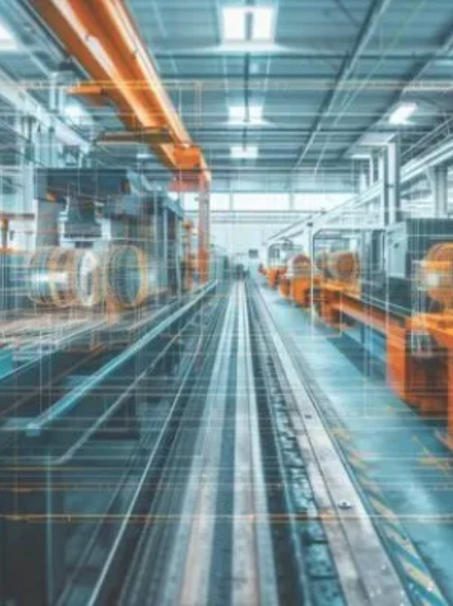
AI4I Predictive
Maintenance ML Project
UNIVERSITY ML PROJECT • MILESTONE 3
Exploratory Data Analysis & Advanced Data Preprocessing Pipeline
PROJECT TEAM MEMBERS
Aiham Bawaneh
Mohammad Aljabali
Mahmoud Bani-Hani
Reem Aldelki
Shahd Alkwaga
Notes:
Welcome. Part 1 is the exploratory analysis, Part 2 the preprocessing pipeline, Part 3 the final verified datasets. Every step is shown with what we did and why.

Slide 2
One File, 12,500 Rows, Verified Before Any Analysis
DATA ASSET & INTEGRITY AUDIT · STEP 0
12,500
14
0
0
ANALYZED RECORDS
ORIGINAL COLUMNS
MISSING VALUES
DUPLICATE ROWS
WHAT WE DID
WHY
We use only the Milestone 2 output, AI4I_with_synthetic_data_cleaned_data.csv. We do not use the 15,000-row file and we do not merge the two files.
The first 10,000 rows are shared by both files. Merging repeats them, so one copy of a row can land in training and another in testing: data leakage.
Sanity check: shape (12,500 × 14), 12 numeric and 2 text columns (Product ID, Type) to encode or drop.
We verify the right file with no nulls and no duplicates before analyzing anything.
AI4I Predictive Maintenance · Milestone 3
02
Notes:
Key defense point: one file only, to avoid duplicated rows leaking across the train/test split. Shape (12500, 14), 0 nulls, 0 duplicates.

Slide 3
What the Numbers Say About Each Sensor
STEP 1 · DESCRIPTIVE STATISTICS
Feature | Mean | Median | Mode | Variance | Std | Q1 | Q3 | P90 | Skew
Air temp [K] | 300.18 | 300.20 | 300.70 | 4.40 | 2.10 | 298.4 | 301.9 | 303.0 | 0.03
Process temp [K] | 310.10 | 310.20 | 310.60 | 2.56 | 1.60 | 308.8 | 311.3 | 312.2 | -0.08
Speed [rpm] | 1520.99 | 1496.0 | 1953.00 | 30918.35 | 175.84 | 1398 | 1620 | 1761 | 0.63
Torque [Nm] | 41.44 | 40.9 | 72.55 | 158.83 | 12.60 | 32.8 | 48.7 | 57.8 | 0.35
Tool wear [min] | 115.14 | 116.0 | 2.00 | 4547.27 | 67.43 | 57 | 176 | 203 | -0.06
Distribution shape
Why standardize
Risk thresholds
Temperatures are symmetric (skew ≈ 0). Torque is near normal. Speed is right-skewed (0.63); its mode 1953 is the IQR cap (536 rows). Tool wear is close to uniform.
Variance is 30,918 for speed and 4,547 for wear against 2.56 for process temperature. Without scaling, large-scale columns dominate distance- and weight-based models.
Half of all runs have torque between 32.8 and 48.7 Nm. P90 is 57.8 Nm for torque and 203 min for tool wear.
AI4I Predictive Maintenance · Milestone 3
03
Notes:
Why: the mean alone can mislead. Comparing mean, median and skew shows symmetric vs skewed distributions, and the variance gap justifies standardization.

Slide 4
Where 22.71% Comes From and What Raises the Risk
STEP 2 · TARGET ANALYSIS & PROBABILITY
CLASS IMBALANCE
CONDITIONAL PROBABILITY
Subset | Rows | Failures | Rate
Original (UDI ≤ 10k) | 10,000 | 339 | 3.39%
Synthetic (UDI > 10k) | 2,500 | 2,500 | 100%
Whole file | 12,500 | 2,839 | 22.71%
Condition | P(F | yes) | P(F | no) | Risk
Torque > 50 Nm | 51.16% | 14.79% | × 3.46
Wear > 200 min | 56.55% | 18.16% | × 3.11
Speed < Q1 | 49.53% | 13.84% | × 3.58
Reading the imbalance
Actionable thresholds
The original data has only 3.39% failures. Over-sampling added 2,500 all-failure rows, so 22.71% is an artificial rate. Quote the relative risk, not the absolute probability.
Above 50 Nm of torque, failure is 3.46 times more likely: set an early warning. After 200 minutes of tool wear it is 3.11 times more likely: replace the tool before minute 200.
AI4I Predictive Maintenance · Milestone 3
04
Notes:
Why: we must know where 22.71% comes from so we do not misinterpret it. Conditional probabilities turn chart patterns into thresholds the plant can act on. They are computed on the adjusted file.

Slide 5
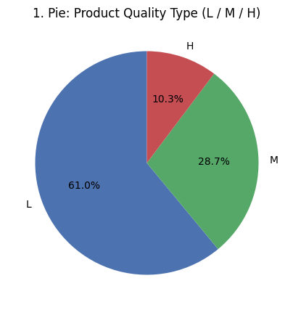
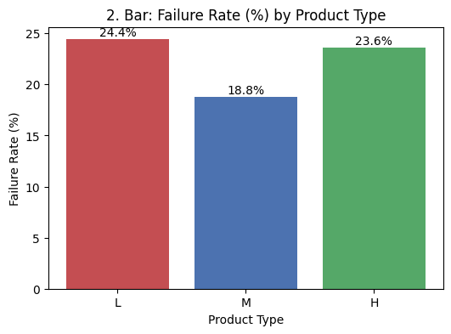
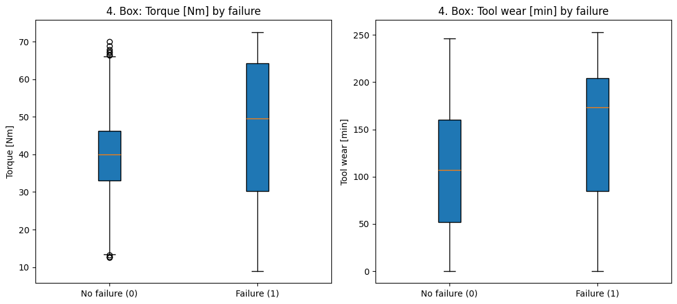
Product Type Mix and Sensor Values by Outcome
STEP 3 · VISUAL EXPLORATION (1 OF 2)
1 · Pie: product type
2 · Bar: failure rate by type
4 · Box: torque and tool wear by failure
61% of machines are Low quality (L).
Rates are close across L, M and H: type alone is a weak predictor.
Failed machines run at higher torque and wear. No dots beyond the whiskers: the IQR capping worked.
WHY THESE CHARTS
The pie shows the category mix, the bar tests whether it explains failures, and the box plots compare each sensor across outcomes and confirm outliers were handled.
AI4I Predictive Maintenance · Milestone 3
05
Notes:
A chart without a takeaway is not an insight, so each chart carries its conclusion.

Slide 6
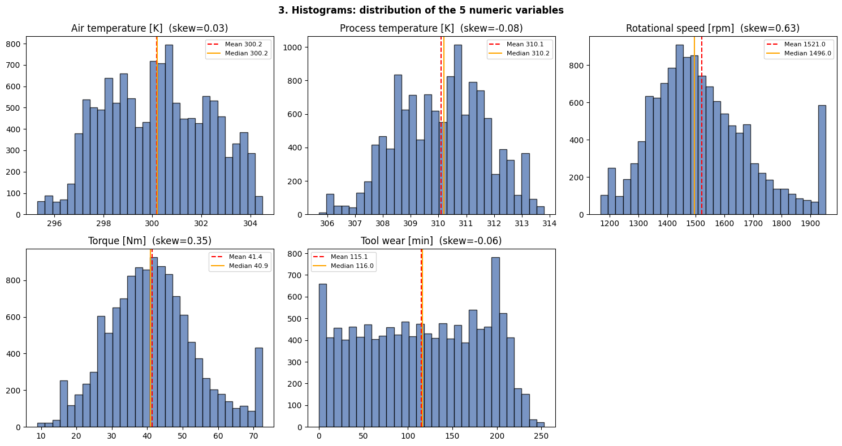
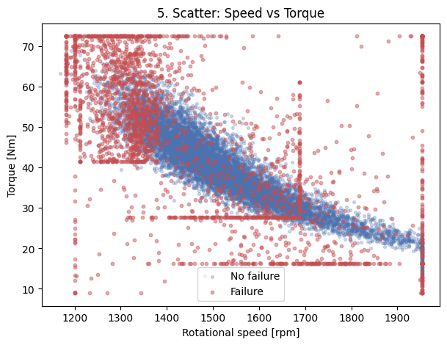
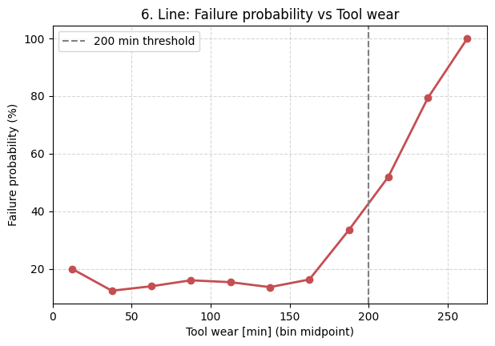
Distributions, Speed vs Torque and Wear Trend
STEP 3 · VISUAL EXPLORATION (2 OF 2)
3 · Histograms: five variables
5 · Scatter: speed vs torque
6 · Line: failure vs tool wear
Temperatures are bell-shaped, speed is right-skewed with a spike at 1953 (the IQR cap), tool wear is near uniform.
Inverse relation (r = −0.72). Failures cluster at low speed and high torque.
About 12–20% up to 175 min, then 33%, 52%, 79%. The last bin has few rows, so its 100% is not quoted.
WHY THESE CHARTS
Histograms check normality before scaling, the scatter shows how two sensors move together, and the trend line shows where risk starts to climb: before about 200 minutes.
AI4I Predictive Maintenance · Milestone 3
06
Notes:
Bins use include_lowest=True and edges up to 275 so wear 0 and 251-253 are kept.

Slide 7
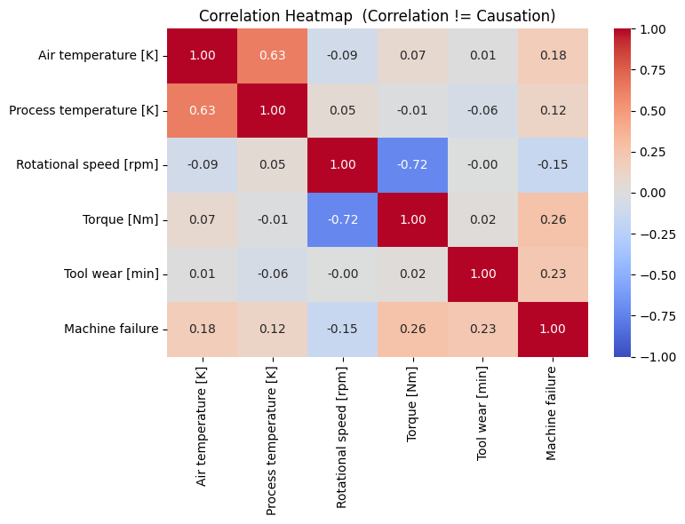
Correlation Is Not Causation
STEP 4 · STATISTICAL ASSOCIATIONS
Torque vs Failure
+0.26
Strongest link with the target, but only weak to moderate. Torque alone does not explain failures.
Speed vs Torque
−0.72
Strong inverse link. It is physics (power = torque × angular speed), not coincidence.
Air vs Process Temp
+0.63
Both follow the plant environment, not one causing the other. 0.63 is the value on our heatmap.
What correlation does not prove
A heatmap summarizes every linear relationship at once and reveals repeated information (multicollinearity).
It gives no direction and rules out no third factor: low speed raises torque and adds stress at once. Causation comes from physical laws or controlled experiments.
AI4I Predictive Maintenance · Milestone 3
07
Notes:
The plan document states r = 0.88 for air vs process temperature but on our file it is about 0.63. Never say torque causes failure: say high torque is associated with higher failure risk.

Slide 8
Six Insights From the Exploration
ANALYTICAL SYNTHESIS
1. Torque early warning
2. Preventive replacement
3. Speed–torque tradeoff
Torque above 50 Nm raises failure risk 3.46 times (51.16% vs 14.79%). Set an alert at 50 Nm.
Tool wear above 200 min raises risk 3.11 times (56.55% vs 18.16%). Replace the tool before minute 200.
Inverse link (r ≈ −0.72). Failures sit at low speed and high torque.
Scatter + heatmap
Step 2 + box plot
Step 2 + line chart
4. Weak category signal
5. Scaling is required
6. Read rates with care
Product type (L/M/H) is a weak failure indicator on its own.
Variance ranges from 2.56 to 30,918, so Standardization is mandatory.
22.71% comes from over-sampling (original 3.39%): rely on relative risk.
Bar chart
Descriptive statistics
Class imbalance table
AI4I Predictive Maintenance · Milestone 3
08
Notes:
Each insight is specific, quantified and actionable, not just a chart without a conclusion.

Slide 9
The Preprocessing Order Is Fixed
PART 2 · PIPELINE ARCHITECTURE
STEP 01
STEP 02
STEP 03
STEP 04
STEP 05
STEP 06
Feature Engineering
Feature Selection
Encoding
Stratified Split
Scaling
Final Check
Type to 0 / 1 / 2.
80 / 20, same failure rate.
Fit on train only.
8 assertions.
Temp_Diff, Power, Strain_Index.
Drop IDs and leakage flags.
Steps 1–3: safe before the split
Step 5: only after the split
They calculate row by row (subtract, multiply, map), so nothing is learned from other rows and nothing leaks.
The scaler learns mean and std from data. Learning them before the split would let the test set leak into training.
WHY PIPELINE ORDER MATTERS
Splitting before scaling keeps test-set statistics hidden during standardization. Scaling first is the most common leakage mistake.
AI4I Predictive Maintenance · Milestone 3
09
Notes:
Order: Feature Engineering, Feature Selection, Encoding, Train/Test Split, Scaling (fit on train only), Final Check.

Slide 10
Feature Engineering: Every Feature Has a Reason
PIPELINE STEP 1 · DOMAIN KNOWLEDGE
1. Temp_Diff
Process temp − Air temp
Measures cooling efficiency. A small gap means weak cooling (linked to HDF failures).
r with target: −0.12
2. Mechanical_Power_W
Torque × rpm × 2π / 60
Mechanical power in watts. Very low or very high power means a power failure (PWF).
r with target: 0.22
3. Strain_Index
Torque × Tool wear
Cumulative stress: high torque on a worn tool (linked to OSF).
r with target: 0.31
Why before the split
Watch out
Each feature uses only its own row, so no information comes from other rows.
Corr(Power, Torque) = 0.93: partly redundant. Fine for trees; note it for linear models.
AI4I Predictive Maintenance · Milestone 3
10
Notes:
Features added without an explanation are a risky decision. Each of these three has a stated physical reason.

Slide 11
Feature Selection: Prove Every Drop With Evidence
PIPELINE STEP 2 · LEAKAGE CONTROL
Excluded columns (leakage / non-predictive)
Retained predictors
UDI
Air & Process temp
Sensors
All 2,500 rows above 10,000 are synthetic failures (0 normal), so the model could read the row number.
Speed & Torque
Sensors
Product ID
Tool wear
Usage counter
Only 10,000 unique IDs in 12,500 rows; H35323 appears 115 times. One ID in both train and test is leakage, and its L/M/H letter already lives in Type.
3 engineered
Derived physics
Type (L, M, H)
Ordinal 0/1/2
TWF, HDF, PWF, OSF, RNF
Machine failure equals any of them in 99.78% of rows. They are the answer itself: target leakage, about 100% without learning.
Result: 12,500 × 10 (9 features + target).
WHY EVIDENCE
“We were told to drop them” is not enough: each decision is proven by a check in the notebook.
AI4I Predictive Maintenance · Milestone 3
11
Notes:
Crosstab: UDI at most 10,000 gives 9,661 normal and 339 failures; UDI above 10,000 gives 0 normal and 2,500 failures. Product ID counts: H35323 115, L50791 94, M17925 40.

Slide 12
Encoding, Stratified Splitting & Standardization
PIPELINE STEPS 3–5 · TRANSFORMATION RIGOR
03 · ENCODING
04 · SPLITTING
05 · SCALING
Ordinal map L=0, M=1, H=2
80 / 20 stratified split
StandardScaler, fit on train only
Quality is ordered (L < M < H), so one 0/1/2 column keeps the order. LabelEncoder would give H=0, L=1, M=2, so we map explicitly.
stratify=y keeps the same failure rate in both sets; random_state=42 gives every member the same split.
Variance gap (30,918 vs 2.56) becomes mean 0 and std 1 on 8 continuous columns. Type stays as is.
Train: 10,000 rows
22.71%
1. scaler.fit_transform(X_train)
2. scaler.transform(X_test)
{'L': 0, 'M': 1, 'H': 2}
Test: 2,500 rows
22.72%
Rows: L 7,626 · M 3,589 · H 1,285
Fitting on all data would put the test mean into the scale: leakage.
Leak checks: index overlap 0, identical rows 0.
AI4I Predictive Maintenance · Milestone 3
12
Notes:
Scaled columns: air temp, process temp, speed, torque, tool wear, Temp_Diff, Mechanical_Power_W, Strain_Index. The scaler is saved as scaler_milestone3.joblib.

Slide 13
Final Readiness Check: 8 of 8 Pass
PIPELINE STEP 6 · VERIFICATION
PIPELINE VERIFICATION CHECKLIST
TEST-SET MEAN AND STD AFTER SCALING
PASS All columns numeric
Feature | Mean | Std
Air temp | −0.006 | 1.002
Process temp | 0.011 | 1.010
Speed | −0.004 | 0.982
Torque | −0.007 | 1.014
Tool wear | 0.001 | 1.004
Temp_Diff | 0.018 | 0.979
Mechanical_Power_W | −0.014 | 0.993
Strain_Index | −0.010 | 0.995
PASS No nulls in train or test
PASS Zero index overlap
PASS No leakage or ID columns left
PASS Train mean ≈ 0 (scaled columns)
PASS Train std ≈ 1 (scaled columns)
PASS Split stratified (difference under 0.2%)
PASS Train + Test = full data
Why assert: if a check fails the notebook stops, so we catch the problem here, not in Module 4.
Close to 0 and 1 but not exact: proof the scaler learned from training data only.
AI4I Predictive Maintenance · Milestone 3
13
Notes:
Skipping a final readiness check is a common mistake. Issues caught here are far cheaper than issues caught in Module 4.

Slide 14
Before and After: Datasets Ready for Modeling
PART 3 · MILESTONE DELIVERABLE
Metric | Before | After
Columns | 14 | 10 (IDs and leakage dropped, 3 features added)
Category columns | 2 text columns (Product ID, Type) | Type → 0/1/2; Product ID dropped
Feature scale | Raw units (variance 30,918 vs 2.56) | Standardized (mean 0, std 1 on train)
Rows train / test | 0 / 0 | 10,000 / 2,500 (no overlap)
train_ready_milestone3.csv
10,000 × 10
test_ready_milestone3.csv
2,500 × 10
scaler_milestone3.joblib
Scales any new data the same way in Module 4.
READY FOR MODELING
Fully numeric, scaled on train only, zero overlap, no ID or leakage columns.
AI4I Predictive Maintenance · Milestone 3
14
Notes:
Columns: 14 before, 10 after (9 features plus target). Train and test files include the target column.

Slide 15
Defending the Pipeline: Limitation and Rubric Evidence
PROJECT CONSIDERATIONS
EXPECTED QUESTION
HOW WE MEET THE RUBRIC
“The synthetic rows were generated before the split. Isn’t that leakage?”
Insight quality
Six quantified insights, such as 3.46 times risk above 50 Nm.
What we checked: no literally identical rows exist between train and test, and synthetic rows are not exact copies.
Correlation analysis
The limitation: over-sampling ran on the full data in Milestone 2, so synthetic rows built from original rows may land in both sets.
Heatmap plus what correlation does not prove.
Feature engineering
Next time: split first, then over-sample the training set only. Until then, Module 4 test scores may be slightly higher than reality.
Three features, each with a physical reason.
Preprocessing pipeline
Fixed order, scaler fit on train only, documented.
Final dataset readiness
Numeric, scaled, zero overlap, 8 of 8 checks pass.
AI4I Predictive Maintenance · Milestone 3
15
Notes:
Be honest: this is a documented limitation, not a hidden flaw. A team that can defend every decision under questions.

Slide 16
From Raw Sensor Data to Model-Ready Features
MILESTONE 3 WRAP-UP
EDA completed, quality verified, leakage contained, and datasets prepared for ML classifier training.
Thank You! Questions & Discussion
PROJECT TEAM MEMBERS
Aiham Bawaneh
Mohammad Aljabali
Mahmoud Bani-Hani
Reem Aldelki
Shahd Alkwaga
Notes:
Thank the audience and invite questions on feature engineering and the leak-free checks.

