Slide 1



Soup Group
Charlie, James , Pio, Soud, Zhakhangir

Slide 2


Agenda
Purpose
Prevalence
Challenge
Solution

Slide 3
1
Purpose

Slide 4

Purpose
Connecting the needy with warm meals.
Addressing widespread hunger.
Bridging the gap for food access and community belonging.
Central to all our efforts.

Slide 5
2
Nationwide Presence: Soup kitchens are vital lifelines in cities and towns alike.
Quiet Dedication: Soup kitchens consistently serve those with food insecurity, often unnoticed.
​
Prevalence & Effort: Soup kitchens highlight both the scale of hunger and the community's response to it.
Prevalance

Slide 6
3
01
The locations of soup kitchens
02
The diverse food options they offer
03
The specific times soup kitchens are open
Challenge

Slide 7
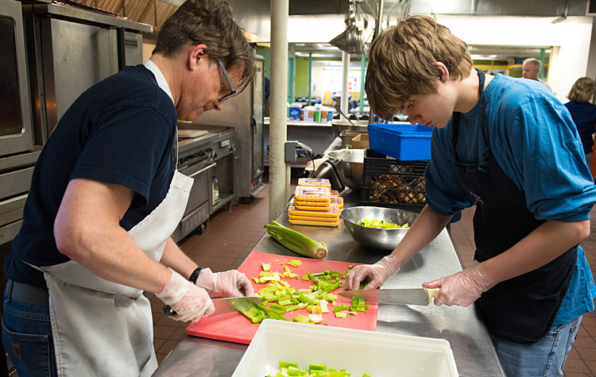
Solution
Centralized Hub
Up-to-Date Details
Easy Navigation
Empowerment

Slide 8

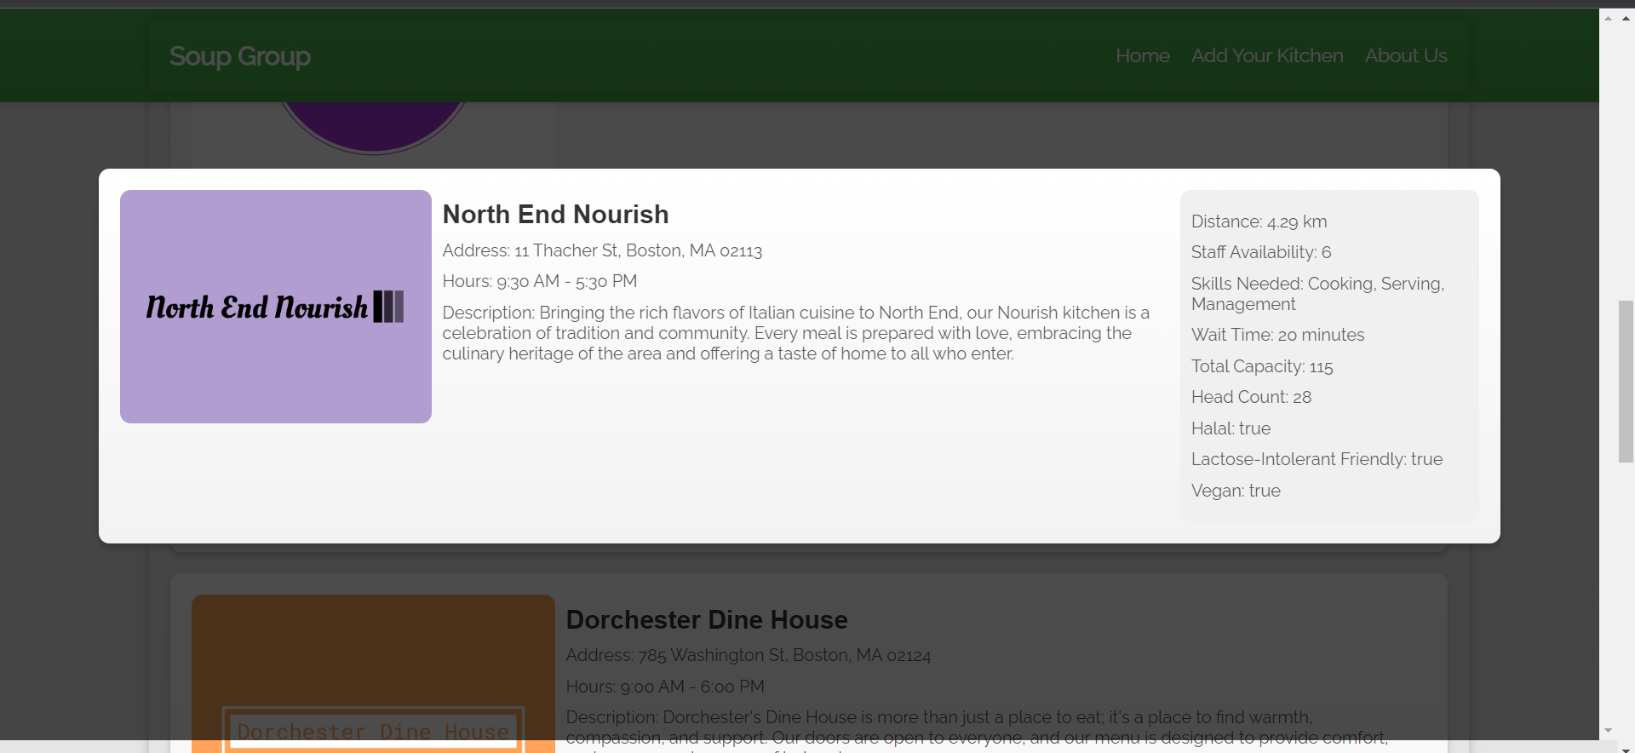
How we do it

Slide 9
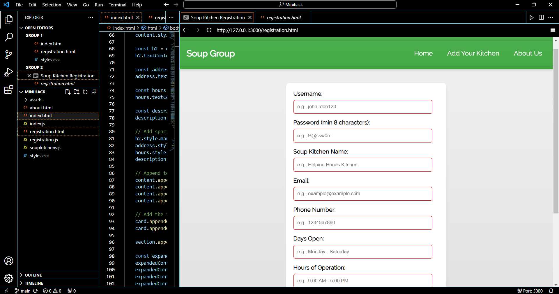

Slide 11
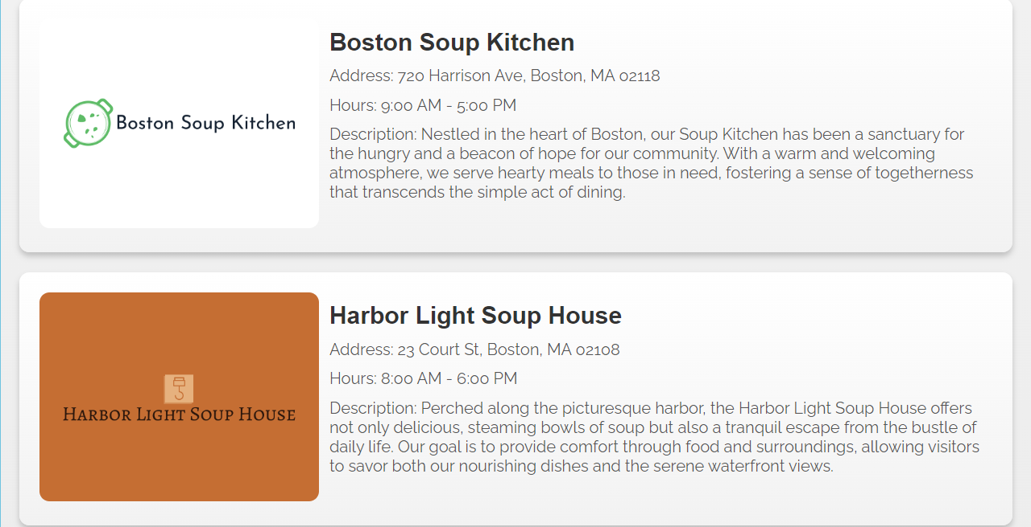
Current Progress
Allows users to accesses closest soup kitchens
Enables soup kitchens to extend their support to those who need it the most
Allows volunteers to see which soup kitchens require the most help
Provides users with a seamless and user-friendly platform

Slide 12

What if?
create a database to add soup kitchens
Validation of credentials
Sanitization of data
Implement graphics, filters and better UI/UX

Slide 13
End Goals
Partnership with Food Suppliers
Analytics and Insight
Nation Wide

Slide 14
Thank You!

