Slide 1
Section 1
(thread review , practice)

Slide 2
20 grades
Will be divided into small project
Will be viewed every week
Students will be chosen randomly
Grades will be given

Slide 3
What is a process ?
A process is a program that i running on your computer
This can be a background task or an entire application
Process is the execution of program instructions
Executing program = process
Any program consisted of one or more process
Any process consisted of at least one thread

Slide 4
How to start a process from C# ?
Use System.Diagnostics namespace
Using class process
Using process we can start any program from a c# program

Slide 5
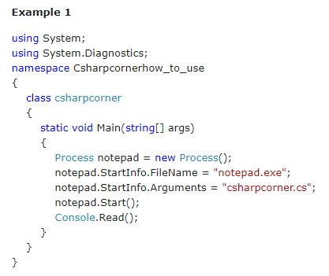
Program 1

Slide 6
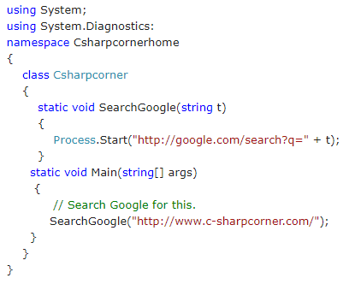
Program 2

Slide 7
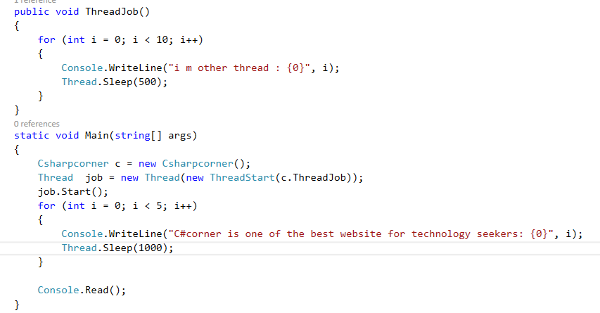
Program 3

Slide 8
Notes on threads
Function that is thread must be void and has not any parameters

Slide 9
What is a thread ?
The smallest part of the program that can be executing and managed by the scheduler
A C# client program (windows , wpf or console ) is created with single thread by the clr and the operation system (main thread)
Is made into multi thread by creating addition thread
Multi threading enable multiple concurrent threads to be executing at the same time which improve the performance

Slide 10
Using threads in c#
Using System.threading
Creating threads
Synchronizing threads
Suspending threads
Aborting threads

Slide 11
Multi tasking
Process based and thread base
Process deals with running multiple programming at the same time
Thread deals with running multiple threads of the same programs
Process based example :- listening to music while search the internet
Thread based :- word can printing and formatting at the same time

Slide 12
State of a thread in general
Running
Ready to run as soon as getting cpu time
It can be suspend and then resume again
It can be blocked waiting for resource
It can be terminated can not resumed

Slide 13
Types of threads in C#
Foreground and background
Background thread will terminated when all foreground threads terminated in the process
Foreground thread can prevent the application from terminating as the clr won't stop the application until the foreground thread is terminated

Slide 14
Methods
Suspend() :- suspends the thread until Resume called
Resume() :- resume suspended thread
Sleep() :- suspend the thread for a specific time in milliseconds if the time is 0 this frees the CPU to be used by other threads
Join() :- make other thread wait for the thread to finished it is task

Slide 15
Checking the states using ThreadState
Aborted -> Aborted already.
AbortRequested -> Responding to an Abort() request.
Background -> Running in background. Same as IsBackground property.
Running -> Running after another thread has called the start()
Stopped -> After finishing run() or Abort() stopped it.

Slide 16
Suspended -> Suspended after Suspend() is called.
Unstarted -> Created but start() has not been called.

Slide 17
Thread properties
Thread.CurrentThread : Static method gives the reference of the thread object which is executing the current code.
Name : Read/Write Property used to get and set the name of a thread
ThreadState : Property used to check the state of a thread.
Priority : Property used to check for the priority level of a thread.

Slide 18
Tread properties continue
IsAlive :
Returns a Boolean value stating whether the thread is alive or not.
IsBackground : Returns a Boolean value stating the running in background or foreground.

Slide 19
Priority levels
Highest
AboveNormal
Normal
BelowNormal
Lowest

Slide 20
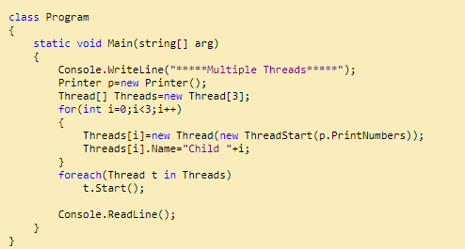
Program 3

Slide 21
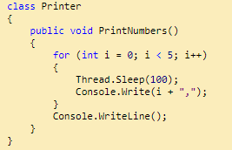
Program 3 continue

Slide 22
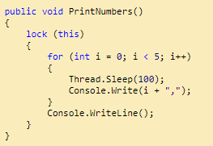
Program 3 update 1

Slide 23
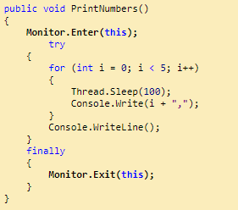
Program 1 update 2

Slide 24
Open file dialog
This is used to open file dialog to change any file you want to open in your application
This can be a text file , image , music or anything at all

Slide 25
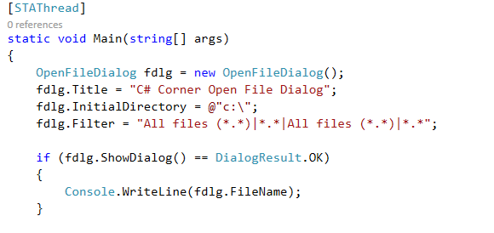
Program 4

Slide 26
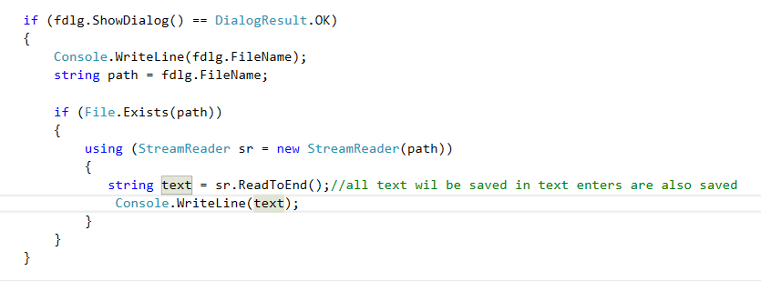

Slide 27
First Task
Create Console Application to search multiple search engines
Create Console application to write to simple text file using streamWrite

Slide 28
References
http://www.c-sharpcorner.com/UploadFile/1d42da/process-and-thread-basics/
https://www.codeproject.com/Articles/26130/Threads-and-Thread-Synchronization-in-C
http://www.c-sharpcorner.com/article/browse-or-open-a-file/
https://docs.microsoft.com/en-us/dotnet/csharp/programming-guide/concepts/threading/walkthrough-multithreading-with-the-backgroundworker-component

Slide 29
References
https://stackoverflow.com/questions/16136383/reading-a-text-file-using-openfiledialog-in-windows-forms

Slide 30
Thank you

