Slide 1
Fitness Buddy
CAPSTONE PROJECT
Presented By:
Al Jaseera Banu .H
Panimalar Engineering College
Electrical and Electronics Engineering

Slide 2
OUTLINE
Problem Statement
Proposed System/Solution
System Development Approach
Algorithm & Deployment
Result (Output Image)
Conclusion
Future Scope
References

Slide 3
Problem Statement
In today’s busy world, many individuals struggle to stay fit due to lack of time, motivation, and personalized guidance. Traditional fitness methods are often costly and rigid. There is a need for an accessible, intelligent assistant that offers personalized workouts, motivation, and healthy tips on demand. The crucial part is delivering consistent, tailored support to help users build lasting fitness habits.

Slide 4
Proposed Solution
The proposed solution aims to help users maintain consistent fitness habits through an intelligent and interactive chatbot system. The chatbot, developed using IBM watsonx, leverages advanced NLP models and external tools to provide personalized workout plans, nutritional tips, real-time information, and motivational support. The system is designed for scalability, accuracy, and user engagement. The following are the core components of the solution:
User Input & Preferences:
Collect user data such as age, gender, fitness goals, dietary preferences, location.
Track real-time parameters like daily mood, availability, and motivation levels to offer adaptive responses.
External Tool Integration:
Wikipedia Search AND Google Search : Fetch detailed explanations for user queries related to health, nutrition, and fitness.
Weather Report: Suggest weather-specific workouts and hydration tips for the user's location.
AI/ML Model Usage:
Use the LLaMA language model for advanced natural language understanding and contextual conversation.
Implement LangGraph for structured flow management, enabling seamless conversation paths (e.g., fitness → food → motivation).
Provide accurate, context-aware replies and suggest realistic goals based on user profile.
Deployment:
Deploy the chatbot using IBM watsonx.AI Studio on a secure, scalable platform.
Ensure 24/7 availability via web and mobile interfaces.
Evaluation:
Analyze chatbot performance using user feedback, engagement level, and token analytics.
Continuously improve response quality through model retraining and data updates.
Result:The chatbot successfully engaged users with personalized and context-aware responses.

Slide 5
System Approach
This section outlines the strategy used to develop and implement the AI-powered fitness chatbot using IBM watsonx.
🔹 System Requirements:
OS: Windows 10 / Ubuntu 20.04+
RAM: 8 GB (16 GB recommended)
Platform: IBM watsonx Studio
Internet: Required for API integration
🔹 Libraries & Tools Used:
LLaMA Model – For generating responses
LangGraph – For workflow and tool routing
LangChain – To use Wikipedia, Google Search, and weather tools
APIs – OpenWeatherMap for weather updates

Slide 6
Algorithm & Deployment
This section outlines the AI model used to build the chatbot and the deployment strategy:
Algorithm Selection:
The LLaMA model was selected for its efficiency in handling large language understanding tasks, enabling intelligent chatbot responses through context-aware processing and compatibility with LangGraph routing.
Data Input:
The chatbot uses user queries as inputs and enhances them with real-time external sources like Wikipedia search, Google search, and weather reports to improve answer relevance and accuracy.
Training Process:
The model was fine-tuned with prompt-response data using LangGraph architecture and token variations (50, 100, 1000) were tested to evaluate performance, optimize cost, and ensure contextual accuracy.
Prediction Process:
Upon receiving user queries, the deployed model dynamically selects tools and routes interactions through LangGraph to generate contextually accurate responses using IBM watsonx.ai infrastructure.

Slide 7
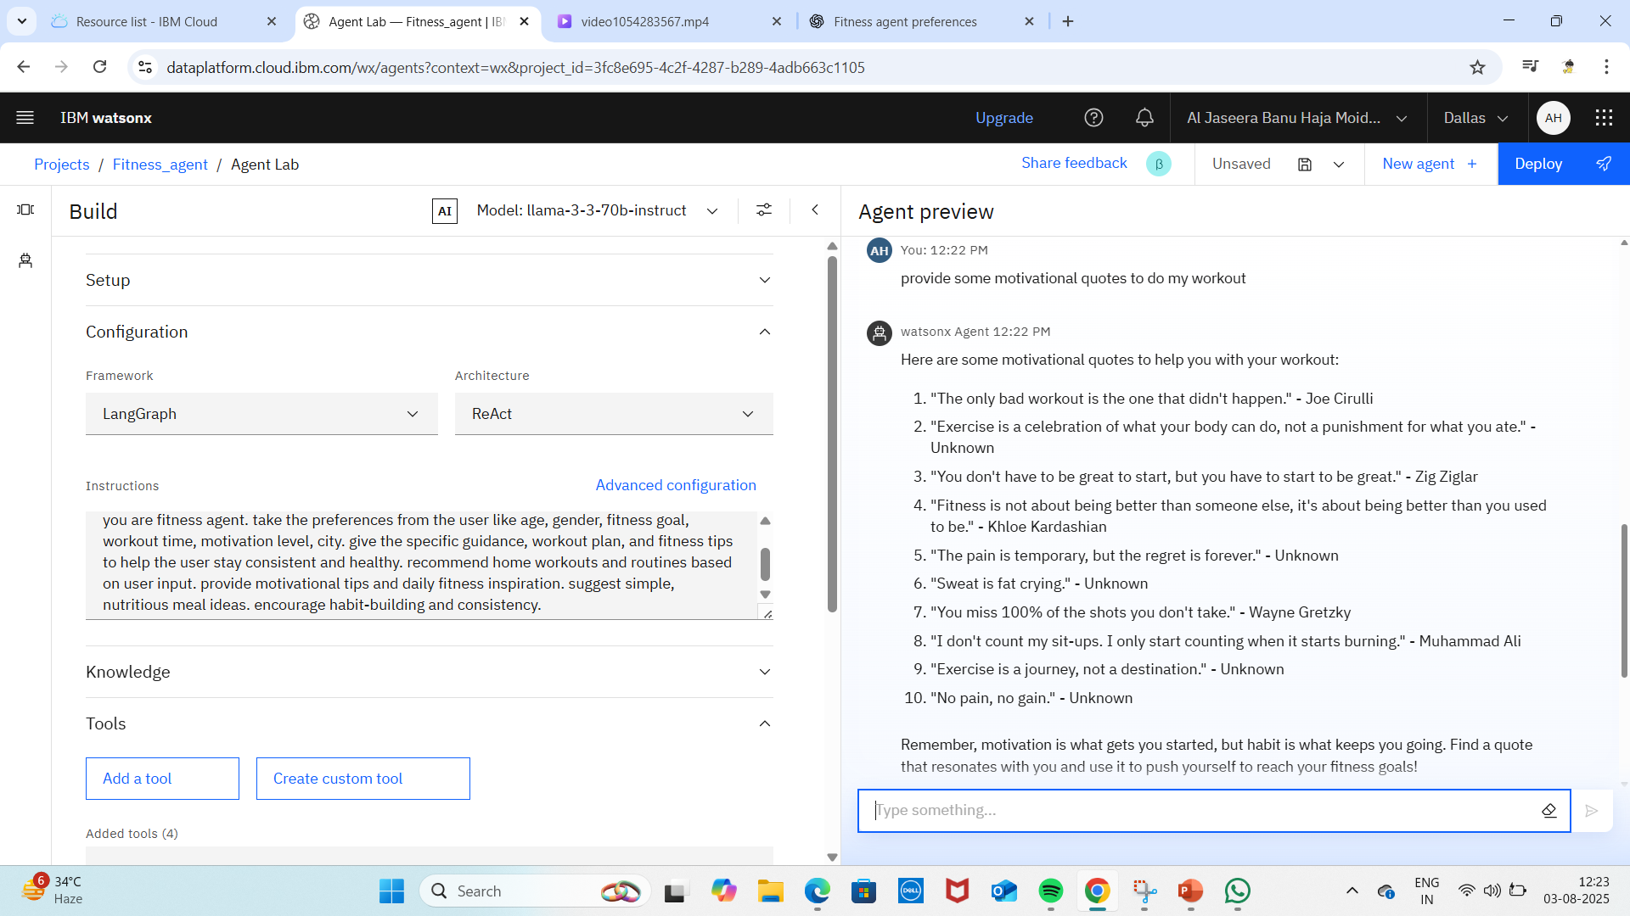
Result
Here I have instructed my agent and used 2000 tokens. And asked “to provide some motivational quotes to do my workout “. So, my output is within 2000 words

Slide 8
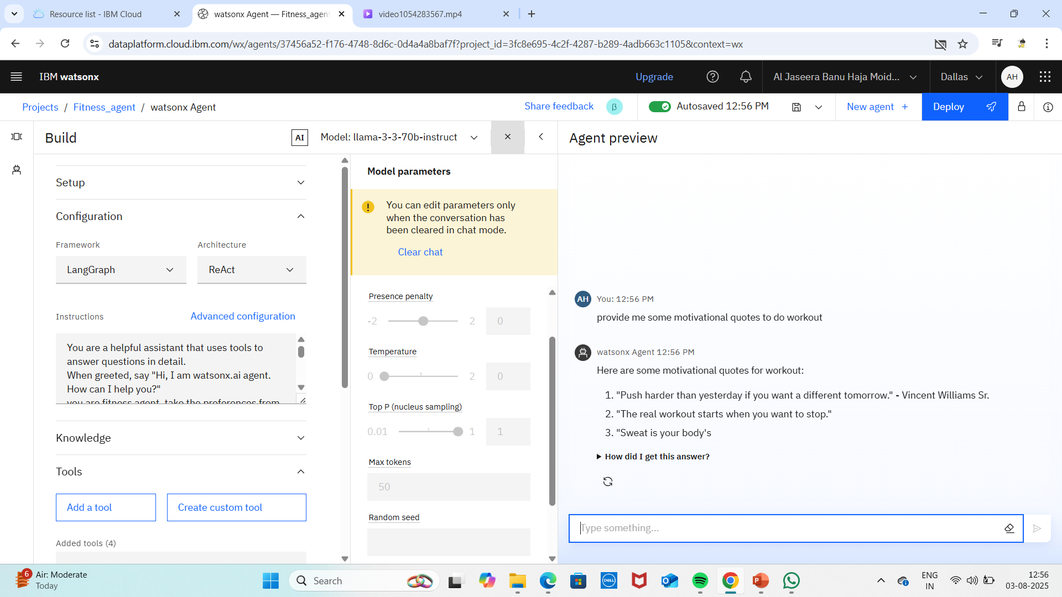
Result
Here I have instructed my agent and used 50 tokens. And asked “to provide some motivational quotes to do my workout “ .So, my output is within 50 words

Slide 9
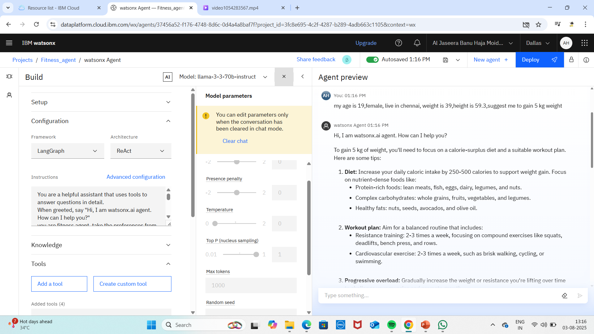
Result
Here I have instructed my agent and used 1000 tokens. And asked “my age is 19, ,female, live in chennai, weight is 39, height is 59.3, Suggest me to gain 5kg weight”. So, my output is within 1000 words

Slide 10
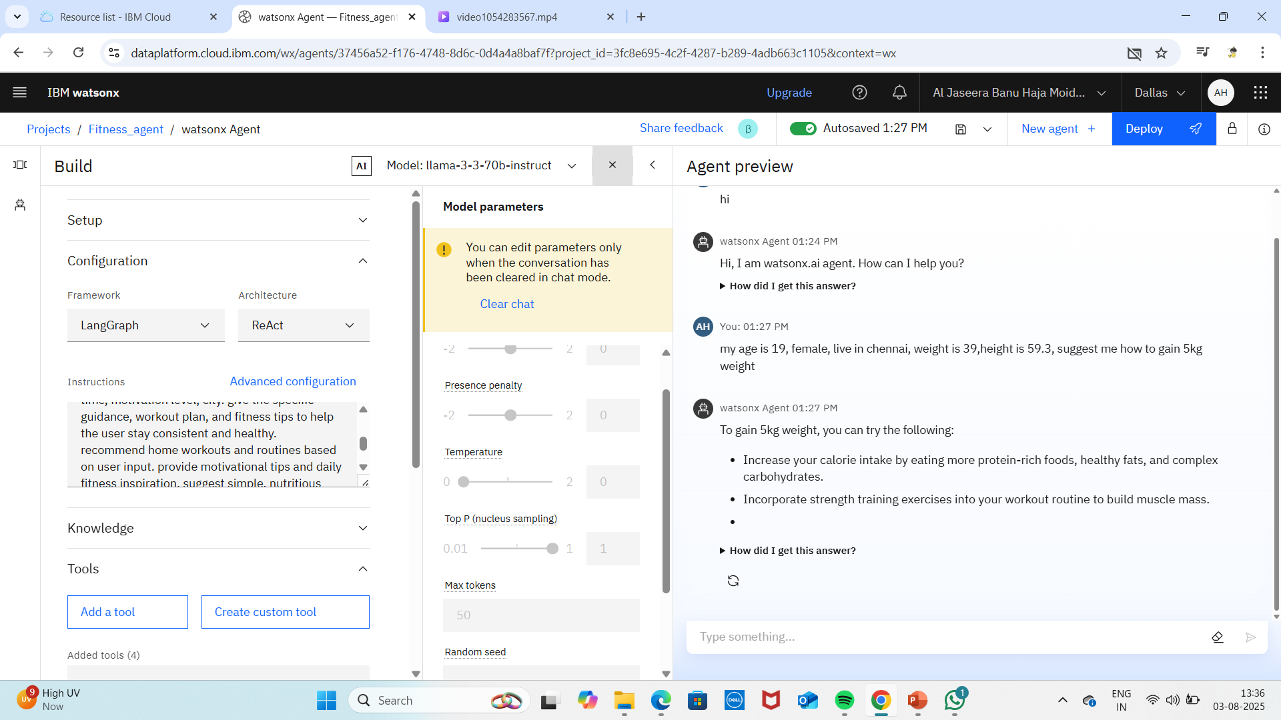
Result
Here I have instructed my agent and used 50 tokens. And asked “my age is 19, ,female, live in chennai, weight is 39, height is 59.3, Suggest me to gain 5kg weight”. So, my output is within 50 words

Slide 11
Conclusion
This intelligent chatbot solution demonstrates how AI-powered virtual fitness assistants can bridge the gap between busy schedules and healthy lifestyles. By combining personalized responses, external tool integration, and advanced language models, the system effectively motivates users to build sustainable fitness habits. The token-based evaluation and modular design allow it to scale efficiently and adapt to user needs, making it a practical alternative to costly and rigid traditional fitness plans.

Slide 12
Future scope
Explore potential enhancements by integrating more advanced tools like sentiment analysis, voice input, and real-time language translation to improve user interaction. Optimize the model using adaptive token usage based on query complexity to boost performance. Extend the system for multilingual support, domain-specific queries (e.g., healthcare, education), and global accessibility. Future iterations can also include federated learning for secure user personalization and edge computing to enable offline or low-latency deployment.

Slide 13
References
Recorded class sessions and hands-on labs provided by the instructor on chatbot development using IBM watsonx.
IBM watsonx official documentation and tutorials.LangGraph and Llama model implementation guides.
Online resources and toolkits for integrating Wikipedia, Google Search, and Weather APIs.

Slide 14
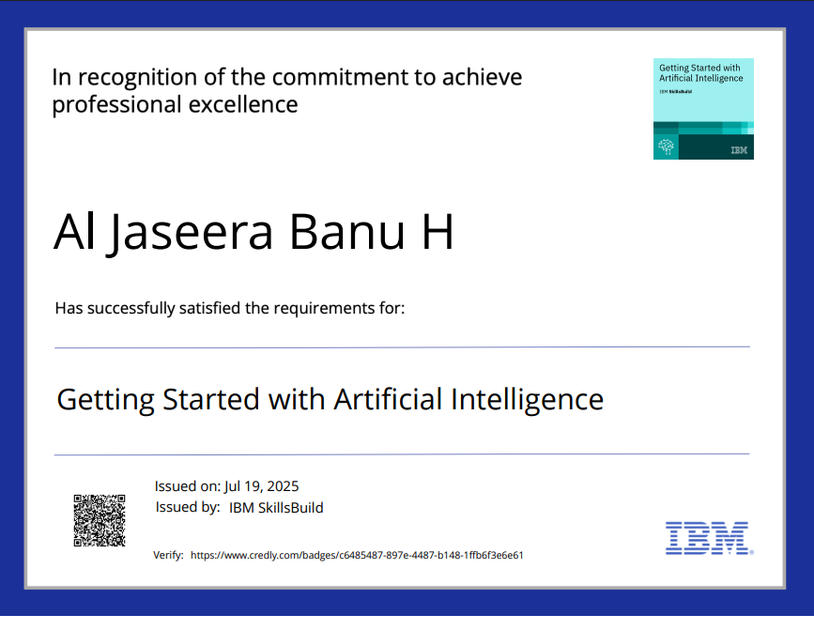
IBM Certifications

Slide 15
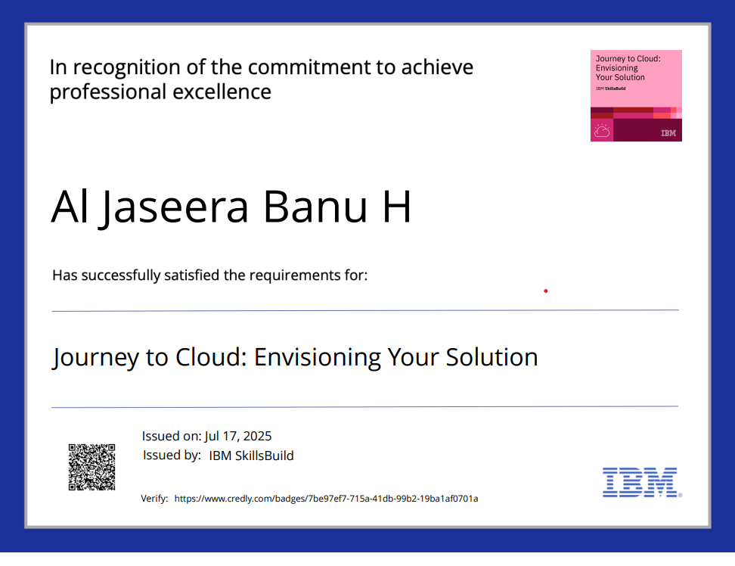
IBM Certifications

Slide 16
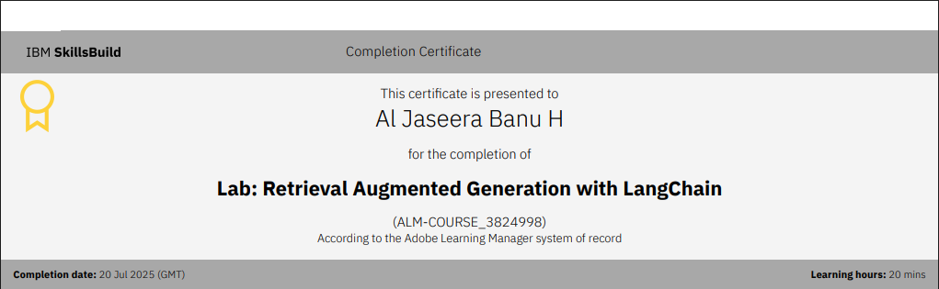
IBM Certifications

Slide 17
THANK YOU

