Slide 1

LLM vs SLM on the Edge
Performance–Cost Trade-offs for Edge & IoT Deployment
SE 455 · UG-9 · SPRING 2026
Alfaisal University · Phase 3 Progress Presentation · 10–15 min

Slide 2
Phase 3 — Progress Feedback
Course
Today's Agenda
SE 455
This is a 10–15 minute progress presentation covering:
Project
Literature synthesis & taxonomy
Identified research gaps
Preliminary architecture decisions
Implementation plan lock-in
UG-9 — Performance–Cost Trade-offs: LLM vs SLM (Edge / IoT)
Term
Spring 2026 · Alfaisal University

Slide 3

Phase 3 Objectives & Today's Storyline
01
Survey the Literature
Synthesize what's known about deploying language models under real edge constraints.
02
Absorb Feedback
Incorporate instructor and peer critique to sharpen our mental model.
03
Lock the Plan
Finalize the implementation plan before the Phase 4 build and report.
04
Define Metrics
Commit to a single application and comparable, reproducible measurements.

Slide 4

Why LLM vs SLM on the Edge Matters
The LLM Problem at the Edge
Target Devices
Hyperscale LLMs deliver strong generative quality but depend on data-center GPUs, large memory, and steady connectivity — a fundamental clash with edge constraints around latency, privacy, and cost.
Raspberry Pi · Jetson Nano · Mobile NPUs
Core Tension
The SLM Promise
How far can the performance–cost trade-off be pushed under real edge constraints?
SLMs and compressed LLMs offer lower latency, reduced energy, and a smaller footprint — but may sacrifice accuracy or generality.

Slide 5
Research Questions
Four questions the literature partially answers — but does not close uniformly across papers:
1
2
Accuracy, Latency & Cost
Architectures & Compression
How do accuracy, latency, memory, energy, and cost compare across cloud vs edge for LLMs vs SLMs?
Which architectures and compression choices make SLMs and quantized LLMs viable on fixed hardware budgets?
3
4
Deployment Topologies
Benchmarking Gaps
How do cloud-only, edge-only, and collaborative topologies reshape the performance–cost trade-off?
What gaps still block systematic comparison in real-world edge deployment practice?

Slide 6
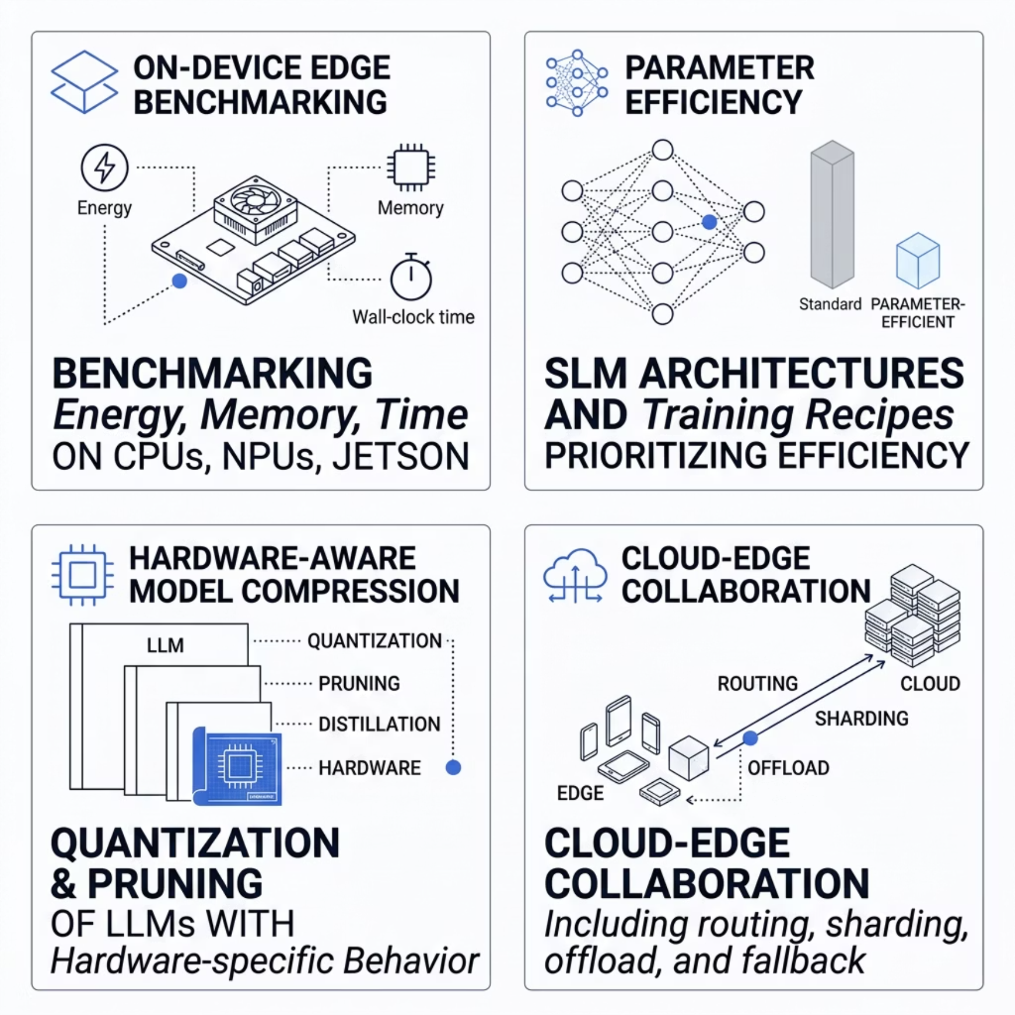

Survey Map — Four Synthesized Themes
How We Read the Literature
Empirical work clusters into these four themes, each illuminating a distinct facet of the edge deployment challenge:
Memory & thermal limits dominate on-device benchmarks
Parameter efficiency — not raw scale — defines SLM design
Bit-width and kernel behavior interact sharply with hardware targets
Topology is inseparable from model scale when judging cost

Slide 7

Theme 1 — Benchmarking & Memory-Bound Edge Inference
Key Finding
Edge LM inference is frequently memory-bound. Quantization lowers RAM pressure but introduces accuracy and thermal risks under continuous workloads.
Cross-Paper Takeaways
Compression curves are hardware-sensitive — no universal winner across CPU / GPU / NPU paths
Distributed edge setups can match cloud latency at lower cost
Fallback mechanisms remain necessary when edge capacity is exceeded

Slide 8

Theme 2 — SLM Design & Task-Fit
"Small" Means Fit-to-Budget
Surveys argue "small" should be understood as fit-to-task and hardware budget, not merely a parameter cutoff number.
Architectural Choices Matter
In sub-billion parameter regimes, depth–width balance, shared embeddings, and grouped-query attention can lift quality substantially.
The Scalability Tension
Empirical sweeps show that modest accuracy gains often require multiplicative VRAM growth — the core efficiency tension UG-9 investigates.

Slide 9


Theme 3 — Compression & Quantization Cautions
Critical Caution: SLMs are not miniature LLMs. Sensitivity to bit patterns differs fundamentally — LLM-tuned quantization recipes can be sub-optimal or harmful when applied to SLMs.
Full LLM
Compressed Edge Model
Apply int4 Quantization
What the Literature Reports
Int4-class schemes can slash resource use with only minor accuracy loss on LLMs
Large-scale benchmarks measure memory, latency, throughput, and energy jointly
SLM-focused quantization requires separate tuning and sensitivity analysis
Hybrid compression strategies report joint improvements in memory, latency, throughput, and energy — but hardware sensitivity demands careful validation.

Slide 10
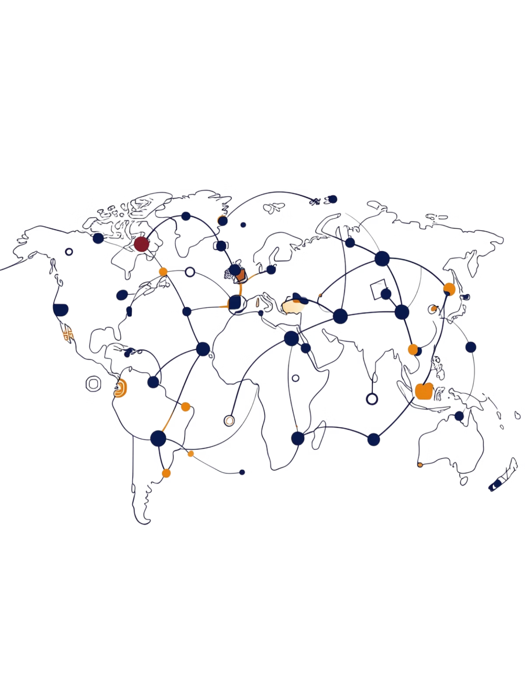



Theme 4 — Hybrid Cloud–Edge Orchestration
Model Partitioning
Partition and shard layers across edge plus cloud nodes to distribute inference load and reduce per-device burden.
Intelligent Routing
Route easy utterances to the edge SLM and hard tasks to the cloud LLM — lowering perceived latency without sacrificing accuracy.
Implication for UG-9
Deployment topology belongs in the same sentence as model scale — both are first-class variables when judging cost and user experience.

Slide 11

Hybrid Cloud–Edge Orchestration for LLM Deployment
A taxonomy, benchmark, and implementation study exploring how model scale, deployment location, and optimization objectives shape cost, latency, and accuracy for UG-9.

Slide 12

Hybrid Cloud–Edge: The Core Idea
Hybrid approaches partition models across nodes, shard layers to edge plus cloud, or route easy utterances to an edge SLM and hard tasks to a cloud LLM.
Lower Latency
Better Throughput
Perceived latency drops by offloading simpler tasks to the edge.
Cloud handles complex tasks without bottlenecking edge capacity.
Deployment Topology Matters
Topology belongs in the same sentence as model scale when judging cost and experience.

Slide 13



A Three-Axis Taxonomy for UG-9
The literature and our experiment are organized along three axes that repeatedly reappear in surveyed papers.
Model Scale
Deployment Location
Optimization Objective
Cloud-scale LLMs · Mid-size SLMs (~single-digit billions) · Tiny/embedded models (<1B params) tuned for latency and energy
Cloud-only · Edge-only · Collaborative with offload, fallback, or partitioning
Accuracy-first · Cost/energy-first · Balanced multi-objective policies adapting batch size, frequency, or model choice at runtime

Slide 14


Key Insights from the Survey
SLMs & Quantized Stacks
Often reach task-specific quality near much larger models while cutting latency, power, and memory — but no single recipe wins everywhere. Hardware, workload, and decoding details shift the Pareto front.
Hybrid deployments improve perceived responsiveness and cost only if routing and capacity planning are honest about when the edge model fails.

Slide 15
Identified Gaps
The literature agrees on problems more often than on numbers. Four areas still need systematic work:
Unified Benchmarks
Compression Validation
Jointly reporting accuracy, latency, energy, memory, and cost on aligned tasks.
Methods validated specifically for SLM failure modes at low bit widths.
End-to-End Studies
Robustness Under Resource Limits
Folding in networking, batching, thermal throttling, and user interaction — not just kernels in isolation.
Hallucination and format errors become safety issues for actuators when resources are constrained.

Slide 16
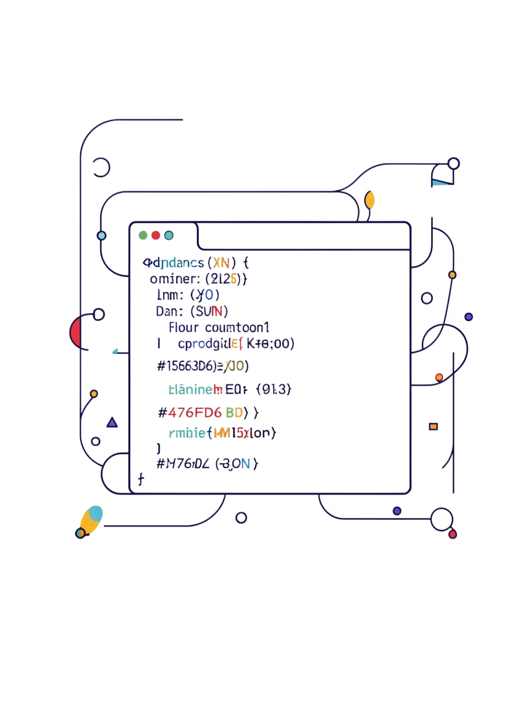
Preliminary System Architecture
Scope is deliberately narrow: one application — natural-language IoT-style commands mapped to strict JSON — executed locally without cloud APIs for full replicability.

Slide 17
Two Benchmark Tracks
A single CLI orchestrates both tracks on shared prompts and scoring.
Shared Evaluation
Track A — Hugging Face
Track B — GGUF Decoder
The same extractor and scorer enforce comparable field accuracy. Logs capture latency and memory proxies suitable for a classroom benchmark.
Seq2seq path using FLAN-T5-small
SmolLM2 at IQ3_XS vs Q4_K_M via llama.cpp

Slide 18
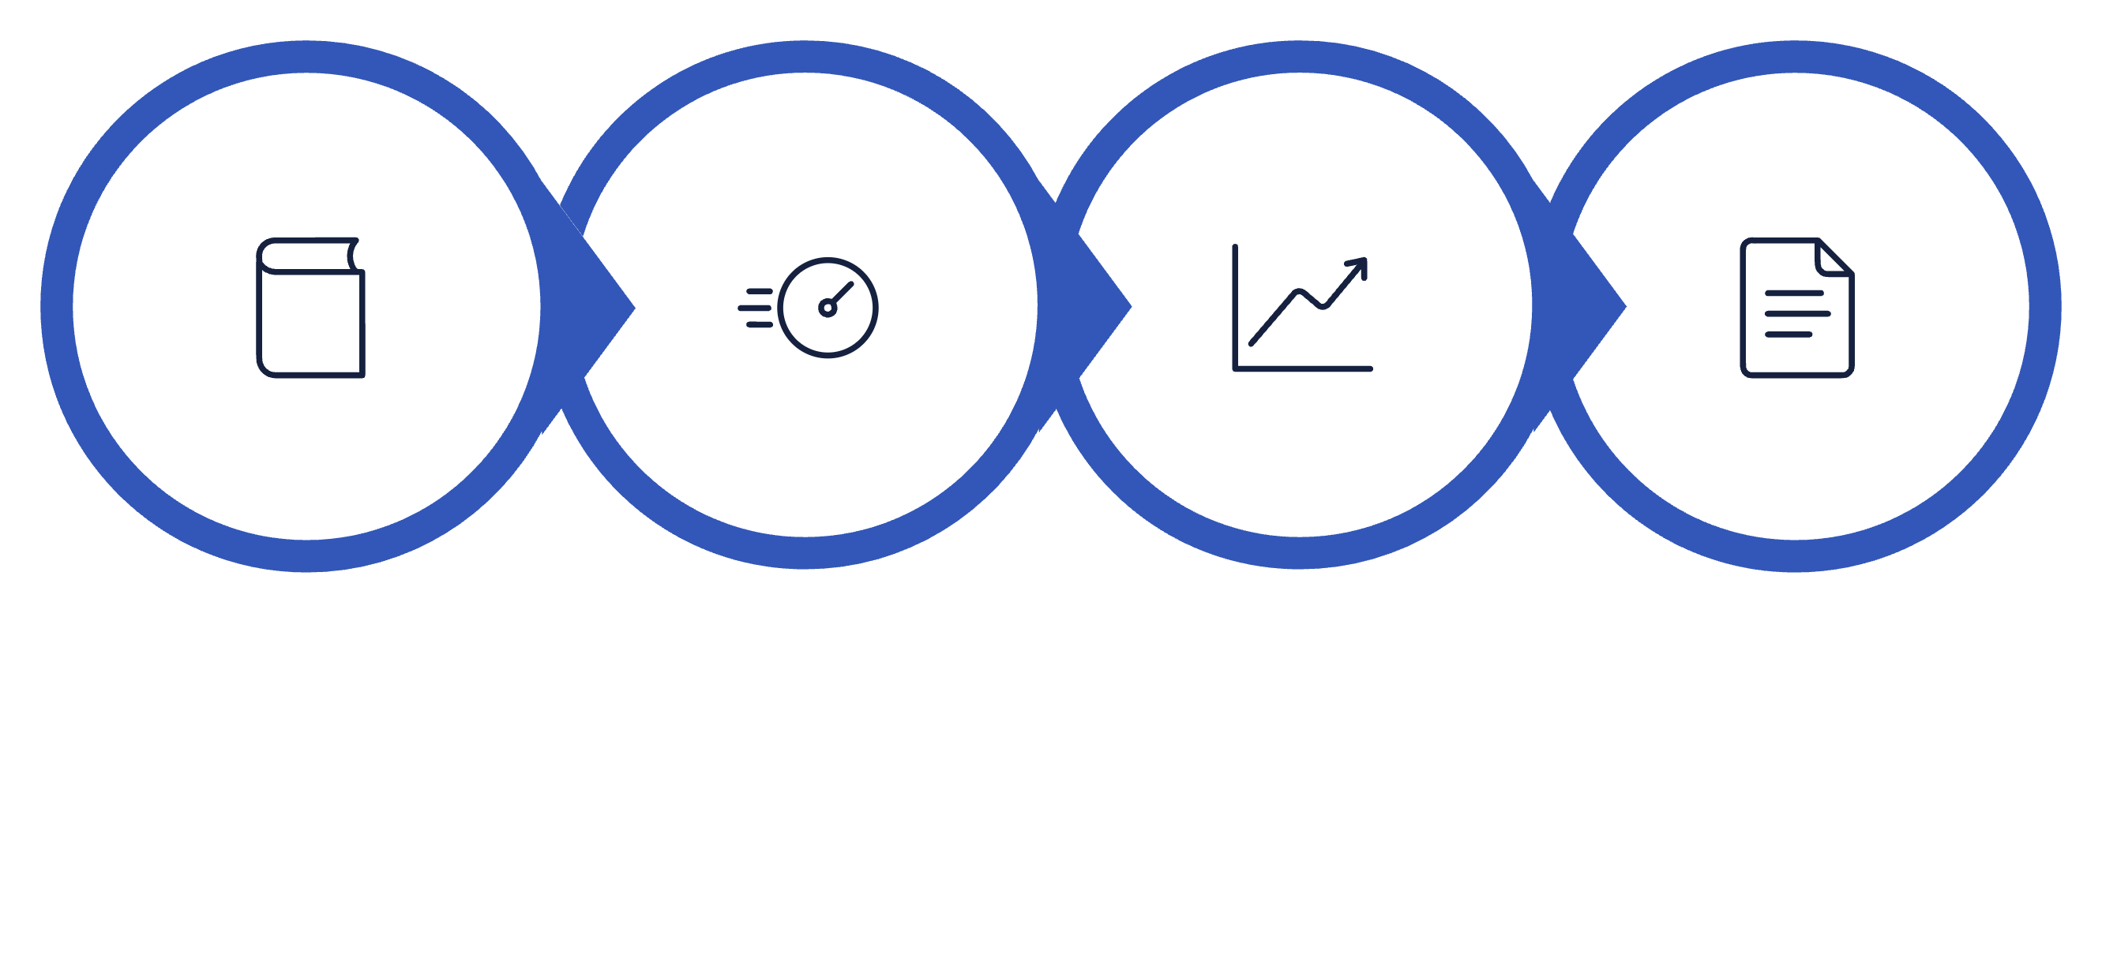




Implementation Plan & Timeline
Literature
Benchmark
Analysis
Reporting
Phase 3 locks the plan; Phase 4 delivers code plus paper. Every table ties to rerunnable commands.

Slide 19
Expected Challenges & Mitigations
Challenges
Mitigations
Cold-start effects inflating first-sample latency
Strict JSON scoring exposing generative drift as zero accuracy
Environment variability across laptops
GGUF runtime constraints in sandboxed environments
Documented replication commands & pinned dependencies
Transparent negative results
Serial benchmarking to reduce interference
Honest discussion of schema mismatch vs. model incompetence

Slide 20


Phase 3 Feedback Requested
1
2
Taxonomy Fit
Metric Bundle
Does the three-axis taxonomy match real cloud / edge / hybrid decisions?
Is our metric bundle adequate for an undergraduate comparative study?
3
Task Fairness
Does constraining both tracks to one JSON IoT task fairly contrast HF seq2seq against quantized GGUF decoding?

