Slide 1


Black Friday Customers Purchase
LR and RFR Modeling
Analysis by Aljawharah Aljuhaymi

Slide 2
Problem Statement:
We want to know better the customer purchase behavior against different products based on historical records

Slide 3
Agenda:
EDA
Models And Evaluation
Future work

Slide 4
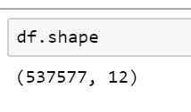
Explanatory Data Analysis:
Large Data Set + 500k rows
12 columns
Target variable : Purchase
We will use Features except Product ID.

Slide 5
Explanatory Data Analysis:
Convert Categorical features to numeric ➔ (CityCategory, Gender, Age ,SatyCurrentcity)
Missing values imputation to 0 in two features ➔ PC_1 and PC_3
Features Distribution ➔ Males more than Females - Singles more than Married – 26to 35 age more than others

Slide 6
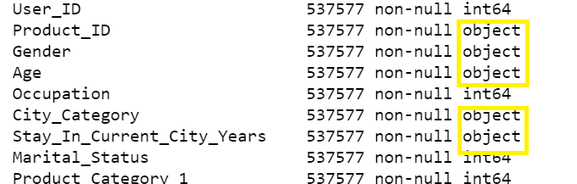
Features Engineering:
Drop Product_ID
Dummy coding categorical Features

Slide 7
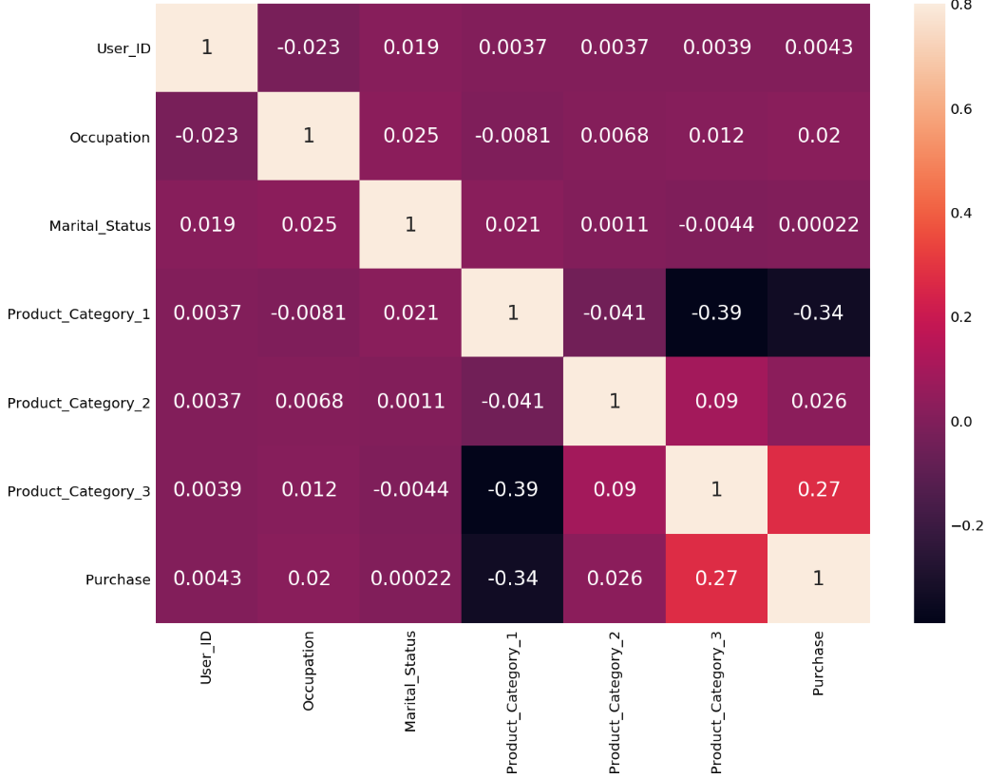
Selecting Feature Columns - Numerical
Target features that show correlation using heatmap
Use logic to disregard features with collinearity (Purchase with PC_3, PC_1)

Slide 8
Root Mean Squared Error: Null vs. Regression
Null Model
Regression

Slide 9
Models And Evaluation:
Random Forest Regressor | Regression
R^2 for training set:86 R^2 for testing set:61 | R^2 for training set:14.36 R^2 for testing set:14.04
MAE:12 MSE:261 RMSE:16 | MAE:18.75 MSE:600 RMSE:24

Slide 10
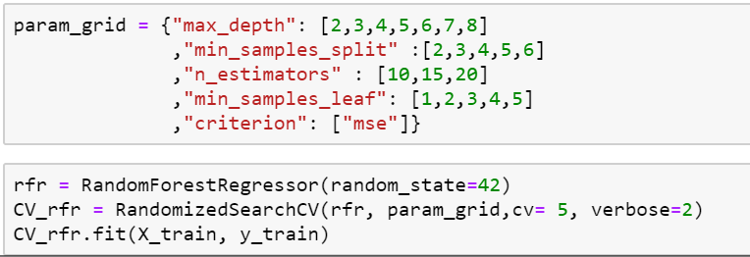
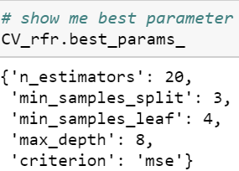
Randomized Search to find best Parameter:
Sampling data ➔ 40%
MAE:12
MSE:245
RMSE:15

Slide 11
Next step:
EDA revisiting
More Data Engineering
Clustering to check common observation in the same cluster.

Slide 12
Thank you Misk :
Questions & thoughts

