Slide 1
CSS (Cascading Style Sheets)
Introduction

Slide 2
What is CSS?
CSS stands for Cascading Style Sheets
CSS describes how HTML elements are to be displayed on screen, paper, or in other media
CSS saves a lot of work. It can control the layout of multiple web pages all at once
External stylesheets are stored in CSS files

Slide 3
CSS Solved a Big Problem
HTML was NEVER intended to contain tags for formatting a web page!
HTML was created to describe the content of a web page, like:
<h1>This is a heading</h1>
<p>This is a paragraph.</p>
When tags like <font>, and color attributes were added to the HTML 3.2 specification, it started a nightmare for web developers. Development of large websites, where fonts and color information were added to every single page, became a long and expensive process.
To solve this problem, the World Wide Web Consortium (W3C) created CSS.
CSS removed the style formatting from the HTML page!

Slide 4
CSS Saves a Lot of Work!
The style definitions are normally saved in external .css files.
With an external stylesheet file, you can change the look of an entire website by changing just one file!

Slide 5
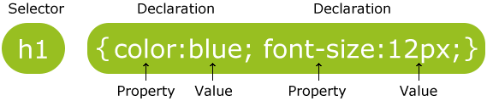
CSS Syntax
A CSS rule-set consists of a selector and a declaration block:
The selector points to the HTML element you want to style.
The declaration block contains one or more declarations separated by semicolons.
Each declaration includes a CSS property name and a value, separated by a colon.
A CSS declaration always ends with a semicolon, and declaration blocks are surrounded by curly braces.

Slide 6

Example
In the following example all <p> elements will be center-aligned, with a red text color:

Slide 7
CSS Selectors
CSS selectors are used to "find" (or select) HTML elements based on their element name, id, class, attribute, and more.

Slide 8
The element Selector
The element selector selects elements based on the element name.
You can select all <p> elements on a page like this (in this case, all <p> elements will be center-aligned, with a red text color):

Slide 9
Example
<!DOCTYPE html>
<html>
<head>
<style>
p {
text-align: center;
color: red;
}
</style>
</head>
<body>
<p>Every paragraph will be affected by the style.</p>
<p id="para1">Me too!</p>
<p>And me!</p>
</body>
</html>

Slide 10
The id Selector
The id selector uses the id attribute of an HTML element to select a specific element.
The id of an element should be unique within a page, so the id selector is used to select one unique element!
To select an element with a specific id, write a hash (#) character, followed by the id of the element.
The style rule below will be applied to the HTML element with id="para1":

Slide 11
Example
<!DOCTYPE html>
<html>
<head>
<style>
#para1 {
text-align: center;
color: red;
}
</style>
</head>
<body>
<p id="para1">Hello World!</p>
<p>This paragraph is not affected by the style.</p>
</body>
</html>

Slide 12
The class Selector
The class selector selects elements with a specific class attribute.
To select elements with a specific class, write a period (.) character, followed by the name of the class.
In the example below, all HTML elements with class="center" will be red and center-aligned:

Slide 13
Example
<!DOCTYPE html>
<html>
<head>
<style>
.center {
text-align: center;
color: red;
}
</style>
</head>
<body>
<h1 class="center">Red and center-aligned heading</h1>
<p class="center">Red and center-aligned paragraph.</p>
</body>
</html>

Slide 14
Referring to more than one class
HTML elements can also refer to more than one class.
In the following example, the <p> element will be styled according to class="center" and to class="large":

Slide 15
Example
<!DOCTYPE html>
<html>
<head>
<style>
p.center {
text-align: center;
color: red;
}
p.large {
font-size: 300%;
}
</style>
</head>
<body>
<h1 class="center">This heading will not be affected</h1>
<p class="center">This paragraph will be red and center-aligned.</p>
<p class="center large">This paragraph will be red, center-aligned, and in a large font-size.</p>
</body>
</html>

Slide 16
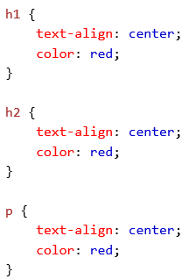

Grouping Selectors
If you have elements with the same style definitions, it will be better to group the selectors, to minimize the code.
To group selectors, separate each selector with a comma.

Slide 17
Universal Selector
There's also a very special selector you can use to apply CSS styling to every element on the page: the * selector.
For example, if you type
You'll create a two-pixel wide solid black border around every element on the HTML page.
* {
border: 2px solid black;
}

Slide 18
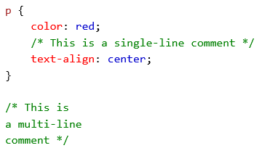
CSS Comments
Comments are used to explain the code, and may help when you edit the source code at a later date.
Comments are ignored by browsers.
A CSS comment starts with /* and ends with */. Comments can also span multiple lines:

Slide 19
Three Ways to Insert CSS
External style sheet
Internal style sheet
Inline style

Slide 20

External Style Sheet
With an external style sheet, you can change the look of an entire website by changing just one file!
Each page must include a reference to the external style sheet file inside the <link> element. The <link> element goes inside the <head> section:

Slide 21
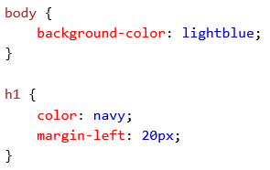
External Style Sheet
An external style sheet can be written in any text editor. The file should not contain any html tags. The style sheet file must be saved with a .css extension.
Here is how the "myStyle.css" looks:

Slide 22
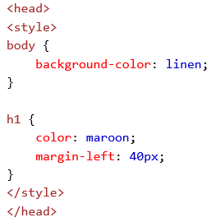
Internal Style Sheet
An internal style sheet may be used if one single page has a unique style.
Internal styles are defined within the <style> element, inside the <head> section of an HTML page:

Slide 23
Inline Styles
An inline style may be used to apply a unique style for a single element.
To use inline styles, add the style attribute to the relevant element. The style attribute can contain any CSS property.
The example below shows how to change the color and the left margin of a <h1> element:

Slide 24
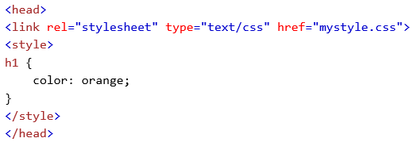
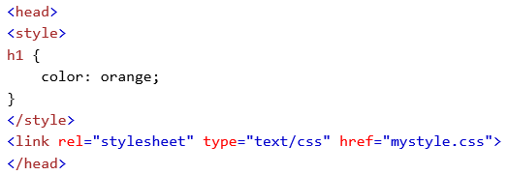
Multiple Style Sheets
If some properties have been defined for the same selector (element) in different style sheets, the value from the last read style sheet will be used.

Slide 25
Cascading Order
What style will be used when there is more than one style specified for an HTML element?
Generally speaking we can say that all the styles will "cascade" into a new "virtual" style sheet by the following rules, where number one has the highest priority:
Inline style (inside an HTML element)
External and internal style sheets (in the head section)
Browser default
So, an inline style (inside a specific HTML element) has the highest priority, which means that it will override a style defined inside the <head> tag, or in an external style sheet, or a browser default value.

Slide 26
CSS Colors
Colors in CSS are most often specified by:
a valid color name - like "red"
an RGB value - like "rgb(255, 0, 0)"
a HEX value - like "#ff0000"

Slide 27
CSS Backgrounds
The CSS background properties are used to define the background effects for elements.
CSS background properties:
background-color
background-image
background-repeat
background-attachment
background-position

Slide 28
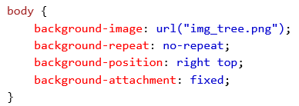
Example

Slide 29
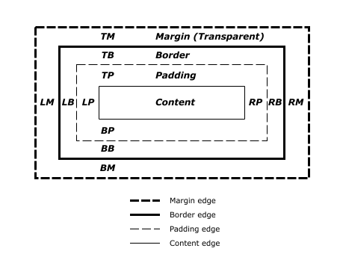
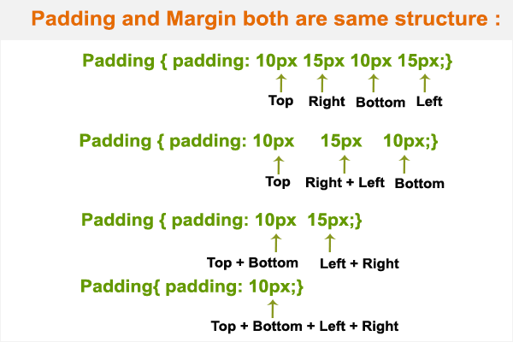
The Box Model

Slide 30

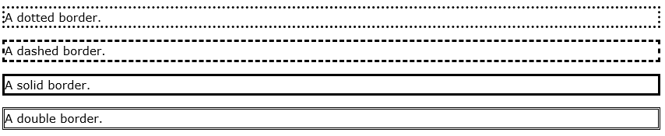
CSS Borders
The CSS border properties allow you to specify the style, width, and color of an element's border.
border-style
border-width
border-color
Examples:
border: 1px dashed black;

Slide 31
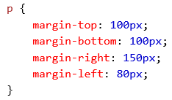
CSS Margins
The CSS margin properties are used to generate space around elements.
The margin properties set the size of the white space OUTSIDE the border.
CSS has properties for specifying the margin for each side of an element:
margin-top
margin-right
margin-bottom
margin-left
margin: 1px 2px 3px 4px;

Slide 32
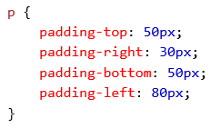
CSS Padding
The CSS padding properties are used to generate space around content.
The padding properties set the size of the white space between the element content and the element border.
The padding clears an area around the content (inside the border) of an element.
Example:

Slide 33

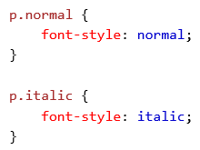

CSS Fonts
Some properties:
font-family (backup fonts)
font-style
font-size

Slide 34
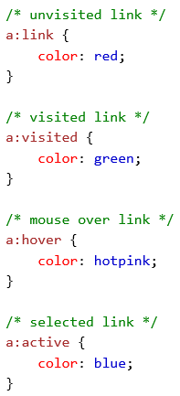
CSS Links
The four links states are:
a:link - a normal, unvisited link
a:visited - a link the user has visited
a:hover - a link when the user mouses over it
a:active - a link the moment it is clicked
Example:

Slide 35
CSS Lists
In HTML, there are two main types of lists:
unordered lists (<ul>) - the list items are marked with bullets
ordered lists (<ol>) - the list items are marked with numbers or letters
The CSS list properties allow you to:
Set different list item markers for ordered lists
Set different list item markers for unordered lists
Set an image as the list item marker
Add background colors to lists and list items

Slide 36
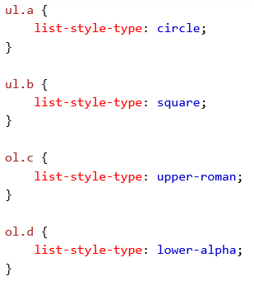
Example

Slide 37
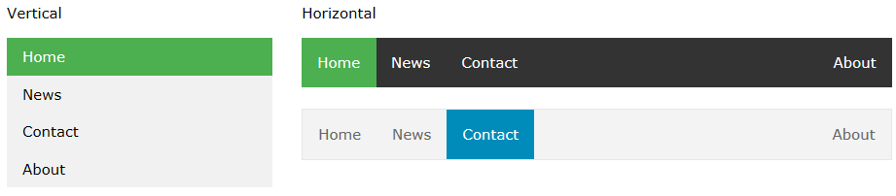
CSS Navigation Bars

Slide 38
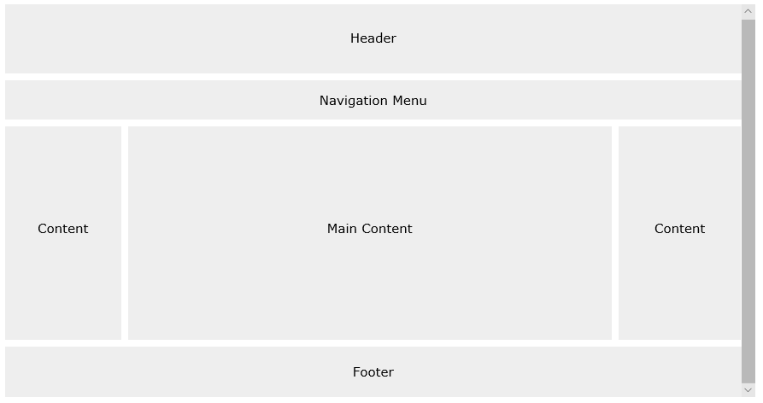
CSS Website Outline

