Slide 1
A.P.W.S
Air Pollution Warning System
TFM Data Science
Alberto Jiménez

Slide 2
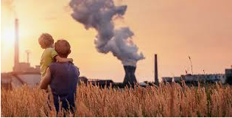
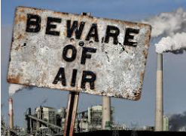
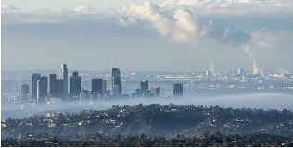
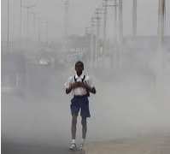
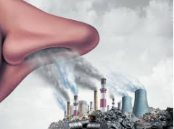
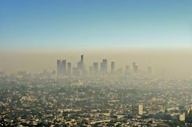
PROBLEM DEFINITION
Air Pollution

Slide 3



Air Pollution Warning System
Air Pollution Factors
Location
Pollutants
Weather
Factors of Rain Fall
Polluting emitters
Chemical Transformations
Sunlight Reactions

Slide 4
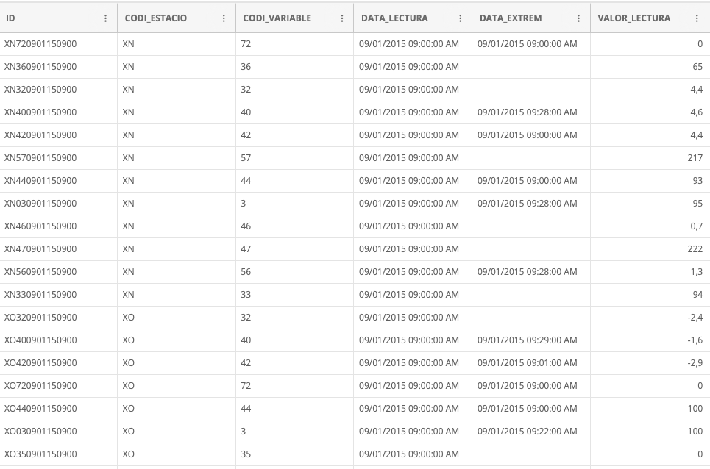
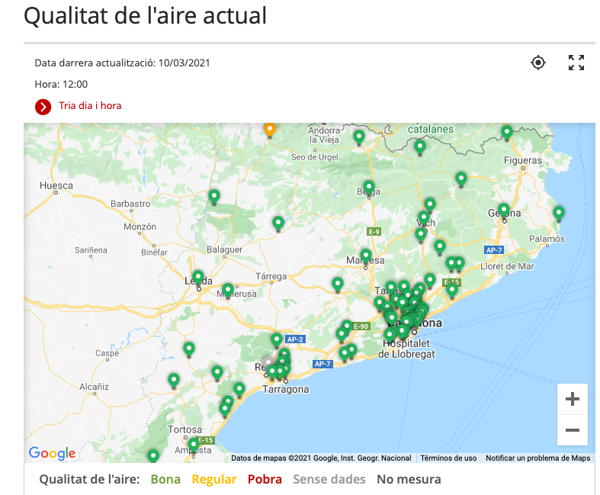
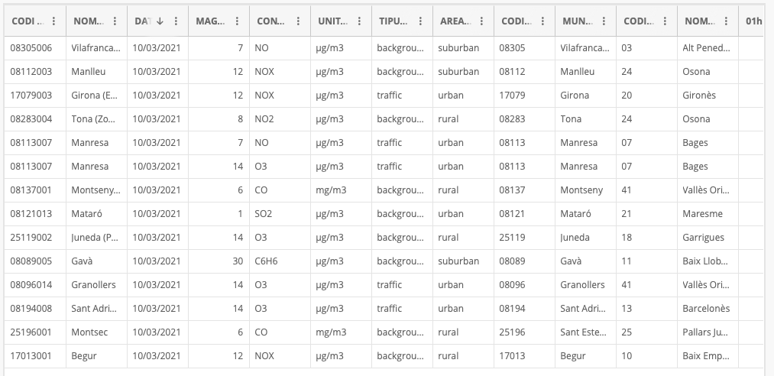
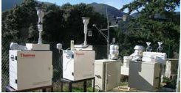


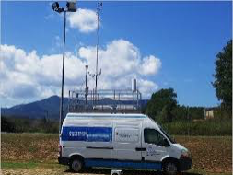
Air Pollution Warning System
Project Phases
Success for the Business
Implementation
Modelling
Objective and Scope establishment
DATASETS
Parametric measures got from XVPCA (Pollution) with data available from period from 2016-today
Incomplete Data
Features Matrix
Target Vector
Feature quantitative analysis
Graphs
(Feature engineering)
DATASET

Slide 5
Air Pollution Warning System
Project Phases
Success for the Business
Success
IMPLEMENT
MODELLING
Modelling
OBJECTIVE
FRONTEND with input forecast parameters and model prediction
DATASETS
CLASSIFIED Prediction Discreet predictive mode for warning, and REGRESSION Prediction Continuous predictive mode for Pollutants
Predict (24h) pollution to warn population.
NOx and PM10 as features.
Parametric measures got from XVPCA (Pollution) with data available from period from 2016-today

Slide 6
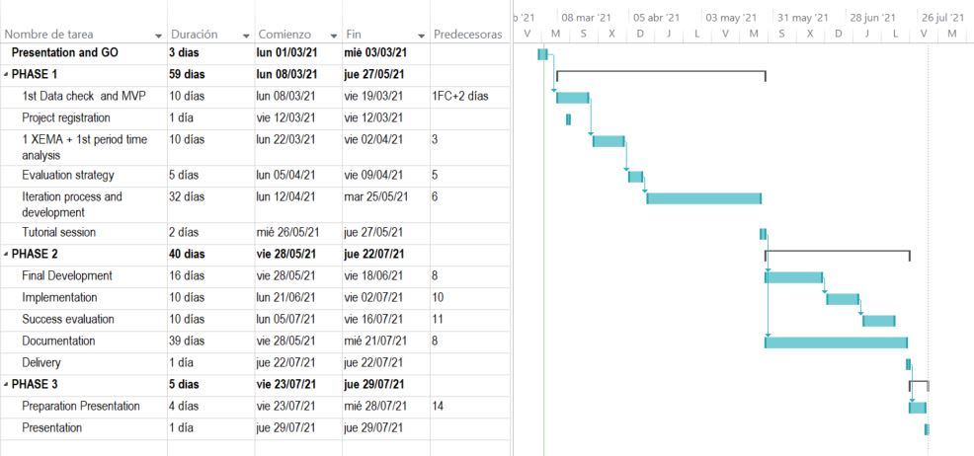
Air Pollution Warning System
PLANNING

Slide 7
Air Pollution Warning System
QUESTIONS & REMARKS
01
DATASETS
Could incomplete data be filled with average value, prior value, prior and next average value? Any other suggestion?.
DATASET Cleaning
02
Features will be selected in order to evaluate those which has a big impact into Pollution by Graphics.
All above considering 2 Pollutants and 1 station.
03
MODEL STRATEGIES
As a contingency plan, it could be reduced to 1 pollutant.
TRAIN and TEST Data
04
I suggest TRAIN dataset from 2015 to 2019, and TEST dataset 2021.
To avoid COVID-19 period.
05
FRONTEND
Forecast data could be got by API or simply file downloaded from the XVPCA website.
DUST POLLUTION DATA
06
FRONTEND forecast against NOx, PM10 parameter data in previous days registered into XVPCA web.

Slide 8
THANKS!

