Slide 1

Stealthy Send
01
Stealthy Send
Presented by
Mohammad Qtaish AE1007
Rakan Khater AD1298
Aya Alhunity AE2602
Supervised by
Dr.Zaid Alhalhouli

Slide 2
Stealthy Send
09
Contents
introduction
Purpose and importance
Main Goals
Data Handling and Security
Error Handling and Validation
User Requirements
Real examples

Slide 3
Stealthy Send
02
introduction
Stealthy Send is an advanced Python-based steganography tool (software) designed to securely hidden embed and extract encrypted data within PNG images.
By integrating robust encryption algorithms, Including two layers of encryption, this tool ensures that hidden data remains confidential and tamper-resistant (Integrity).
The combination of these encryption methods with steganography not only conceals the existence of the data but also fortifies it against unauthorized access and manipulation.

Slide 4
Stealthy Send
02
introduction
The tool leverages Least Significant Bit (LSB) encoding to embed data into PNG images, ensuring that the visual quality remains intact.
To enhance data security level, the tool employs dual-layer encryption using AES in CBC mode and RC4, making the hidden data resistant to unauthorized access.
This project demonstrates the effective integration of cryptography and steganography, offering a practical tool that balances data concealment and encryption.

Slide 5
Stealthy Send
09
Purpose and importance
Purpose:
The primary goal of this project is to create a reliable and secure steganography tool that can be used to conceal data within images while maintaining high levels of security.
Importance:
The importance of Stealthy Send lies in its ability to provide a dual-layer encryption and data-hiding solution for secure communication. It ensures sensitive information remains concealed and protected from unauthorized access

Slide 6
Stealthy Send
04
Enhance Data Security
Main
Goals
Implement strong encryption techniques (AES and RC4) to ensure the confidentiality and integrity of hidden data.
Effective Data Hiding
Utilize Least Significant Bit (LSB) encoding to discreetly hide data within PNG images without significantly altering their appearance.
User-Friendly Interface:
Develop a comprehensive Command-Line Interface (CLI) that allows users to easily encode and decode data, manage encryption keys, and specify file paths.

Slide 7
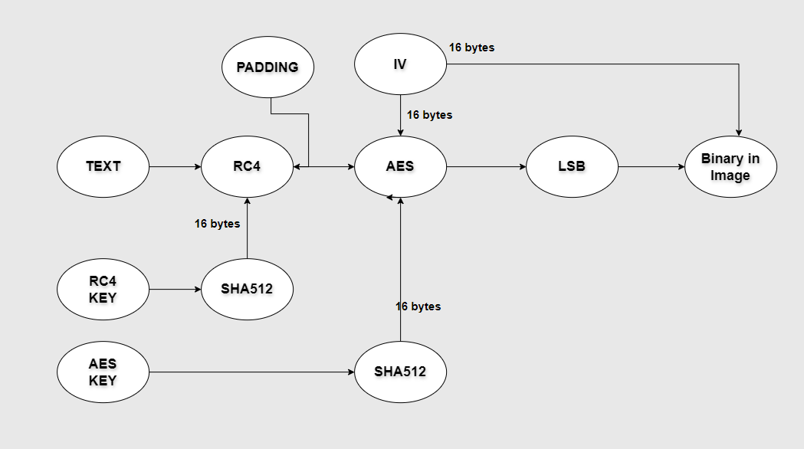
Stealthy Send
04
Process Work

Slide 8
Stealthy Send
02
Data Handling and Security
Padding:
Purpose: Padding ensures that the data being encrypted aligns with the block size requirements of AES. This prevents issues during the encryption and decryption processes by making the data length compatible with the encryption algorithm.
Initialization Vector (IV) Encoding:
Binary Encoding: The IV used in AES encryption is encoded as binary data and embedded along with the encrypted message. This ensures that the decryption process has the necessary context to accurately reconstruct the original data.
Security: IV is essential for CBC mode to ensure that identical plaintext blocks are encrypted differently each time, enhancing security.

Slide 9
Stealthy Send
02
Error Handling and Validation
Input Validation:
Image Format Check: Ensures that only PNG images are used, avoiding compatibility issues.
Payload Capacity Check: Validates that the image has sufficient capacity to store the embedded data, preventing overflow issues.
User Feedback:
Error Messages: Provides informative error messages to guide users in resolving issues related to invalid inputs or processing errors.

Slide 10
Stealthy Send
02
User Requirements
Image Format:
PNG: The tool supports encoding and decoding data within PNG images.
Python Version: Python 3.x .
Key Management:
Key Options: Users can either provide specific AES and RC4 keys or generate random keys.
Command-Line Interface (CLI):
CLI Functionality: Users interact with the tool through a command-line interface for encoding, decoding, and key management operations.

Slide 11
Stealthy Send
09
Real examples

Slide 12
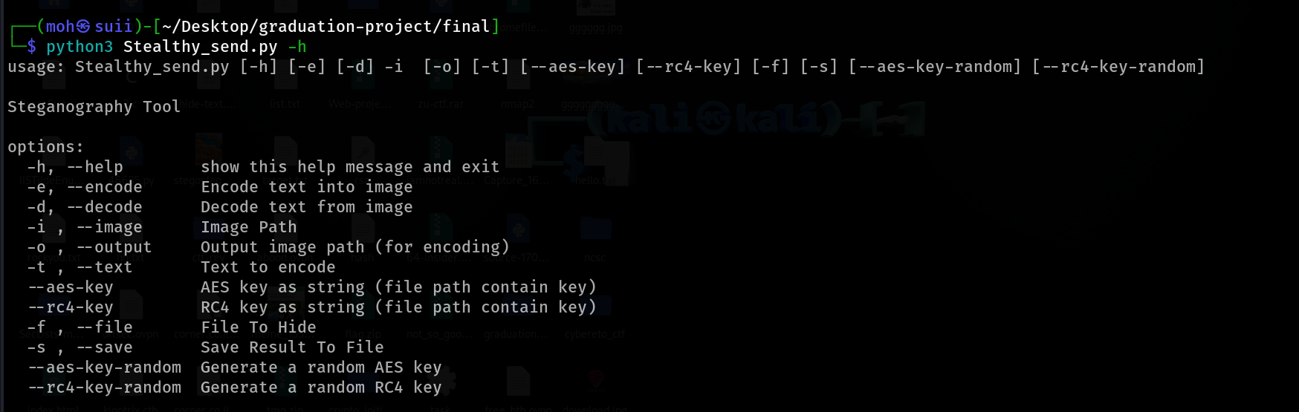
Stealthy Send
09
Display the help menu

Slide 13
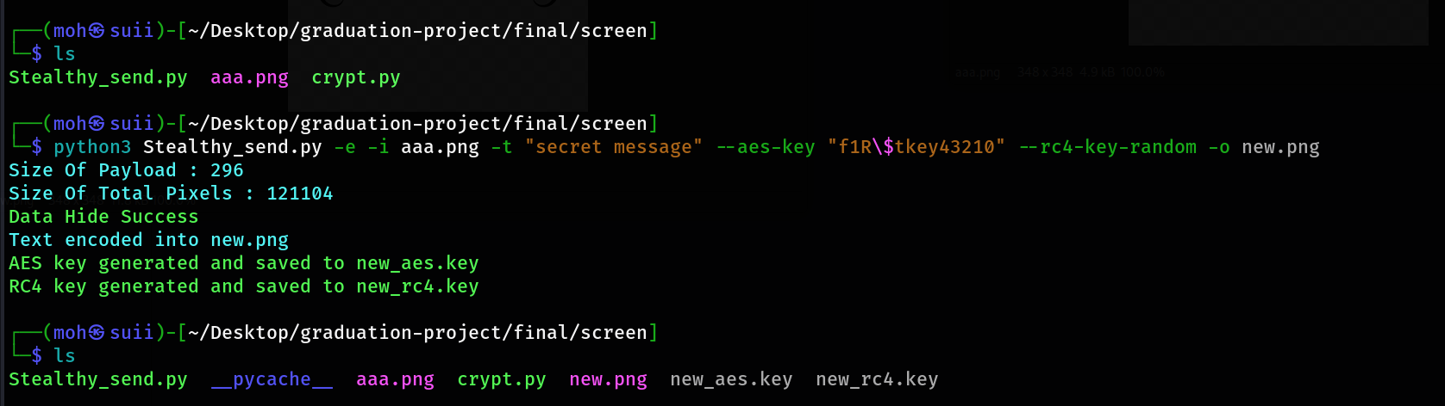
Stealthy Send
09
Example to encode image have secret message with two different key

Slide 14
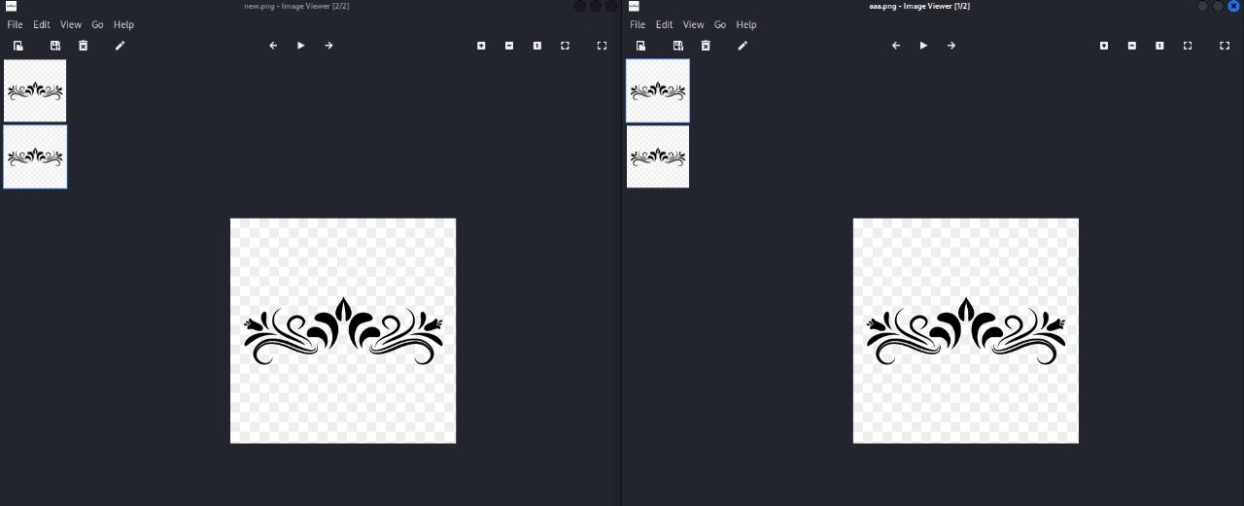
Stealthy Send
09
Show image before and after encoding without any difference

Slide 15
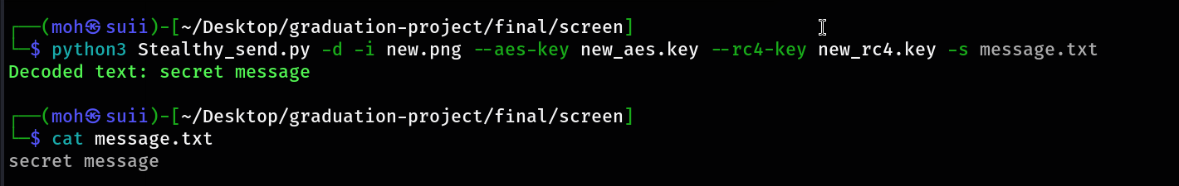
Stealthy Send
09
Decode the encoded image using the encrypted keys and save the result

Slide 16
Stealthy Send
10
Thank you

