Slide 1
Multiview Normal Field Integration using Graph-Cuts
CESCG 2012
Smolenice, Slovakia
Author: Aljoša Ošep
Mentors: Michael Weinmann, Reinhard Klein

Slide 2
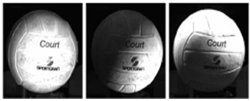
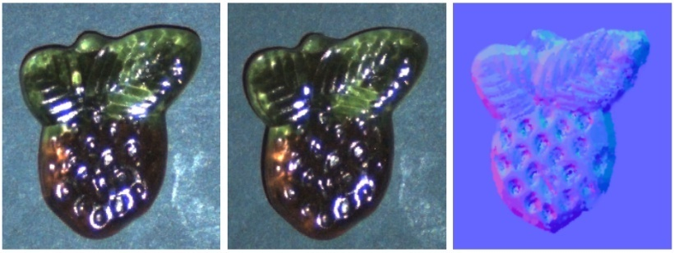
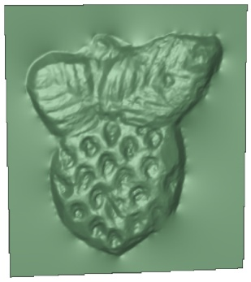

Motivation
Many techniques for surface normal field estimation using shading cues from single view
How can information from several viewpoints be combined?
Image credits: R. Basri, D. Jacobs, I. Kemelmacher (left), T. Chen, M. Goesele, H.P. Seidel (right)

Slide 3
Overview
Introduction
Problem Statement
Approach
Algorithm
Results
Conclusions and Future Work

Slide 4
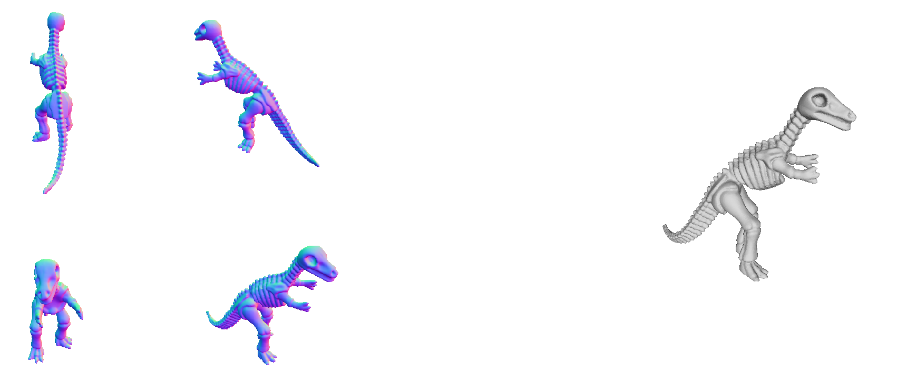
Introduction
Given: normal fields from several views
Goal: recovery of full 3D shape of the object
?

Slide 5
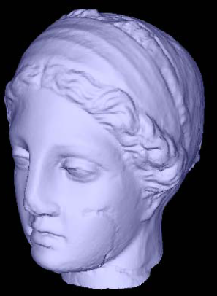
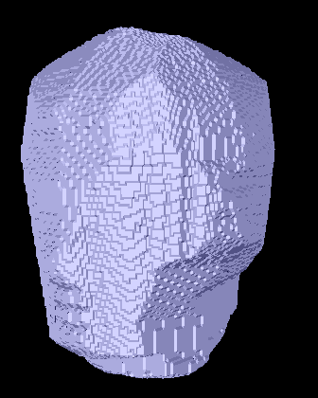
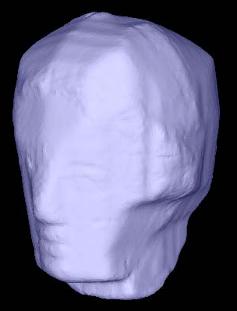
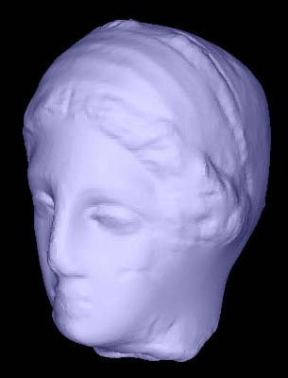
Method by Chang et al.
Multiview normal field integration using level set methods (J. Y. Chang, K. M. Lee and S. U. Lee, CVPR’07)
First work addressing the problem
Energy functional, consisting of area and flux term, optimized by level sets method
Image credits: J. Y. Chang, K. M. Lee and S. U. Lee

Slide 6




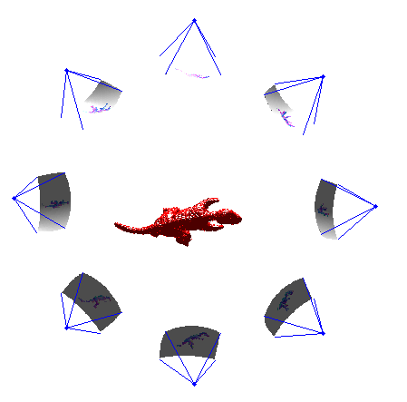
Problem Statement
Given:
N calibrated cameras
Projection matrices
Normal fields
Goal:
Reconstruction of surface
Problem:
Inferring coordinates of all surface point given normal fields estimates

Slide 7
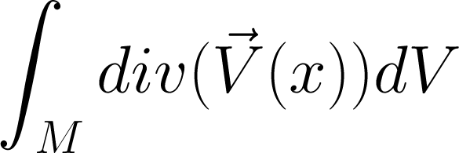
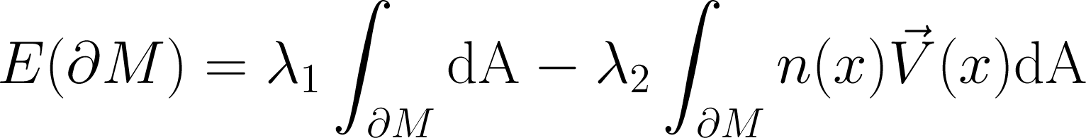
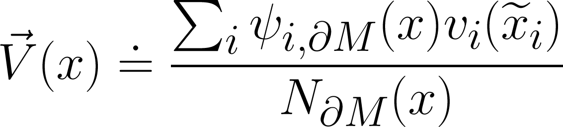
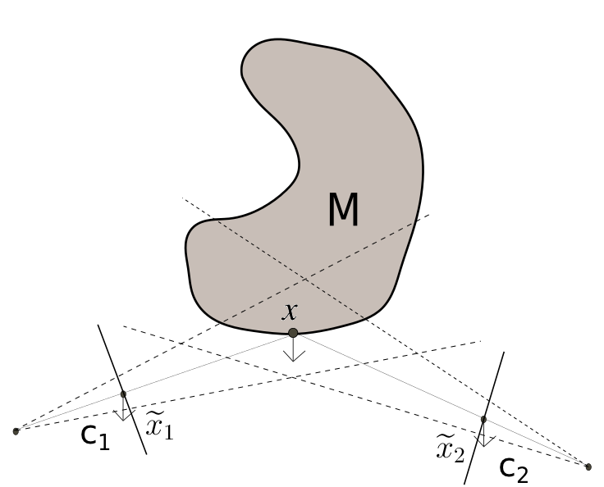

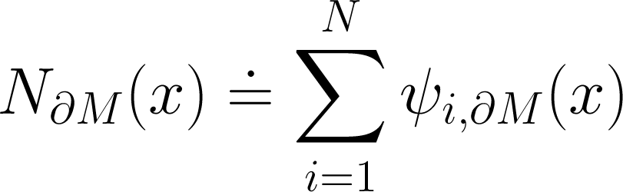
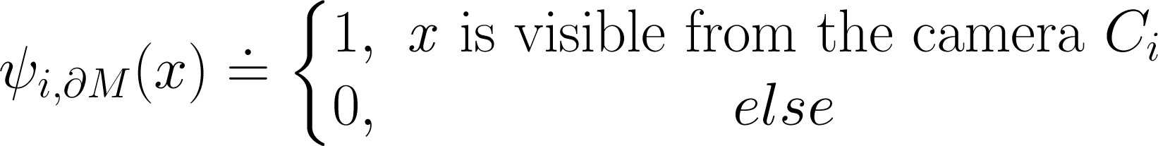
Approach
Can be globally optimized via Graph-Cuts!
(V. Kolmogorov and Y. Boykov. What metrics can be approximated by geo-cuts, or global optimization of length/area and ﬂux.)
Energy minimization

Slide 8

Algorithm in a Nutshell
Compute the vector field
Initialize the model by silhouette carving
Compute the visibility
Project normal fields
Compute divergence of (Gauss theorem)
Construct a graph
Establish n-links (Adjacent nodes)
Establish t-links (Terminals)
Compute the Min-Cut on the constructed graph
Extract the isosurface using Marching Cubes

Slide 9
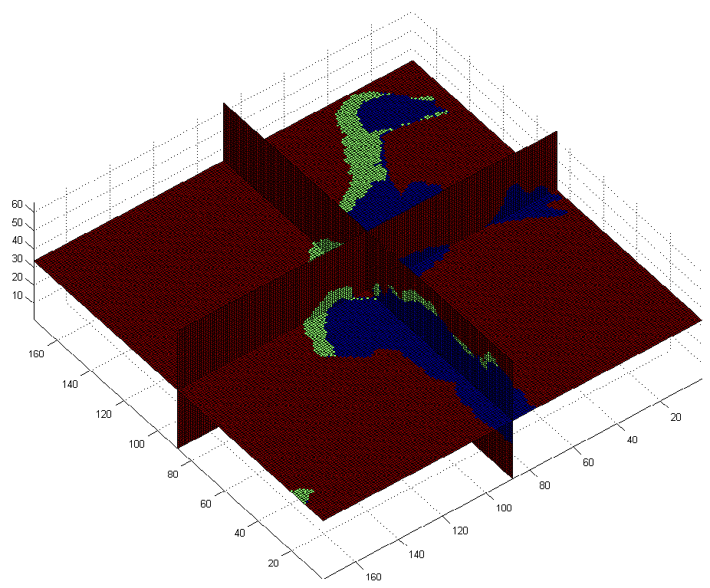
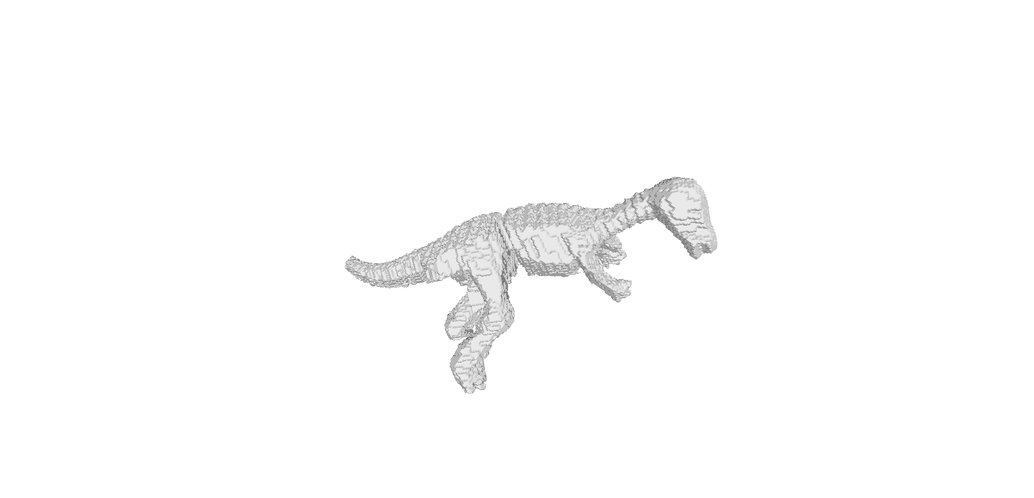
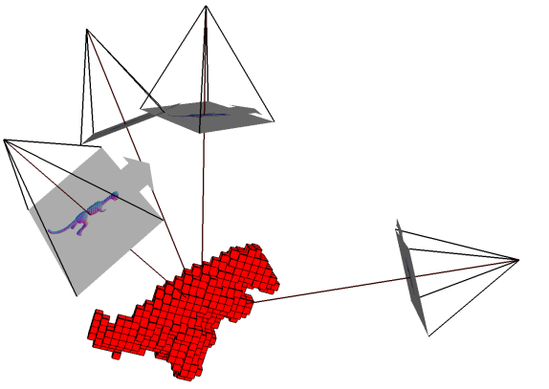
Computation of the Vector Field
Initial guess of the surface by visual hull
Silhouette carving
Provides visibility approximation
Compute visibility based on the visual hull
Project normal fields to the visual hull
To the bands of “visible” voxels
Silhouette carving
Visual hull
Visibility
Seen
Unseen

Slide 10
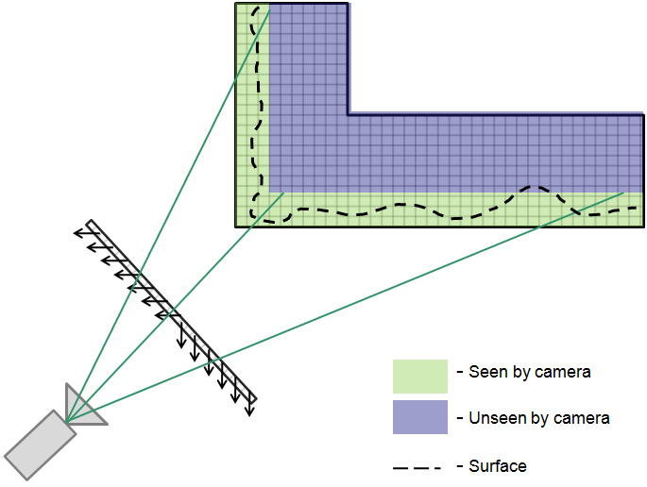
Computation of the Vector Field

Slide 11
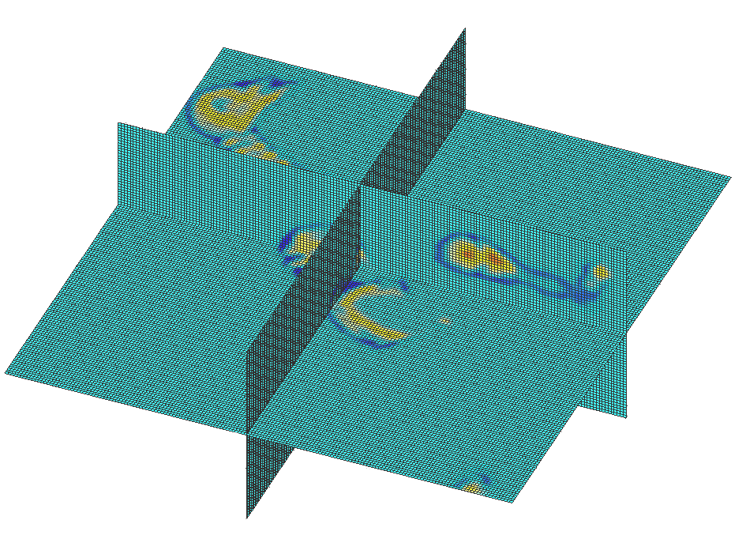
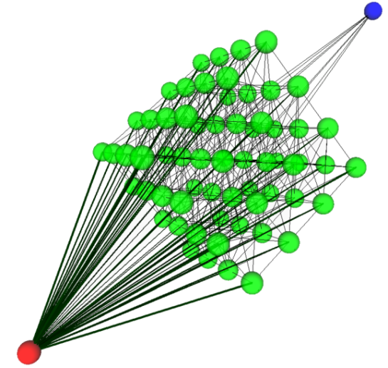

Energy optimization via Graph-Cuts
Compute divergence of
Construct a graph
Data fitness term
T-links
Volumetric potential
Regularization term
N-links
Compute Min-Cut
Surface corresponds to an s/t-cut on the constructed graph!

Slide 12
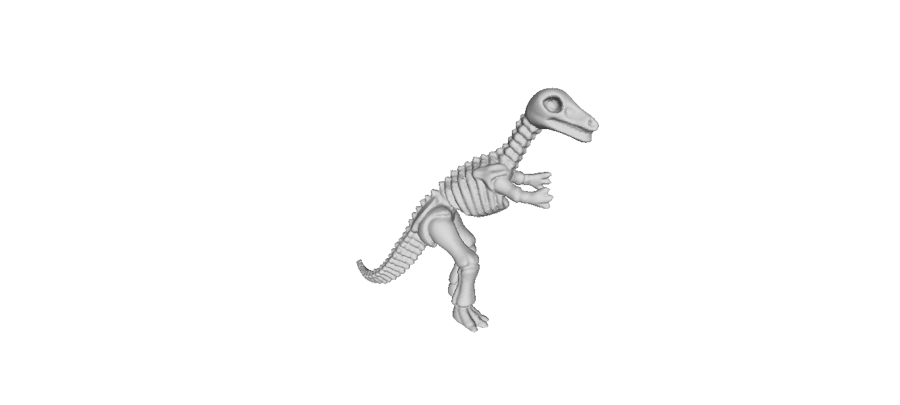
Results on Synthetic Data Sets
Cyberware Dinosaur
58194 vertices, 112384 faces

Slide 13
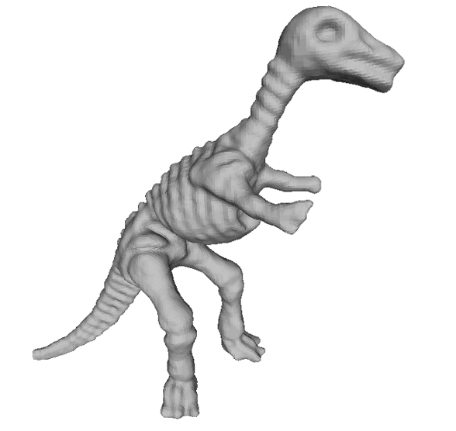
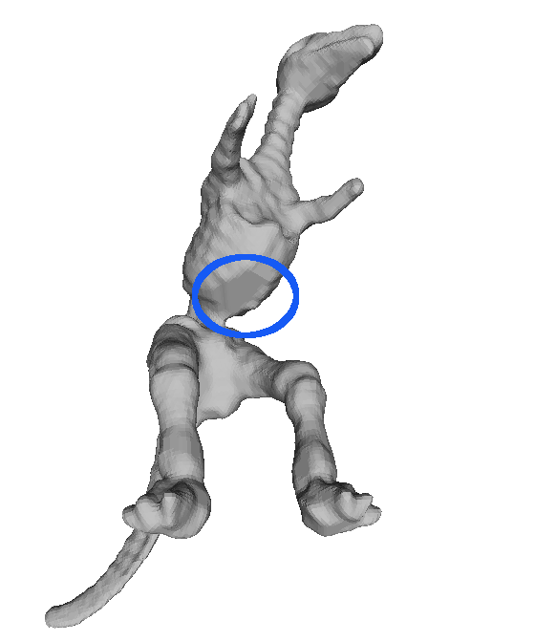
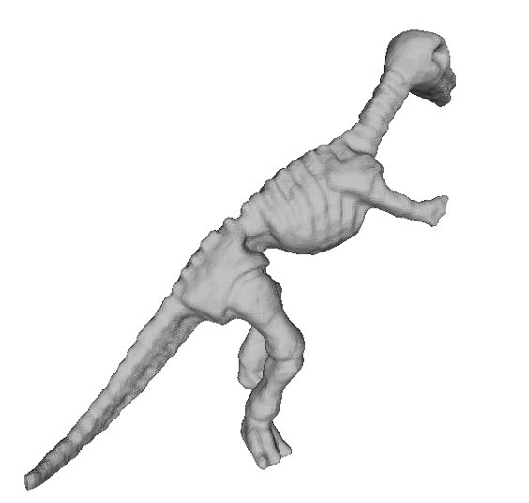
Results - Dino
Grid size: 178x171x66 Band: 6 Cameras: 16

Slide 14
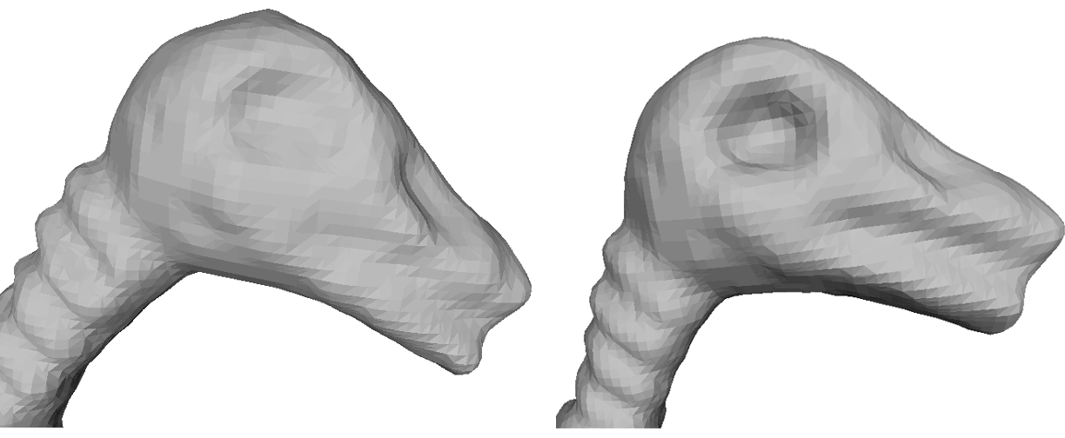
Results - Dino
Band: 3
Band: 6
Grid size: 178x171x66 Cameras: 16

Slide 15
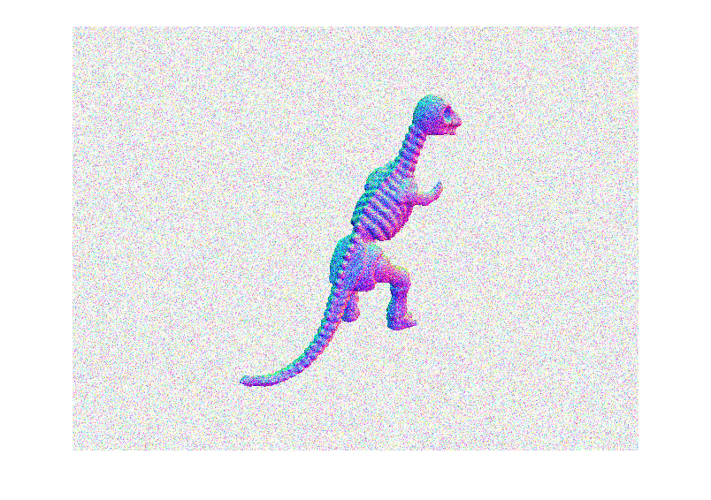
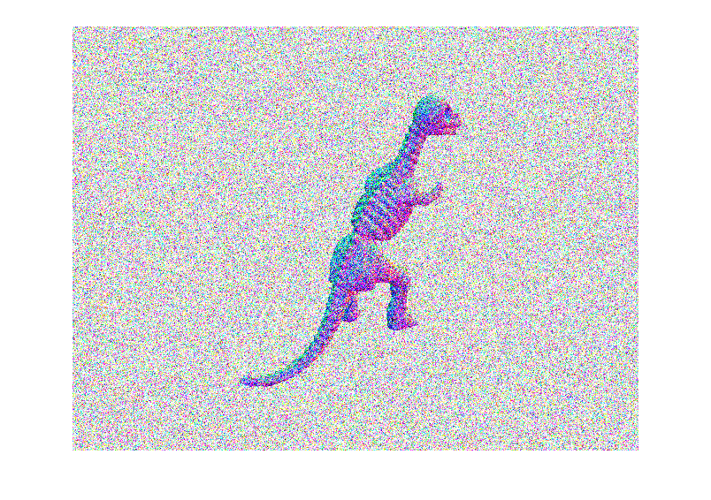
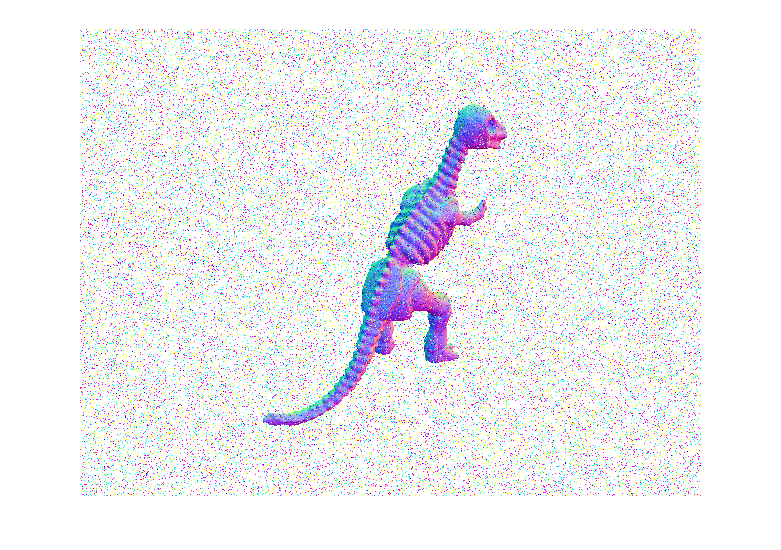
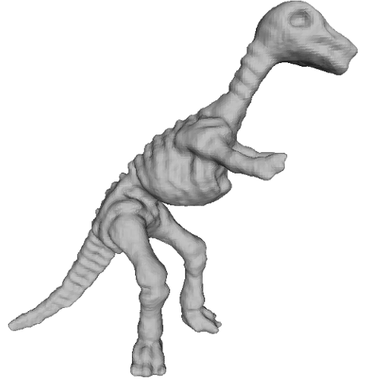
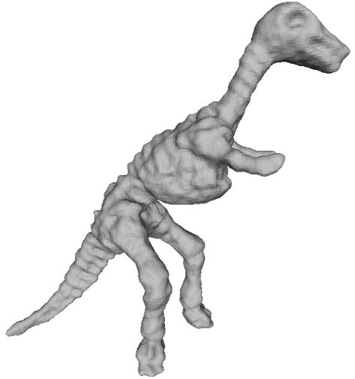
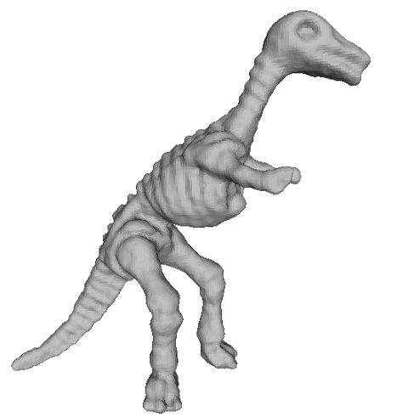
Results - Noise
Gaussian noise (σ=0.05)
Gaussian noise (σ=0.2)
Salt & Pepper
Grid size: 178x171x66 Band: 6 Cameras: 16

Slide 16
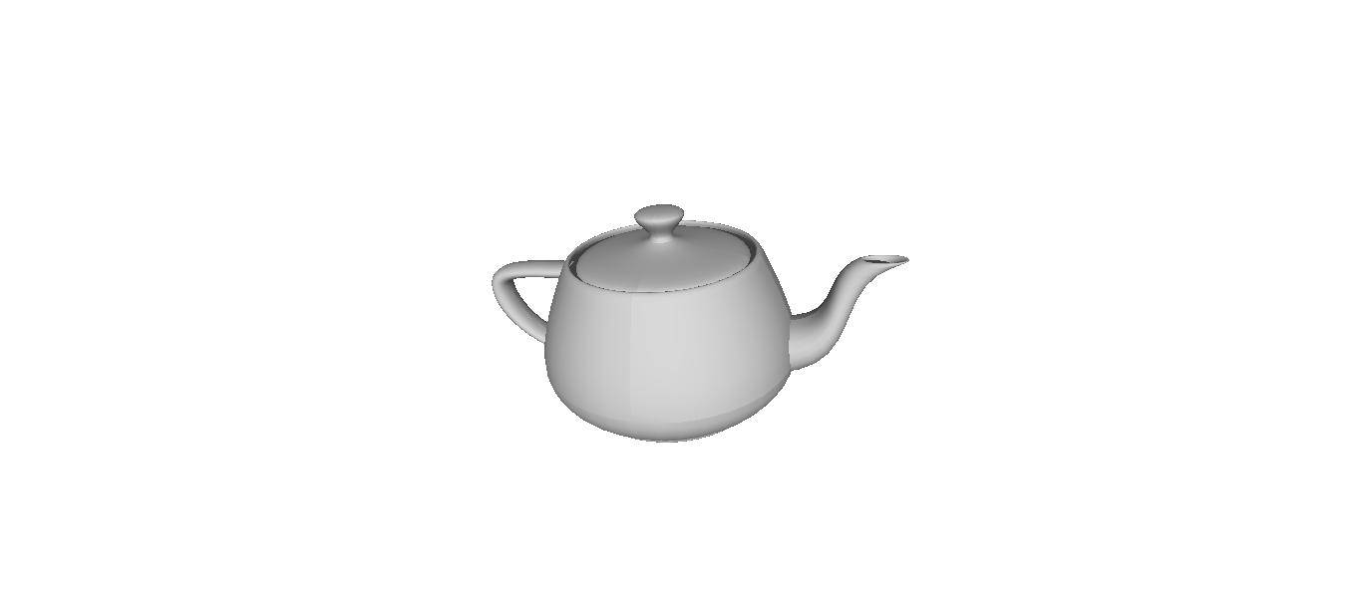
Results - Teapot
Utah Teapot
3644 vertices, 4320 faces

Slide 17
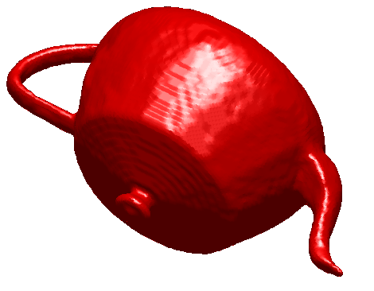
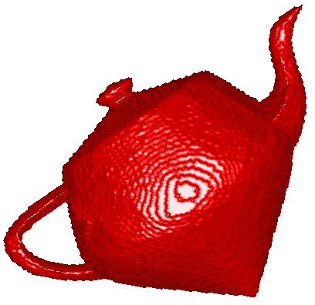
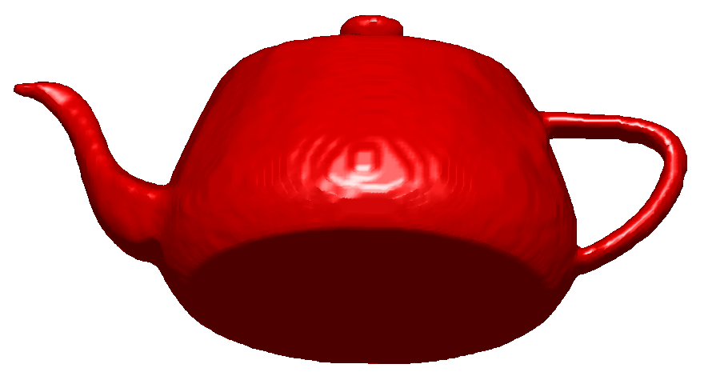
Results - Teapot
Grid size: 184x124x166 Band: 3 Cameras: 16

Slide 18
Conclusion
Multiview Normal Field Integration with Graph-Cuts
Global solution of discretized version of utilized energy functional (under visibility constraints!)
Algorithm robust to noise

Slide 19
Future Work
Optimization of visibility computation
Iterative re-projection of normal fields
Additional energy term penalizing large deviations of back-projected normals
Use of adaptive data structures (e.g. octrees)
Testing with real data (Shape-from-X)

Slide 20
Thank you for your attention!

