Slide 1
Publishing: How To and Peer Review
19 April 2024

Slide 2
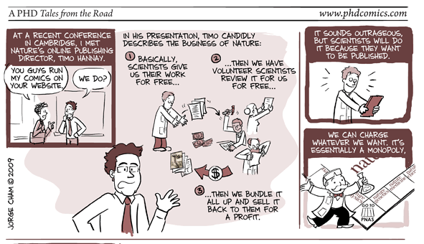
Congratulations! You wrote a paper and want to get it published.
Now what?

Slide 3
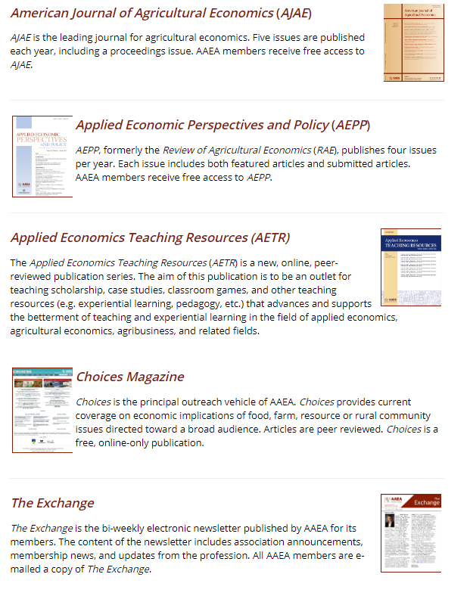




Where? Publishing Process
Professional associations: American Agricultural Economics Association (AAEA)
Universities
For-profit publishing houses

Slide 4
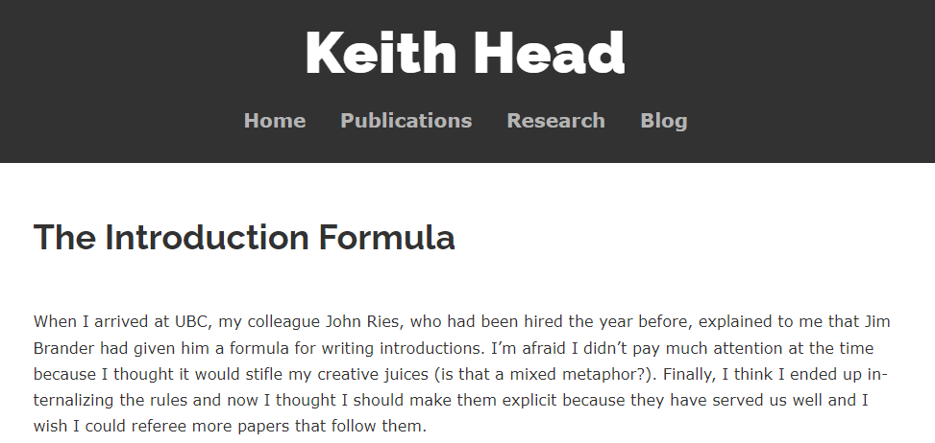
When? Publishing Process
Preparing for submission
Economical Writing: D. McCloskey
12: “Avoid boiler plate”
14: “A paragraph should have a point”
15: “Make tables, graphs, displayed equations, and labels on images readable by themselves”
Head’s “Introduction formula”
Hook
Question
Antecedents
Value Added
Road Map
Presentation matters
Revise, revise, revise: … and then submit.

Slide 5
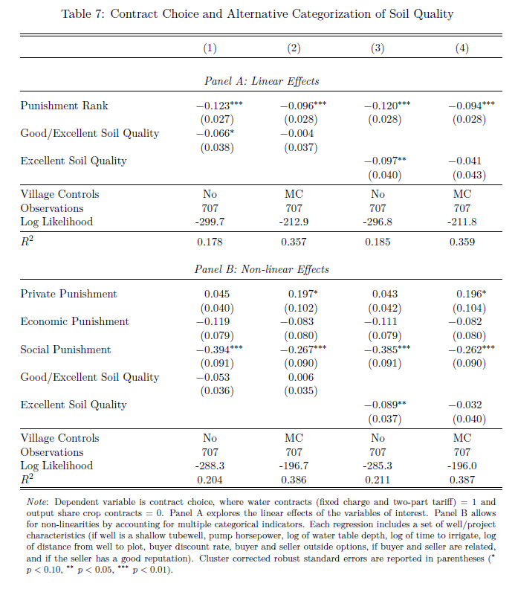

Slide 6
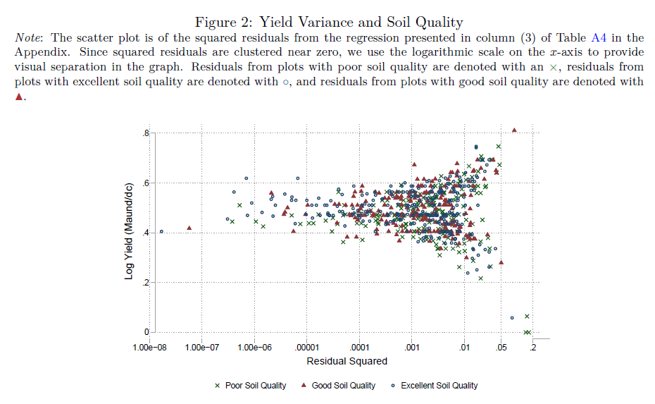

Slide 7
How? Publishing Process
Submitting to a journal
Select an appropriate outlet
Read the aims and scope of the journal - make sure you're familiar with what they're looking for, what they've previously published, etc.
Adapt for standards of journal
Make sure things are together - editing, bibliography
Submit a cover letter, if required
If you're rejected, started again. Might be rejected with comments or receive a ``desk reject'' which comes directly from the editor. If R\&R (revise and resubmit), then carefully address comments - and submit again. Publishing is full of rejection - and that's okay.

Slide 8
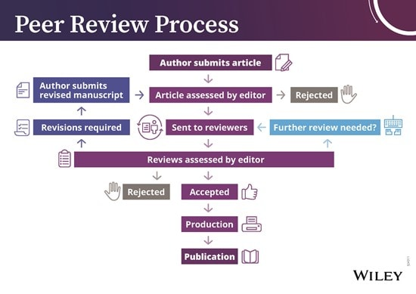
How? Publishing Process
Submit your paper
Peer reviewed
Single blind
Double blind
Response
Reject
Revise and resubmit
Accept

Slide 9
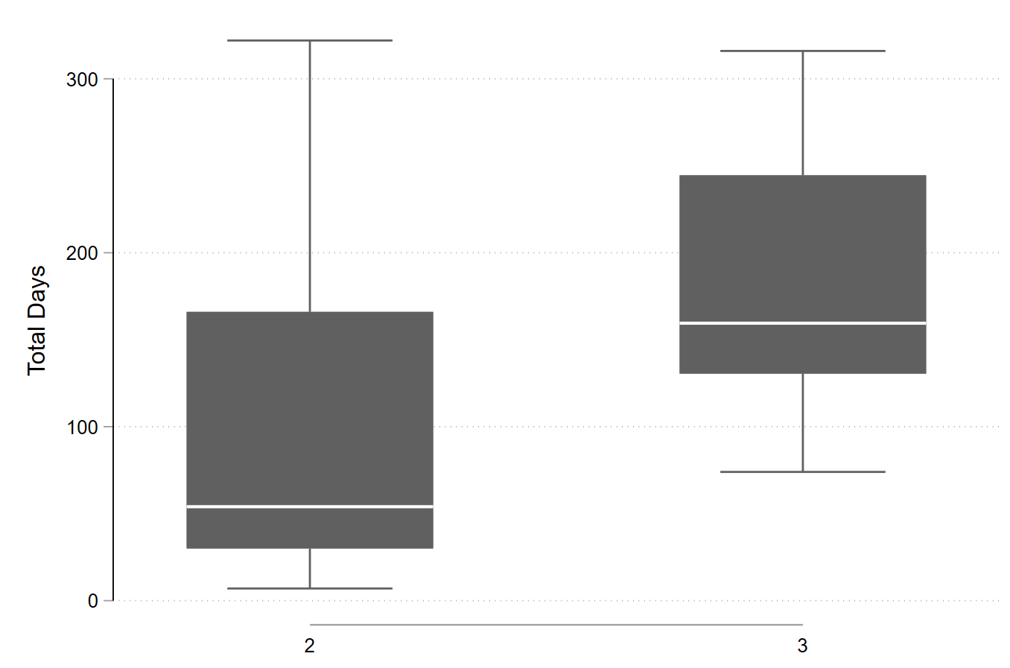
How? Publishing Process
26 papers
Currently in review: 4
Largest number of times paper submitted: 9
Fewest number of times paper submitted: 1
Longest time with editors: 322 (with 316 shortly behind)
Shortest time with editors: 7

Slide 10
Who Me? Publishing Process
Peer Review
Receive invitation from editor for a specific article
Usually accompanied by a due date - make sure you hit this! Publishing times are long - do your best to make sure that you do this service in due time.
Thoughtfully consider article and make recommendation for (1) accept, (2) various on revisions, and (3) reject.
Lots can be said about being a good reviewer - share some resources.
Above all: be quick and be helpful.
Don't ask people to do ridiculous things, don't ask them to do things that aren't necessary. And don't recommend a revision if you don't see a clear path to publication in the specific journal for which you are reviewing!

Slide 11
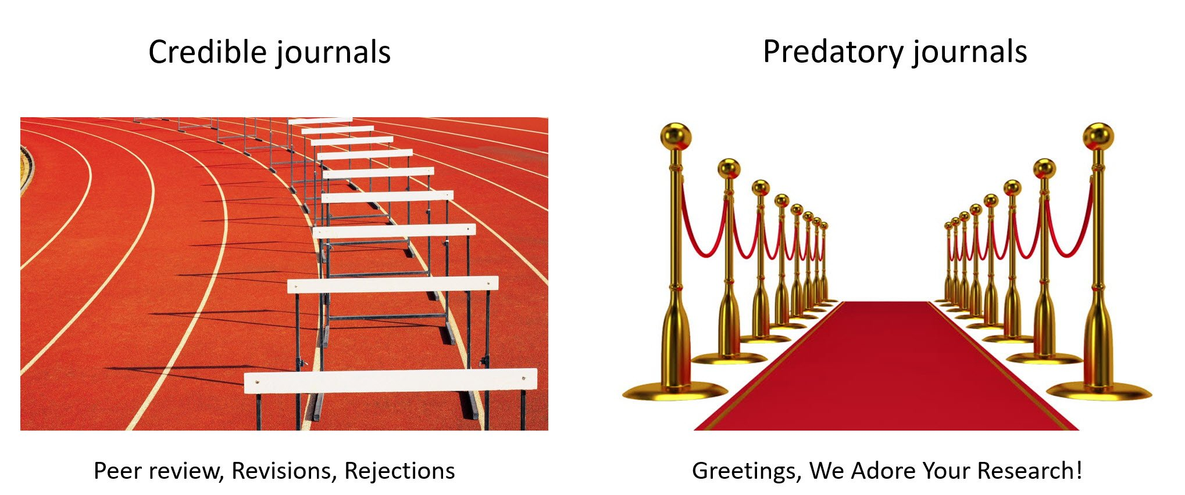
What? Predatory journals and conferences
Exploitative, often open-access academic publishing that involves charging publication fees, without peer-review
People are “tricked” into publishing into them, thinking they are reputable

Slide 12
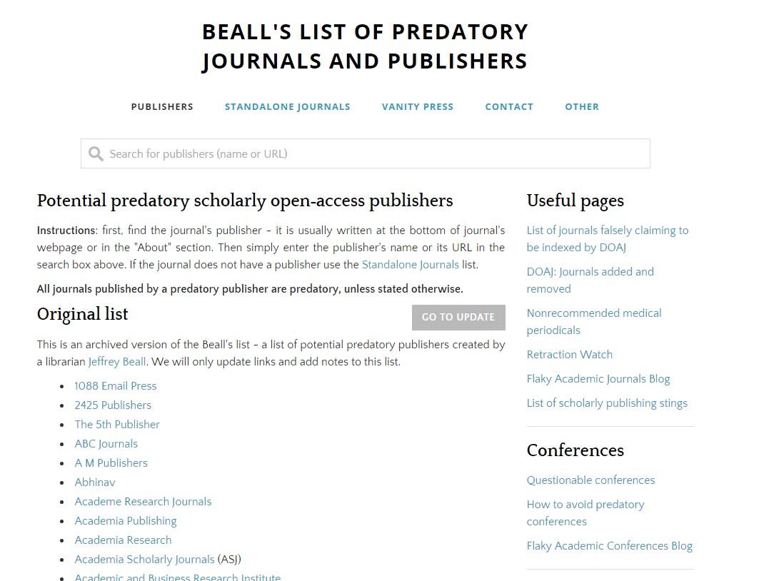
Why? Predatory journals and conferences
Incentives to publish and promote research strong
Prey on lack of knowledge
Researchers seeking more outlets
Reputable journals can publish about predation
Contemporaneous submissions

Slide 13
How? Predatory journals and conferences
The journal does not have a formal editorial / review board.
The publisher has no policies or practices for digital preservation.
The publisher has a “fleet” of journals, and the home page for all appears the same.
The publisher doesn’t share information or hides information about fees, offering to publish something … and then sending an invoice.
The journal name does not reflect its origin.
The journal has a made-up measure of standing, e.g., “view factor” instead of impact factor.

Slide 14
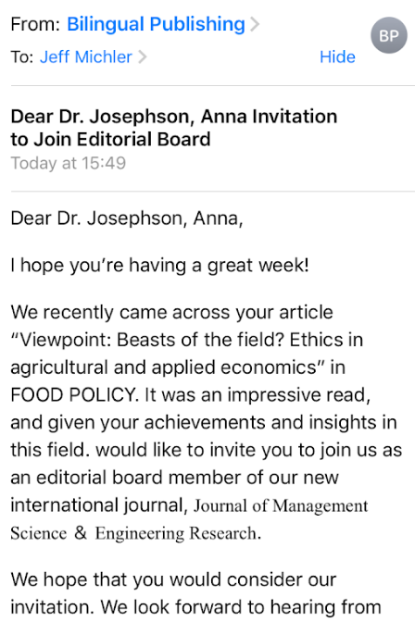
How? Predatory journals and conferences
Know it when you see it
Aggressive solicitations
Experience
1. Do you or your colleagues know the journal? Do you recognize the editorial board?
2. Can you easily contact the publisher?
3. Is the journal clear about their author submission process?
4. Is it clear what fees will be charged?
5. Are they promising a quick (2-3 month publication)?

