Slide 1
AREC596: Workflow
19 January 2024
Week 2

Slide 2
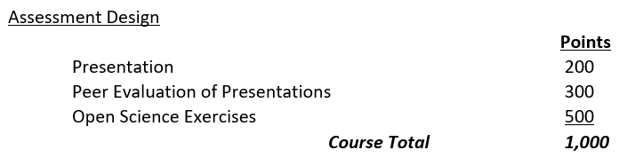
Two Syllabus Changes
Presentation time:
First years: 15 minutes
Second years: 30 minutes
“Grading” weights:

Slide 3
Workflow
Workflow: a repeatable series of actions necessary for completing a task.
It is jargon in manufacturing, management, and software development, but the concept is extremely useful for applied economics research.
Establishing a workflow should be undertaken as a first step.
The sign of a good workflow management system is that when a project is opened, one is immediately able to figure out where all the files are, what the files do, and the order in which they must be run.

Slide 4

Motivation: Transparency and Replicability
Despite its mathematical base, statistics is as much an art as it is a science. A great many manipulations and even distortions are possible within the bounds of propriety. Often the statistician must choose among methods, a subjective process, and find the one that he will use to represent the facts.
-Daryl Huff

Slide 5

Motivation: Make Your Life Easier
Bus Factor: measurement of risk resulting from information (and capacities) held by only one individual.
Essentially: what is lost if this person gets hit by a bus?
Clear workflow makes it easier to return to a project later.

Slide 6
Objectives and Goals
The objectives of a workflow should be to create accurate, efficient, simple, standardized, automated, usable, scaleable, interchangeable, and portable results.
The final goal is to be able to replicate a paper or other piece of research with a single push of a button.
Push button replication
Successful workflow takes all the steps which go into the process of creating a final research project and consolidates them into a single stream of work. This makes it easier to complete your work and share that work with peers and colleagues.
Having established a workflow for a single project, the structure of that workflow can be adapted, with minimal cost, to new projects.

Slide 7
Workflow Principles
Principle
Practice
Data should be treated as immutable.
Do not ever edit your raw data.
Also:
Do not edit your raw data manually.
Do not edit your raw data in Excel.
Do not overwrite your raw data.
Do not save multiple versions of the raw data.
Code in a workflow should move the raw data through a pipeline from cleaning to final analysis.
So you need to start with raw data.
Data should be stored separate from code or other files that manipulate data or otherwise analyze data.
Code on GitHub
Data in OneDrive / GoogleDrive / Dropbox …

Slide 8
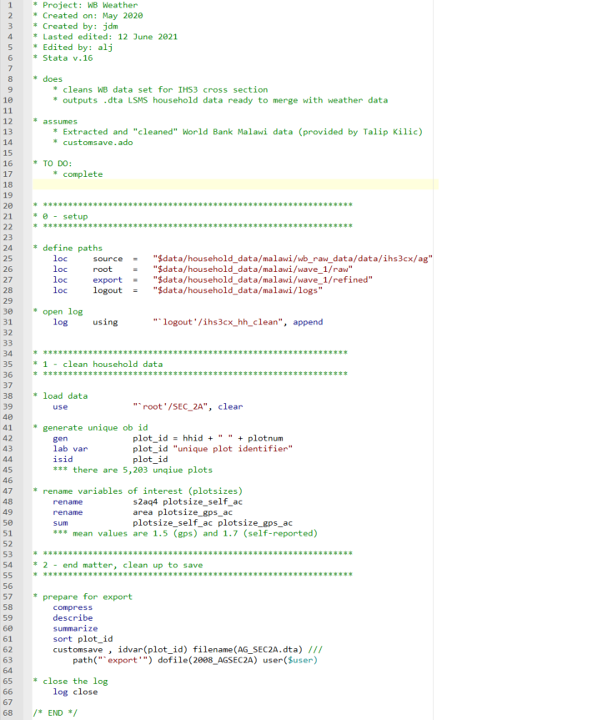
Workflow Principles
Principle and Practice
Use version control: GitHub
Version control is a system that that records every time changes are made to a file so that you can examine any specific version of the file later.
Version control systems track and save changes to the code in the background in a single file, allowing you to go back in time and examine any version and compare what changed between version (and between editors).
There is no need to save multiple versions of the same file.

Slide 9
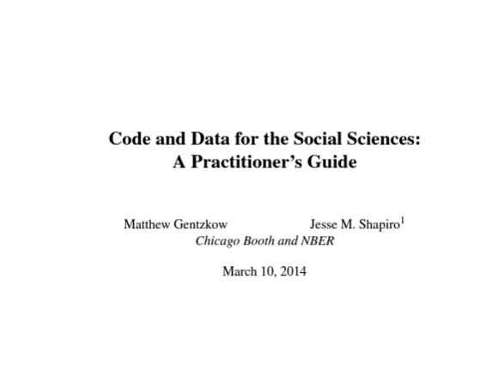
Specifics Will Vary
Specifics of a workflow will vary but:
Your raw data are immutable.
You will use a version control system.
For next week: read Gentzkow + Shapiro (2014):
https://web.stanford.edu/~gentzkow/research/CodeAndData.pdf
I’ll send via email

Slide 10
Recommendations for Good Workflow
Create a development environment.
Streamline your coding script files.
Generate a master file.
Use a consistent style.

Slide 11
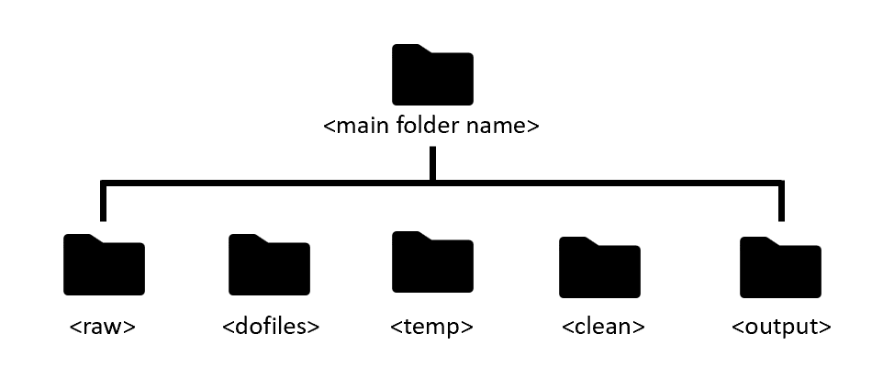
Development Environment
Development environment: the folder structure in which data and code live.
At its best, the code itself will generate the development environment, creating all the necessary folders and placing all the necessary files in those folders, like an installer package for a piece of software.
At a minimum, a development environment should be obvious, easily described, and readily understood.
A good development environment:
Has a clear folder structure, effective naming conventions, makes use of relative paths, and includes a comprehensive README.
Should easily expand to accommodate complexity while still being easy to navigate.

Slide 12
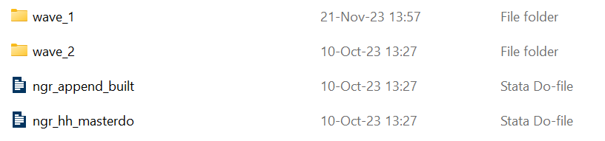
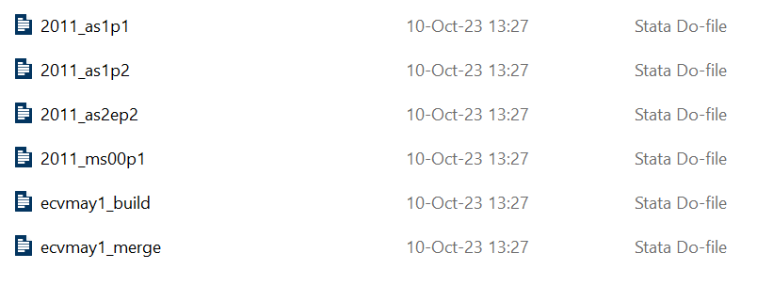
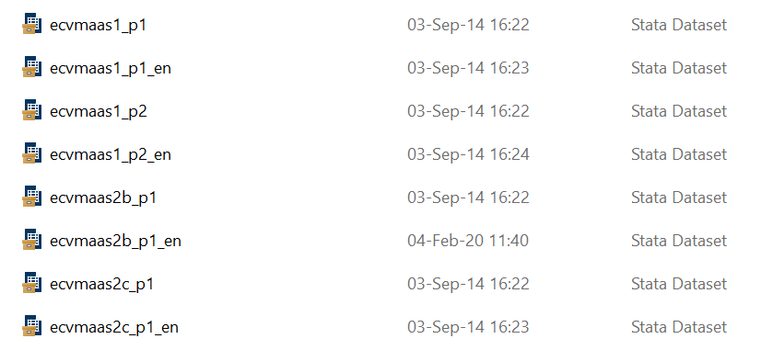
Streamlining Code
Think carefully about the organization of files themselves.
Efficient and clear code is an integral part of a workflow.
To this end, code files should do only one thing.
Variables should be cleaned in a single file.
Cleaned data saved in a new folder, such as ``temp.‘’
A different script file should then merge together the cleaned individual data files.
Another script file should read in the merged data and conduct all of the analysis.
Organize your script files into folders that clone the folder structure of the raw data.
Use a single script file to clean each raw data file and give the script file the same name as the raw data file it cleans.
Have decipherable names for the intermediate script files that merge cleaned data together.

Slide 13
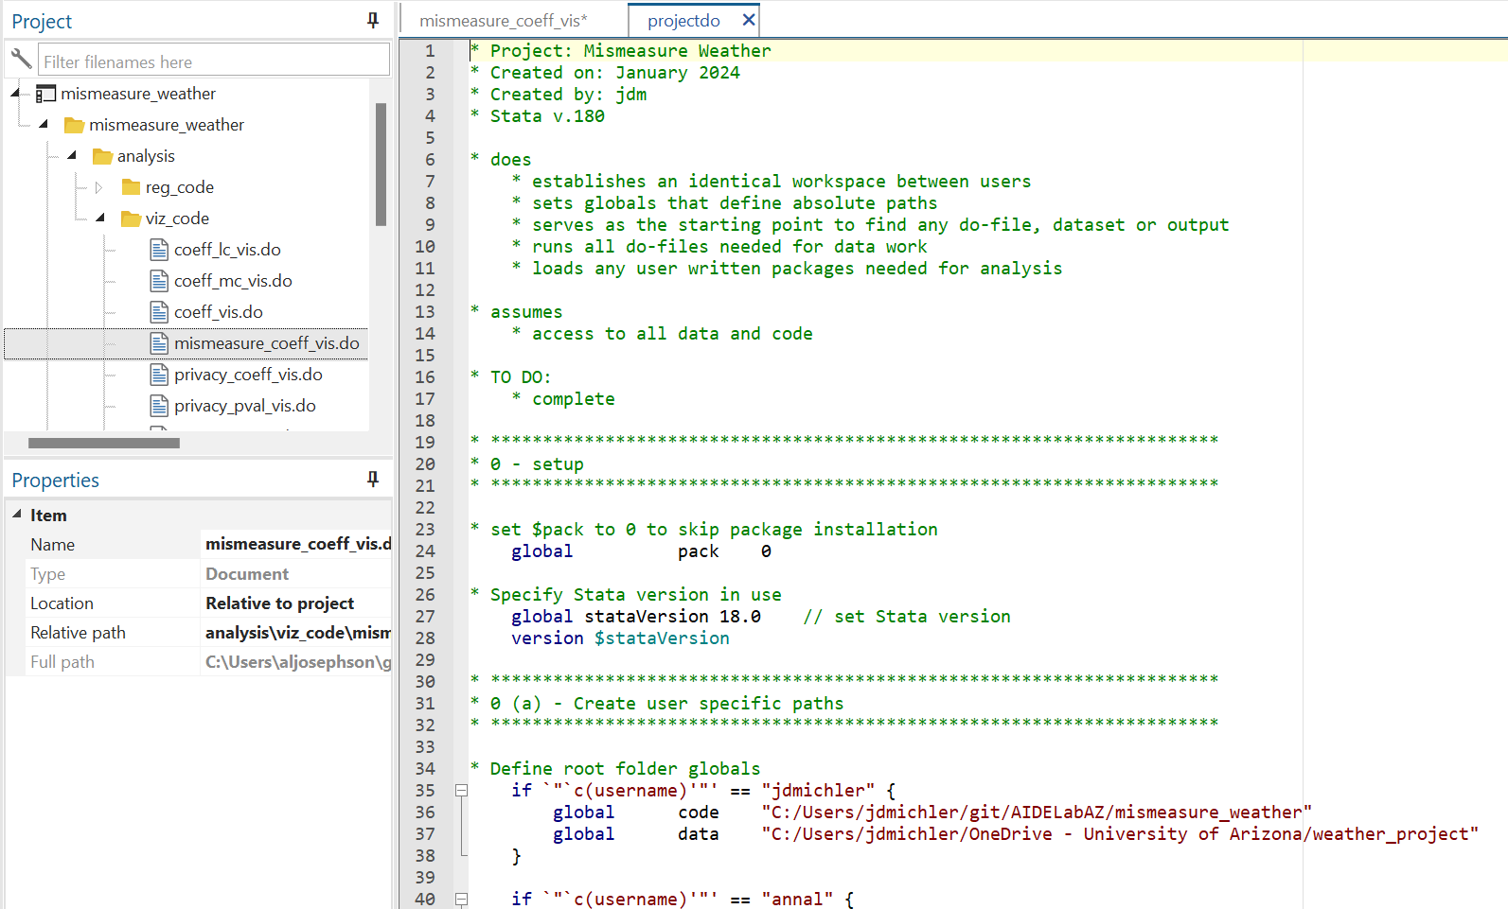
Masterfile
Generate a master or overall project script file: it serves a single purpose, which is to run all of the subsidiary script files for the project, compiling everything together in its entirety and outputting all of the results.
This saves you and other researchers the time of trying to figure out what coding files need to be run.
A master script file (projectdo) allows one to achieve the objective of a successful workflow: push button replication. It should:
Define the root directories for each user, so that the code in all of the subsidiary files knows where to look for the data without having to change directory paths in every file.
Create the development environment itself, downloading the data and placing it in the correct folders.
Install any user-written packages so that the code does not break when it tries to use a package that the current user does not have installed on their machine.
Runs all of the code in the proper order.

Slide 14
Consistent Style
Code should include documentation within each script file which describes details about the project and file, what the file does, what it assumes the user has, and what must still be done on the file.
Headings should label what is being done in a particular section, though following the recommendation above, a single file should not have more than a few sections.
Spaces and tabs should be used liberally in order to make reading code easier.
Comments can be helpful for clarifying and sharing what is intended to occur in a code block and clarifying what actually occurred.
Be guided by computational empathy, always remembering that the code is meant to be run by others, who have none of the context that the original author might have.

Slide 15
For Next Week
Download GitHub Desktop
Ensure you are connected to the AREC596 Repo
Email me about:
Your thesis
If you’d like a sample project
Real data
Example data
Read: Gentzkow + Shapiro (2014)

Slide 16

Questions? …And a “quiz”!

