Slide 1
AREC596: GitHub
26 January 2024
Week 3

Slide 2

Git
Takes a “snapshot” of what an entire folder of files looks like (a "commit") and save that snapshot to a timeline (the "history").
You can then jump to any part of the history to roll back that entire folder to what it looked like at the time of the snapshot (you can "checkout" any commit in the history).
Syncs commit history with other people. You could download ("pull") all of the commits made in the history to somewhere on your computer (a "repository") and have access to all changes.

Slide 3
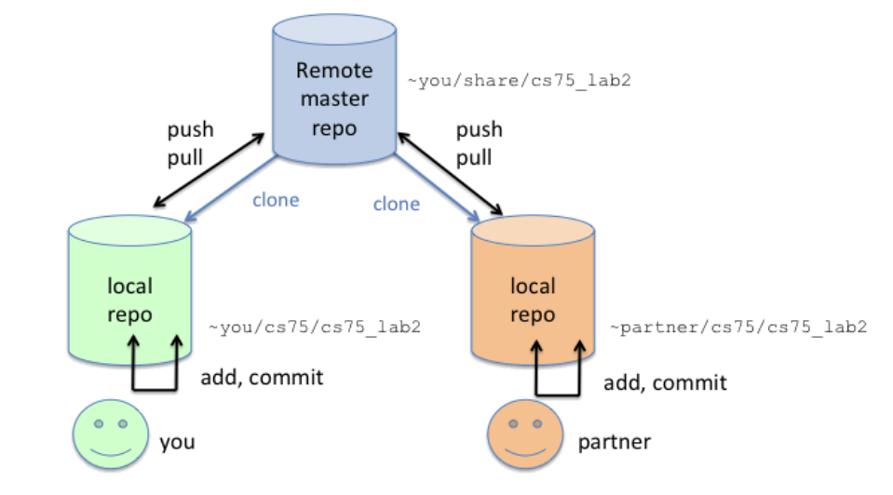
Git
Have one repository that acts as a "main" copy of the history (a "central repository").
All collaborators upload ("push") their changes to it, and they can then pull all changes from their teammates from a single unified location.
https://www.cs.swarthmore.edu/~newhall/unixhelp/git_create.php

Slide 4

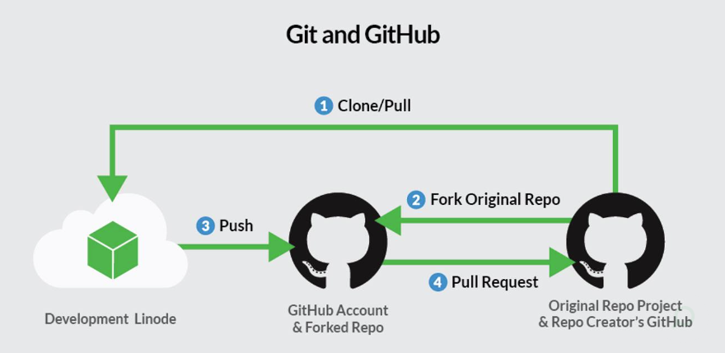
GitHub
Runs Git under the hood, gives you a nice UI to explore the repository contents and act through the website.
Effectively: GitHub serves as the central repository.
https://www.linode.com/docs/guides/how-to-install-git-and-clone-a-github-repository/

Slide 5
For Next Week
Email me about:
Your thesis
If you’d like a sample project
Real data
Example data
Do: GitHub Skills – Introduction to GitHub
https://github.com/skills/introduction-to-github

Slide 6
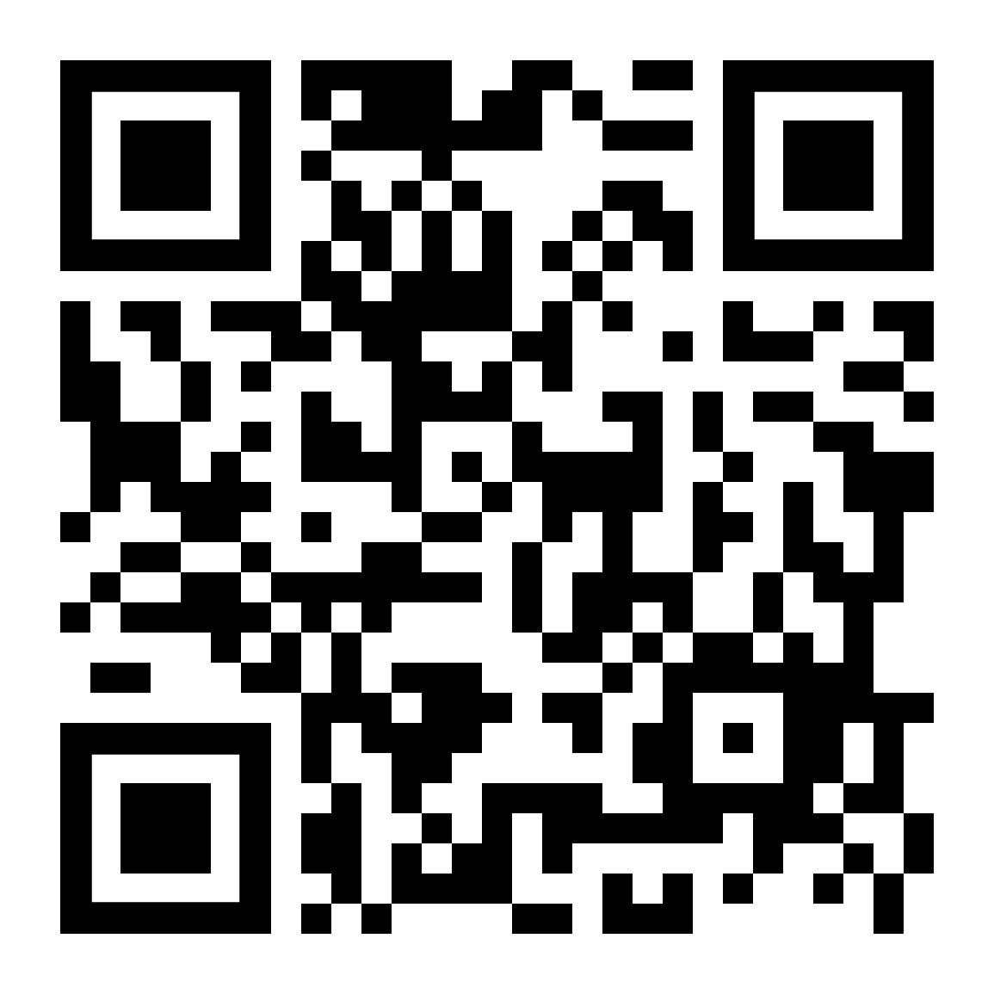
Questions? …And another “quiz”!

