Slide 1
Bomberman
Albert Yoo and Brian Aspinwall

Slide 2
Bomberman
fast-paced, strategic gameplay
2 player pvp
fun, casual game

Slide 3
Rules to the Game
To win, destroy the other bomberman
players place bombs on a grid with breakable and unbreakable obstacles
players have 3 lives and lose a life if they contact an explosion
Bombs explode in a 2 by 2 explosion cross, destroying all but grey bricks

Slide 4
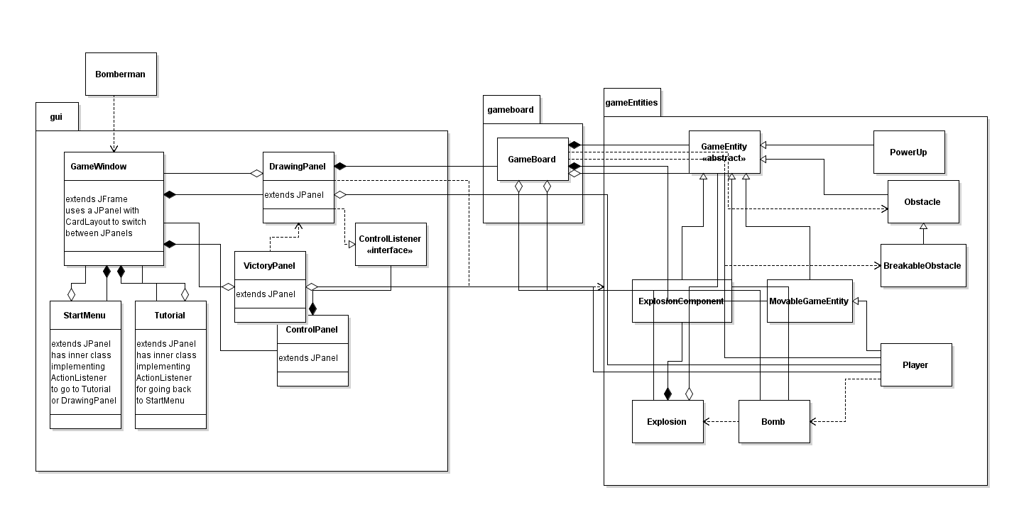
Code Overview

Slide 5
Design Decisions
Usage of a 2d array for non moving GameEntities and ArrayLists for the other entities such as Player, Bomb, and Explosion
GameWindow contains CardLayout and can switch between JPanels
GameEntity is a superclass that all other types of game entities can extend from

Slide 6
Hardest problems
direction control of MovableGameEntity and collision detection
timing the explosions and bombs within the run method of DrawingPanel
organizing GameEntities and its subclasses in the GameBoard class

Slide 7
Instructions
Player 1: WASD keys and q
Player 2: Arrow keys and space

Slide 8
Current Features and Bugs
Bomb explosion timing is not accurate
When the first Player bomberman is removed from the game, the second Player bomberman2 can be controlled by controls for bomberman
even when the second Player wins the game, the Victory Panel shows that the first Player wins the game
the lives for each player are not shown
Tutorial is empty

Slide 9
Next Steps
fix the player error
add information about the game in the ControlPanel
multiple levels
more players - networking?
more items and powerups
better obstacle design - make it easier to maneuver between obstacles

