Slide 1
EK4
(Extraterrestrial Kidnapping of the 4th Kind)
Deekshita Chigullapally, Vanessa Hurtado,
Francisco Rocha, Alice Yu
Notes:
Deekshita

Slide 2
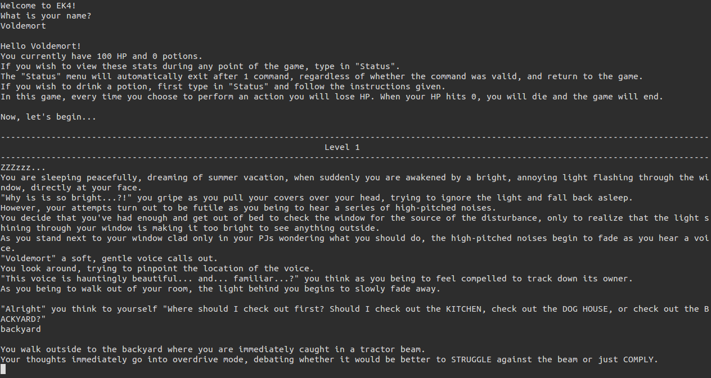
Our game begins with the player in their house when a beam of light appears in their backyard. Throughout the game, the player decides what to do as they journey into the extraterrestrial unknown. Each time they commit an action, their health decreases, creating the need to find the quickest route back home.
Notes:
Deekshita

Slide 3
Java vs. Haskell
Haskell has only immutable objects while Java has both immutable and mutable objects
Haskell does not allow for branching or loops
Java has a more extensive library
Notes:
Alice

Slide 4
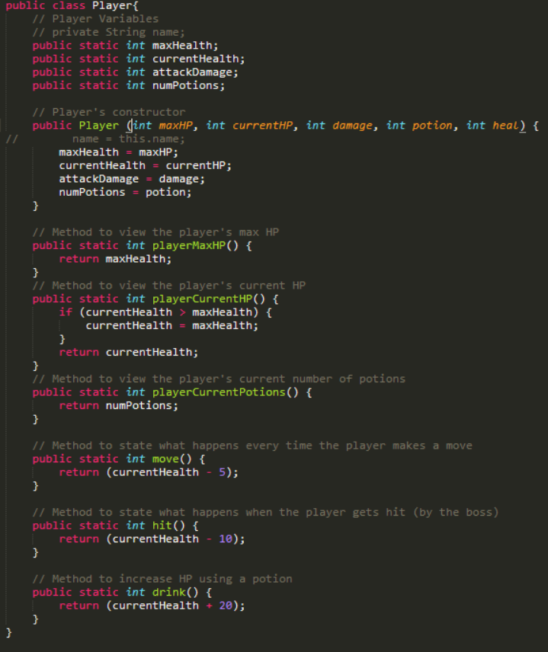
Java review
Simple, but lengthy
Similar to pseudocode
Numerous libraries
Notes:
Pseudocode: For example, loop statements
Alice

Slide 5
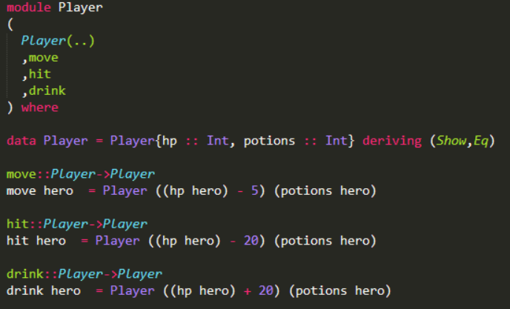
Haskell review
Few examples
Harder to implement
Many limitations
Everything has to be written in terms of functions
Notes:
Frankie

Slide 6
Current Progress
Storyline is completed
Implementation in Java is completed
Implementation in Haskell is in progress
Notes:
Vanessa

Slide 7
Challenges
Coming up with an original storyline was harder than expected
Less experience with functional programming logic
Coding in Haskell was extremely hard
Immutable objects
No loops or branching statements
Error checking and debugging
IO Monads
Notes:
Deekshita

Slide 8
Demo
Demo Video: https://youtu.be/u2N0OwPxczI
Notes:
Deekshita and Alice

