Slide 1


Slide 2
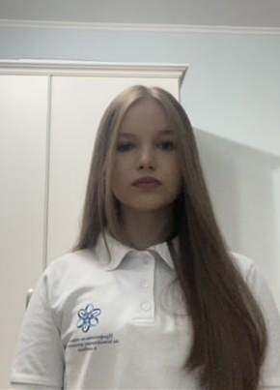
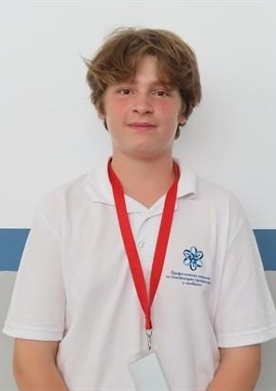
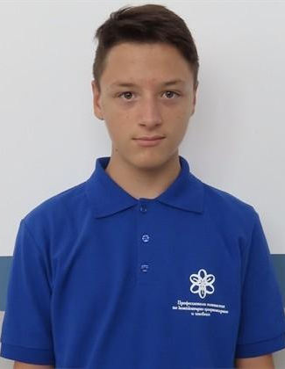
Our Team
Mila Lazarova
Designer
Borimir Kirov
Back-end developer
Alexander Georgiev
Scrum-trainer
Dimitar Dimitrov
Back-end developer

Slide 3
Stages of creation
01
03
02
04
Create team
Make an application
Choose an idea
Make documentation

Slide 4






FIRST ANNOUNCEMENT

Slide 5
Let’s get to the application

