Slide 1
Asset Management System
- Alka Kumari

Slide 2
Background
This project is inspired and takes me back to my very first job. It was in a start-up company and every employee was working on something additional other than just the assigned job.
As a Project Coordinator, other than overseeing the projects on-hand, I was also managing the assets in the company in absence of the HR. But there was no proper system for it in place, in short they were maintaining the all the details on a physical notebook.
Later on I converted everything on a simple excel spreadsheet which was easy to maintain and share with all the colleagues. Hence, when we were asked to come up with a project idea, managing assets in a proper database clicked right away on my mind.
Hence, in Asset Management System I have attempted to arrange and maintain a record of the various assets that are generally available in a company. The Management System is a condensed form of how a business could maintain the specifics of its assets and keep a track of them.
The system will keep a record of information specific to each asset owned and operated by the company. In addition to that, maintaining quick information such as which asset was issued, to whom the asset was issues to, when was it issued, and when was it returned.

Slide 3
Tables used for Database
Employee | To keep the details of all the employees in the company
Department | Department details for all the Employees
Harddrive | Every Employees will get an Harddrive on the date of joining to store the details of the projects they are working on
Telephone | Every Employee shall have a landline assigned to them. They can also have a office mobile phone along with a landline.
Assets | Details of all the assets owned by the company shall be present in here.
Asset Assignment | This table will show which assignment has been issued to whom along with the reason of issuance, return date, asset details and employes details who have issued the asset.

Slide 4
Subtype tables for Supertype Table Asset
Laptop | This is an Asset-type for table Asset consisting details regarding the laptops and their properties like- LAPTOP_ID, LAPTOP_BRAND, LAPTOP_RAM, LAPTOP_PROCESSOR, LAPTOP_SCREEN_TYPE
ipad | This is an Asset-type for table Asset consisting details regarding the ipad and their properties like - IPAD_ID, IPAD_STORAGE, IPAD_WARRANTY, IPAD_STYLUS, IPAD_MANUFACTURED_YEAR
Tablet | This is an Asset-type for table Asset consisting details regarding the tablet and their properties like- TABLET_ID, TABLET_COLOR, TABLET_SIZE, STYLUS, TABLET_SLEEVE
Headphones | This is an Asset-type for table Asset consisting details regarding the headphones and their properties like- HP_ID, HP_WIRED, HP_DB_RANGE, HP_NOISE_CANCEL, HP_COLOR

Slide 5
Relationships among Entities
COMPONENTS OF THE ERM
ENTITY | RELATIONSHIP | CONNECTIVITY | ENITITY
EMPLOYEE | Belongs | 1:1 | DEPARTMENT
EMPLOYEE | Has | 1:1 | HARDDRIVE
EMPLOYEE | Has | 1:M | TELEPHONE
EMPLOYEE | Requests | M:N | ASSET
*ASSET_ASSIGNMENT is the composite entity that implements the M:N relationship “EMPLOYEE requests ASSET”

Slide 6
What Went Well
01
02
03
Crow’s Foot Notation
Creating Database
Relationship in phpmyadmin
Crow’s Foot Notation was the first method I started with. To understand what attributes to add and how to display all of the relationships between tables, it gave me an insight into the database design.
A great deal of concepts were clarified through creating and putting values into databases. The process of building our own database was enjoyable and a great learning experience to me.
I was also amazed to see how relationships between tables gets created by its own when there were no errors in the tables.

Slide 7
What I Struggled with
To come up with what kind of entities and attributes to use, to store the details for the database
It was difficult to conceive a subquery in a way, such that the output would represent what I wanted to show.

Slide 8
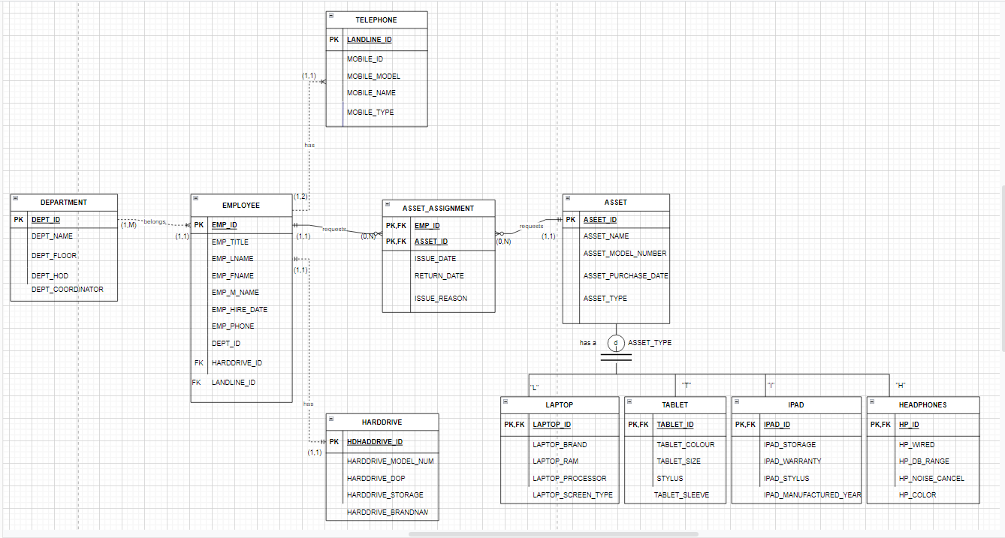
C R O W ‘s F O O T N O T A T I O N

Slide 9
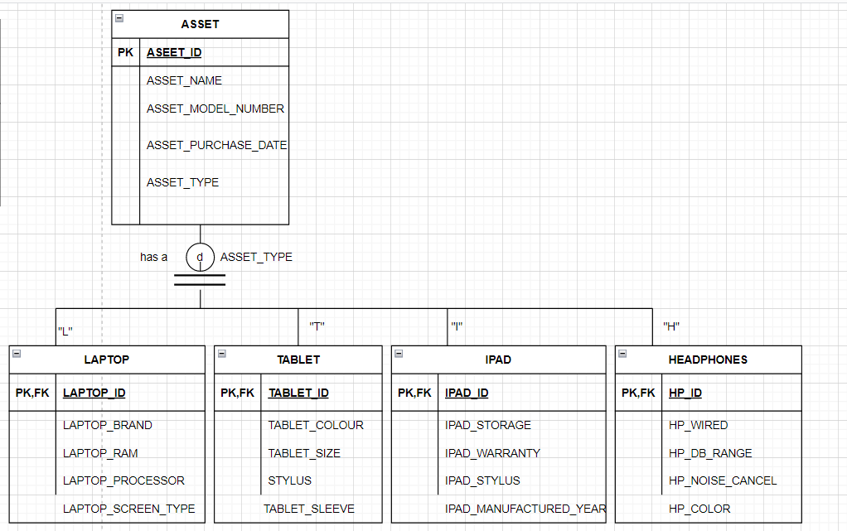
SUBT YPE / SUPERT YPE

Slide 10
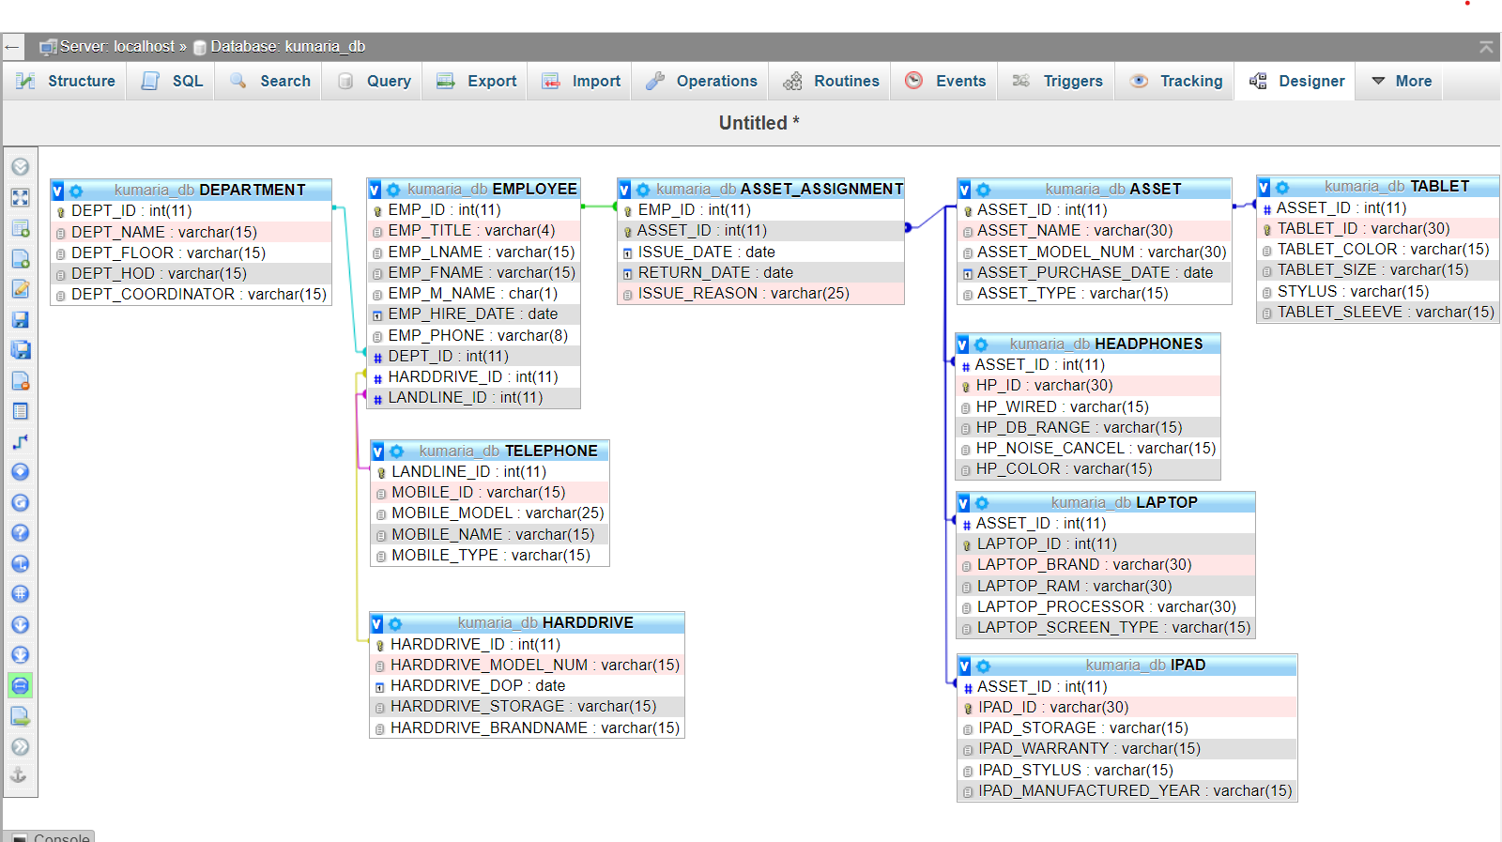
Relationships in phpMyAdmin

Slide 11
Thank you
- Alka Kumari

