Slide 1
Mobile Price Range Classification

Slide 2
INDEX :
Aim
About dataset
Import necessary packages
Basic pre-processing
Exploratory data analysis
Detection and removing outliers
K fold cross validation
Logistics Regression
Random Forest Classifier
Hyperparameter Tuning
Xg Boost classifier
Model performance
Anova and Chi square test

Slide 3
AIM:
To find the discrepancies in data.
To find relationship across various factors.
To pre-process the data and remove outliers.
To gather the best model performance.
Compare models with various performance Metrics.

Slide 4
Dataset has 21 columns and 2000 rows
Id : ID
battery_power : Total energy a battery can store in one time measured in mAh
blue : Has bluetooth or not
clock_speed : speed at which microprocessor executes instructions
dual_sim : Has dual sim support or not
fc : Front Camera megapixels
four_g : Has 4G or not
int_memory : Internal Memory in Gigabytes
m_dep : Mobile Depth in cm
mobile_wt : Weight of mobile phone
n_cores : Number of cores of processor
pc : Primary Camera megapixels
px_height: Pixel Resolution Height
px_width: Pixel Resolution Width
ram: Random Access Memory in Megabytes
sc_h : Screen Height of mobile in cm
sc_w : Screen Width of mobile in cm
talk_time : longest time that a single battery charge will last when you are
three_g : Has 3G or not
touch_screen : Has touch screen or not
wifi : Has wifi or not
Price_range : This is the target variable with value of 0(low cost), 1(medium cost), 2(high cost) and 3(very high cost).

Slide 5
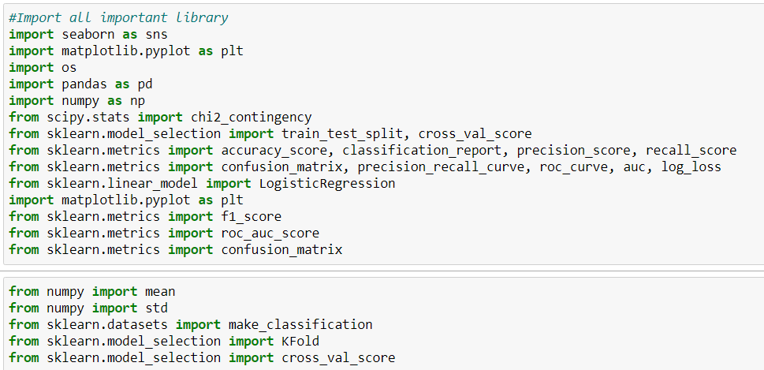
IMPORT NECESSARY PACKAGES:
We used pandas to convert the csv file for processing.
Sklearn as we all know houses many levels of different machine learning models .
We employed matplotlib and sea born for plotting the graphs and other visualization processes.

Slide 6
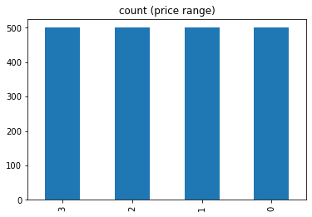
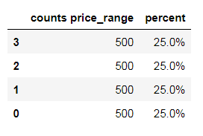
EXPLORATORY DATA ANALYSIS:
This graph implicates that total counts for different price is equal.So our dataset is balanced datasets

Slide 7
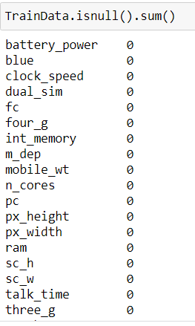
EXPLORATORY DATA ANALYSIS:
From this code we find any missing value.
This tables shows that there is no missing value.

Slide 8
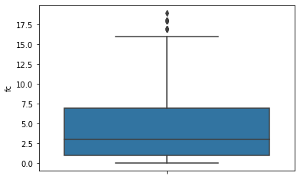
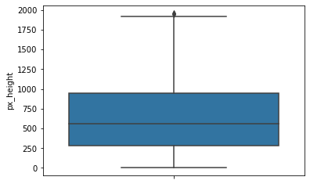
DETECTION AND REMOVING OUTLIERS:
The box plots give us a much more idea about how many number of outliers there are and help us to remove it .

Slide 9
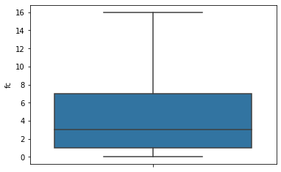
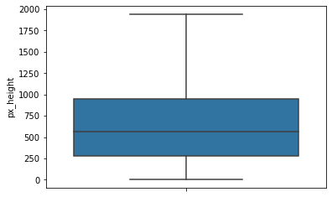
DETECTION AND REMOVING OUTLIERS:
Features fc and px_height has outliers so we remove and clean with specific value.
LR=(Q1 - 1.5 * IQR)
UR=(Q3 + 1.5 * IQR)

Slide 10
Hypothesis testing:
We performed chi sq test and ANOVAs test to check there relationship with dependent variable.
Chi square is performed between price range and categorical features.
Categorical features is after observing data bluetooth, dual_sim, four_g, n_cores, three_g, touch_screen, wifi, Price_range is categorical features in this data.
After chi sq test performed between this features with price range we found there is no association between them.
Also performing Anova we found battery power ,ram , int_memory , px_height , px_width have significant difference with price range.

Slide 11
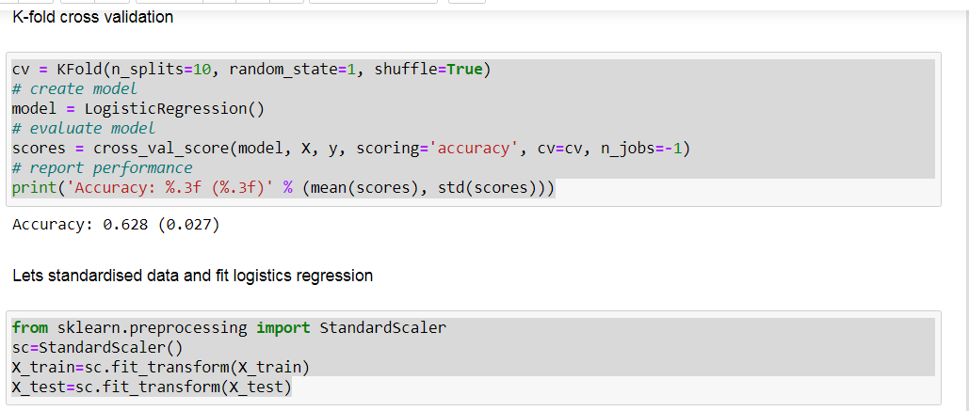
K-FOLD CROSS VALIDATION AND STANDARDISATION:

Slide 12
MODEL PERFORMANCE :
MODEL | Training Accuracy (Before Standardized) | Testing Accuracy(Before Standardized) | Training Accuracy (After Standardized) | Testing Accuracy (After Standardized) | F1 Score
Logistic Regression | 0.64 | 0.63 | 0.97 | 0.93 | 0.93
RANDOM FOREST Classifier | 1 | 0.88 | 1.0 | 0.88 | 0.87
XG Boost Classifier | 1 | 0.92 | 1.0 | 0.91 | 0.91

Slide 13
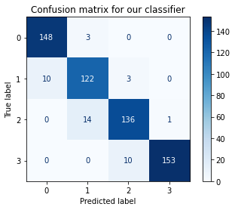
CONCLUSION
battery power ,ram , int_memory , px_height , px_width this features is very important for price change.
It is very apparent that Logistics Regression Model is best model for train and test data.
Before Standardization data accuracy is very low it is under fit model but after standardization model accuracy is increases.

Slide 14
FURTHER ACTIONS:
We also build model with only those columns which has significant difference with price range .
Ram show significant impact on price range.
Xgboost is robust method we can also used.

Slide 15

THANK YOU

