Slide 1
RLHF on
Sentence Generating
T34
马雨菲 119010233
隋皓然 120090339
尹启骅 120090784
姚星瞳 120040065

Slide 2
TABLE OF CONTENTS
01
02
03
Discussion
Introduction &
Background
Method & Implementation
What do the results imply?
What is our task?
Why use RLHF?
What did we do?

Slide 3
Introduction & Background
01
Reinforcement Learning
Human Feedback

Slide 4
Our task
- Start from sentence generating, we want to build a model to generate story with the beginning given by us.
- The content should be consistent, logical and creative.
- We choose reinforcement learning with human feedback (RLHF) to achieve our goal.

Slide 5
Why RLHF?
For traditional language model:
Most of them are still trained with a simple next token prediction loss (e.g. cross entropy).
Hard to capture the feature like: whether a story is creative or not.
Reinforcement learning with human feedback:
Can introduce human feedback as a measure of performance and use that as a loss to optimize the model.
The idea: Based on reinforcement learning, it introduces human feedback as a measure of performance and use that as a loss to optimize the model.
Great AI language model like InstructGPT and ChatGPT are trained with this method.

Slide 6
Method & Implement
02
Reinforcement Learning with Human Feedback

Slide 7
Schema of RLHF
RLHF is a complicate method involving multiple models and multiple phases. It can be decomposed into three parts.
Pretrained Model
Training Reward Model
Reinforcement Learning

Slide 8
Pretrained Language Model (LM)
A nature language processing model that create a series of texts.
This is the basis for RLHF
The text generated by the LM will become the dataset for Reward Model and Reinforcement Learning Process
No best LM for RLHF
Most of the successful cases use pretrained LM based on Transformer
GPT (OpenAI)
Gopher (deepmind)
Transformer (Anthropic)

Slide 9
Reward Model
A model that receives a series of texts and returns a scalar reward
Use the manual ranking of text generated by LM as the training data set of RM
Ranking instead of rating
Rating may be biased due to differences in personal values
Rank the text generated by LM based on the human feedback
interestingness, positive or negative emotion, logicality

Slide 10
Reinforcement Learning
Tuning the parameters and matrix of the LM to maximize the reward that RM returns for the text it generates
Iterative optimize the parameters, update RM and LM until LM met the requirements
Common reinforcement learning method in RLHF
Policy Gradient(PG)
Proximal Policy Optimization(PPO)

Slide 11
Method & Implement
02
Reinforcement Learning Human Feedback
+
Language Model

Slide 12
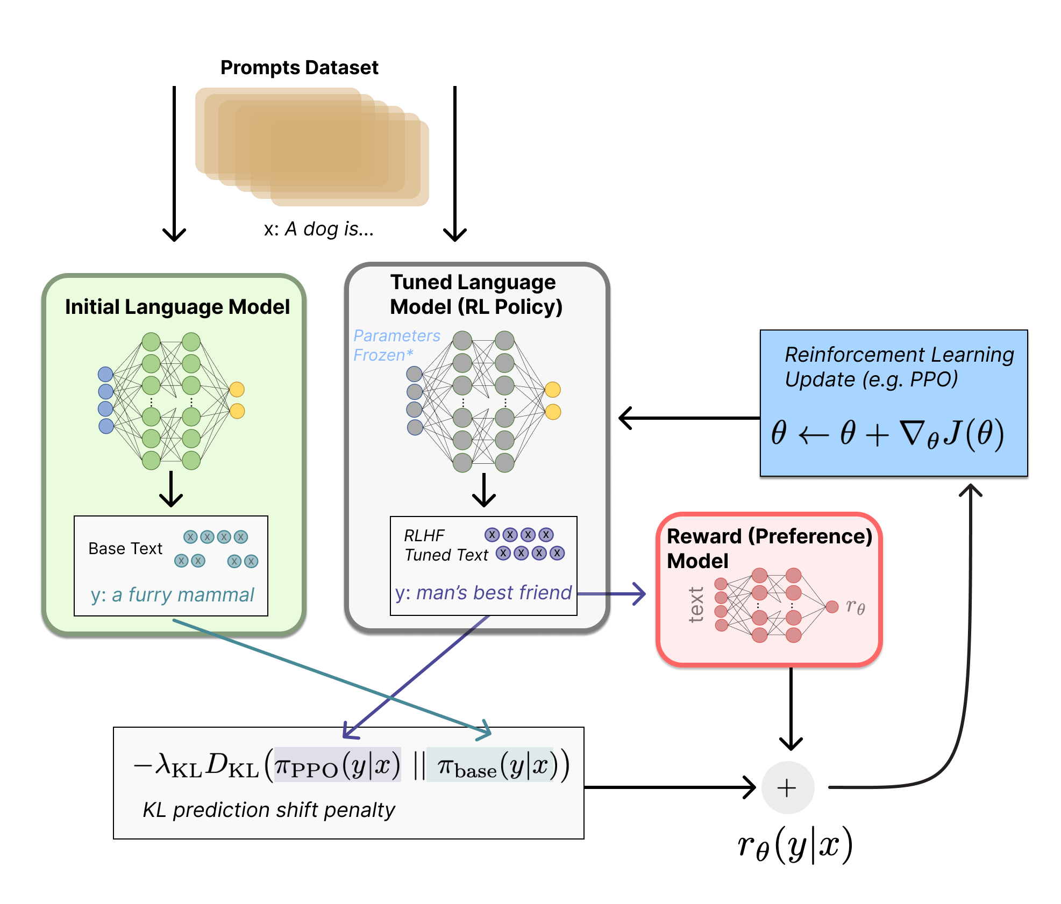
KL-penalty
-Kullback-Leibler (KL) divergence - Constrains the RL fine-tuning result to not result in in a LM that output gibberish

Slide 13
PPO
-On Policy algorithm -Works with discrete or continuous actions -Optimized for parallelization

Slide 14
Challenges
Device limitations
Data quantity limitation
Model Choosing
Codes Implement
Unable to use RL4LM
A good model requires a lot of manual feed back and pretrained data
Most of the pre-trained models do not match our needs or the effect is relatively poor
A large amount of codes and configuration files that need to be modified

Slide 15
Language Model: GPT-2
GPT-1
GPT-2
GPT-3
1
1st GPT model, with 117 million parameters
2
3
1.5 billion parameters ; high-quality, coherent text
175 billion parameters;
Perform a wide range of natural language tasks
2018
2019
2020

Slide 16
Training Process
Dataset+Prompt
Reward
STEP 02
STEP 04
STEP 01
STEP 03
GPT-2
Improve
Randomly choose
By human feedback
Output the following part based on the prompt
the reward model

Slide 17
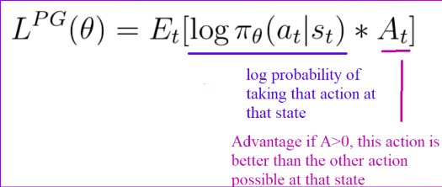
Proximal Policy Optimization
Why PPO?
Its ability to handle exploration and exploitation effectively.

Slide 18
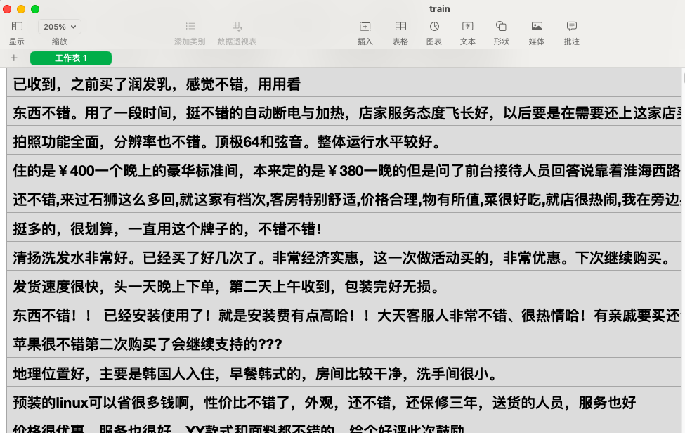
Data set + Prompt
Data set
SATURN
STEP 01
STEP 02
Mostly collected from comments
Why?
Easy to collect
Easy to find Criteria for human feedback

Slide 19
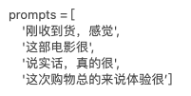
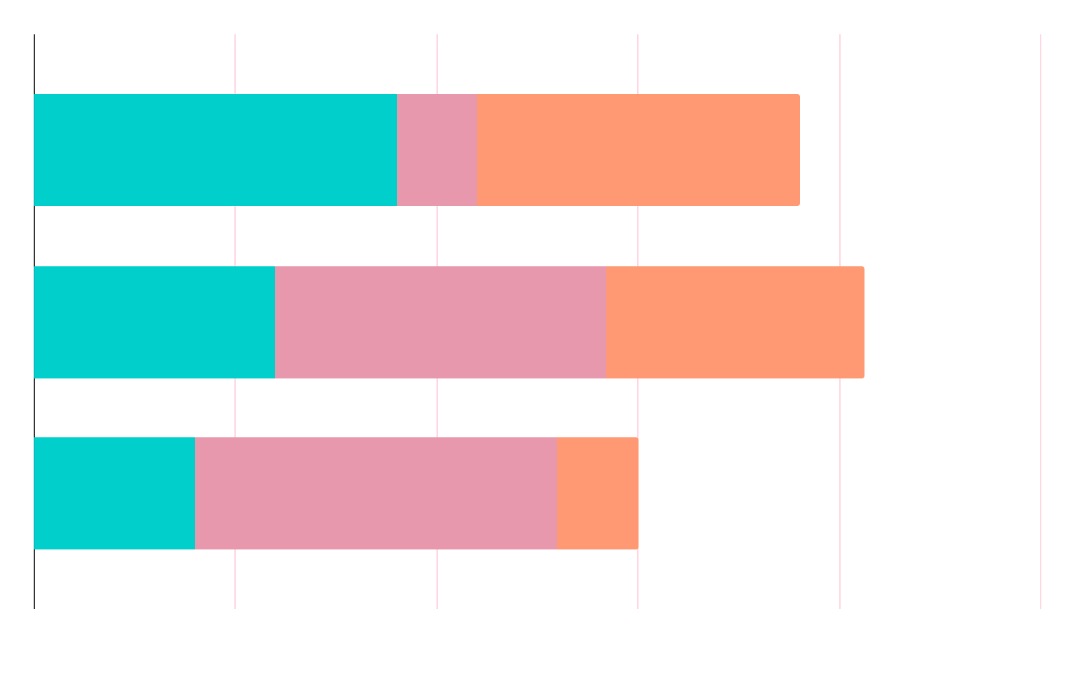

Prompt + GPT-2 (NO human rewards)
SATURN
STEP 01
STEP 02
Just received the goods, I feel...
This film is very…
To be honest, this…
Overall, this experience is… …
Output 1:Just received the goods, I feel a little bit out of expectation, not good
Output 2: Just received the goods, I feel a little speechless, the delivery is too slow

Slide 20

Language Model + human rewards
STEP 02
STEP 03
What we want:
Language model can learn to generate "positive emotion" sentences
What we do:
Evolve the existing GPT model through "reinforcement learning”
Score each generated result of the model, for example:

Slide 21
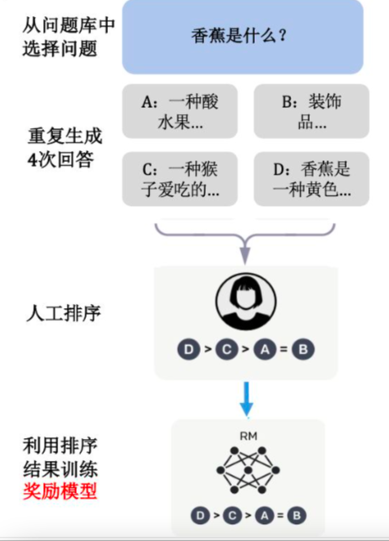
Language Model + human rewards
Rank by human
Train the Reward Model by ranking results
STEP 02
STEP 03
Question input: What is banana?
4 generated answers to the question:
A. Banana is a kind of fruits with sour taste…
B. Banana is a kind of decoration…
C. A fruit that monkeys like…
D. Banana is a kind of yellow…

Slide 22

Language Model + human rewards
Rank Loss
STEP 02
STEP 03
Suppose now there is a sorted sequence: A > B > C > D.
We need to train a scoring model. The score given by the model to the four sentences must satisfy r(A) > r(B) > r(C) > r(D).
loss = r(A) - r(B) + r(A) - r(C) + r(A) - r(D) + r(B) - r(C) + ... + r(C) -r(D)
loss = -loss

Slide 23
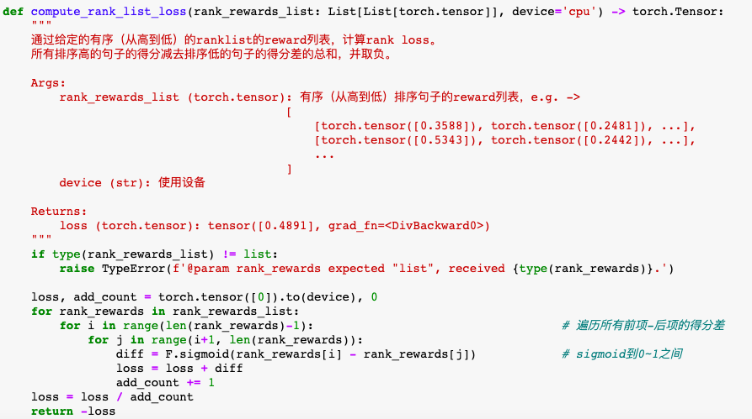
Language Model + human rewards
STEP 02
STEP 03
The rank_loss function is listed as follows：we need to traverse and add up the score difference of the front and back items:

Slide 24
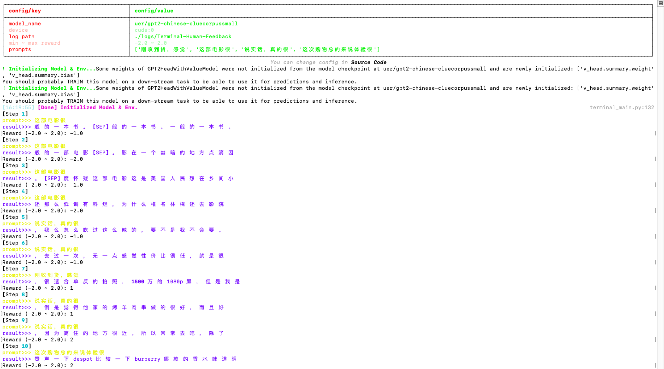
STEP 02
STEP 03
Language Model + human rewards
Mercury is the closest planet to the Sun and the smallest one in the Solar System—it’s only a bit larger than the Moon. The planet’s name has nothing to do with the liquid metal

Slide 25
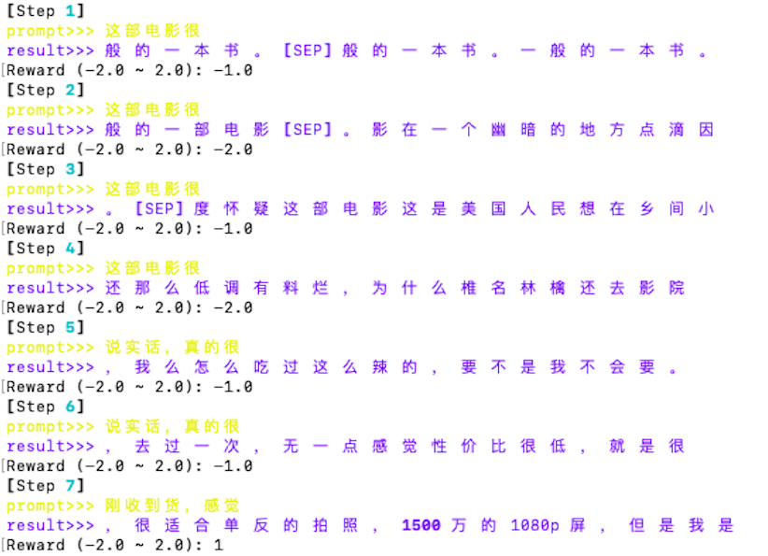
STEP 02
STEP 03
Language Model + human rewards
We build a platform to support manual scoring.
We iterate the model by manually entering the rewards.

Slide 26


STEP 03
STEP 04
Human Rewards -> reward model
We use rank list (-2.0~2.0) to help train the reward model
We iterate the model by a script:
After starting the training, the terminal will print the following information:

Slide 27

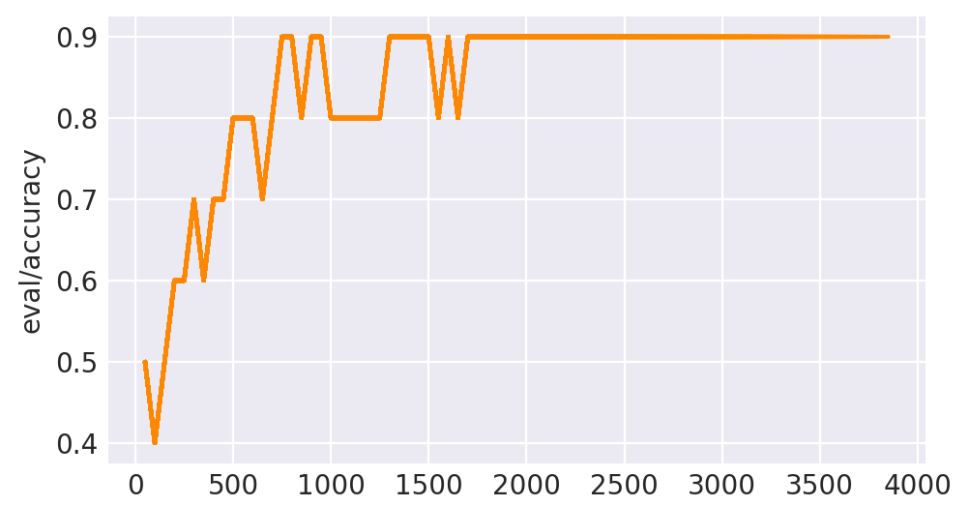
STEP 03
STEP 04
Human Rewards -> reward model
Continue to train:
Keep training: Training Curve

Slide 28

STEP 03
STEP 04
Human Rewards -> reward model
After completing the training, we run the prediction script to see the scoring of the trained model:
Apple is good and Fresh! The delivery is fast!----[3.6902]
Quality control is terrible. I opened the box and found obvious damage to the upper left corner of the screen. ----[-4.7479]

Slide 29
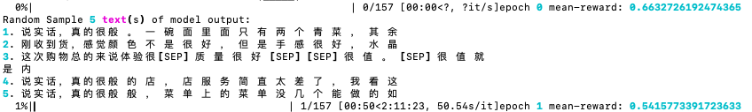



STEP 02
Language Model + machine rewards
STEP 03

Slide 30
ANALYSIS
Mean-reward:
The average score of the model under every epoch
54.2%
76.6%
90.6%
epoch
Mean-reward
Epoch 1
40
144

Slide 31
Discussion + Q&A
03
Reinforcement Learning Human Feedback

Slide 32
Discussion
Future developement:
Task:
from generating sentence to generating story
Model:
Update reward criteria to train more applicable model
RLHF exploration:
Segmentation of LM and RM
2. Application in real life

Slide 33
REFERENCES
https://www.infoq.com/news/2022/01/deepmind-gopher/
https://blogs.nvidia.com/blog/2022/03/25/what-is-a-transformer-model/
https://openai.com/research/openai-baselines-ppo
https://transformer.huggingface.co/doc/gpt2-large
https://openai.com/research/gpt-2-1-5b-release
https://github.com/opendilab/awesome-RLHF
https://huggingface.co/uer/gpt2-chinese-cluecorpussmall

Slide 34
Q & A

Slide 35
THANKS

