Slide 1
MD5 Message Digest Algorithm

Slide 2
outline
Introduction
MD5 Algorithm Structure
Implementation Steps
Performance
MD5 vs. MD4
Summary

Slide 3
Introduction
MD5 algorithm was developed by Professor Ronald L. Rivest in 1991.
According to RFC 1321, “MD5 message-digest algorithm takes as input a message of arbitrary length and produces as output a 128-bit "fingerprint" or "message digest" of the input.
The MD5 algorithm is intended for digital signature applications.
A large file must be "compressed" in a secure manner before being encrypted with a private (secret) key under a public-key cryptosystem such as RSA.”

Slide 4
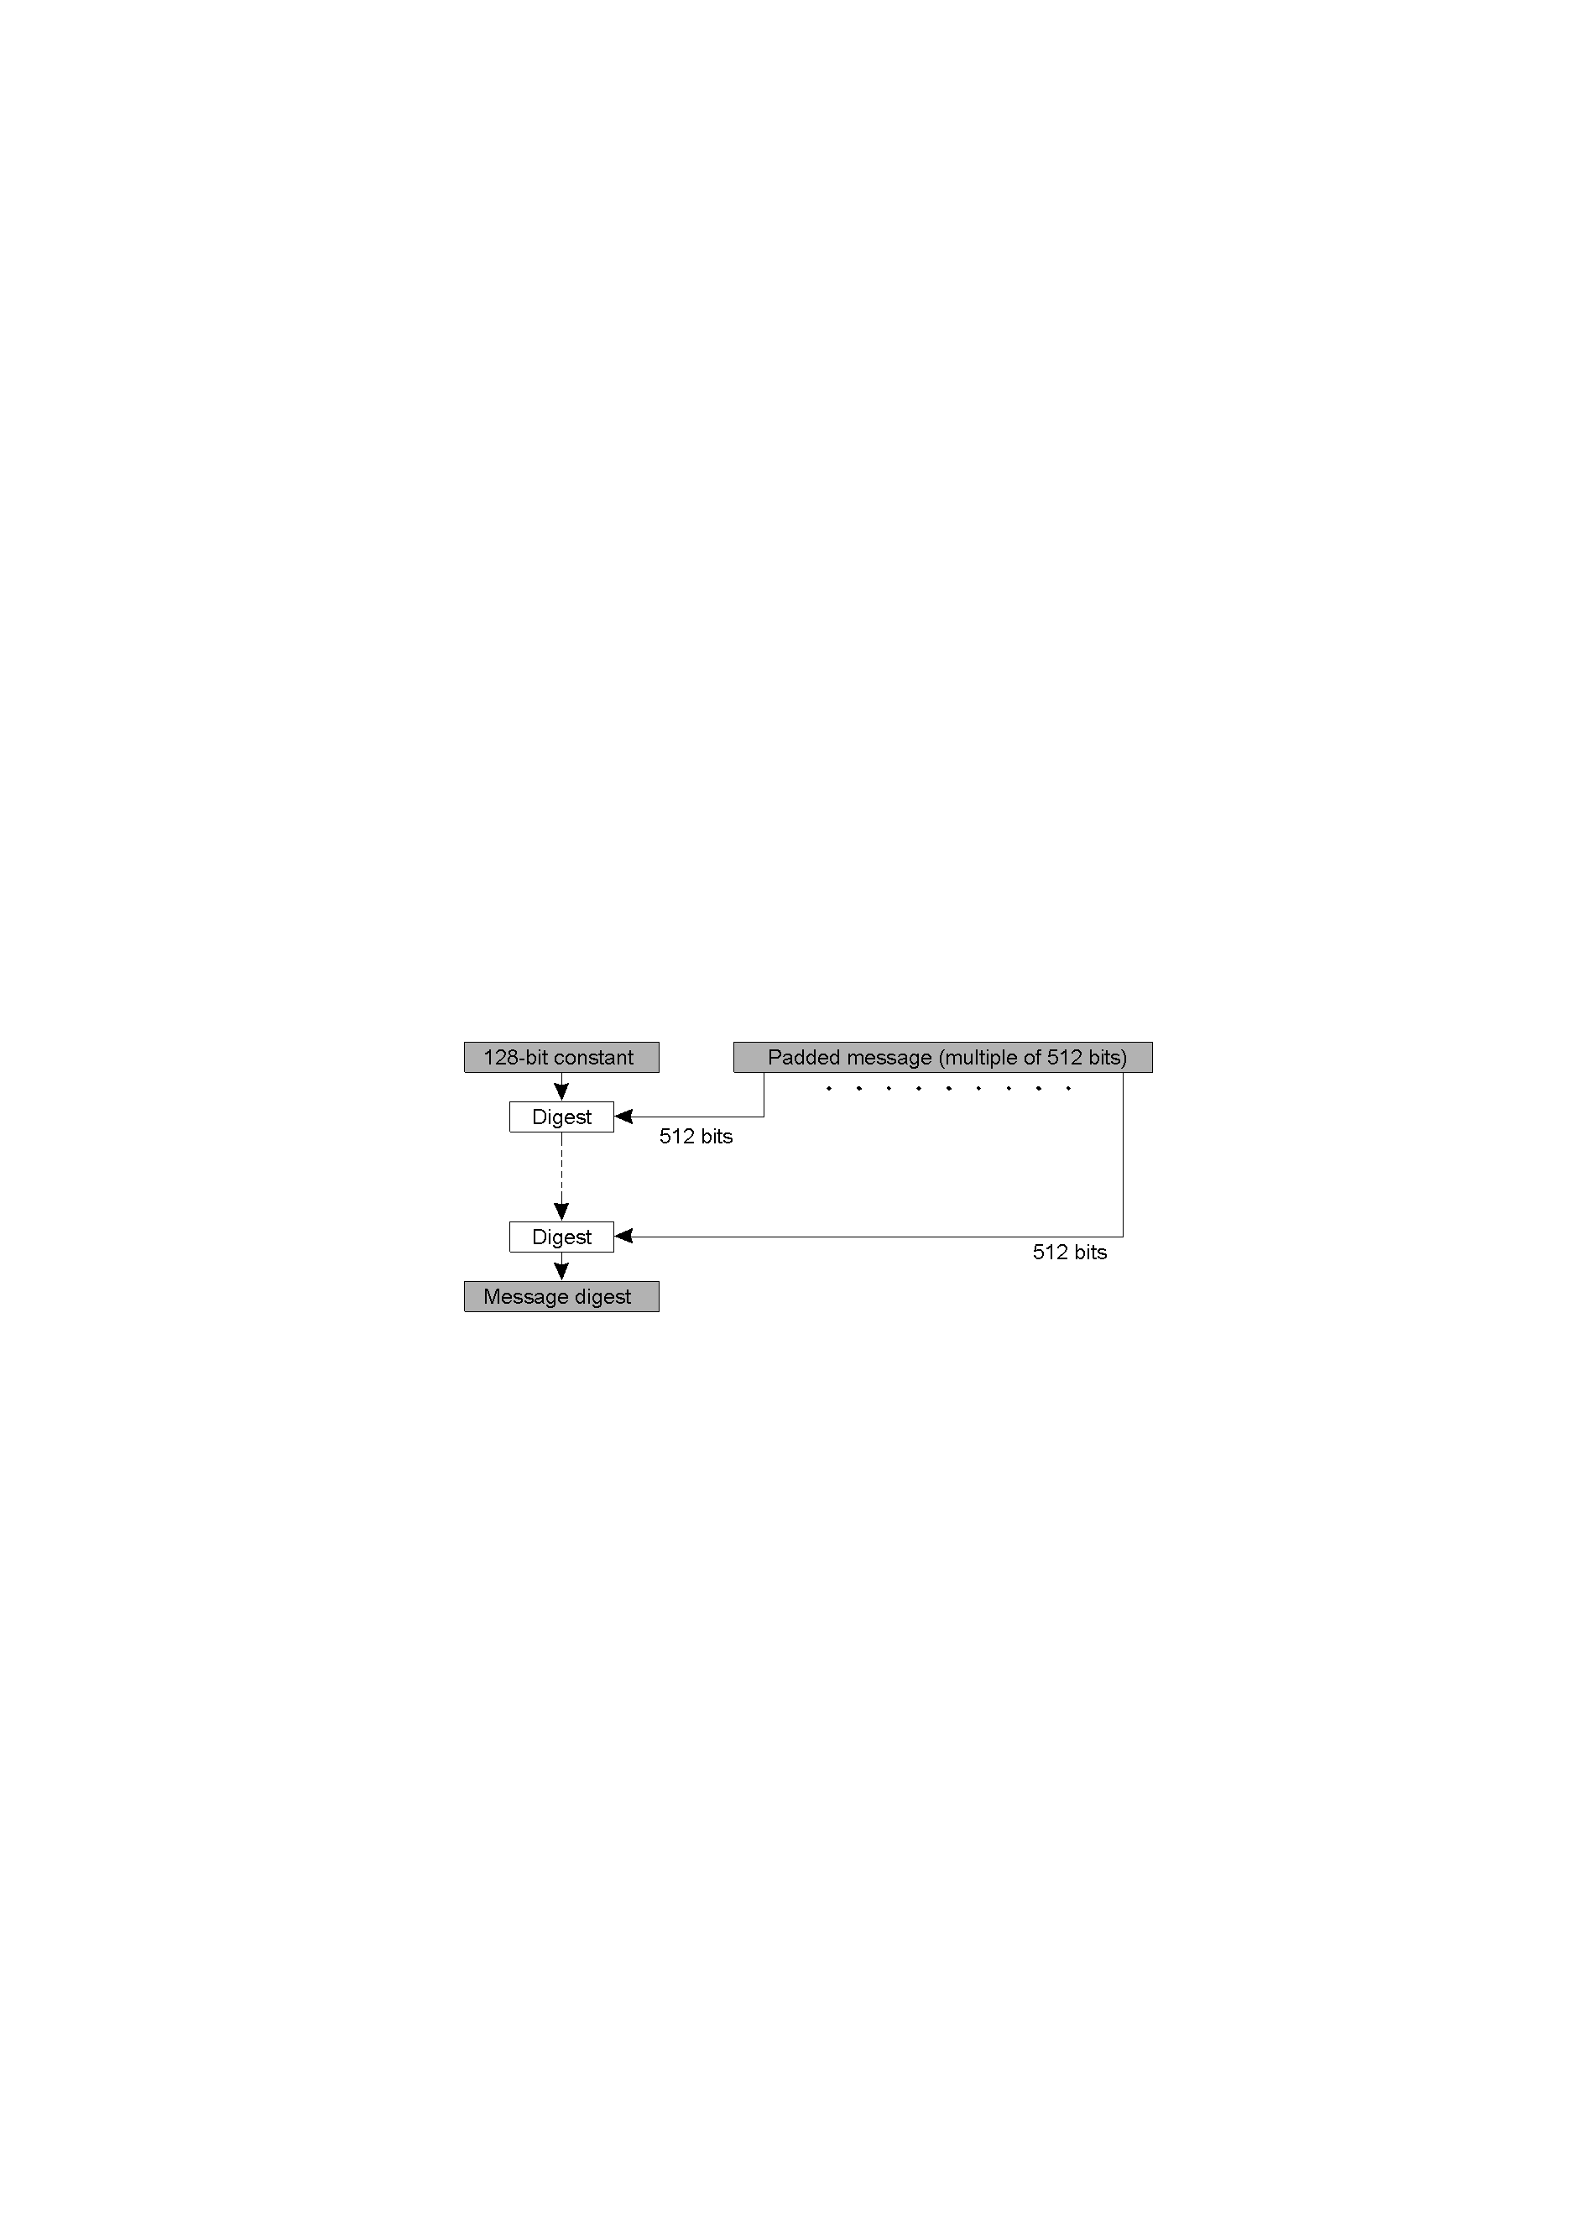
MD5 Algorithm Structure

Slide 5
Implementation Steps
Step1 Append padding bits
The input message is "padded" (extended) so that its length (in bits) equals to 448 mod 512. Padding is always performed, even if the length of the message is already 448 mod 512.
Padding is performed as follows: a single "1" bit is appended to the message, and then "0" bits are appended so that the length in bits of the padded message becomes congruent to 448 mod 512. At least one bit and at most 512 bits are appended.
Message length: 1200 bits
Padding : 272 bits
Size of original message: 64 bits
Total =1200+272+64 = 1536 bits (512*3)

Slide 6
Implementation Steps
Step2. Append length
A 64-bit representation of the length of the message is appended to the result of step1.
If the length of the message is greater than 2^64, only the low-order 64 bits will be used.
The resulting message (after padding with bits and with b) has a length that is an exact multiple of 512 bits.
The input message will have a length that is an exact multiple of 16 (32-bit) words.

Slide 7
Implementation Steps
Step3. Initialize MD buffer
A four-word buffer (A, B, C, D) is used to compute the message digest. Each of A, B, C, D is a 32-bit register. These registers are initialized to the following values in hexadecimal, low-order bytes first):
        word A: 01 23 45 67
        word B: 89 ab cd ef
        word C: fe dc ba 98
        word D: 76 54 32 10

Slide 8
Implementation Steps
Step4. Process message in 16-word blocks
Divide the current 512 bit block into 16 sub blocks each of 32 bits(32*16=512)
Four functions will be defined such that each function takes an input of three 32-bit words and produces a 32-bit word output.
      F (X, Y, Z) = XY or not (X) Z
      G (X, Y, Z) = XZ or Y not (Z)
      H (X, Y, Z) = X xor Y xor Z
      I (X, Y, Z) = Y xor (X or not (Z))

Slide 9
Implementation Steps
Round 1.
[abcd k s i] denote the operation a = b + ((a + F (b, c, d) + X [k] + T [i]) <<< s).
Do the following 16 operations.
[ABCD 0 7 1] [DABC 1 12 2] [CDAB 2 17 3] [BCDA 3 22 4]
[ABCD 4 7 5] [DABC 5 12 6] [CDAB 6 17 7] [BCDA 7 22 8]
[ABCD 8 7 9] [DABC 9 12 10] [CDAB 10 17 11] [BCDA 11 22 12]
[ABCD 12 7 13] [DABC 13 12 14] [CDAB 14 17 15] [BCDA 15 22 16]

Slide 10
Performance
 | Key size/hash size(bits) | Extrapolated Speed (Kbytes/sec.) | PRB Optimized (Kbytes/sec.)
TEA | 128 | 700 | -
DES | 56 | 350 | 7746
Triple-DES | 112 | 120 | 2842
IDEA | 128 | 700 | 4469
RSA | 512 | 7 | -
SHA | 160 | 750 | 25162
MD5 | 128 | 1740 | 62425

Slide 11
MD5 vs. MD4
A fourth round has been added.
Each step has a unique additive constant.
The function g in round 2 was changed from (XY v XZ v YZ) to (XZ v Y not(Z)).
Each step adds in the result of the previous step.
The order in which input words are accessed in rounds 2 and 3 is changed.
The shift amounts in each round have been optimized. The shifts in different rounds are distinct.

Slide 12
Summary
Comparing to other digest algorithms, MD5 is simple to implement, and provides a "fingerprint" or message digest of a message of arbitrary length.
It performs very fast on 32-bit machine.
MD5 is being used heavily from large corporations, such as IBM, Cisco Systems, to individual programmers.
MD5 is considered one of the most efficient algorithms currently available.

