Slide 1
What is CSS?
• CSS & HTML
• The Box Model
• Style Sheet Implementation
• CSS Rule Structure
• HTML & DIVs
• Common CSS properties
• CSS Cascade and Inheritance
• Resources

Slide 2
What is CSS?
Body
{
font-family: Arial;
background: #000;
}
#container
{
text-align: left;
width:1020px;
}
#header
{
height:232px;
}
#footer
{
width: 100%;
padding: 0 10px;
margin-bottom: 10px;
}
CSS stands for Cascading Style Sheet.
Typical CSS file is a text file with an extention.css and contains a series of commands or rules.
These rules tell the HTML how to display.

Slide 3
CSS Benefits
• Separates structure from presentation
• Provides advanced control of presentation
• Easy maintenance of multiple pages
• Faster page loading
• Better accessibility for users
• Easy to learn

Slide 4
“HTML without CSS is like a piece of candy without a pretty wrapper.”
HTML and CSS work together to produce beautiful and functional Web sites
• HTML = structure
• CSS = style
Attach a style sheet to a page by adding the code to the <head> section of the HTML page.
There are 3 ways to attach CSS to a page:
1. External Style Sheet: Best used to control styling on multiple pages.
<link rel="stylesheet" type="text/css“ media="all" href="css/styles.css" />
<html>
<head>
<title>css hello world</title>
<link rel="stylesheet" type="text/css" href="style1.css" title= "style 1"/>
<link rel="stylesheet" type="text/css" href="style2.css" title= "style 2"/>
</head>
<body>
<p> Hello World</p>
</body>
</html>

Slide 5
2. Internal Style Sheet: Best used to control styling on one page.
<style type=“text/css”>
Value | Media Type
All | All Types
Aural | Speech Synthesizer
Tv | Television
Handheld | Handheld Devices such as mobile phones
Print | Printer
Projection | Projector
Screen | Computer Monitor

Slide 6
<html>
<head>
<style>
body {
background-color: linen;
}
h1 {
color: maroon;
margin-left: 40px;
}
</style>
</head>
<body>
<h1>hello</h1>
</body>
</html>

Slide 7
Inline Styles
An inline style may be used to apply a unique style for a single element.
To use inline styles, add the style attribute to the relevant element. The style attribute can contain any CSS property.
<h1 style="color:blue;margin-left:30px;">This is a heading</h1>
What style will be used when there is more than one style specified for an HTML element?
1. Inline style (inside an HTML element)
2. External and Internal style sheets (in the head section)
3. Browser default

Slide 8
CSS Rule Structure
A CSS RULE is made up of a selector and a declaration. A declaration consists of property and value.
selector {property: value;}- Declaration Block
body {background: purple;}
Grouping Selectors
h1 {color: black;}
h1 {font-weight: bold;}
h1 {background: white;}
h1 {
color: black;
font-weight: bold; Group the same selector with different declarations together on one line.
background: white;
}

Slide 9
h1 {color: yellow;}
h2 {color: yellow;}
h3 {color: yellow;}
Example of grouping selectors (both are correct):
h1, h2, h3 {color: yellow;}
Comments in CSS
• Explain the purpose of the coding
• Help others read and understand the code
• Serve as a reminder to you for what it all means
• Starts with /*and ends with*/
p {color: #ff0000;} /*Company Branding*/

Slide 10
Typical Web Page (Browser)
Cointainer

Slide 11
Typical Web Page (HTML)
Typical HTML Web page is made up of containers (boxes)
or DIVs.
Each DIV is assigned an ID or a Class.
<div id=“container”>
<div id=“header”>Insert Title</div>
<div id=“main">content
<div id=“menu”>content</div>
</div>
<div id=“footer”>content</div>
</div>

Slide 12
The CSS file uses the same DIV/ID/Class names as the HTML and uses them to style the elements.
#container {property: value;}
#menu {property: value;}
#main {property: value;}
#footer {property: value;}
IDs (#) are unique and can only be used once on the page
Classes (.) can be used as many times as needed

Slide 13
The id and class Selectors
In addition to setting a style for a HTML element, CSS allows you to specify your own selectors called "id" and "class".
The id Selector
The id selector is used to specify a style for a single, unique element.
The id selector uses the id attribute of the HTML element, and is defined with a
"#".
The style rule below will be applied to the element with id="para1":
Example
#para1
{
text-align: center;
color: red;
}

Slide 14
The class Selector
The class selector is used to specify a style for a group of elements. Unlike the id selector, the class selector is most often used on several elements.
This allows you to set a particular style for any HTML elements with the same class.
The class selector uses the HTML class attribute, and is defined with a "."
In the example below, all HTML elements with class="center" will be center-aligned:
Example
.center
{
text-align:center;
}
In the example below, all p elements with class="center" will be centeraligned:
Example
p.center {text-align:center;}

Slide 15
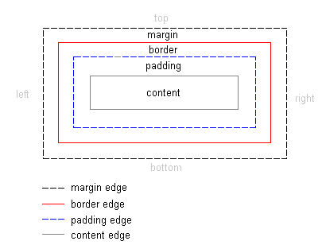

Slide 16
CSS Box Properties
• Background-color
• Width
• Padding
• Margin
• Border-width
• Border-color
• Border-style

Slide 17
Width
#box {width=“50px”}
#box {width=“100%”}
#box {width=“auto”}
Height
#box {height=“auto”}
Float
#box {float:left; margin-right: 10px;}
Clear
Border
Padding
Margin

Slide 18
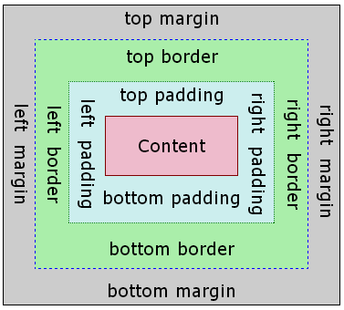

Slide 19
The list-style-type property
ol { list-style-type: lower-roman; } CSS
Possible values:
i. none : No marker
ii. disc (default), circle, square
iii. Decimal: 1, 2, 3, etc.
iv. decimal-leading-zero: 01, 02, 03, etc.
v. lower-roman: i, ii, iii, iv, v, etc.
vi. upper-roman: I, II, III, IV, V, etc.
vii. lower-alpha: a, b, c, d, e, etc.
viii. upper-alpha: A, B, C, D, E, etc.
x. lower-greek: alpha, beta, gamma, etc.
others: hebrew, armenian, georgian, cjk-ideographic, hiragana…

