Slide 1
WEB ENGINEERING Paper Code: ETCS-308
Text Books:
[T1] Web Technologies: A Computer Science Perspective, Jeffrey C. Jackson, Pearson Education India, 2007.
[T2] Web Engineering: A Practitioner's Approach by Roger S Pressman, David Lowe, TMH, 2008.
Reference Books:
[R1] Achyut Godbole, Atul Kahate, “Web Technologies”, McGraw-Hill Education, Third Edition.
[R2] Uttam K Roy, “Web Technologies”, Oxford University Press, 2012.
[R3] Chris Bates, "Web Programming", Wiley
[R4] Web Engineering by Gertel Keppel, Birgit Proll, Siegfried Reich, Werner R., John Wiley.
[R5] Thinking on the Web: Berner's LEE, Godel and Turing, John Wiley & Sons Inc.

Slide 2
UNIT – I
History of the Internet, Basic internet protocols, World Wide Web (W3C), HTTP: Hypertext Transfer Protocol.
Markup languages-XHTML: Introduction to HTML, basics of XTHML, HTML elements, HTML tags, lists, tables, frames, forms, defining XHTML’s abstract syntax, defining HTML documents.
CSS style sheets: Introduction, CSS core syntax, text properties, CSS box model, normal flow box layout, other properties like list, tables, DHTML, XML, XML documents & vocabulary, XML versions & declarations, Introduction to WML. [T1,T2][No. of hrs. 10]
UNIT – II
Client Side Programming: JAVA Scripts, basic syntax, variables & data-types, literals, functions, objects,
arrays, built-in objects, JAVA Script form programming, Intrinsic event handling, modifying element style,
document trees,
Server side programming – Java Servlets: Servlet architecture, life cycle, parameter data, sessions, cookies, servlets capabilities, servlets & concurrency. Introduction to JSP, JSP Tags, JSP life cycle, custom tags. [T1,T2][No. of hrs. 12]

Slide 3
UNIT – III
Security Threats, Security risks of a site, Web attacks and their prevention, Web security model, Session management, authentication, HTTPS and certificates, Application vulnerabilities and defenses. Client-side security, Cookies security policy, HTTP security extensions, Plugins, extensions, and web apps, Web user tracking. Server-side security tools, Web Application Firewalls (WAFs) and Fuzzers. [T1,T2][No. of hrs. 10]
UNIT – IV
Introduction to Web 2.0 and Web 3.0, Concepts and Issues, Latest Trends in Web Technologies. Web Security concerns. Applications of Web Engineering Technologies in distributed systems etc. Case studies using different tools. [T1,T2][No. of hrs. 12]

Slide 4
Course Outcomes:
At the end of the course student will be able to: |  | PO/ PSO | Bloom Level
ETCS308.1 | Explain the concept of different internet protocols used in W3C,HTML,CSS. | PO1, PSO1 | L1-Remembering, L2-Understanding
ETCS308.2 | Apply concepts of Java Scripts for client side programming. | PO3, PO1, PSO1 | L1-Remembering, L2-Understanding, L3-Apply
ETCS308.3 | Apply concepts of server side programming using Java Servlets and JSP | PO1, PO3, PSO1 | L1-Remembering, L2-Understanding, L3-Apply
ETCS308.4 | Analyze and Compare various security Threats, vulnerabilities of a site. | PO7, PO8, PSO1 | L1-Remembering, L2-Understanding, L4-Analyzing
ETCS308.5 | Compare Client-side and Server-side Security tools, Web 2.0 and Web 3.0. | PO6, PO7, PSO1 | L2-Understanding L3-Applying, L5-Evaluating
ETCS308.6 | Discuss different web security tools used in applications of Web Engineering Technologies in distributed systems. | PO5, PO12, PSO1, PSO2 | L3-Apply L4-Analyzing L6-Creating

Slide 5
Mid Term 15 Marks
Internal Assessment Evaluation 10 Marks
4 Quizzes 1 Mark Each
3 Quizzes before Mid Term
1 Quiz After Mid Term
One Case Study 2 Marks
One Class Test 4 Marks

Slide 6
Web Essentials: Clients, Servers, and Communication
History of the Internet,
Basic Internet Protocols,
World Wide Web (W3C),
HTTP: Hypertext Transfer Protocol.

Slide 7
The Internet
Technical origin: ARPANET (late 1960’s)
One of earliest attempts to network heterogeneous, geographically dispersed computers
Email first available on ARPANET in 1972 (and quickly very popular!)
ARPANET access was limited to selected DOD(Department of Defense)-funded organizations
Open-access networks
Regional university networks (e.g., SURAnet)
CSNET for CS departments not on ARPANET
NSFNET (1985-1995)
Primary purpose: connect supercomputer centers
Secondary purpose: provide backbone to connect regional networks

Slide 8
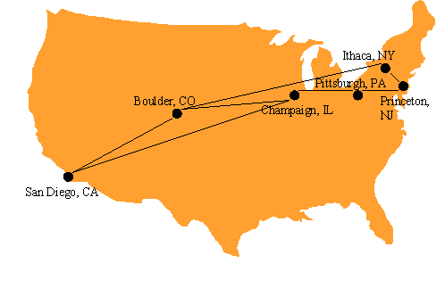
The 6 supercomputer centers connected by the early NSFNET backbone

Slide 9
Original NSFNET backbone speed: 56 kbit/s
Upgraded to 1.5 Mbit/s (T1) in 1988
Upgraded to 45 Mbit/s (T3) in 1991
In 1988, networks in Canada and France connected to NSFNET
In 1990, ARPANET is decommissioned, NSFNET the center of the internet
Communication protocol: how computers talk
Cf. telephone “protocol”: how you answer and end call, what language you speak, etc.
Internet protocols developed as part of ARPANET research
ARPANET began using TCP/IP in 1982
Designed for use both within local area networks (LAN’s) and between networks

Slide 10
Internet Protocol (IP)
IP is the fundamental protocol defining the Internet (as the name implies!)
IP address:
32-bit number (in IPv4)
Associated with at most one device at a time (although device may have more than one)
Written as four dot-separated bytes, e.g. 192.0.34.166
IP function: transfer data from source device to destination device
IP source software creates a packet representing the data
Header: source and destination IP addresses, length of data, etc.
Data itself
If destination is on another LAN, packet is sent to a gateway that connects to more than one network

Slide 11
IP
Source
Network 1
Gateway
Destination
Gateway
Network 2
Network 3

Slide 12
IP
Source
LAN 1
Gateway
Destination
Gateway
Internet Backbone
LAN 2

Slide 13
Transmission Control Protocol (TCP)
Limitations of IP:
No guarantee of packet delivery (packets can be dropped)
Communication is one-way (source to destination)
TCP adds concept of a connection on top of IP
Provides guarantee that packets delivered
Provide two-way (full duplex) communication
TCP also adds concept of a port
TCP header contains port number representing an application program on the destination computer
Some port numbers have standard meanings
Example: port 25 is normally used for email transmitted using the Simple Mail Transfer Protocol (SMTP)
Other port numbers are available first-come-first served to any application

Slide 14
TCP
{
Source
Destination
Establish
connection.
Can I talk to you?
OK. Can I talk to you?
OK.
{
Here’s a packet.
Send packet
with
acknowledgment.
Got it.
{
Here’s a packet.
Resend packet if
no (or delayed)
acknowledgment.
Here’s a resent packet.
Got it.

Slide 15
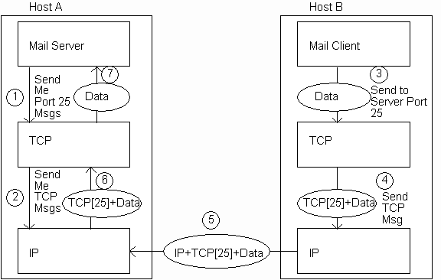
TCP

Slide 16
User Datagram Protocol (UDP)
Like TCP in that:
Builds on IP
Provides port concept
Unlike TCP in that:
No connection concept
No transmission guarantee
Advantage of UDP vs. TCP:
Lightweight, so faster for one-time messages

Slide 17
Domain Name Service (DNS)
DNS is the “phone book” for the Internet
Map between host names and IP addresses
DNS often uses UDP for communication
Host names
Labels separated by dots, e.g., www.example.org
Final label is top-level domain
Generic: .com, .org, etc.
Country-code: .us, .in, etc. Domains are divided into second-level domains, which can be further divided into subdomains, etc.
E.g., in www.example.com, example is a second-level domain
A host name plus domain name information is called the fully qualified domain name of the computer
Above, www is the host name, www.example.com is the FQDN

Slide 18
DNS
DNS lookup program provides command-line access to DNS (on most systems)
looking up a host name given an IP address is known as a reverse lookup
Recall that single host may have multiple IP addresses.
Address returned is the canonical IP address specified in the DNS system.
ipconfig (on windows) can be used to find the IP address (addresses) of your machine
ipconfig /displaydns displays the contents of the DNS Resolver Cache (ipconfig /flushdns to flush it)

Slide 19
Analogy to Telephone Network
IP ~ the telephone network
TCP ~ calling someone who answers, having a conversation, and hanging up
UDP ~ calling someone and leaving a message
DNS ~ directory assistance

Slide 20
Higher-level Protocols
Many protocols build on TCP
Telephone analogy: TCP specifies how we initiate and terminate the phone call, but some other protocol specifies how we carry on the actual conversation
Some examples:
SMTP (email) (25)
FTP (file transfer) (21)
HTTP (transfer of Web documents) (80)

Slide 21
World Wide Web
Originally, one of several systems for organizing Internet-based information
Competitors: WAIS, Gopher, ARCHIE
Distinctive feature of Web: support for hypertext (text containing links)
Communication via Hypertext Transport Protocol (HTTP)
Document representation using Hypertext Markup Language (HTML)
The Web is the collection of machines (Web servers) on the Internet that provide information, particularly HTML documents, via HTTP.
Machines that access information on the Web are known as Web clients.
A Web browser is software used by an end user to access the Web.

Slide 22
Hypertext Transport Protocol (HTTP)
HTTP is based on the request-response communication model:
Client sends a request
Server sends a response
HTTP is a stateless protocol:
The protocol does not require the server to remember anything about the client between requests.

Slide 23
HTTP
Normally implemented over a TCP connection (80 is standard port number for HTTP)
Typical browser-server interaction:
User enters Web address in browser
Browser uses DNS to locate IP address
Browser opens TCP connection to server
Browser sends HTTP request over connection
Server sends HTTP response to browser over connection
Browser displays body of response in the client area of the browser window
The information transmitted using HTTP is often entirely text
Can use the Internet’s Telnet protocol to simulate browser request and view server response

Slide 24
HTTP
Connect
{
$ telnet www.example.org 80
Trying 192.0.34.166...
Connected to www.example.com (192.0.34.166).
Escape character is ’^]’.
GET / HTTP/1.1
Host: www.example.org
HTTP/1.1 200 OK
Date: Thu, 09 Oct 2003 20:30:49 GMT …
Send
Request
{
{
Receive
Response

Slide 25
HTTP Request
Structure of the request:
start line
header field(s)
blank line
optional body

Slide 26
HTTP Request
Structure of the request:
start line
header field(s)
blank line
optional body

Slide 27
HTTP Request
Start line
Example: GET / HTTP/1.1
Three space-separated parts:
HTTP request method
Request-URI (Uniform Resource Identifier)
HTTP version

Slide 28
HTTP Request
Start line
Example: GET / HTTP/1.1
Three space-separated parts:
HTTP request method
Request-URI
HTTP version
We will cover 1.1, in which version part of start line must be exactly as shown

Slide 29
HTTP Request
Start line
Example: GET / HTTP/1.1
Three space-separated parts:
HTTP request method
Request-URI
HTTP version

Slide 30
HTTP Request
Uniform Resource Identifier (URI)
Syntax: scheme : scheme-depend-part
Ex: In http://www.example.com/ the scheme is http
Request-URI is the portion of the requested URI that follows the host name (which is supplied by the required Host header field)
Ex: / is Request-URI portion of http://www.example.com/

Slide 31
URI
URI’s are of two types:
Uniform Resource Name (URN)
Can be used to identify resources with unique names, such as books (which have unique ISBN’s)
Scheme is urn
Uniform Resource Locator (URL)
Specifies location at which a resource can be found
In addition to http, some other URL schemes are https, ftp, mailto, and file

Slide 32
HTTP Request
Start line
Example: GET / HTTP/1.1
Three space-separated parts:
HTTP request method
Request-URI
HTTP version

Slide 33
HTTP Request
Common request methods:
GET
Used if link is clicked or address typed in browser
No body in request with GET method
POST
Used when submit button is clicked on a form
Form information contained in body of request
HEAD
Requests that only header fields (no body) be returned in the response

Slide 34
HTTP Request
Structure of the request:
start line
header field(s)
blank line
optional body

Slide 35
HTTP Request
Header field structure:
field name : field value
Syntax
Field name is not case sensitive
Field value may continue on multiple lines by starting continuation lines with white space
Field values may contain MIME types, quality values, and wildcard characters (*’s)

Slide 36
Multipurpose Internet Mail Extensions (MIME)
Convention for specifying content type of a message
In HTTP, typically used to specify content type of the body of the response
MIME content type syntax:
top-level type / subtype
Examples: text/html, image/jpeg

Slide 37
HTTP Quality Values and Wildcards
Example header field with quality values: accept: text/xml,text/html;q=0.9, text/plain;q=0.8, image/jpeg, image/gif;q=0.2,*/*;q=0.1
Quality value applies to all preceding items
Higher the value, higher the preference
Note use of wildcards to specify quality 0.1 for any MIME type not specified earlier

Slide 38
HTTP Request
Common header fields:
Host: host name from URL (required)
User-Agent: type of browser sending request
Accept: MIME types of acceptable documents
Connection: value close tells server to close connection after single request/response
Content-Type: MIME type of (POST) body, normally application/x-www-form-urlencoded
Content-Length: bytes in body
Referer: URL of document containing link that supplied URI for this HTTP request

Slide 39
HTTP Response
Structure of the response:
status line
header field(s)
blank line
optional body

Slide 40
HTTP Response
Structure of the response:
status line
header field(s)
blank line
optional body

Slide 41
HTTP Response
Status line
Example: HTTP/1.1 200 OK
Three space-separated parts:
HTTP version
status code
reason phrase (intended for human use)

Slide 42
HTTP Response
Status code
Three-digit number
First digit is class of the status code:
1=Informational
2=Success
3=Redirection (alternate URL is supplied)
4=Client Error
5=Server Error
Other two digits provide additional information

Slide 43
HTTP Response
Structure of the response:
status line
header field(s)
blank line
optional body

Slide 44
HTTP Response
Common header fields:
Connection, Content-Type, Content-Length
Date: date and time at which response was generated (required)
Location: alternate URI if status is redirection
Last-Modified: date and time the requested resource was last modified on the server
Expires: date and time after which the client’s copy of the resource will be out-of-date
ETag: a unique identifier for this version of the requested resource (changes if resource changes)

Slide 45
Client Caching
A cache is a local copy of information obtained from some other source
Most web browsers use cache to store requested resources so that subsequent requests to the same resource will not necessarily require an HTTP request/response
Ex: icon appearing multiple times in a Web page

Slide 46
Client Caching
Client
Server
Browser
1. HTTP request for image
Web
Server
2. HTTP response containing image
3. Store image
Cache

Slide 47
Client Caching
Client
Server
Browser
Web
Server
I need that
image
again…
Cache

Slide 48
Client Caching
Client
Server
Browser
Web
Server
This…
HTTP request for image
I need that
image
again…
HTTP response containing image
Cache

Slide 49
Client Caching
Client
Server
Browser
Web
Server
I need that
image
again…
Get image
… or this
Cache

Slide 50
Client Caching
Cache advantages
(Much) faster than HTTP request/response
Less network traffic
Less load on server
Cache disadvantage
Cached copy of resource may be invalid (inconsistent with remote version)

Slide 51
Client Caching
Validating cached resource:
Send HTTP HEAD request and check Last-Modified or ETag header in response
Compare current date/time with Expires header sent in response containing resource
If no Expires header was sent, use heuristic algorithm to estimate value for Expires
Ex: Expires = 0.01 * (Date – Last-Modified) + Date

Slide 52
Character Sets
Every document is represented by a string of integer values (code points)
The mapping from code points to characters is defined by a character set
Some header fields have character set values:
Accept-Charset: request header listing character sets that the client can recognize
Ex: accept-charset: ISO-8859-1,utf-8;q=0.7,*;q=0.5
Content-Type: can include character set used to represent the body of the HTTP message
Ex: Content-Type: text/html; charset=UTF-8

Slide 53
Character Sets
Technically, many “character sets” are actually character encodings
An encoding represents code points using variable-length byte strings
Most common examples are Unicode-based encodings UTF-8 and UTF-16
IANA maintains complete list of Internet-recognized character sets/encodings

Slide 54
Character Sets
Typical US PC produces ASCII documents
US-ASCII character set can be used for such documents, but is not recommended
UTF-8 and ISO-8859-1 are supersets of US-ASCII and provide international compatibility
UTF-8 can represent all ASCII characters using a single byte each and arbitrary Unicode characters using up to 4 bytes each
ISO-8859-1 is 1-byte code that has many characters common in Western European languages, such as é

Slide 55
Web Clients
Many possible web clients:
Text-only “browser” (lynx)
Mobile phones
Robots (software-only clients, e.g., search engine “crawlers”)
etc.
We will focus on traditional web browsers

Slide 56
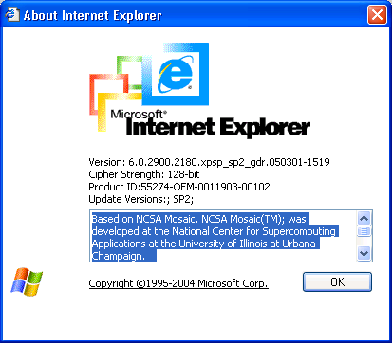
Web Browsers
First graphical browser running on general-purpose platforms: Mosaic (1993)

Slide 57
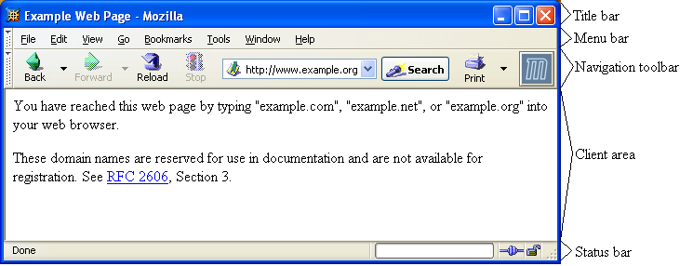
Web Browsers

Slide 58
Web Browsers
Primary tasks:
Convert web addresses (URL’s) to HTTP requests
Communicate with web servers via HTTP
Render (appropriately display) documents returned by a server

Slide 59
HTTP URL’s
http://www.example.org:56789/a/b/c.txt?t=win&s=chess#para5
host (FQDN)
port
path
query
fragment
authority
Request-URI
Browser uses authority to connect via TCP
Request-URI included in start line (/ used for path if none supplied)
Fragment identifier not sent to server (used to scroll browser client area)

Slide 60
Web Browsers
Standard features
Save web page to disk
Find string in page
Fill forms automatically (passwords, CC numbers, …)
Set preferences (language, character set, cache and HTTP parameters)
Modify display style (e.g., increase font sizes)
Display raw HTML and HTTP header info (e.g., Last-Modified)
Choose browser themes (skins)
View history of web addresses visited
Bookmark favorite pages for easy return

Slide 61
Web Browsers
Additional functionality:
Execution of scripts (e.g., drop-down menus)
Event handling (e.g., mouse clicks)
GUI for controls (e.g., buttons)
Secure communication with servers
Display of non-HTML documents (e.g., PDF) via plug-ins

Slide 62
Web Servers
Basic functionality:
Receive HTTP request via TCP
Map Host header to specific virtual host (one of many host names sharing an IP address)
Map Request-URI to specific resource associated with the virtual host
File: Return file in HTTP response
Program: Run program and return output in HTTP response
Map type of resource to appropriate MIME type and use to set Content-Type header in HTTP response
Log information about the request and response

Slide 63
Web Servers
httpd: UIUC, primary Web server c. 1995
Apache: “A patchy” version of httpd, now the most popular server (esp. on Linux platforms)
IIS: Microsoft Internet Information Server
Tomcat:
Java-based
Provides container (Catalina) for running Java servlets (HTML-generating programs) as back-end to Apache or IIS
Can run stand-alone using Coyote HTTP front-end

Slide 64
Web Servers
Some Coyote communication parameters:
Allowed/blocked IP addresses
Max. simultaneous active TCP connections
Max. queued TCP connection requests
“Keep-alive” time for inactive TCP connections
Modify parameters to tune server performance

Slide 65
Web Servers
Some Catalina container parameters:
Virtual host names and associated ports
Logging preferences
Mapping from Request-URI’s to server resources
Password protection of resources
Use of server-side caching

Slide 66
Tomcat Web Server
HTML-based server administration
Browse to http://localhost:8080 and click on Server Administration link
localhost is a special host name that means “this machine”

Slide 67
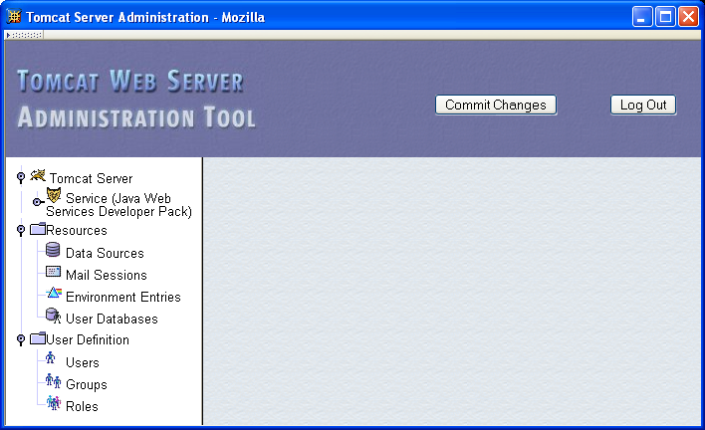
Tomcat Web Server

Slide 68
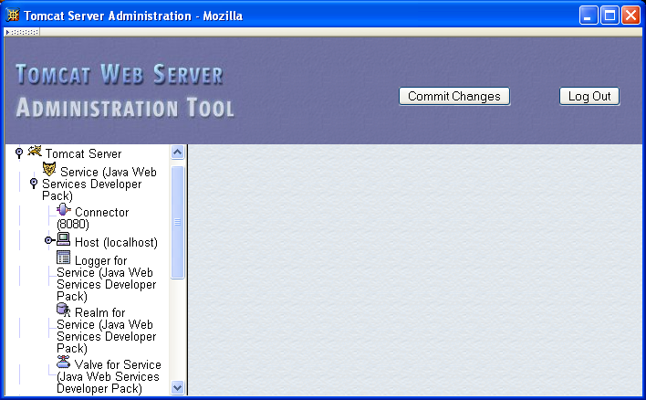
Tomcat Web Server

Slide 69
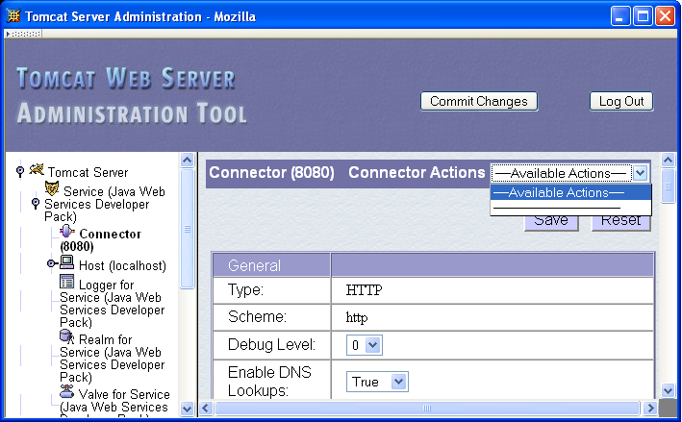
Tomcat Web Server

Slide 70
Tomcat Web Server
Some Connector fields:
Port Number: port “owned” by this connector
Max Threads: max connections processed simultaneously
Connection Timeout: keep-alive time

Slide 71
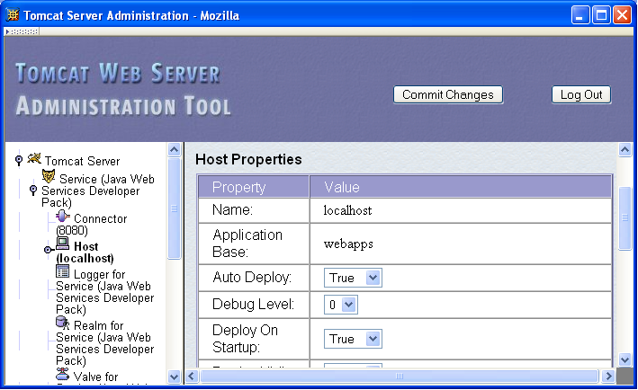
Tomcat Web Server

Slide 72
Tomcat Web Server
Each Host is a virtual host (can have multiple per Connector)
Some fields:
Host: localhost or a fully qualified domain name
Application Base: directory (may be path relative to JWSDP installation directory) containing resources associated with this Host

Slide 73
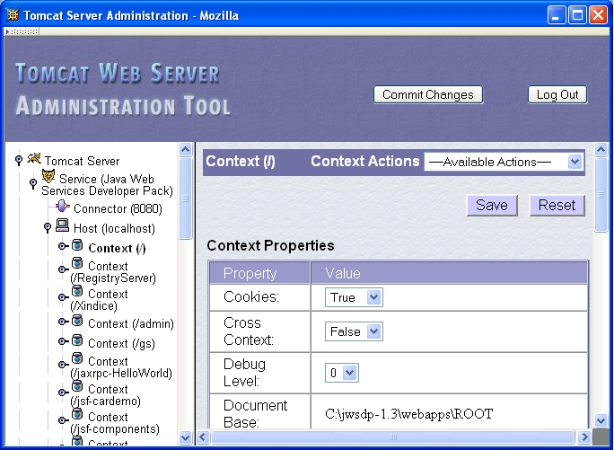
Tomcat Web Server

Slide 74
Tomcat Web Server
Context provides mapping from Request-URI path to a web application
Document Base field is directory (possibly relative to Application Base) that contains resources for this web application
For this example, browsing to http://localhost:8080/ returns resource from c:\jwsdp-1.3\webapps\ROOT
Returns index.html (standard welcome file)

Slide 75
Tomcat Web Server
Access log records HTTP requests
Parameters set using AccessLogValve
Default location: logs/access_log.* under JWSDP installation directory
Example “common” log format entry (one line): www.example.org - admin [20/Jul/2005:08:03:22 -0500] "GET /admin/frameset.jsp HTTP/1.1" 200 920

Slide 76
Tomcat Web Server
Other logs provided by default in JWSDP:
Message log messages sent to log service by web applications or Tomcat itself
logs/jwsdp_log.*: default message log
logs/localhost_admin_log.*: message log for web apps within /admin context
System.out and System.err output (exception traces often found here):
logs/launcher.server.log

Slide 77
Tomcat Web Server
Access control:
Password protection (e.g., admin pages)
Users and roles defined in conf/tomcat-users.xml
Deny access to machines
Useful for denying access to certain users by denying access from the machines they use
List of denied machines maintained in RemoteHostValve (deny by host name) or RemoteAddressValve (deny by IP address)

Slide 78
Secure Servers
Since HTTP messages typically travel over a public network, private information (such as credit card numbers) should be encrypted to prevent eavesdropping
https URL scheme tells browser to use encryption
Common encryption standards:
Secure Socket Layer (SSL)
Transport Layer Security (TLS)

Slide 79
Secure Servers
Browser
TLS/ SSL
I’d like to talk securely to you (over port 443)
TLS/ SSL
Web
Server
HTTP
Requests
Here’s my certificate and encryption data
HTTP
Requests
Here’s an encrypted HTTP request
Here’s an encrypted HTTP response
Here’s an encrypted HTTP request
HTTP
Responses
HTTP
Responses
Here’s an encrypted HTTP response

Slide 80
Secure Servers Man-in-the-Middle Attack
Fake
DNS
Server
Fake
www.example.org
100.1.1.1
What’s IP
address for
www.example.org?
100.1.1.1
My credit card number is…
Browser
Real
www.example.org

Slide 81
Secure Servers Preventing Man-in-the-Middle
Fake
DNS
Server
Fake
www.example.org
100.1.1.1
What’s IP
address for
www.example.org?
100.1.1.1
Send me a certificate of identity
Browser
Real
www.example.org

