Slide 1
Denial of service attack
A Case Study

Slide 2

An introduction
A denial of service (DoS) is an action that prevents or impairs the authorized use of networks, systems, or applications by exhausting resources such as central processing units (CPU), memory bandwidth, and disk space.
Typical aims of DoS attacks:
>consuming bandwidth with large traffic volumes
> overload or crash the network handling software
>send specific types of packets to consume limited available

Slide 3
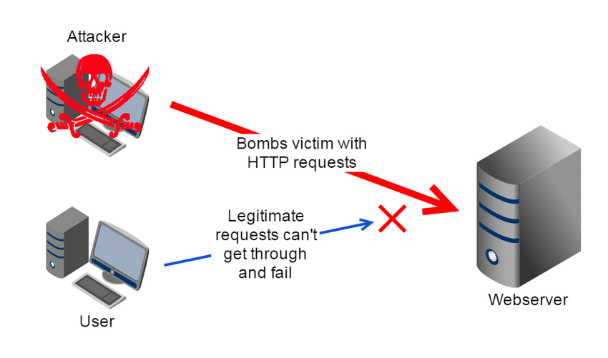
DoS attacks often target web servers of high-profile organizations such as banking, commerce, and media companies, or government and trade organizations.
DoS attacks do not typically result in the theft or loss of significant information or other assets, they can cost the victim a great deal of time and money to handle.

Slide 4
Types of Dos
There are two general methods of DoS attacks:
i) Flooding services
ii) Crashing services

Slide 5
Flooding services
Flood attacks occur when the system receives too much traffic for the server to buffer, causing them to slow down and eventually stop. Popular flood attacks include:
i) Buffer overflow attacks: the most common DoS attack. The concept is to send more traffic to a network address than the programmers have built the system to handle.
ii) ICMP flood: leverages misconfigured network devices by sending spoofed packets that ping every computer on the targeted network, instead of just one specific machine. The network is then triggered to amplify the traffic.
iii) SYN flood – sends a request to connect to a server, but never completes the handshake. Continues until all open ports are saturated with requests and none are available for legitimate users to connect to.

Slide 6
Crashing Services
Other DoS attacks simply exploit vulnerabilities that cause the target system or service to crash. In these attacks, input is sent that takes advantage of bugs in the target that subsequently crash or severely destabilize the system, so that it can’t be accessed or used.

Slide 7
Distributed Denial of Service
An additional type of DoS attack is the Distributed Denial of Service (DDoS) attack.
A DDoS attack occurs when multiple systems orchestrate a synchronized DoS attack to a single target.
The essential difference is that instead of being attacked from one location, the target is attacked from many locations at once.

Slide 8
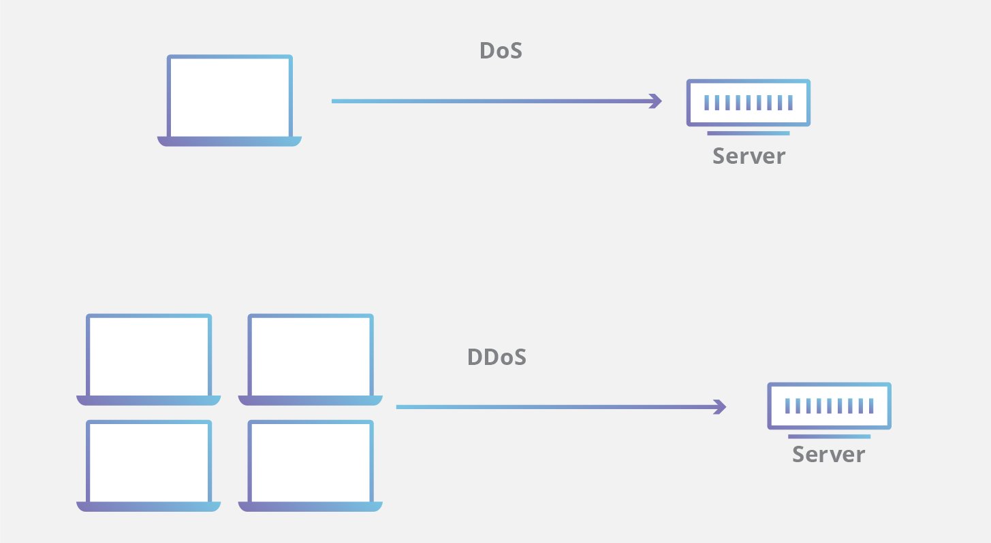
The distribution of hosts that defines a DDoS provide the attacker multiple advantages:
i) He can leverage the greater volume of machine to execute a seriously disruptive attack
ii) The location of the attack is difficult to detect due to the random distribution of attacking systems (often worldwide)
iii) It is more difficult to shut down multiple machines than one
iv) The true attacking party is very difficult to identify, as they are disguised behind many (mostly compromised) systems

Slide 9
Prevention is better than cure!
Let's start with the bad news: It is very difficult to defend against a sophisticated DDoS attack launched by a determined adversary.
One of the more well-known countermeasures against a SYN flood is the use of "SYN cookies" either in the server OS or, better yet for network efficiency, in a network security device.
SYN cookies provide a more efficient method for tracking incoming TCP connections lessening the chance for a typical SYN flood to overwhelm the stack.

Slide 10
An effective defense against an HTTP flood can be the deployment of a reverse proxy -in particular a collection of reverse proxies spread across multiple hosting locations
A reverse proxy sits between a client and the server.
Instead of the client directly querying the server, the client would instead query the reverse proxy.
The reverse proxy then queries the server and returns the result, acting as a middleman.
Deploying this type of architecture can be done in the scramble after an attack has begun, or baked into the network architecture of a web site as a preventative defense.

Slide 11
HOwever
The limitation with these DoS defenses is that if the attacker can generate network traffic at a higher rate than your network's Internet connection can handle, it will be hard to avoid a meltdown. But what these defense strategies do accomplish is at least force the attacker to get a bigger gun.

Slide 12
We have reached the end Thank you!
Presentation By:
Avinash Kumar(40251207717)
Anuj Mahajan(00251207717)
Aditya Sharma(20151203116)
Aditya Vats(20251203116)
Shiv Shankar Dash(20351203116)

