Slide 1
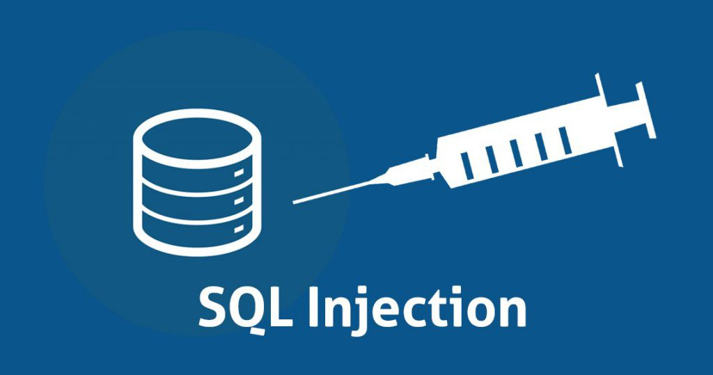

Presented by :-
Sarthak Gupta 02651203116
Shankar Jha 02851203116
Archie Singh 35151203116
Disha Lamba 35351203116
Smriti Kanojia 03051203116

Slide 2

Contents
Introduction
Attack Intent
Real World Examples
How S Q L Injection works?
Impact of S Q L injection
Types of attacks
Defense Against S Q L Injection
Conclusion

Slide 3

SQL injection is a code injection technique, used to attack data-driven applications, in which malicious SQL statements are inserted into an entry field for execution
This is a method to attack web applications that have a data repository.
The attacker would send a specially crafted S Q L statement that is designed to cause some malicious action.

Slide 4

On August 17, 2009, the United States Justice Department charged an American citizen Albert Gonzalez and two Russians with the theft of 130 million credit card numbers using an S Q L injection attack.
In 2008 a sweep of attacks began exploiting the S Q L injection vulnerabilities of Microsoft's IIS web server and S Q L database server. Over 500,000 sites were exploited.

Slide 5

Determining database schema
Extracting data
Adding or modifying data
Bypassing authentication

Slide 6
The ability to inject S Q L commands into the database engine through an existing application
S Q L injection is the use of publicly available fields to gain entry to your database.
This is done by entering S Q L commands into your form fields instead of the expected data.
Improperly coded forms will allow a hacker to use them as an entry point to your database

Slide 7





1. App sends form to user.
Attacker
Form
Attacker submits form with S Q L
exploit data.
Application builds string with exploit data.
Application sends S Q L query to
DB.
DB executes query, including exploit, sends data back to application.
Application returns data to user.
User
Pass
‘ or 1=1--
Firewall
DB Server
Web Server

Slide 8
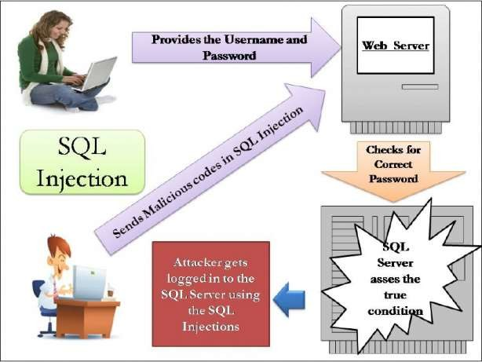

Slide 9
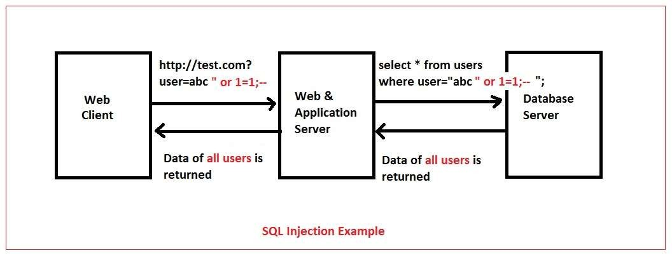

Slide 10

Unauthorized Access Attempt:
password =
S Q L statement becomes:
select count(*) from users where username = ‘user’
and password =
Checks if password is empty OR 1=1, which is always true, permitting access.
’ or 1=1 --
‘’ or 1=1 --

Slide 11

Database Modification Attack:
password =
DB executes two S Q L statements:
select count(*) from users where username = ‘user’ and password = ‘foo;
foo’; delete from table users
where username like ‘%
’
delete from table users where username like ‘%’

Slide 12

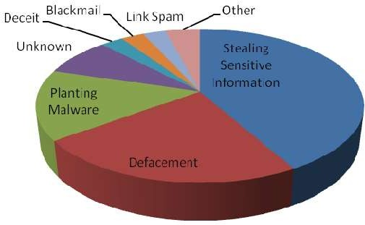
Leakage of sensitive information.
Reputation decline.
Modification of sensitive information.
Loss of control of db server.
Data loss.
Denial of service.

Slide 13

1. First order attacks
The attacker can simply enter a malicious string and cause the modified code to be executed immediately
2. Second order attacks
The attacker injects into a persistent storage (such as a table row) which is deemed as a trusted source. An attack is subsequently executed by another activity.
1. Lateral Injection

Slide 14
3. Lateral Injection
The attacker can manipulate the implicit function To_Char() by changing the values of the environment

Slide 15

Injection through user input
Injection through cookies
Injection through server variables
First order injection

Slide 16
Websites require constant access to the database.
Firewalls provide little or no defense against S Q L injection attacks.
Your website is public and firewalls must be set to allow every site visitor access to your database, usually over port 80/443.
Antivirus programs are equally ineffective at blocking S Q L injection attacks.

Slide 17
1. Comprehensive data sanitization
Web sites must filter all user input
For example, e-mail addresses should be filtered to allow only the characters allowed in an e-mail address.
Its S Q L injection defenses can catch most attempts to sneak S Q L through web channels.

Slide 18
2. Use a web application firewall
A popular example is the free, open source module ModSecurity.
ModSecurity provides a sophisticated and ever-evolving set of rules to filter potentially dangerous web requests.

Slide 19
3. Limit database privileges by context
Create multiple database user accounts with the minimum levels of privilege for their usage environment.
For example, the code behind a login page should query the database using an account limited only to the relevent credentials table.
This way, a breach through this channel cannot be leveraged to compromise the entire database.

Slide 20
4. Avoid constructing SQL queries with user input
Even data sanitization routines can be flawed.
Using S Q L variable binding with prepared statements or stored procedures is much safer than constructing full queries.

Slide 21

S Q L injection is technique for exploiting applications that use relational databases at their back end.
Applications compose S Q L statements and send to database.
S Q L injection use the fact that many of these applications concatenate the fixed part of S QL statement with user-supplied data that forms W H E R E predicates or additional sub-queries.

Slide 22
The technique is based on malformed user- supplied data
Transform the innocent S Q L calls to a malicious call
Cause unauthorized access, deletion of data, or theft of information
All databases can be a target of S Q L injection and all are vulnerable to this technique.
The vulnerability is in the application layer outside of the database, and the moment that the application has a connection into the database.

Slide 23



