Slide 1
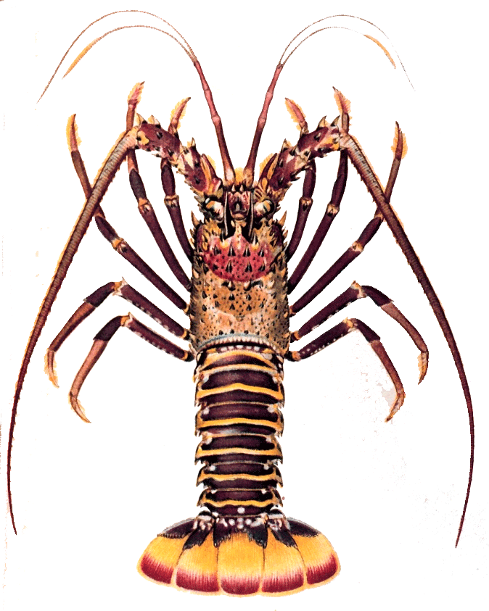
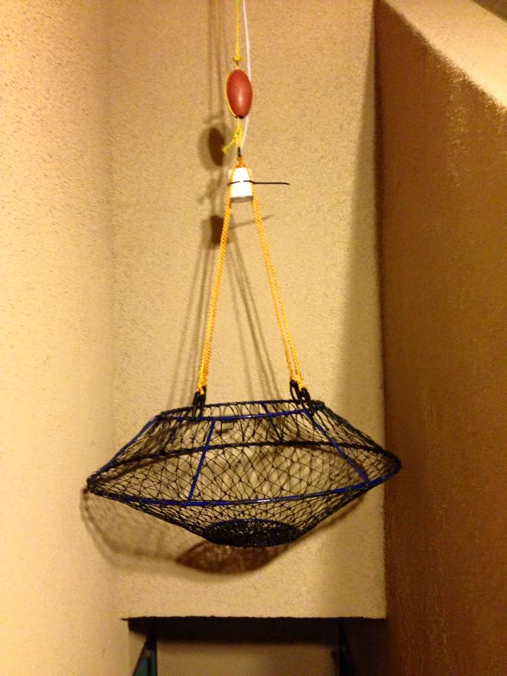
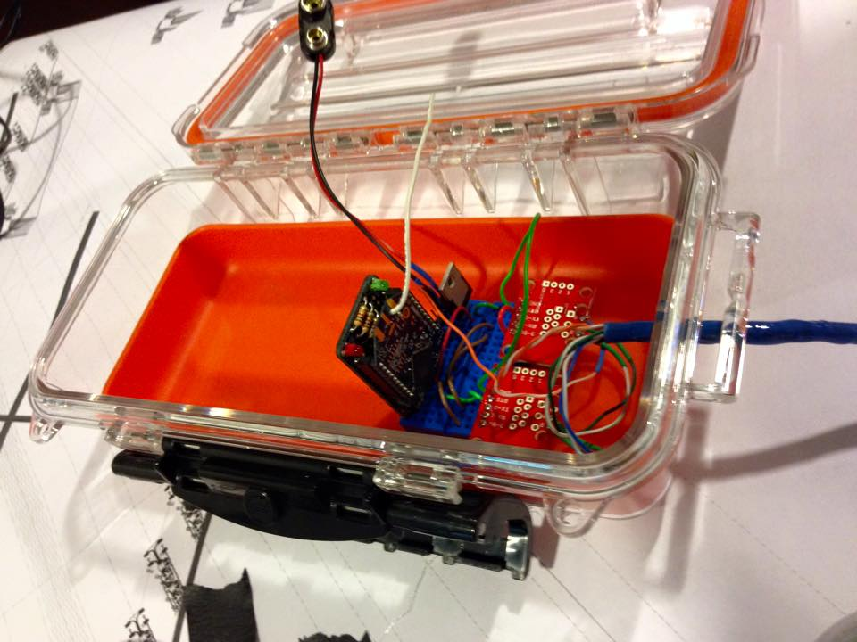
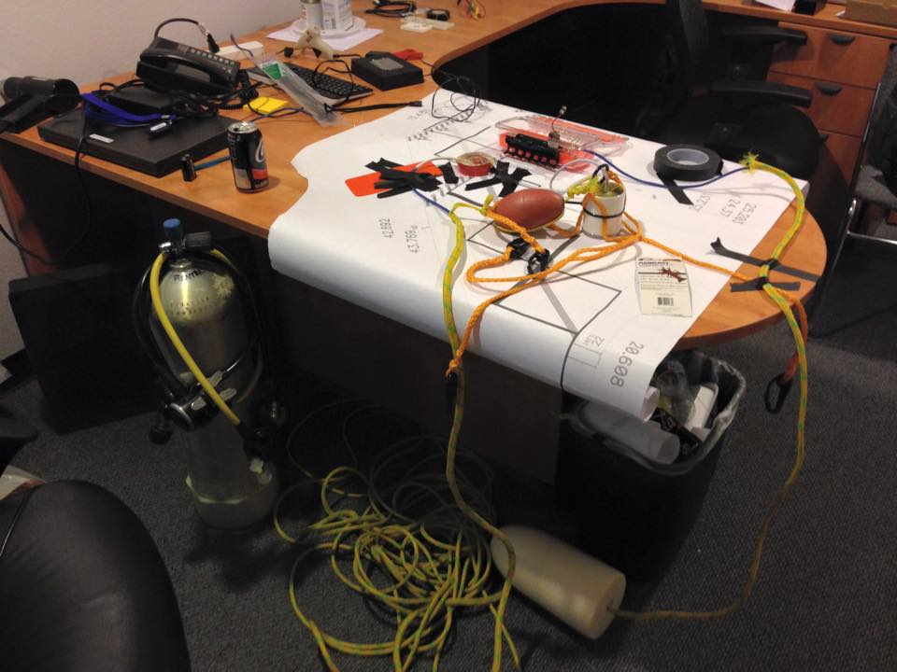
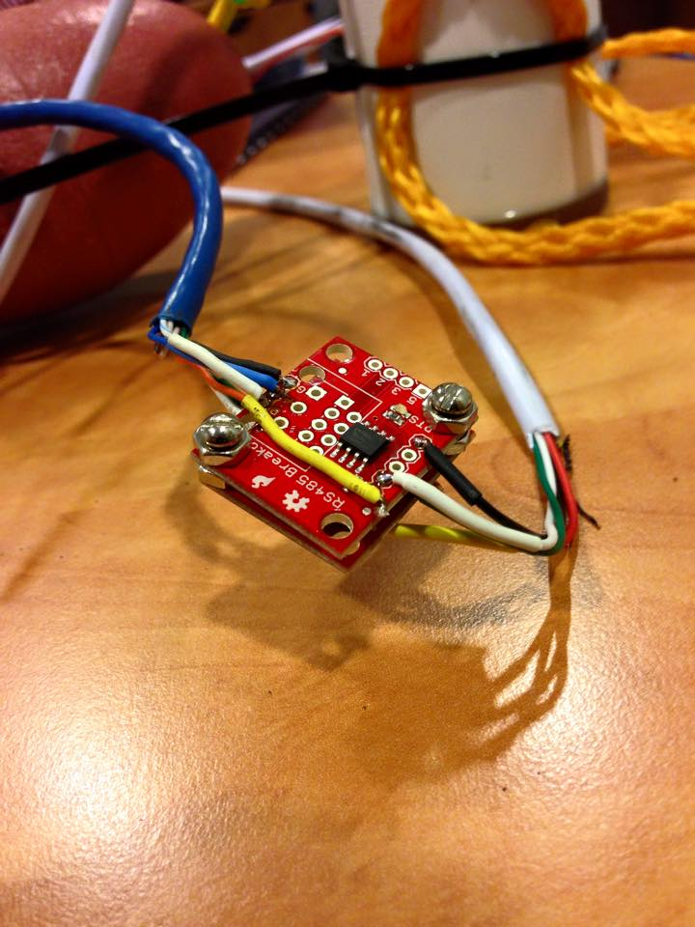
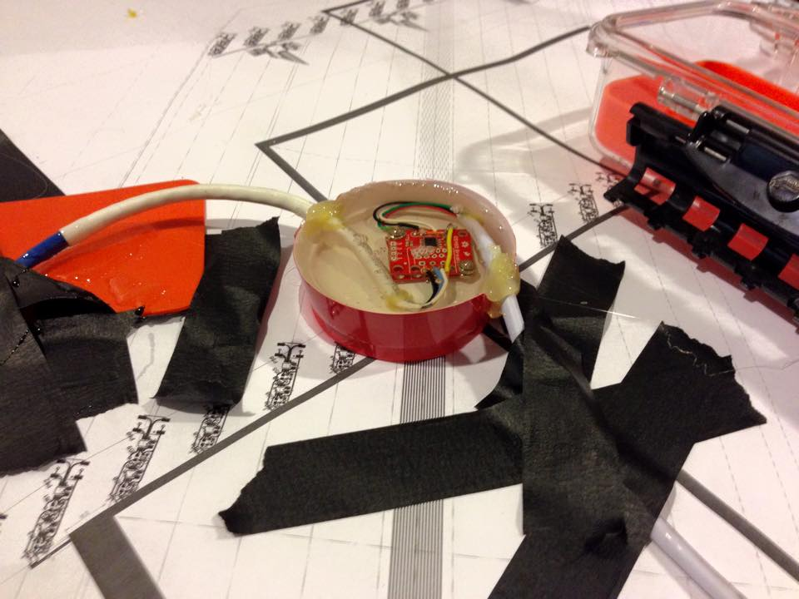
Lobsters
Xbee
Serial Buffer in Python code had to be modified to accommodate Xbee ->RS485->Camera->RS485->Xbee path to 200 bytes/packet (down from the original 8k of the cameras initial hard wired run).
Test Run
02/27/2014, conducted initial test of single node trap aboard “Christopher’s Way” off of the San Pedro wall.
Mechanics of trap design performed according to plan.
Camera successfully grabbed images and transmitted them via RF data communication to and from a single node.
Images were sub-par and indicate a need for a revised lighting scheme.
Buoy was operated outside of the water and eventually overheated. This was anticipated, and plenty of sample images were acquired while the system was active.
Video that has almost nothing to do with any scientific aspect of the test

