Slide 1
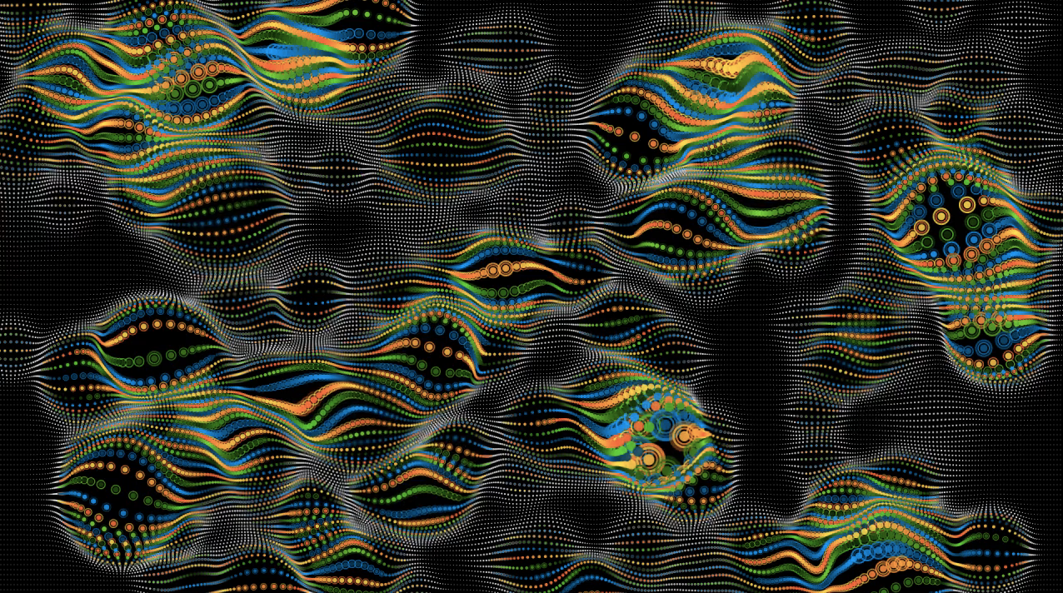

Pattern, Rhytm is a dancer
Marius Watz, ElectroPlastique, 2005

Slide 2
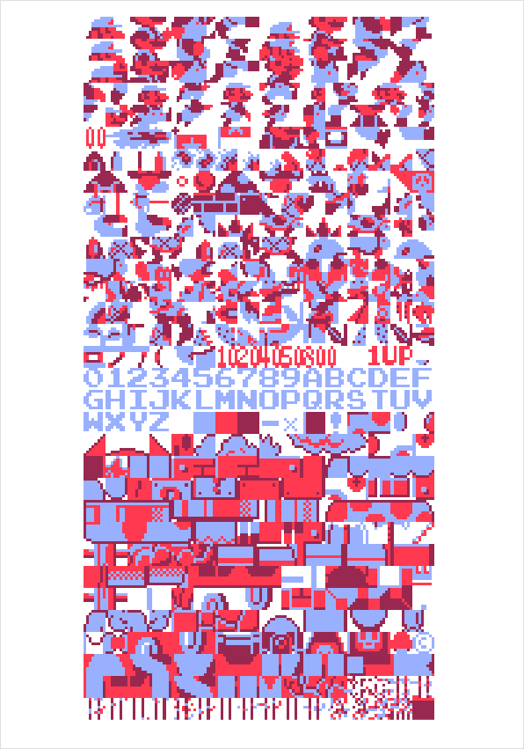
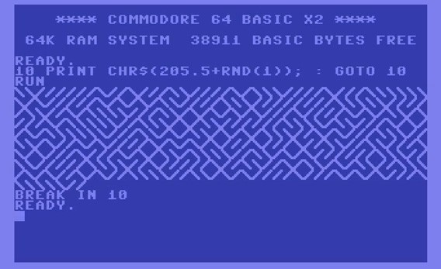
Repeatition/Modularity
Casey Reas, 10 PRINT, http://10print.org/
Ben Fry, Mario Soup, http://benfry.com/mariosoup/

Slide 3
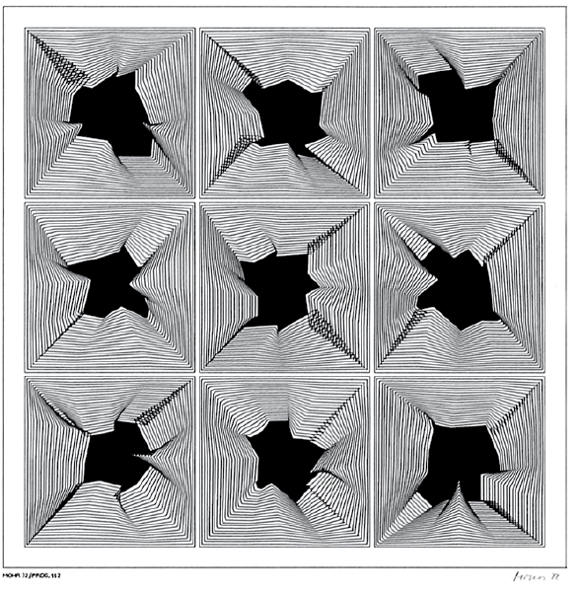
Manfred Mohr, I
Lady Quark, 1972

Slide 4
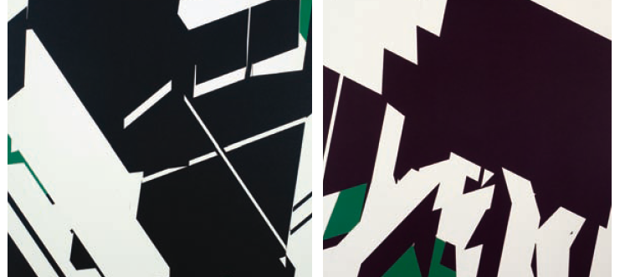
Manfred Mohr, II
Manfred Mohr, P1011-H1, P1011-I1, 2004.

Slide 5
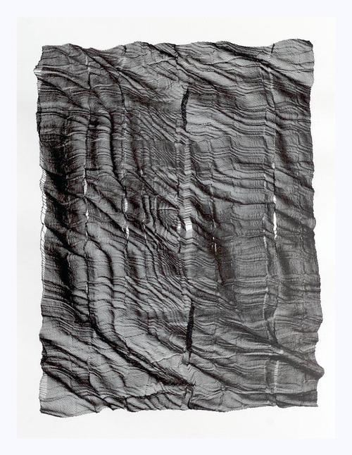
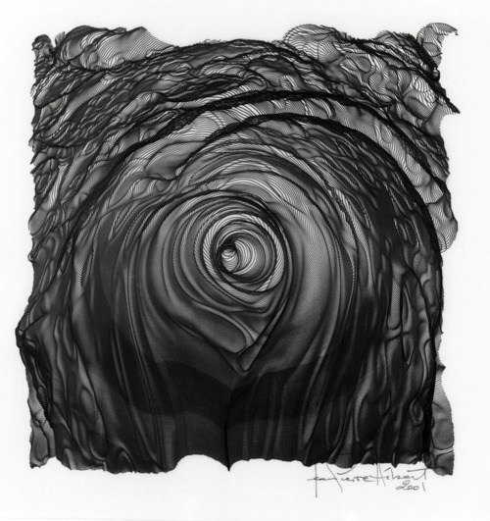
Trasformation
Jean-Pierre Hérbert, Fractured Landscape, 2004.
http://jeanpierrehebert.com

Slide 6

ITcoder
Alessandro Capozzo, Abstractscape2, 2006. http://www.abstract-codex.net/abstractscapeprints/index.html

