Slide 1
Advance Data Analytics
Task - 3
Create samples using MIMIC-II ICU data and Icentia 11k ECG data with the help of random sampling and reservoir sampling and find the optimal sample size.
Group Number - 30
Group Members - Taniya Adil (IIT2019054)
Alka Trivedi (IIT2019055)

Slide 2
Importance And Objective
With the advancement in technology we are having a lot of not only static data but dynamic data also. There is a growing need to analyze both the data at rest and data in motion to drive the applications in today’s technical world. Our project can help in streaming the real world dynamic data and in random sampling the data for further analysis.
The objective of our project is to create samples using MIMIC-II ICU data and Icentia 11k ECG data with the help of random sampling and reservoir sampling and find the optimal size.

Slide 3
Introduction
Spark Streaming is an API that can be connected with a wide variety of sources including kafka to deliver high scalability, throughput, fault-tolerance, and other benefits for a high-functioning stream processing mechanism. These are some features that benefits processing live data streams and channelizing them accurately.
This project uses kafka and zookeeper for data preprecessing and data streaming. And for data sampling we have used random sampling and reservoir sampling.
Sampling is a general technique for tackling massive amounts of data. A sample is a subset of data that has approximately the same properties of the original data.
(i) Random sampling - Every case of the population has an equal probability of inclusion in sample. Stratified sampling is where the population is divided into strata (or subgroups) and a random sample is taken from each subgroup.
(ii) Reservoir sampling - It is a family of randomized algorithms for randomly choosing k samples from a list of n items, where n is either a very large or unknown number.

Slide 4
Dataset Used And Pre-requisites
The dataset used for this project is MIMIC-II ICU admissions.csv dataset for streaming purpose.
For the data sampling purpose we are making an input.txt file from the data consumer consumed data.
Prerequisites:
Kafka
Zookeeper
Spark
Python3
Linux Operating System

Slide 5
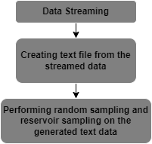
Methodology
The flow of execution of the project is ===>
Data Streaming:
Producer will read the csv file extract its data
Extracted data will be send to the consumer

Slide 6
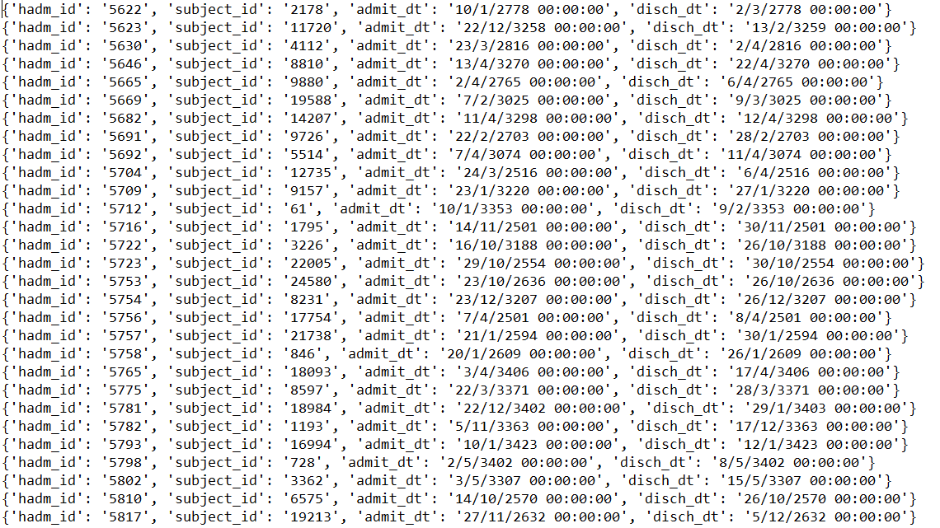
Creating text file from the streamed data:
The data which the consumer will consume will be written on to a text file name ‘input.txt’ which will serve as an input for the sampling

Slide 7
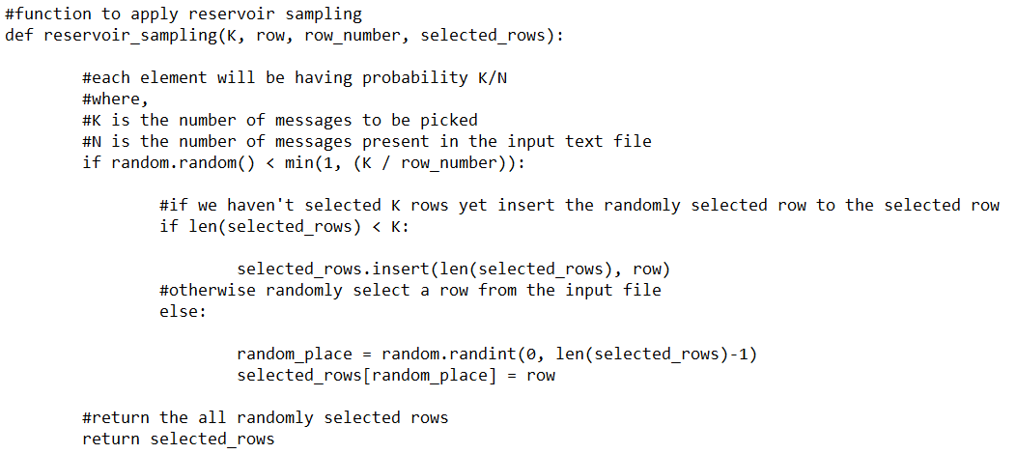
Performing random sampling:
From the imputed text file random number of messages will be sampled. Since, in random sampling all the messages have same probability for sampled so we are taking any random message without replacement.
Performing reservoir sampling:
Here we will be given as input a number ‘K’ which will be the number of messages we wanted to extract from the text file. In reservoir sampling the probability of each message will be K/N where N is the number of messages in the text file. Also, one thing to note is that N will be changing every time as the data is streaming continuously into the text file. That is why in this sampling all messages will not be having same probability to be sampled. In this sampling also we are sampling messages without replacement.

Slide 8
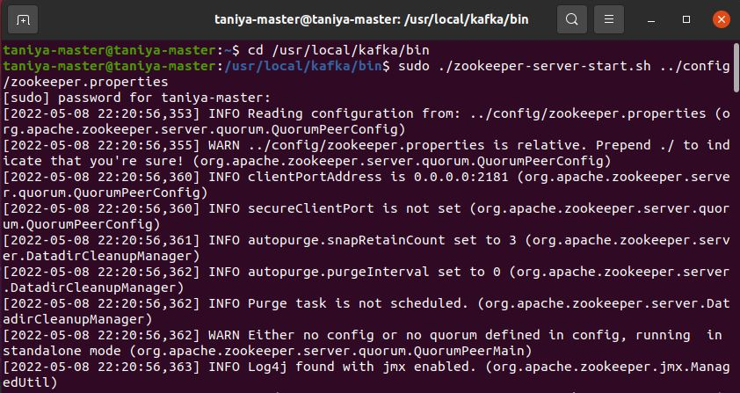
Week - 1: Data Stream Generation Using Kafka
Starting Zookeeper-server

Slide 9
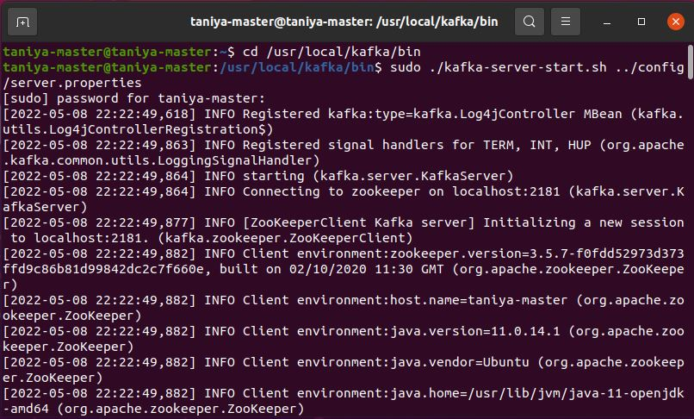
Starting Kafka-server

Slide 10
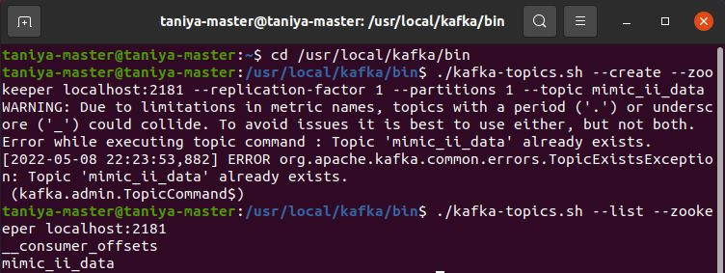
Created Topic MIMIC_DATA and Listed Topic MIMIC_DATA

Slide 11
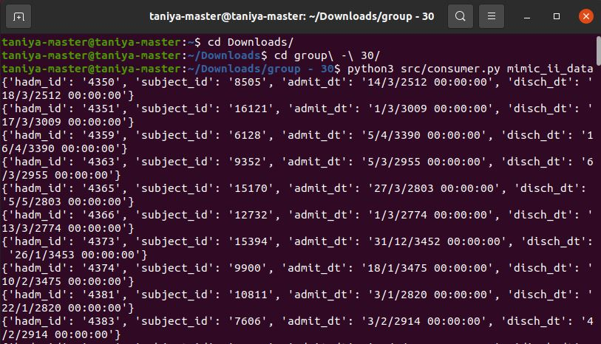
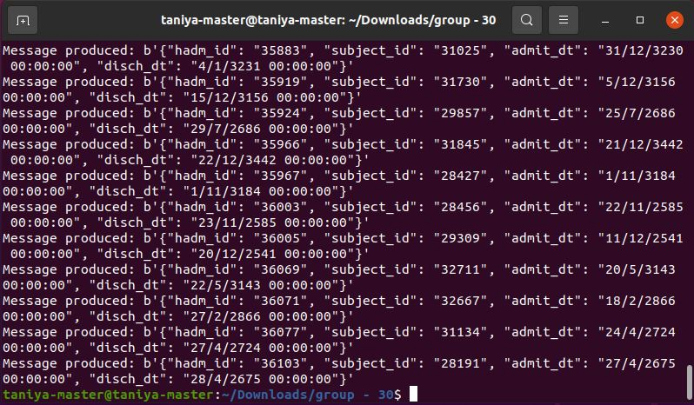
Running consumer.py
Running Producer.py

Slide 12
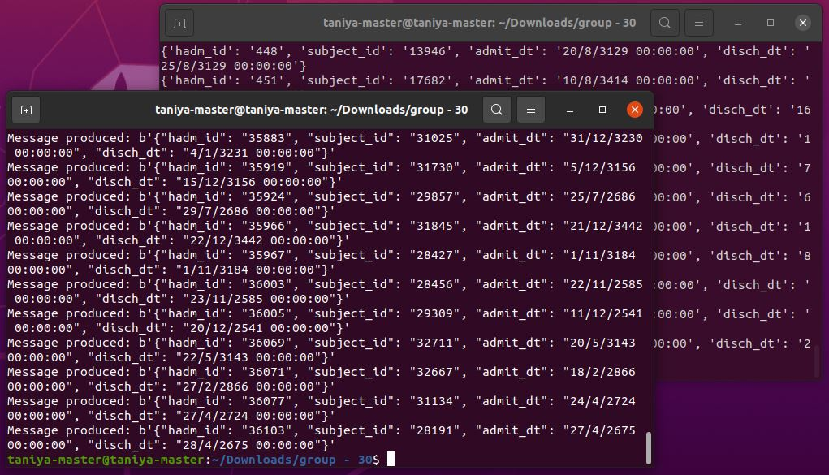
Running Consumer-producer.py both and showing Data streamed

Slide 13
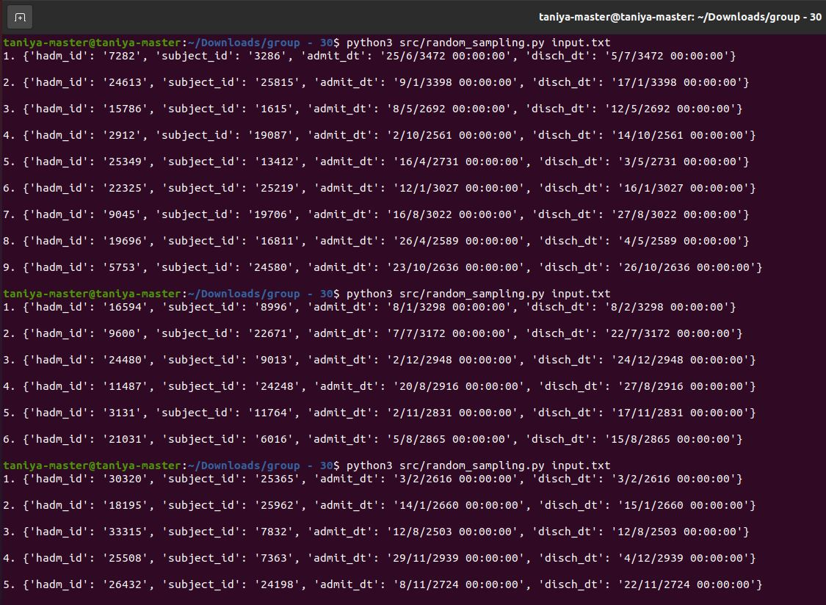
Random Sampling

Slide 14
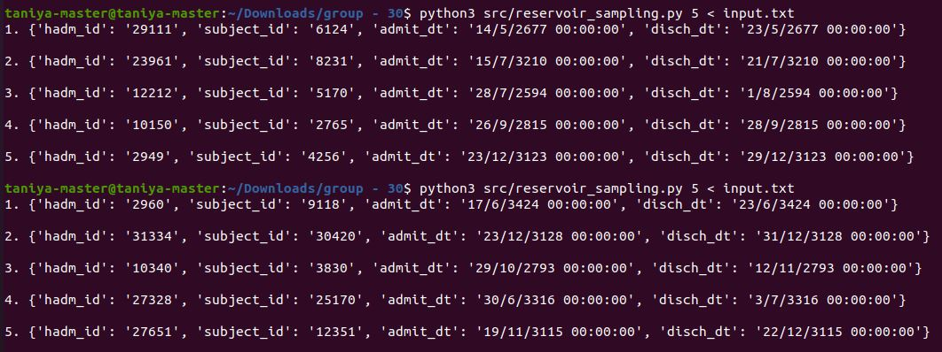
Performing Reservoir Sampling Technique

Slide 15
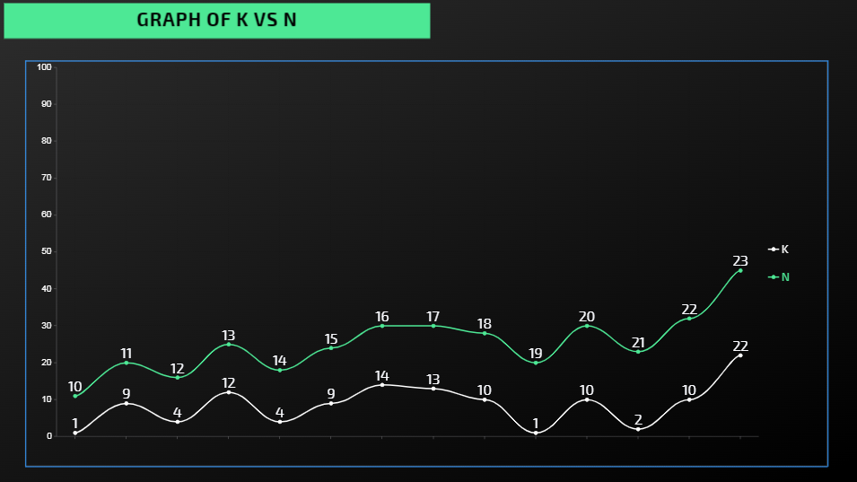
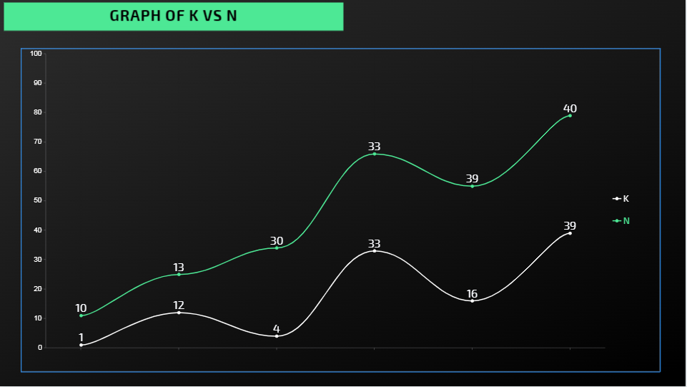
Result
The value of ‘K’ is fixed in Reservoir Sampling whereas in Random Sampling it is a random value between (1,n), Hence the difference in both the algorithms will only be the sampled number of messages at a given time.
Random Sampling
Reservoir Sampling

Slide 16
Future Work
The future work in this project includes the following elements:
Integrating the other attributes from the dataset to create a more robust pattern to help health Experts in more Accurate Analysis.
Integrating the whole project into a website or app to monitor the changes in real-time data that will make it more easier to draw accurate conclusions in given circumstances.
Integrating a deep learning model into the project so that the system keeps learning from the current data and changing data as well.

Slide 17
References
THANK YOU!
[1] https://github.com/gstamatelat/random-sampling
[2] https://journals.sagepub.com/doi/pdf/10.1177/1550147718773999
[3] https://www.ece.iastate.edu/snt/files/2019/01/sss-edbt-2019.pdf

