Slide 1
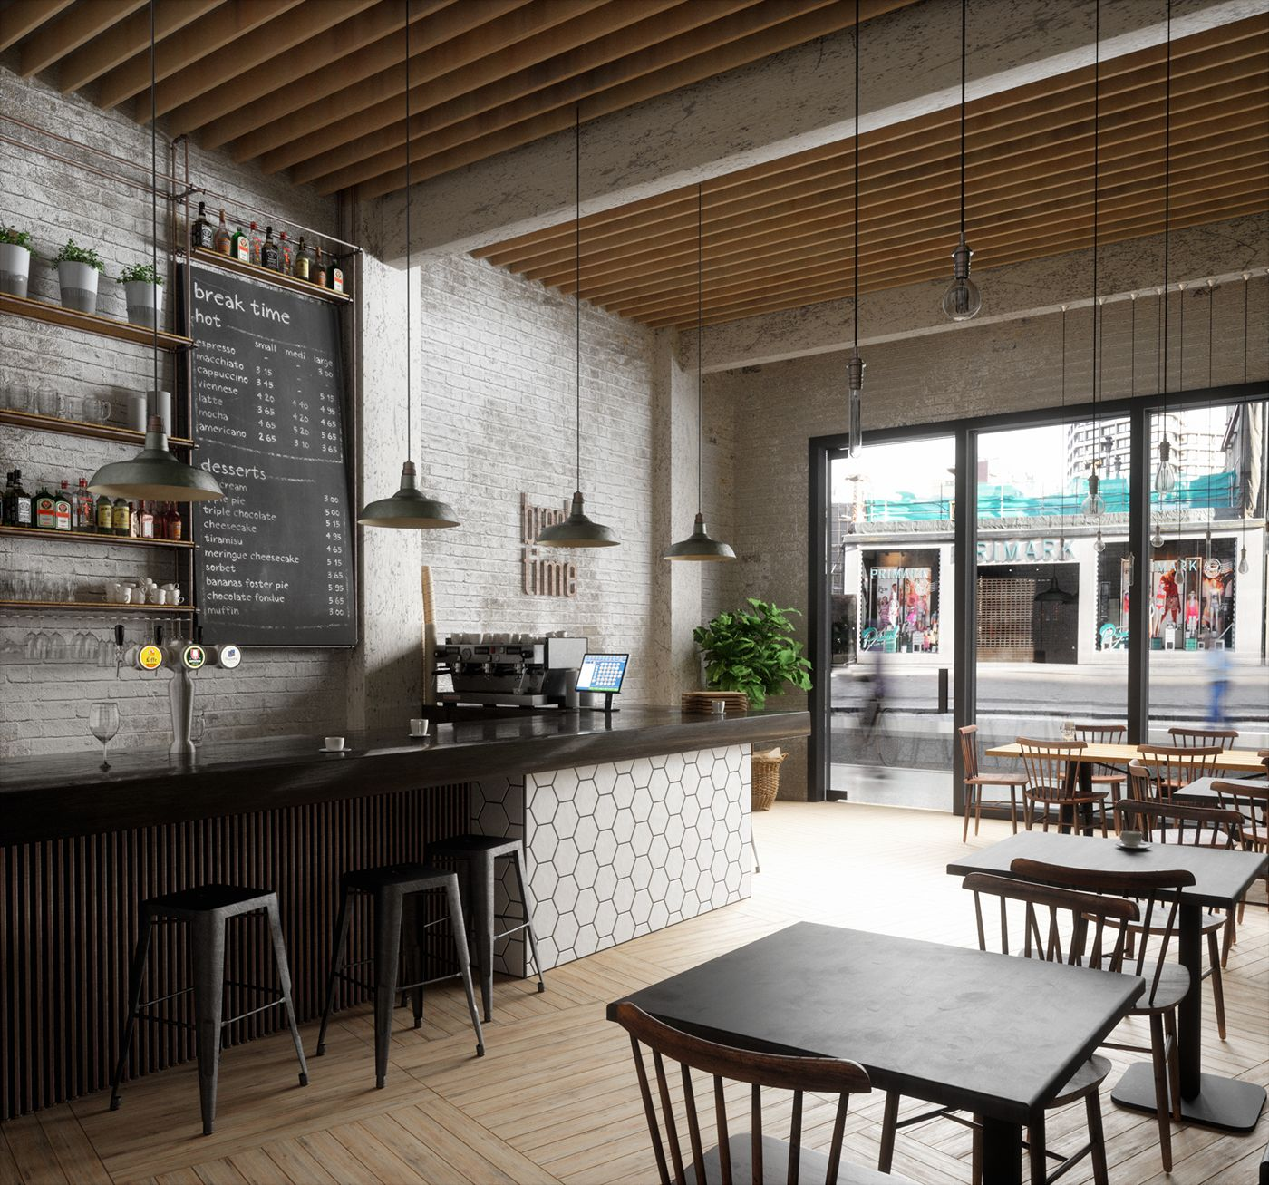
Coursera Capstone – The battle of Neighborhoods
Recommending a neighborhood for a new café shop in Toronto, Canada

Slide 2
Problem Description
This project is a hypothesis for an entrepreneur who would like to open a new business (a Café shop) in the capital city of Canada, Toronto, and would like to search for a suitable neighborhood for such kind of business.
The entrepreneur would like to avoid strong competition as he/she is new to the business by targeting a neighborhood with no or little number of Café shops!

Slide 3
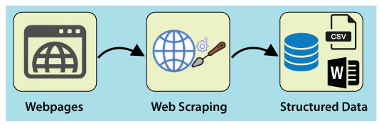
Data Acquisition and Cleaning
Scrapping the following Wikipedia page to get needed information about different neighborhoods of Toronto:
https://en.wikipedia.org/wiki/List_of_postal_codes_of_Canada:_M

Slide 4
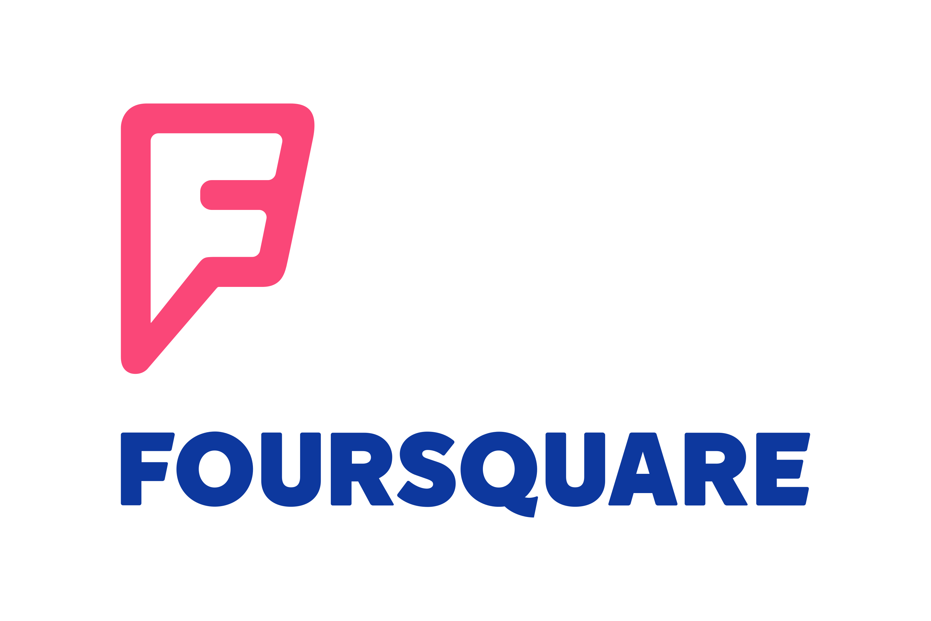
Data Acquisition and Cleaning
Using Foursquare API to get more info about venues of each neighborhood in Toronto such as name, location and categories

Slide 5
Methodology
Data Acquisition and Preparation
Exploratory Data Analysis
Clustering neighborhoods

Slide 6
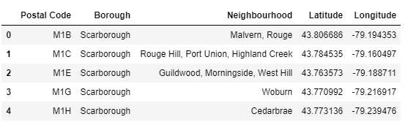
Data Acquisition and Preparation
Scrapping Wikipedia webpage to get needed information about Toronto neighborhoods
Getting neighborhoods' coordinates
Using Foursquare API to get location data

Slide 7
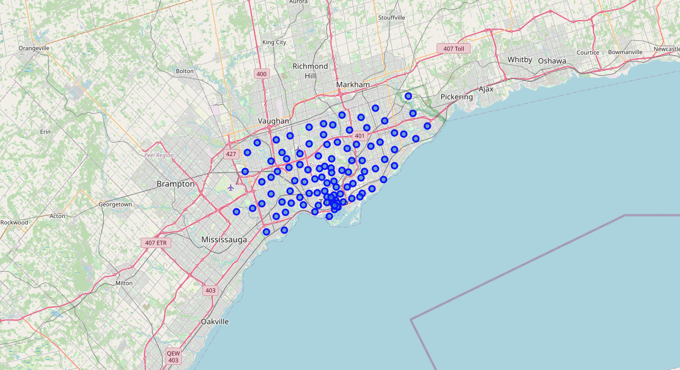
Exploratory Data Analysis
Visualizing Toronto and its neighborhoods
Creating a data-frame with pandas one hot
encoding for the venue categories
Calculating the mean of the frequency for every category

Slide 8
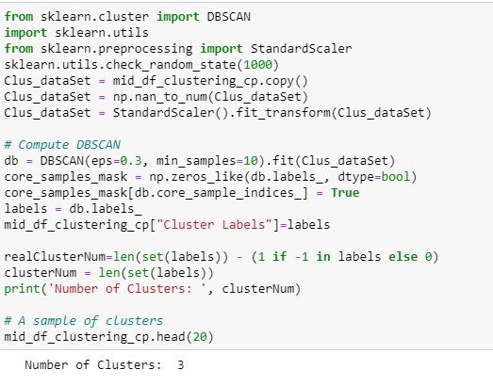
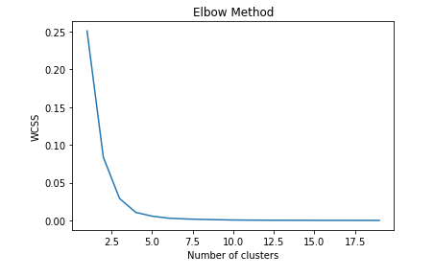
Clustering Neighborhoods
DBScan Clustering
KMean clustering

Slide 9
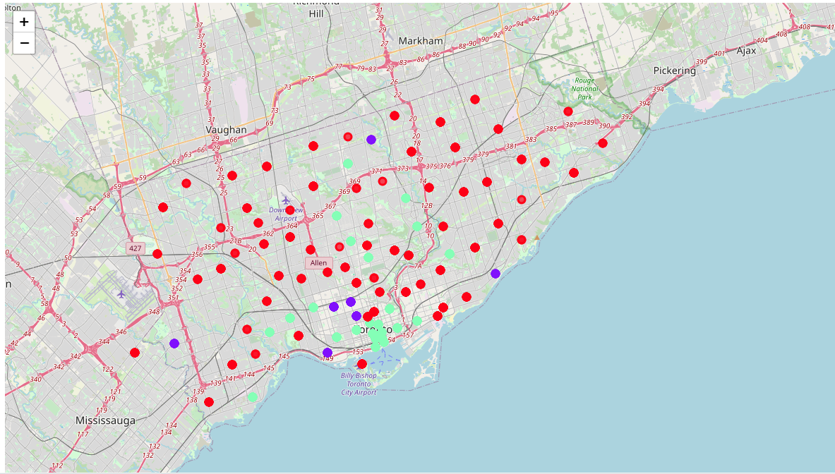
Results
The clustering output of both used clustering algorithms shows that we can cluster Toronto neighborhoods into 3 distinct clusters in terms of the number of available café shops in every neighborhood. The clusters are the following:
Cluster 0: Neighborhoods with little or no café shops
Cluster 1: Neighborhoods with high number of café shops
Cluster 2: Neighborhoods with some café shops

Slide 10
Discussion
In this project we were able to use location data to visualize and analyze the neighborhoods of Toronto city, and segment and cluster these neighborhoods according to the existence and popularity of café shops.
One main limitation of this project could be that we considered only a single factor for segmenting neighborhoods to find the most suitable ones for opening a new café shop which is the existence and frequency of café shops! However, to achieve a solid result, many other factors could be put in consideration when looking for the optimal location such as population density, average income of residents, taxes and rent costs for every neighborhood. Future research and projects could take into considerations all of these factors and possible other factors to reach better results.

Slide 11
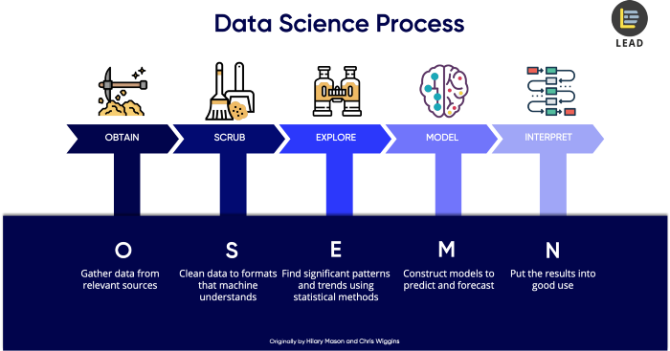
Conclusion

