Slide 1
DenseNet
Group2
8/20/2023

Slide 2
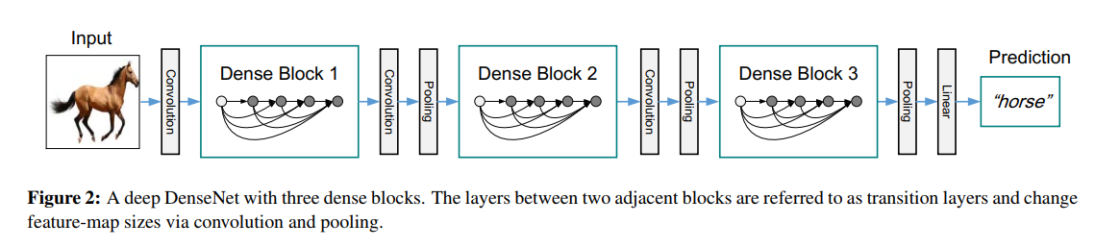
DenseNet Overview
2017 CVPR Best Paper Award
Densely Connected Convolutional Networks
Convolution + Pooling + { Transition Layer + Dense Block } × n +Classification Layer

Slide 3
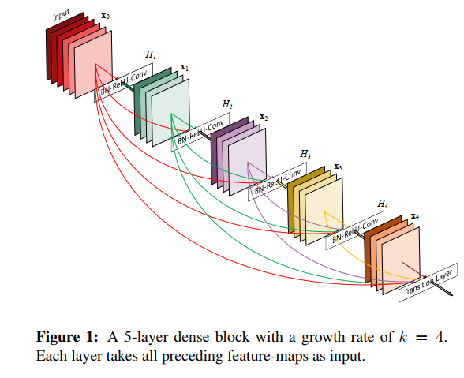
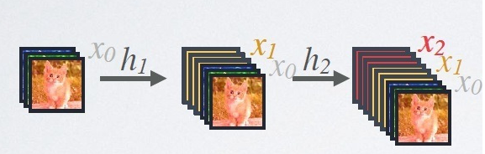

DenseNet Structure
Each subsequent layer will receive all preceding layers
as its additional input.
All layers input will finally come to transition layer.
$X_{l}=H_{l}\left(X_{l−1}\right)+X_{l−1}$
$X_{l}=H_{l}\left( \left[X_{0}+X_{1}+…+X_{l−1}\right] \right)$
$X_{i}$ = feature image
$H_{i}$ = nonlinear transformation = BN + ReLU + Conv(1×1) + Conv(3×3)

Slide 4
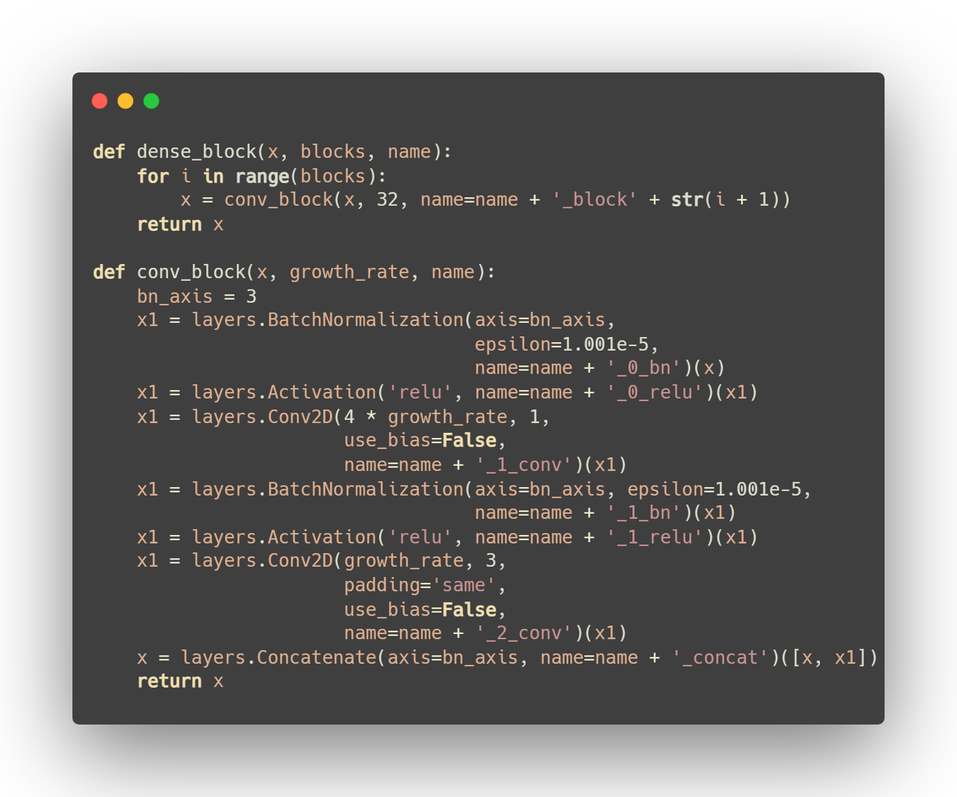
DenseNet Code

Slide 5
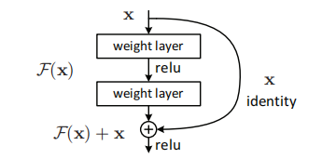
DenseNet v.s. ResNet
ResNet has a residual connection, so it requires adding an "x".

Slide 6
DenseNet Transition
DenseNet uses Transition Layer for final output.
Transition Layer = BN + Conv(1×1) ＋2×2 average-pooling
Transition Layer connects different Dense Blocks, is mainly to integrate the features obtained from the previous Dense Block, reduce the width and height of the previous Dense Block.
It also achieves down-sampling effect, and halves the width and height of the feature map
The author hopes that the size of the feature maps within each Dense Block is unified.

Slide 7
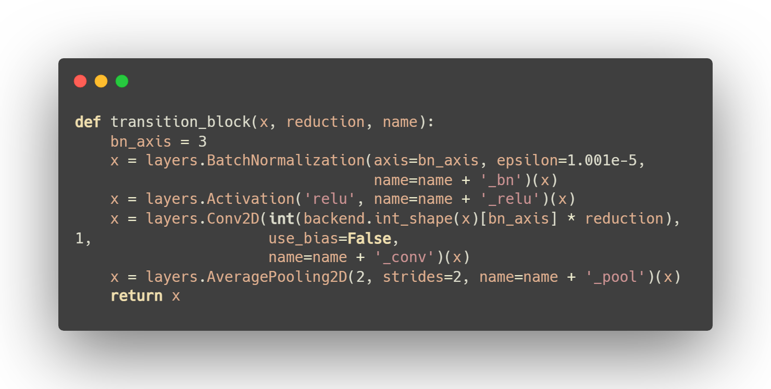
DenseNet Code
Transition Layer = BN + Conv(1×1) ＋2×2 average-pooling

Slide 8
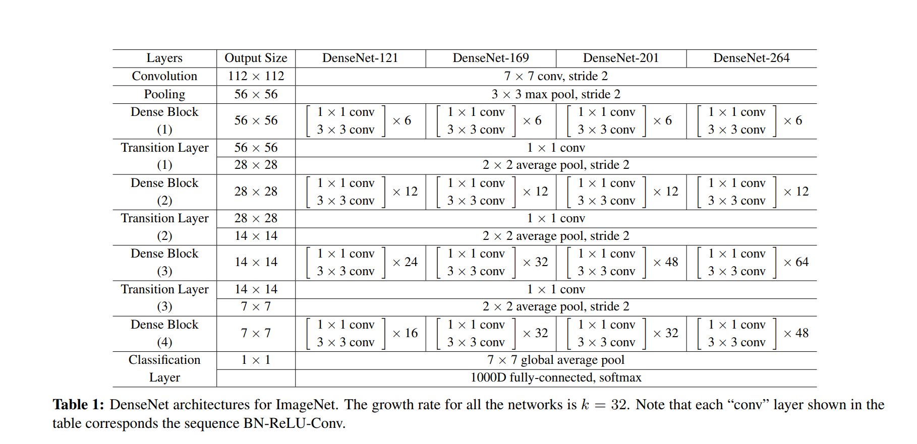
DenseNet Complete Structure
A total of 121 convolutional layers.
After a final 7x7 average pooling, a fully-connected layer is added, which could also be regarded as the softmax layer.

Slide 9
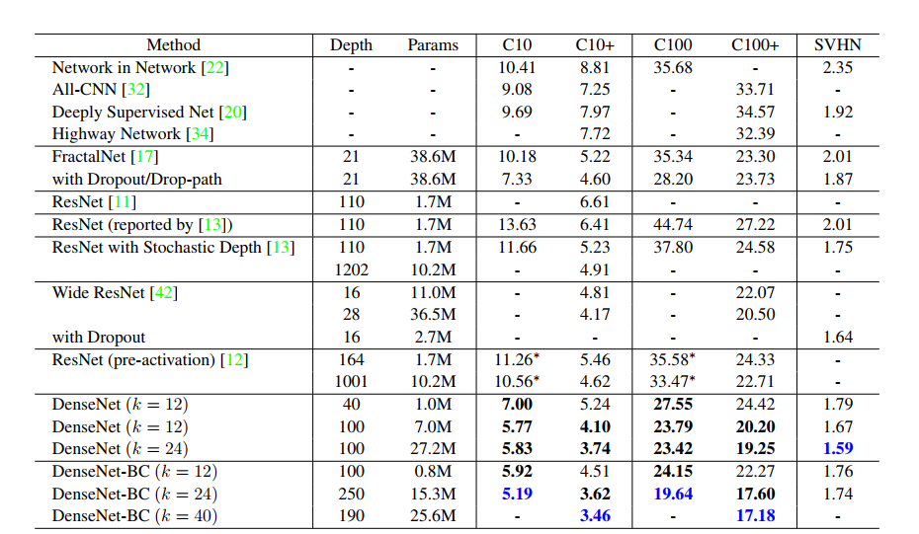
DenseNet Complete Results
The value of K should be moderate.
Due to the depth issue, there is still a gap compared to ResNet.

Slide 10
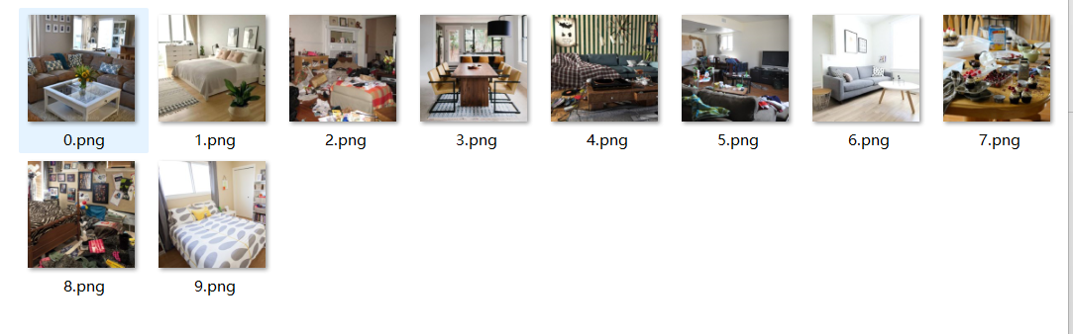
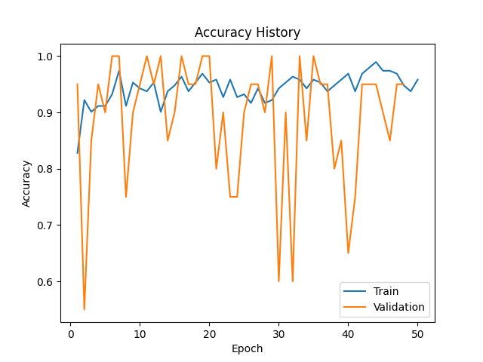
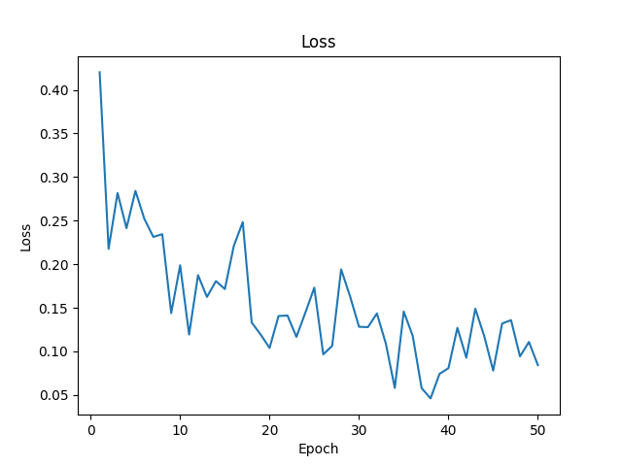
DenseNet Application
DenseNet detects whether a room is clean or messy.
Dataset: https://www.kaggle.com/datasets/cdawn1/messy-vs-clean-room
For the data in the test set, the accuracy remains above 97%,.
The loss curve is kind of ideal(due to the small dataset) .
But sometimes the computational workload can be heavy.

Slide 11
Thanks!

