Slide 1
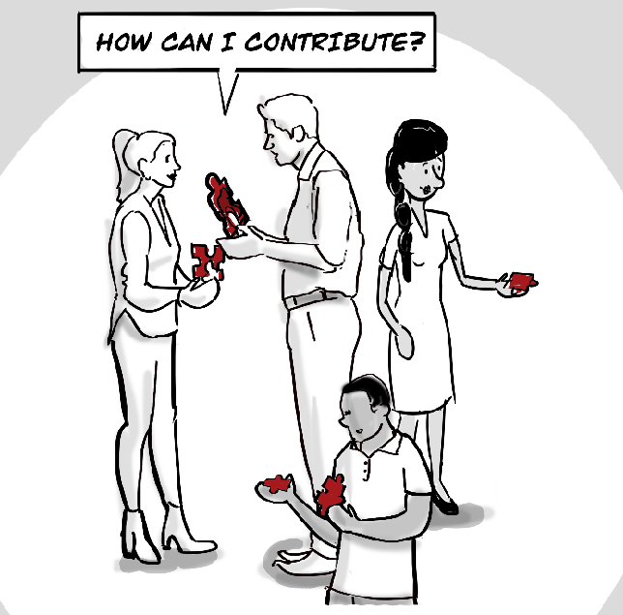
PROBLEM: COLLABORATION TO INNOVATE IS OFTEN NOT EFFECTIVE
Information is fragmented
Best practices are not easily sharable
Lack of awareness of existing initiatives,so duplicated efforts
Citizens find it hard to contribute
Collaboration has too many hurdles
Hard to connect with the right capabilities / talent
Hard to align stakeholders around challenges
We need to better support Societal Innovation.
Notes:
to do: needs to be made more visual
Lack of adequate tools, not integrated
Many parties involved, different backgrounds
Fragmented best practices / community
Duplication of efforts
Facilitating collaboration & tracking progress
Hard to find parties with right skills, capabilities and resources

Slide 2
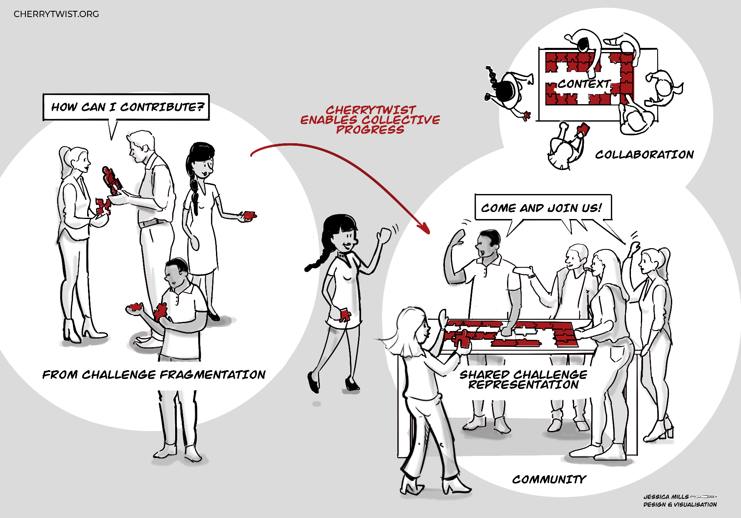
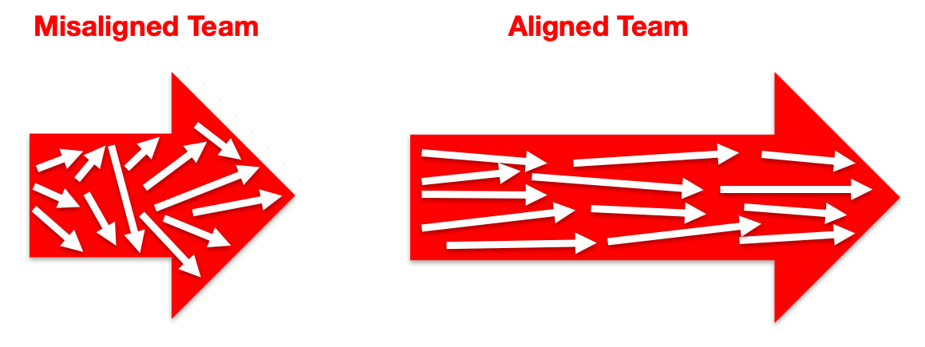
MISSION DRIVEN: CHALLENGE CENTRIC
Challenge: dissatisfaction with current reality
Context: What do we want to change?
Community: Who wants to contribute?
Collaboration: How are we going to work together?
Coordination: How do we align our activities?
Notes:
The shared representation (context) of the desired outcomes and insights, created from different perspectives and interests.
The people and organisations (community) that wish to collaborate, a social network around the context.
esign principles
Open and shared
Scalable + decentralized architecture
Extendable, templatable and integratable
An integrated platform, with modules covering
Challenge Information Management
Community Interaction Management
Collaboration incentives + tracking
Governance

Slide 3
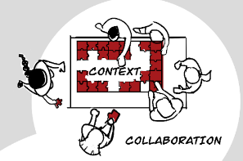
NETWORK EFFECT: SHARED COMMUNITY
Challenge Platform
Challenge #1
Challenge #2
Challenge # n
Community

Slide 4

NETWORK EFFECT: SHARED COMMUNITY
Community
Community
Community
Hub #1
Hub #2
Hub #n
Community
Community
Challenges
Challenge Hub
Open Innovation Hub (SAAS)

Slide 5
DECENTRALIZATION READY, FLEXIBLE DEPLOYMENT
Clients
Users
Custom Client
E.g. Virtual Reality
Alkemio Web Client
Integration
E.g. Teams, Slack
CT Extensions
CT Extensions
Alkemio Server
Challenges
Challenges
Challenges
Community
Notes:
Use provided web client, or create your own
Or integrated into your existing tooling

Slide 6
Alkemio Platform - Components
API
Authentication
E.g. Ory Oathkeeper, Kratos
Alkemio Server
CAS
E.g. IPFS
Communications
E.g. Matrix Synapse
SSI
E.g. Jolocom
SqL Storage
E.g. MySql, Postgres
Notes:
Use provided web client, or create your own
Or integrated into your existing tooling

Slide 7
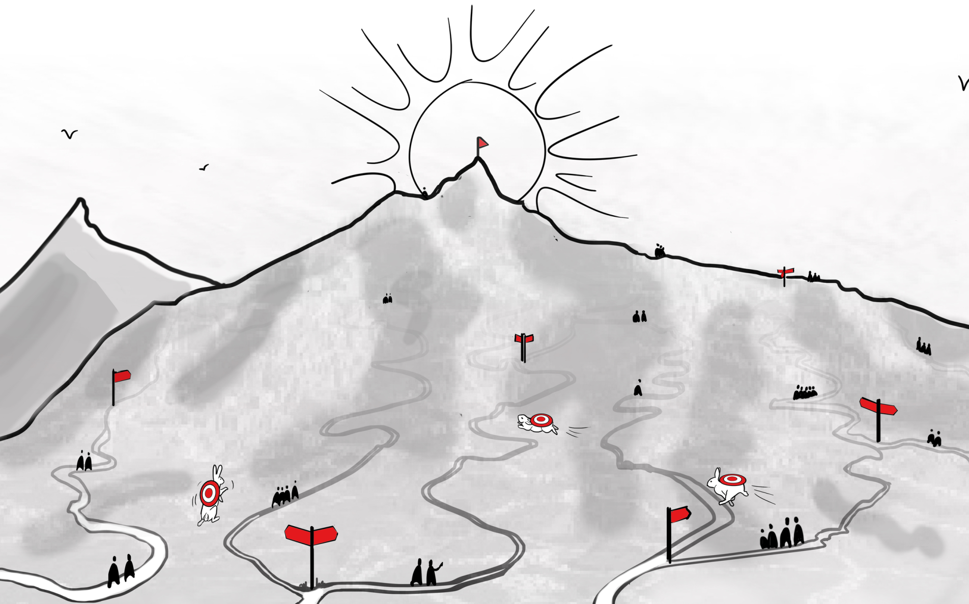
Challenge
Context

Slide 8

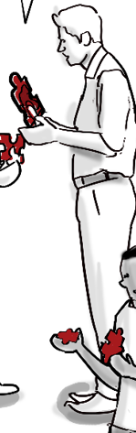
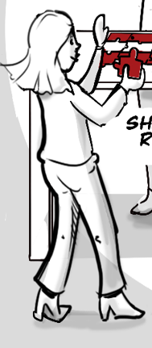

Challenge
Community
Context

Slide 9
Challenge
Collaboration & Coordination
Project
Project
Project
Project
Project
Project
Community
Context

