Slide 1
Session 1
Introduction

Slide 2
Session 1 – Introduction
Before we start
What is this course about?
How we push data through a funnel to apply ML models properly
  Functional
  Technical
  Organizational
Evaluation
  Final Exam: 20%
  Class Participation: 15%
  Group Presentation: 30%
  Individual Work: 35%
Technical requirements
  You will need a computer with Anaconda (pandas, matplotlib and scikit-learn come with Anaconda)
  Other software will be installed during the course as needed using pip install
Contact
  jgarcias@faculty.ie.edu

Slide 3
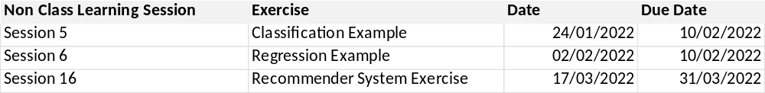
Session 1 – Introduction
Before we start
Assignments and due dates
  Workgroup Datathon: 18-03-2022
  Individual assignments:

Slide 4
Session 1 – Introduction
A Few Data Science Resources
You will always find good resources about some specific question just asking Google
Books:
Hands-on Data Science and Python Machine Learning
  Frank Kane
  Packt Publishing
Python for Data Analysis
  William McKinney
  O’Reilly Media
Data Mining and Knowledge Discovery Handbook
  Oded Maimom, Lior Rokach – Editors
  Springer
Deep Learning. Ian Goodfellow, Yoshua Bengio, Aaron Courville
  The MIT Press, Cambridge Massachussetts
Web sites:
https://towardsdatascience.com
https://www.kaggle.com - http://blog.kaggle.com
https://scikit-learn.org

Slide 5
Session 1 – Introduction
The Big Picture - Modeling
What is a model?
  Models are functions to calculate a predicted value from a collections of inputs
  Most of your models will predict a value (regression) or a class (classification)

Slide 6
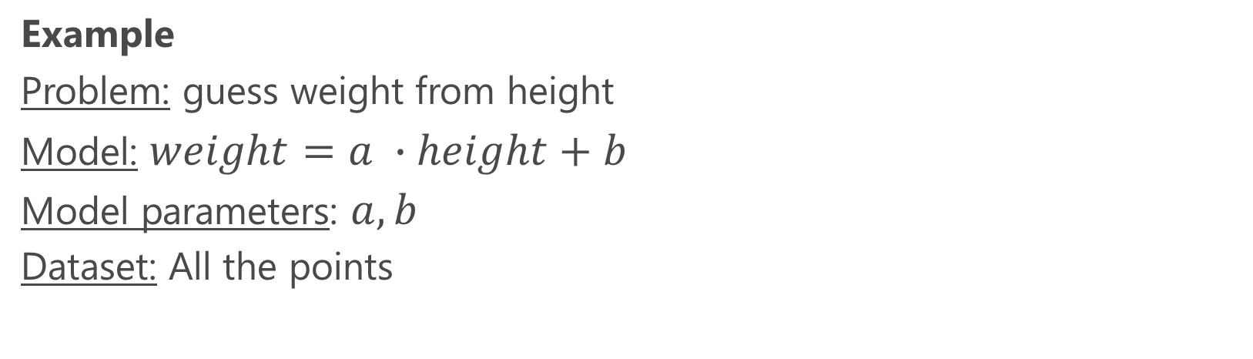
Session 1 – Introduction
The Big Picture - Modeling
What is a model?
  Models are functions to calculate a predicted value from a collections of inputs
  Most of your models will predict a value (regression) or a class (classification)

Slide 7

Session 1 – Introduction
The Big Picture - Modeling
What is a model?
  Models are functions to calculate a predicted value from a collections of inputs
  Most of your models will predict a value (regression) or a class (classification)
Your work is:
Understand the problem you want to solve
  Identify inputs and outputs
Choose a model depending on the “shape” of your data
  Find some suitable ML model in your library
Calculate the model parameters
  There must be some criteria to adjust the model to the data points (for instance, sum the distance from predicted to actual values)
  Given a criteria, we need a clever algorithm that calculates the parameter values that minimizes the criteria for our dataset. This process is called training
Choose appropiate metaparameters
Height

Slide 8
Session 1 – Introduction
Let’s Practice
The mother of all ML programs with scikit-learn

Slide 9
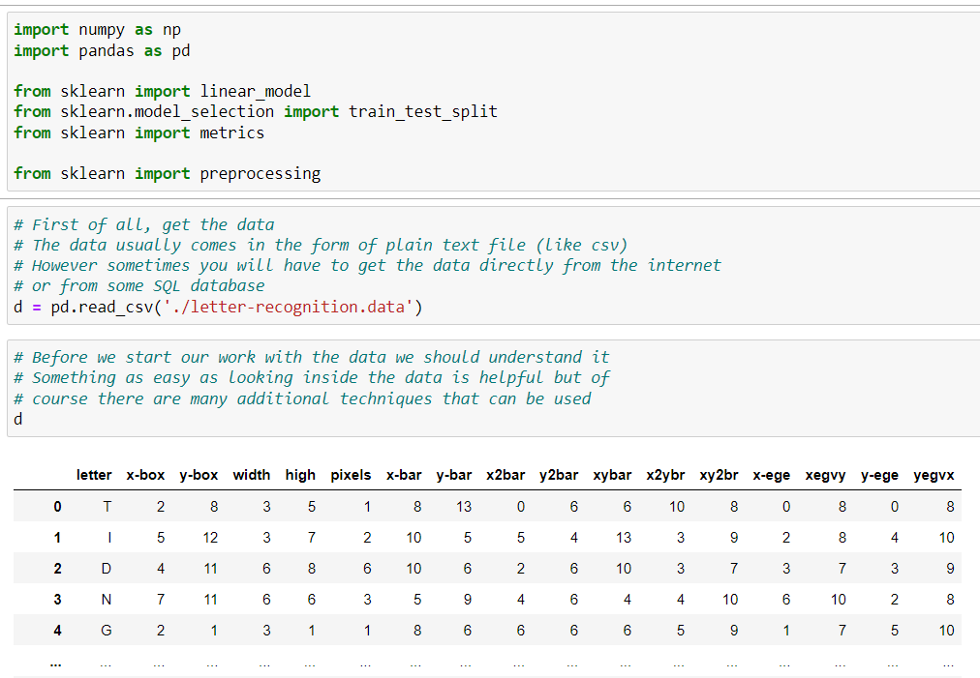
Session 1 – Introduction
Let’s Practice

Slide 10
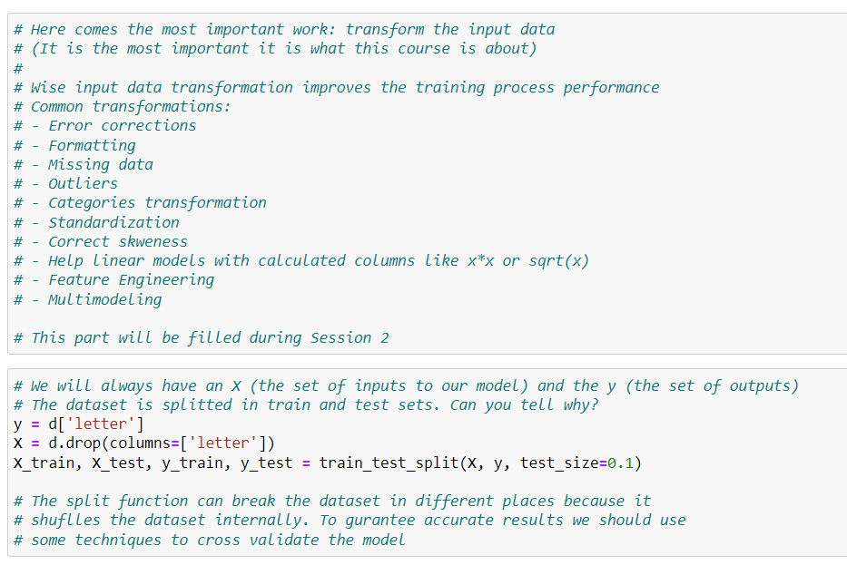
Session 1 – Introduction
Let’s Practice

Slide 11
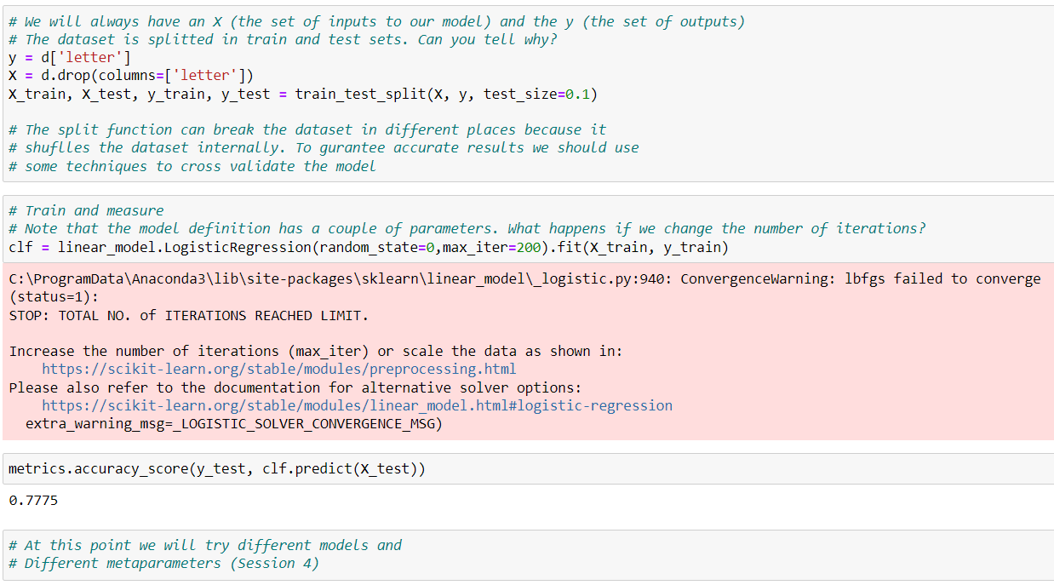
Session 1 – Introduction
Let’s Practice

Slide 12
Session 1 – Introduction
Wrap up
d = pd.read_csv('./letter-recognition.data’)
y = d['letter']
X = d.drop(columns=['letter'])
X_train, X_test, y_train, y_test = train_test_split(X, y, test_size=0.1)
clf = linear_model.LogisticRegression(random_state=0,max_iter=200)
clf.fit(X_train, y_train)
print(metrics.accuracy_score(y_test, clf.predict(X_test)))

Slide 13
Session 1 – Introduction
Data Types
Data types
String
Int (How many digits Int?)
Real (Double, Float…)
Date
Boolean
Structured Data Types
  Arrays
  Maps/Dictionaries

Slide 14
Session 1 – Introduction
Data Formats
Data formats
The very standard: csv, tsv, excel, json…
Apache avro – row oriented
  Json metadata
  Serialization: Json and binary
Apache parquet – column oriented
  Very efficient encoding 1TB -> 130GB
  Can be distributed in several files for parallel reading

Slide 15
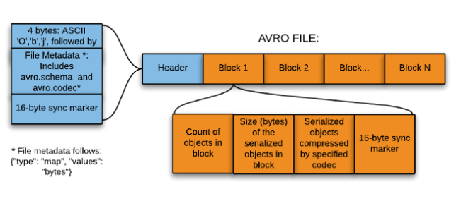
Session 1 – Introduction
Data Formats - avro
{
"type" : "record",
"name" : “student",
"namespace" : “ie.example",
"fields" : [
{"name": "name", "type": "string", "default" : "NONE"},
{"name": "age", "type": "int", "default" : -1},
{"name": "subjects", "type": "array", "items": "string"}
{"name": "first", "type": ["string", "null"] }
]
}

Slide 16
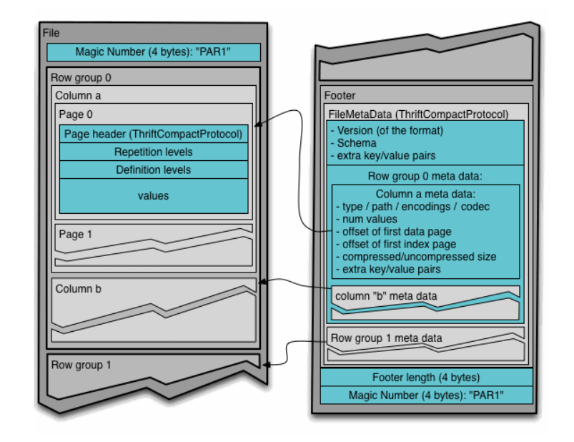
Session 1 – Introduction
Data Formats - parquet
Source: https://parquet.apache.org/documentation/latest/

Slide 17
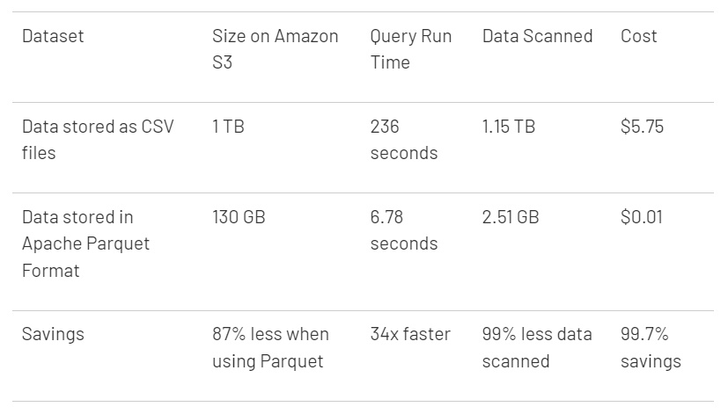
Session 1 – Introduction
Data Formats - parquet
Source: https://databricks.com/glossary/what-is-parquet

Slide 18
Session 1 – Introduction
Databases
Relational databases
  Access to remote DB in Python:
      import psycopg2
      connection = psycopg2.connect(\
      dbname= 'sensorsdata',
      host= 'redshift-cluster-1.ci0x5voydyv2.eu-west-1.redshift.amazonaws.com',
      port= '5439',
      user= 'ieuser',
      password= 'thisisIE1!’)
      cursor.execute("SELECT * FROM SensorTemporalData;")
      result = cursor.fetchall()
      df = pd.DataFrame(result)

Slide 19
Session 1 – Introduction
Internet Data
Internet Data
Data Services
      import urllib.request as url
      remoteFile = url.urlopen('https://www.quandl.com/api/v3/datasets/OPEC/ORB/data.csv?&api_key=LwmAyD-1JHAzhMKKSvDX')
      html = remoteFile.read().decode('ascii').splitlines()
Cloud Files: access to a S3 file
      s3 = boto3.resource(service_name='s3’, region_name='us-east-2’, … )
      s3_file = s3.Bucket('ie-dataengineering-datasets’).object('iris.csv’).get()
      df = pd.read_csv(data[‘body’], index_col=0)

