Slide 1
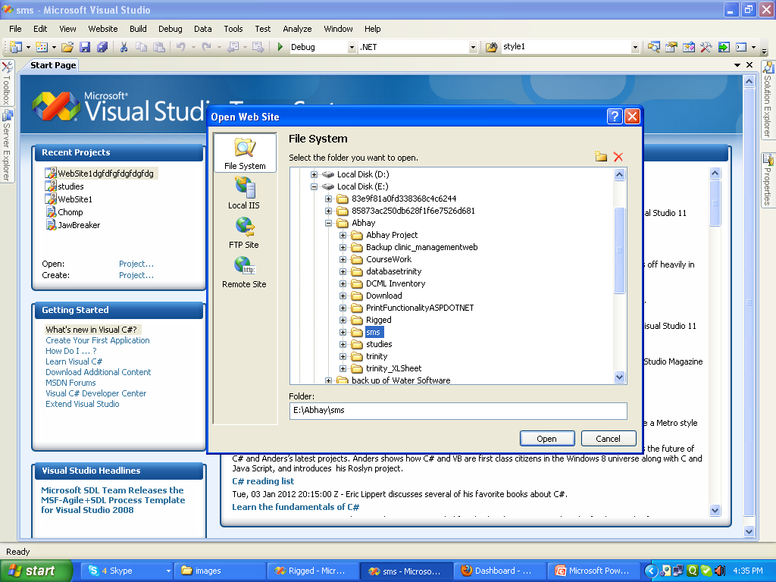

Slide 2
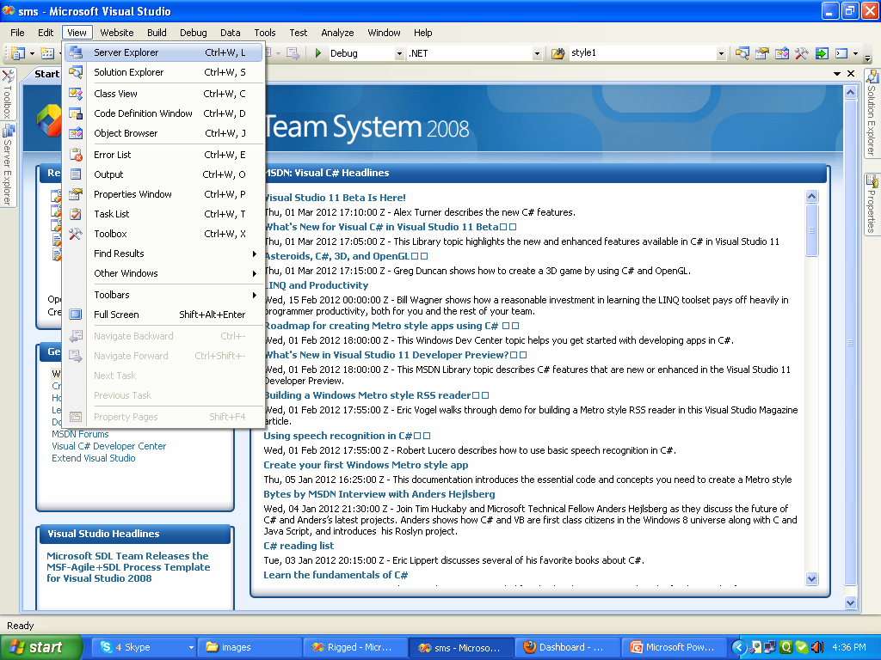

Slide 3
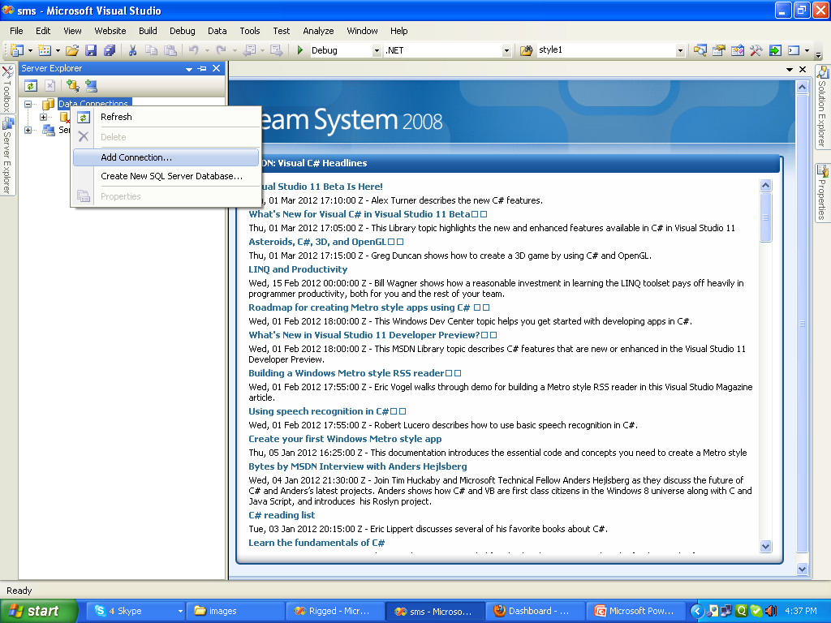

Slide 4
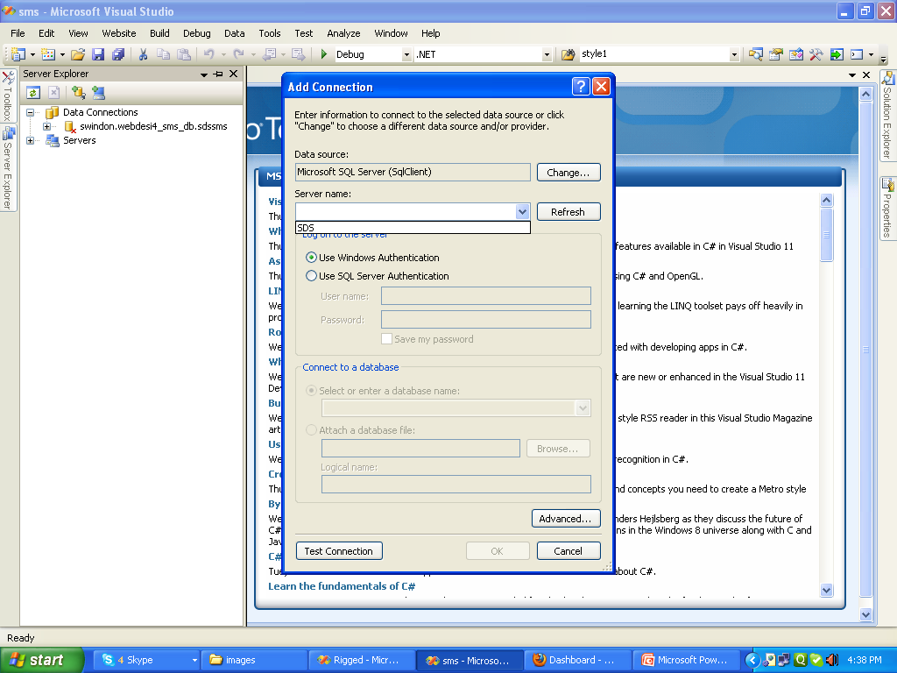
Select server name Choose Sql Server Auth and Fill Uid and Pass

Slide 5
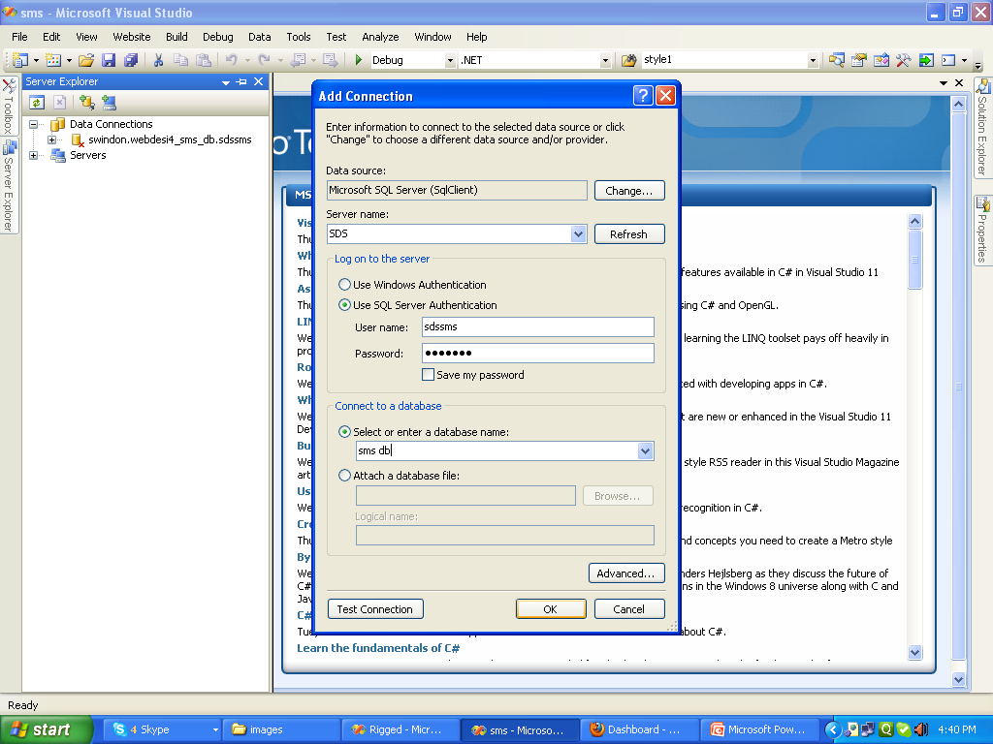

Slide 6
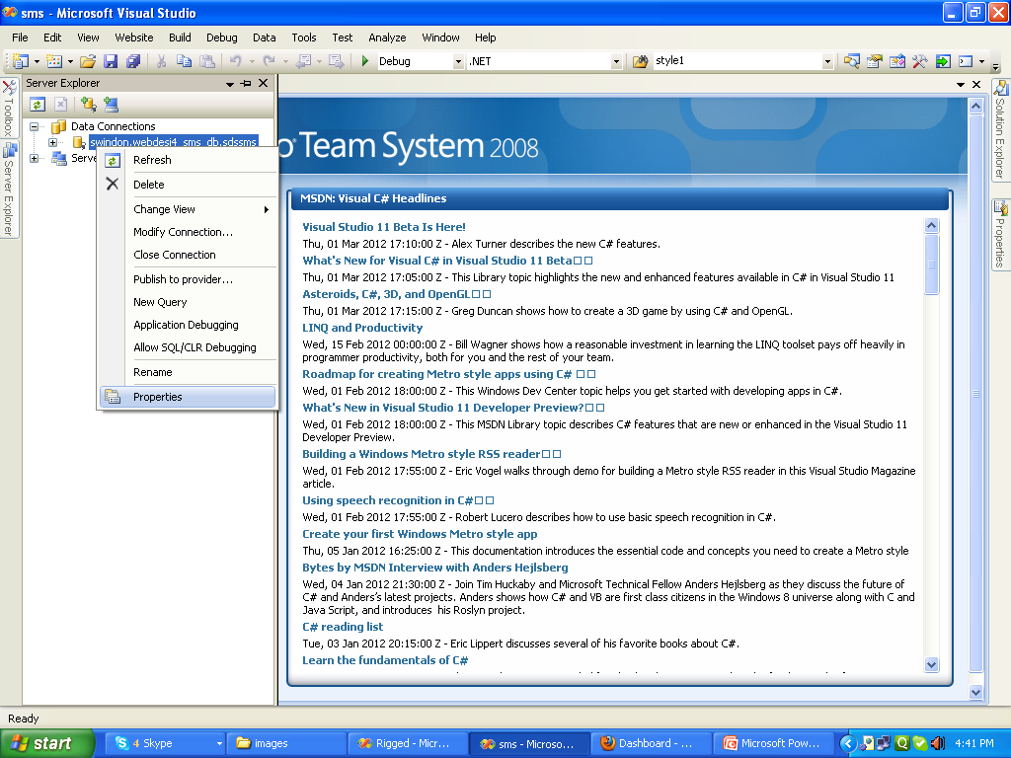

Slide 7
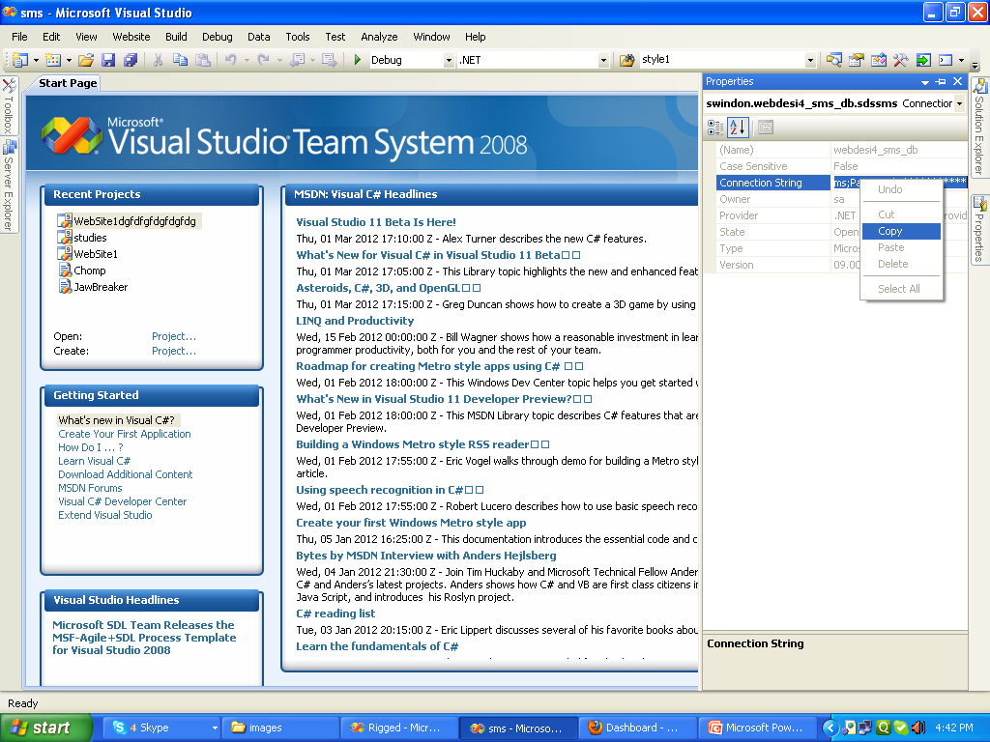
Copy This Connection string

Slide 8
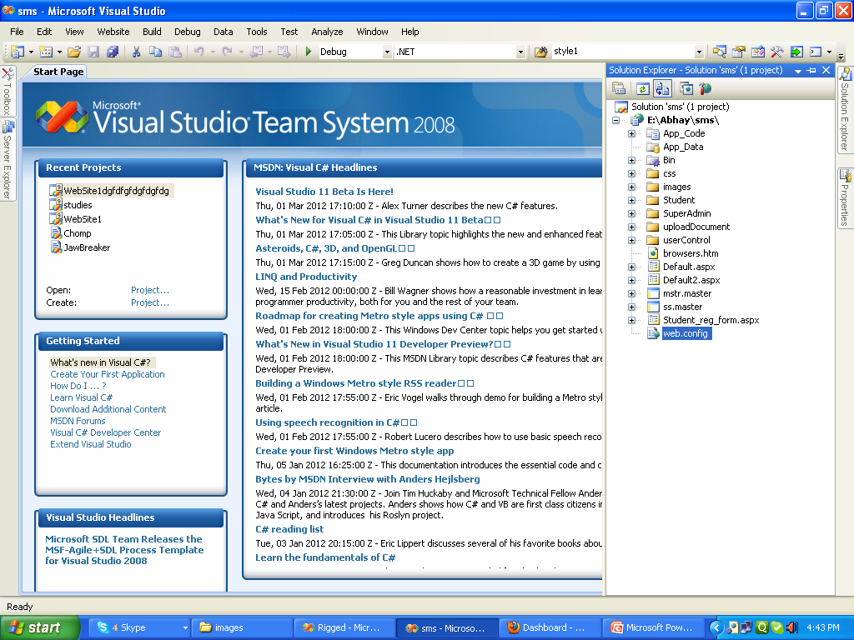

Slide 9
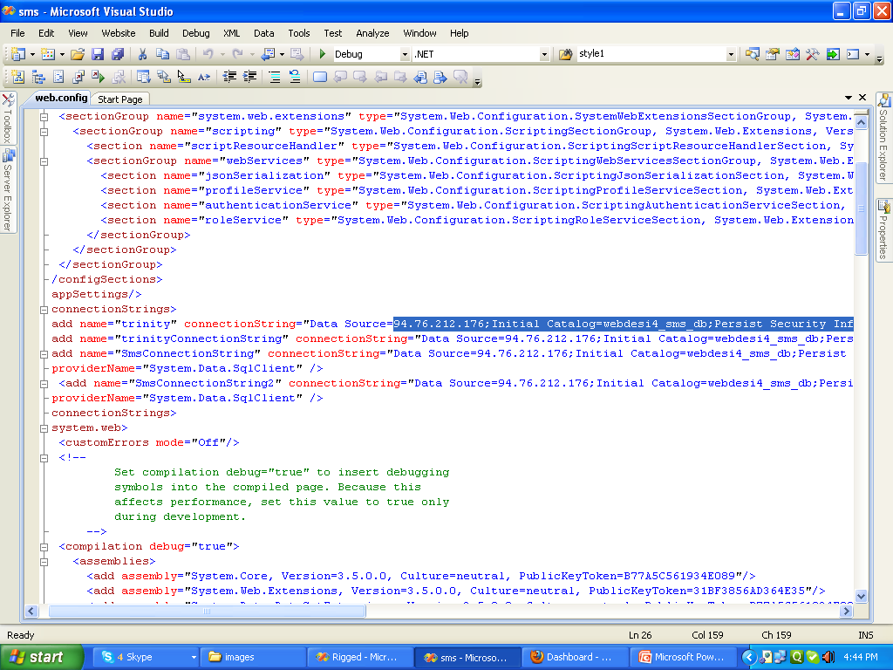
Past here as in blue line

Slide 10
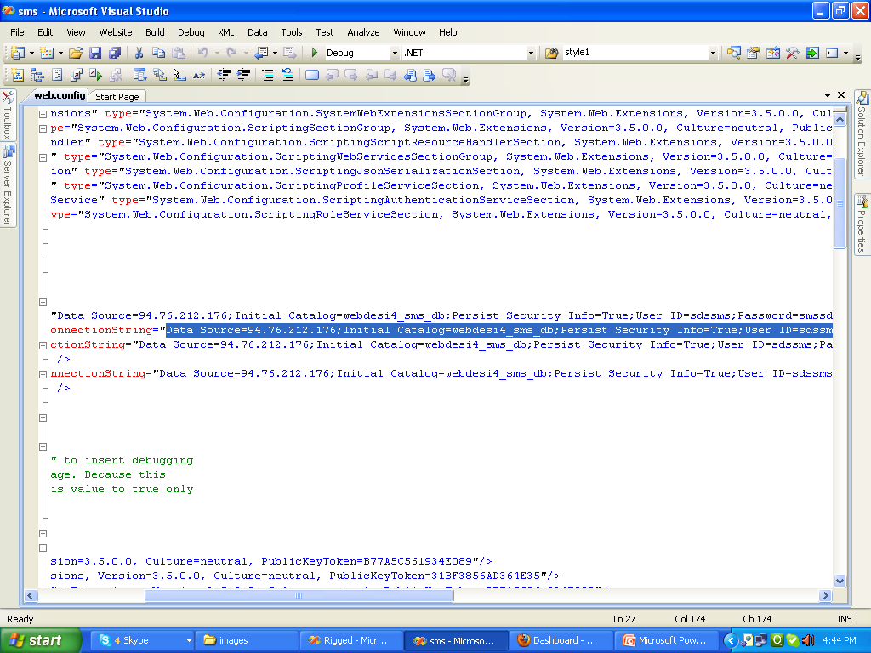
Past here as in blue line

Slide 11
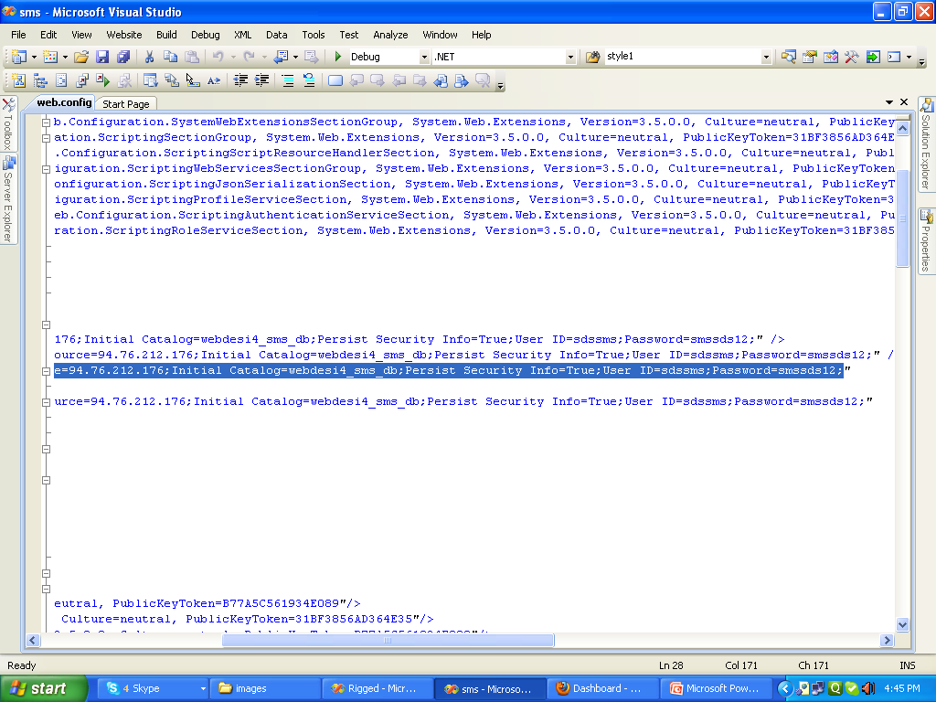
Past here as in blue line

Slide 12
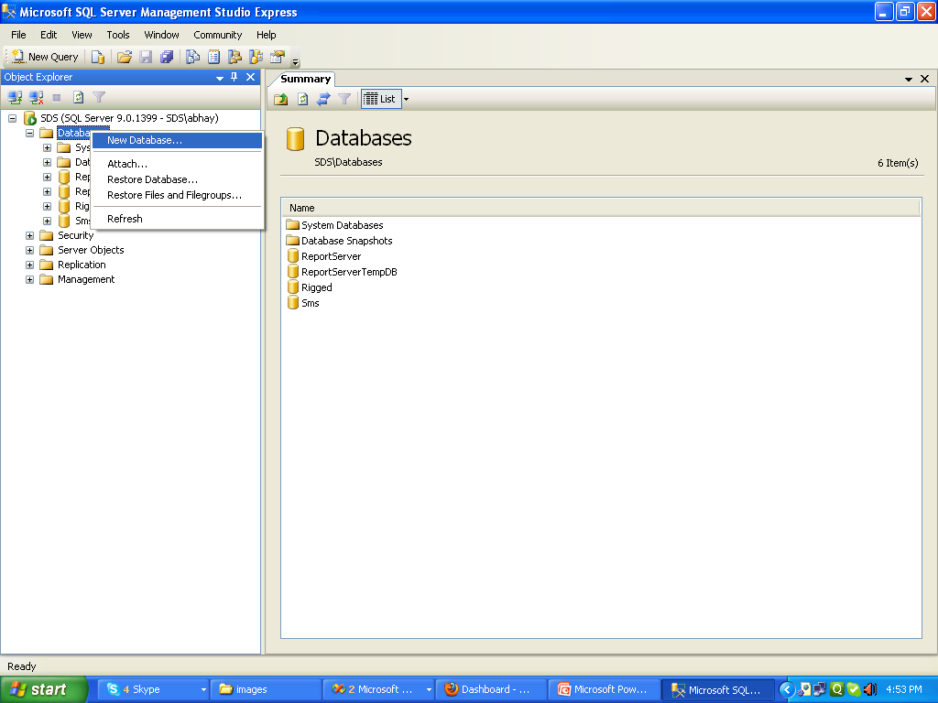
Go to object explorer and choose new database

Slide 13
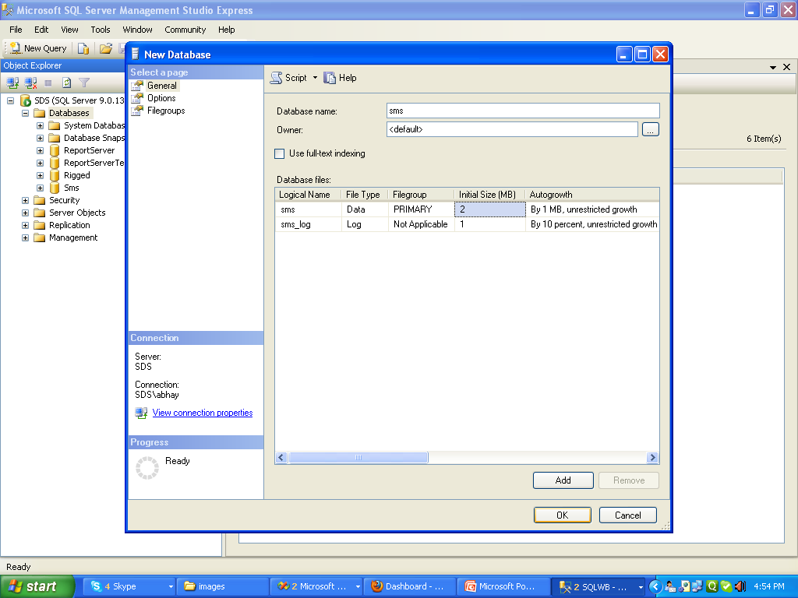
Plz write sms in database name and click ok plz don’t press add button

Slide 14
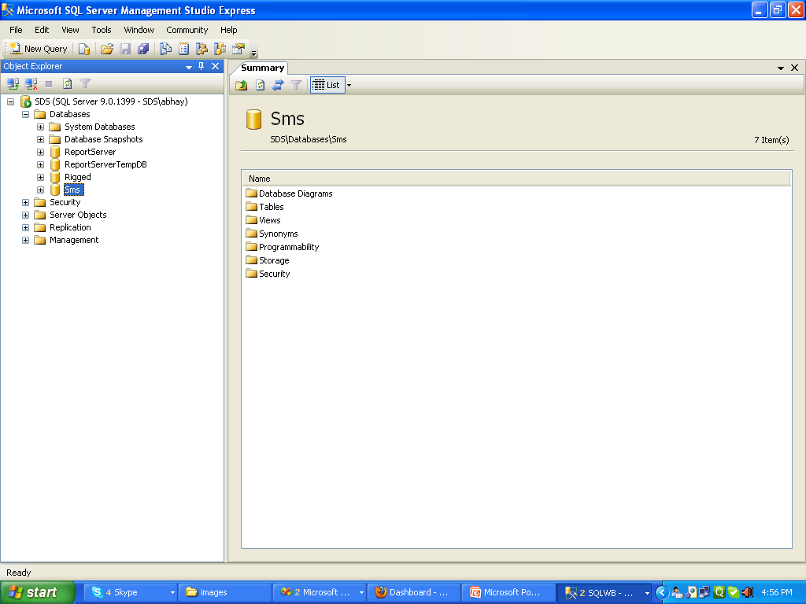

Slide 15
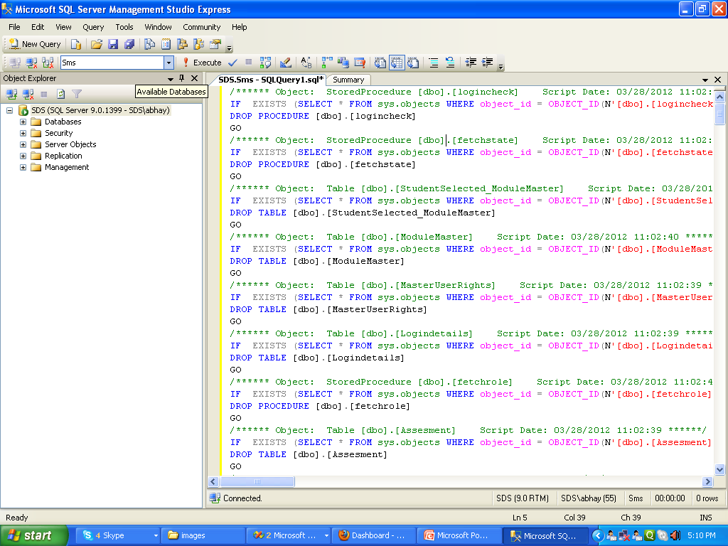
Plz Run Script on query analazyer(given by me) Make Sure Choose Database name(Show in tooltip available Database) sms and execute

